Slide 1
Implementation of a Neural Network-Based Perceptual Loss for Audio
Suprabha Ghosh
Matric-Nr: 64365
Multirate Signal Processing
Technische Unversität Ilmenau
Project supervised by
Prof. Dr.-Ing Gerald Schuller
Dr. rer. nat. Muhammad Imran

Slide 2
Abstract
Project focuses on perceptual loss in audio using deep embeddings
Uses OpenL3 and VGGish to compute audio similarity
Compares embedding similarity with PESQ and STOI metrics
Adds Gaussian noise to simulate degradation levels
Results validate strong correlation with traditional perceptual metrics

Slide 3
Introduction
Traditional metrics lack semantic understanding of audio
Neural embeddings can model perceptual aspects better
Objective: Implement & evaluate perceptual loss using embeddings
Scope: One clean file, five noise levels, OpenL3 & VGGish only

Slide 4
Methodology Overview
Convert input audio to 16 kHz mono WAV
Add Gaussian noise at 5 levels to create degraded audio
Extract embeddings using OpenL3 and VGGish
Compute cosine similarity with clean reference
Compare against PESQ and STOI scores

Slide 5
Tools & Technologies
Librosa & Soundfile – Audio preprocessing
OpenL3 & TorchVGGish – Embedding models
PESQ & PySTOI – Traditional metric libraries
Matplotlib & Seaborn – Visualization
NumPy & Pandas – Data handling

Slide 6
Evaluation Strategy
Evaluate degradation impact via embedding similarity
Compute PESQ and STOI between clean & noisy audio
Use cosine similarity for embedding comparison
Correlate similarity scores with PESQ/STOI
Use regression and correlation matrices for validation

Slide 7
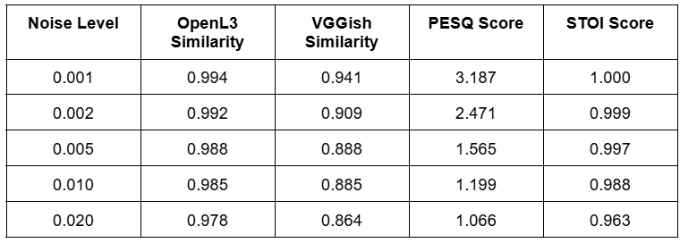
Quantitative Results
The embedding similarities and metric scores across noise levels are summarized in the final report:

Slide 8
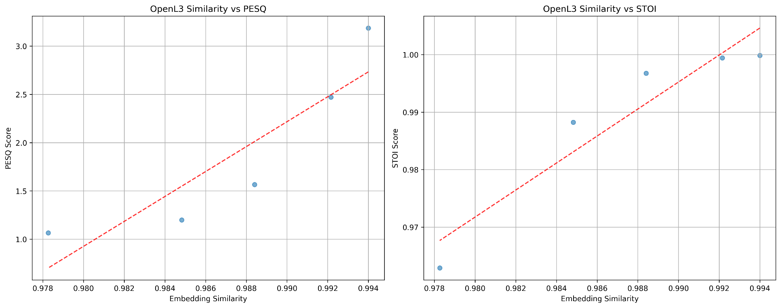
Visual Results
OpenL3 Similarity vs PESQ/STOI scatter plots with regression lines

Slide 9
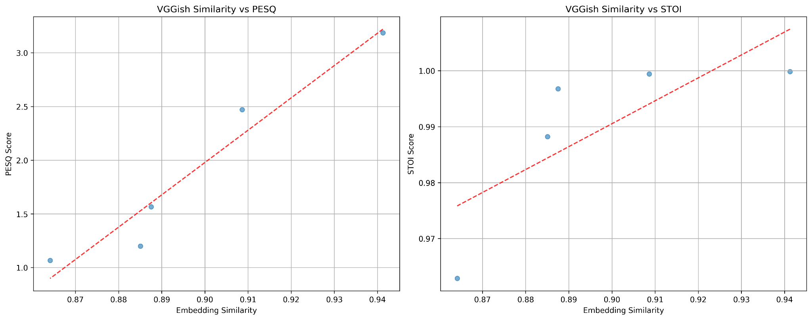
Visual Results
VGGish Similarity vs PESQ/STOI scatter plots with regression lines

Slide 10
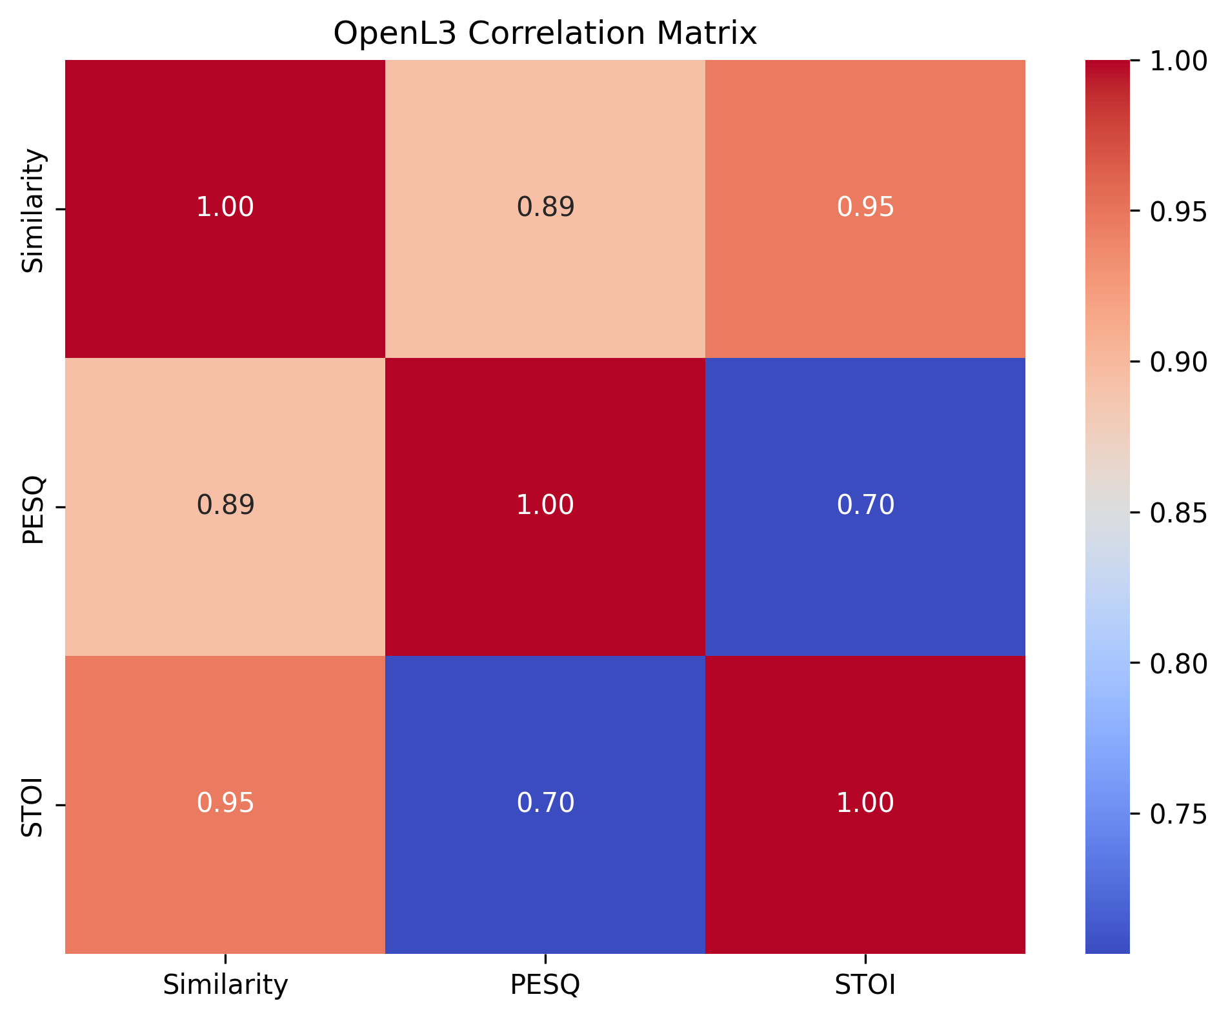
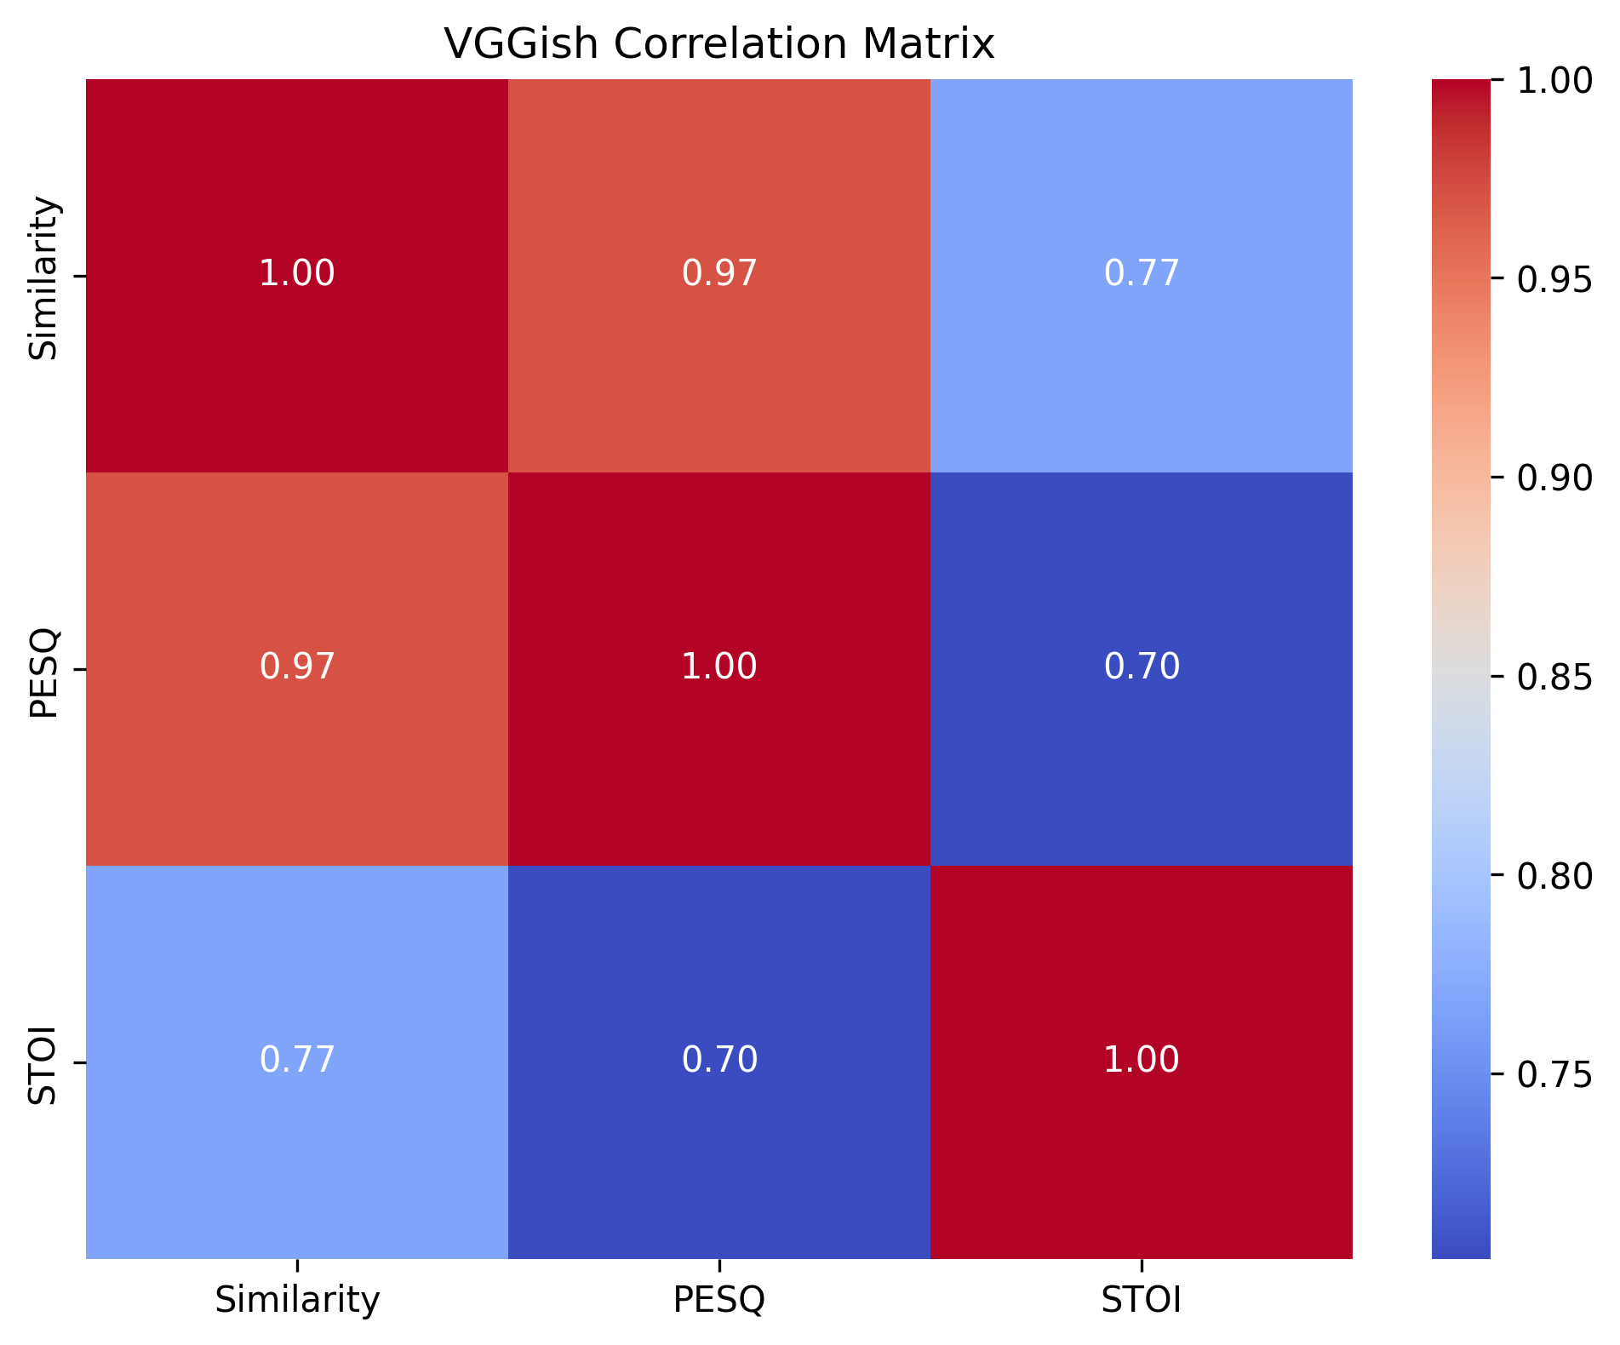
Visual Results
Heatmaps showing correlation coefficients

Slide 11
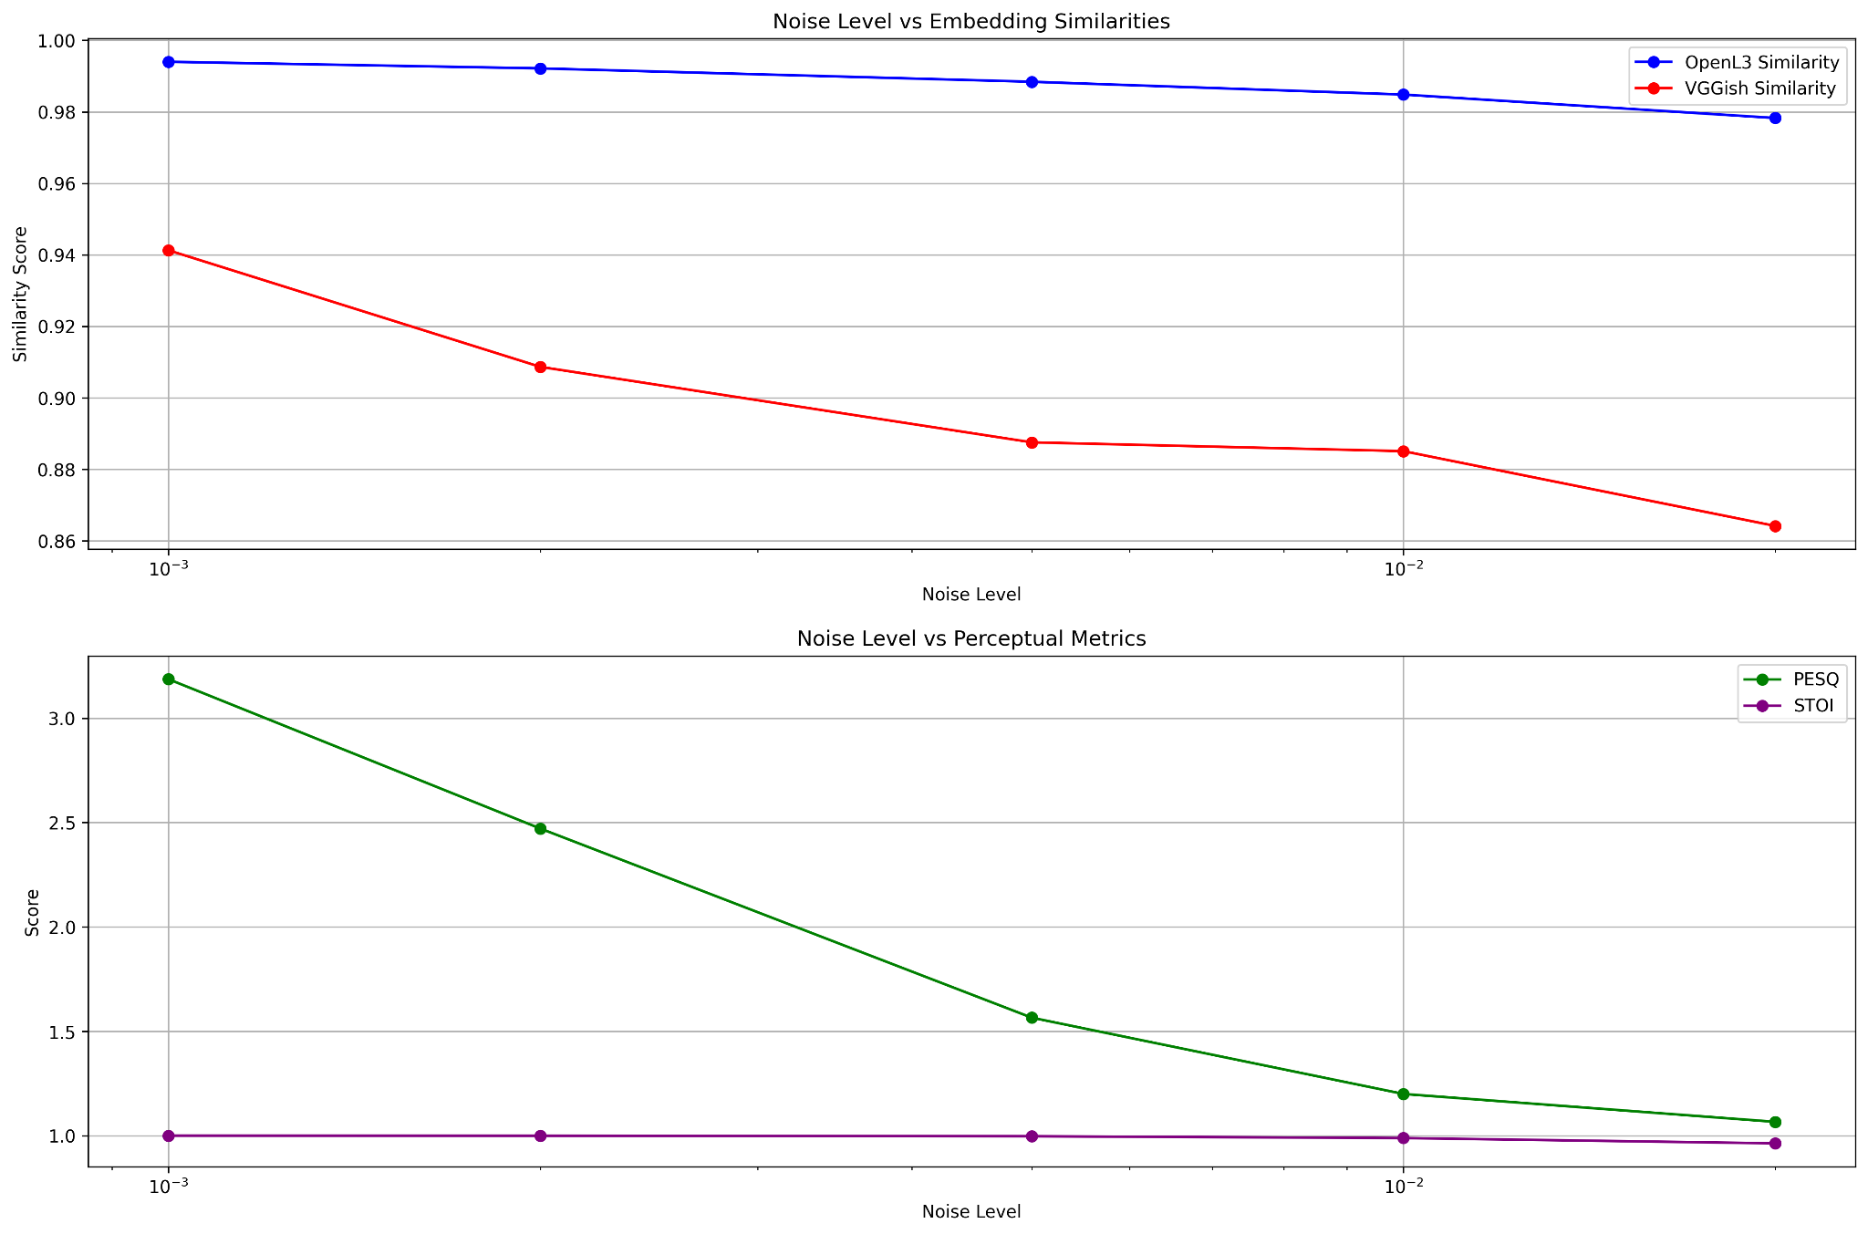
Visual Results
Line graphs of score degradation vs noise level

Slide 12
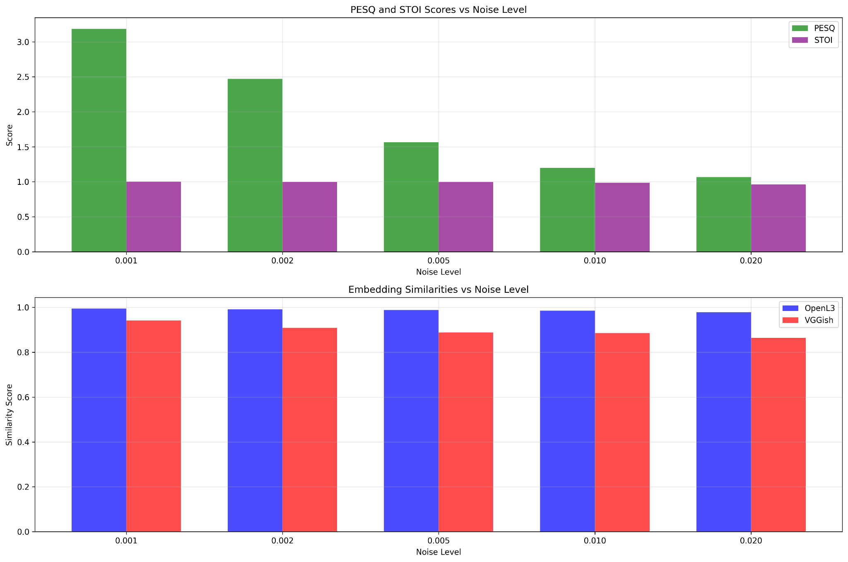
Visual Results
Bar plots comparing metrics side-by-side

Slide 13
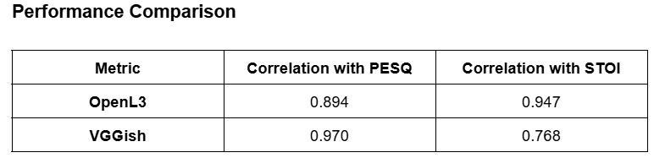
Comparative Analysis
OpenL3 better aligned with intelligibility (STOI)
VGGish better aligned with perceived quality (PESQ)
Both outperform raw waveform comparison methods
Visualization confirms metric-to-similarity match
Results show practical use in speech/audio systems

Slide 14
Discussion
Embeddings reflect perceptual audio similarity well
VGGish is more sensitive to noise, useful for quality metrics
OpenL3 is robust, better for intelligibility metrics
Errors minor and mostly at extreme noise levels
Limitation: only Gaussian noise and one audio file used

Slide 15
Conclusion & Future Work
Neural embeddings are valid perceptual loss metrics
High correlation with PESQ and STOI supports hypothesis
Future: add more audio types, real-world distortions
Explore dynamic time alignment for better similarity
Integrate into training loss for speech enhancement models

Slide 16
References
Hershey, S., Chaudhuri, S., Ellis, D. P. W., Gemmeke, J. F., Jansen, A., Moore, R. C., … & Wilson, K. (2017). CNN architectures for large-scale audio classification. In ICASSP.
Cramer, J., Wu, H. H., Salamon, J., & Bello, J. P. (2019). Look, Listen, and Learn More: Design Choices for Deep Audio Embeddings. In ICASSP.
ITU-T P.862.2 (2007). Perceptual evaluation of speech quality (PESQ): Wideband extension to Recommendation P.862 for the assessment of wideband telephone networks and speech codecs.
Taal, C. H., Hendriks, R. C., Heusdens, R., & Jensen, J. (2010). A short-time objective intelligibility measure for time-frequency weighted noisy speech. In ICASSP.

