Slide 1
Implementation of a Neural Network-Based Perceptual Loss for Audio
Suprabha Ghosh
Matric-Nr: 64365
Multirate Signal Processing
Technische Universität Ilmenau
Project supervised by
Prof. Dr.-Ing Gerald Schuller
Dr. rer. nat. Muhammad Imran

Slide 2
Introduction
Project investigates perceptual similarity between audio signals
Traditional metrics (PESQ [1], STOI [2]) focus on time-domain/psychoacoustic features
Neural embeddings provide data-driven feature representation
Aim is to evaluate whether neural similarity reflects perceptual loss
Uses OpenL3 [3] and VGGish [4] models to extract embedding representations

Slide 3
Objective
Develop pipeline to generate clean and degraded audio samples
Extract embeddings from OpenL3 [3] and VGGish [4] pretrained models
Calculate perceptual metrics (PESQ [1], STOI [2]) for each degradation
Measure cosine similarity between embeddings of clean and degraded audio
Analyze correlation between neural embeddings and perceptual scores

Slide 4
Methodology – Audio Degradation
Audio downsampled to 16 kHz mono for standardization
Degradation simulated using three techniques:
Noise addition with varying Gaussian noise levels
Bitrate degradation via downsampling/upsampling
Compression via bit-depth quantization and filtering
Three quality levels: High, Low, and Extreme for each type
Ensures controlled variation across samples

Slide 5
Methodology – Embedding Extraction
Clean and degraded audio processed using:
OpenL3 [3] (music mode, 512-dim): Trained on large-scale music dataset
VGGish [4] (128-dim): Based on AudioSet embeddings
Extracted embeddings saved per file using .npy format
Extraction implemented in batch mode with reproducible seeds
All audio processed uniformly for reliable comparison

Slide 6
Methodology – Evaluation Pipeline
Embedding comparison done using cosine similarity
Reflects directional similarity between embedding vectors
PESQ and STOI scores computed using:
PESQ [1] for speech perceptual quality
STOI [2] for intelligibility measurement
Metrics stored for each degraded variant across types
CSV files used for tabulation and visualization scripts

Slide 7
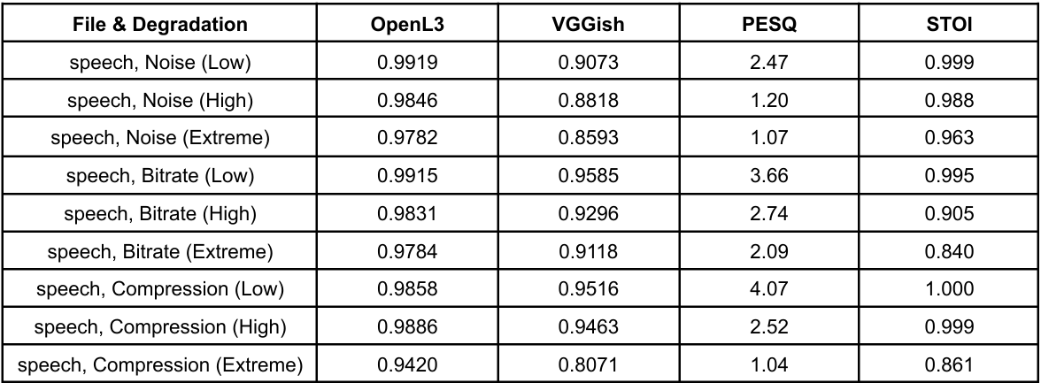
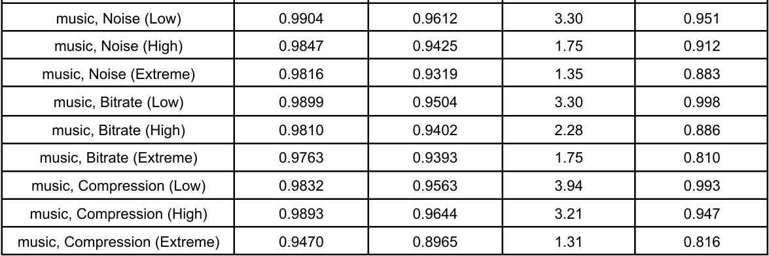
Results – Statistical Overview
Combined results from 3 degradation types × 3 levels × multiple files
Metrics demonstrate expected trends with degradation severity
High-quality audio scores consistently better

Slide 8
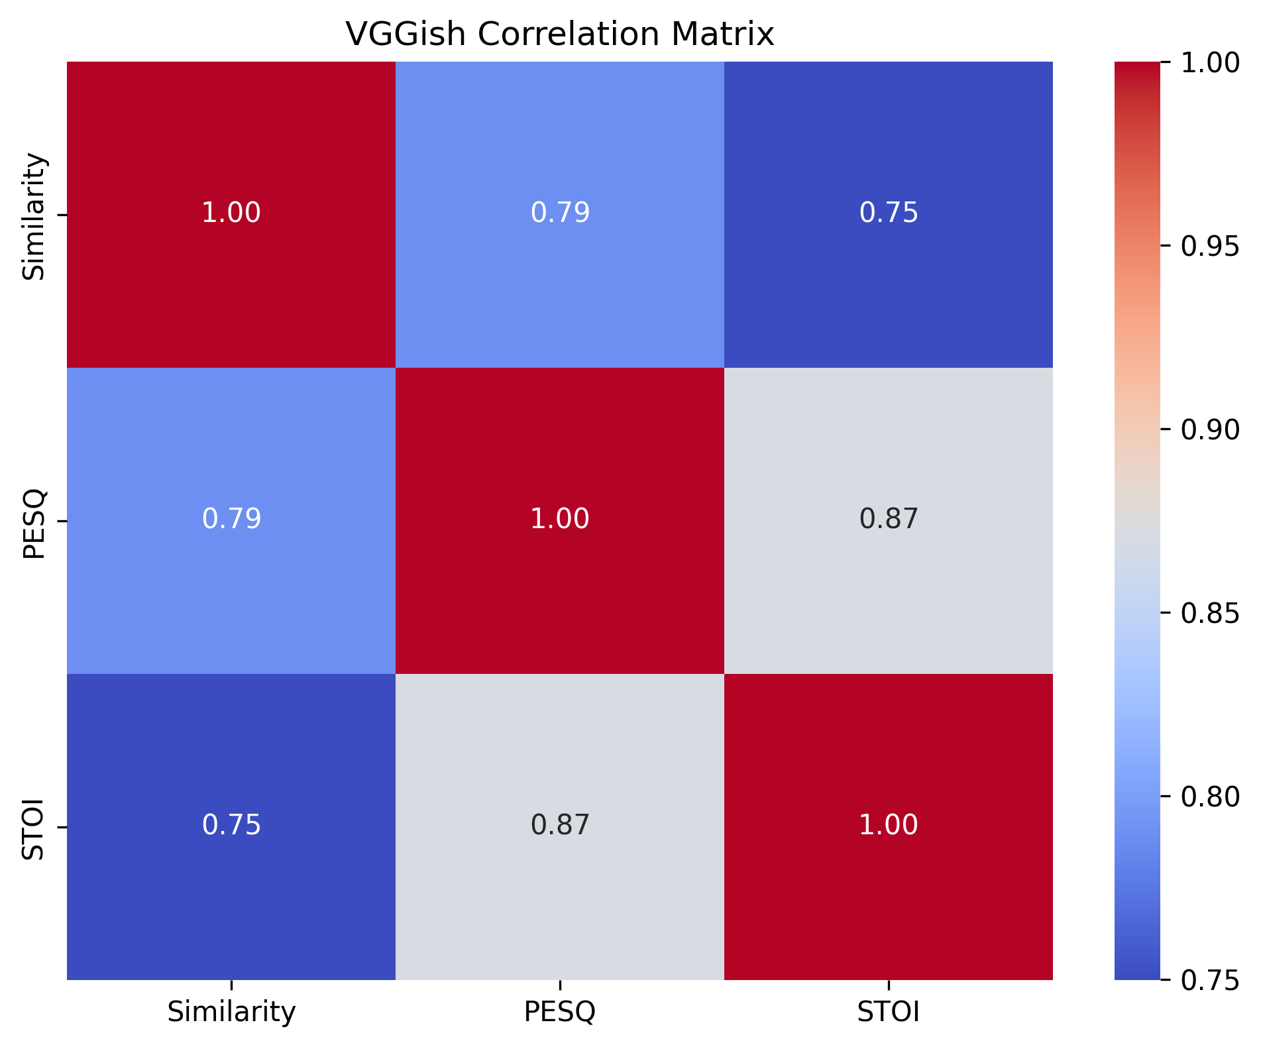
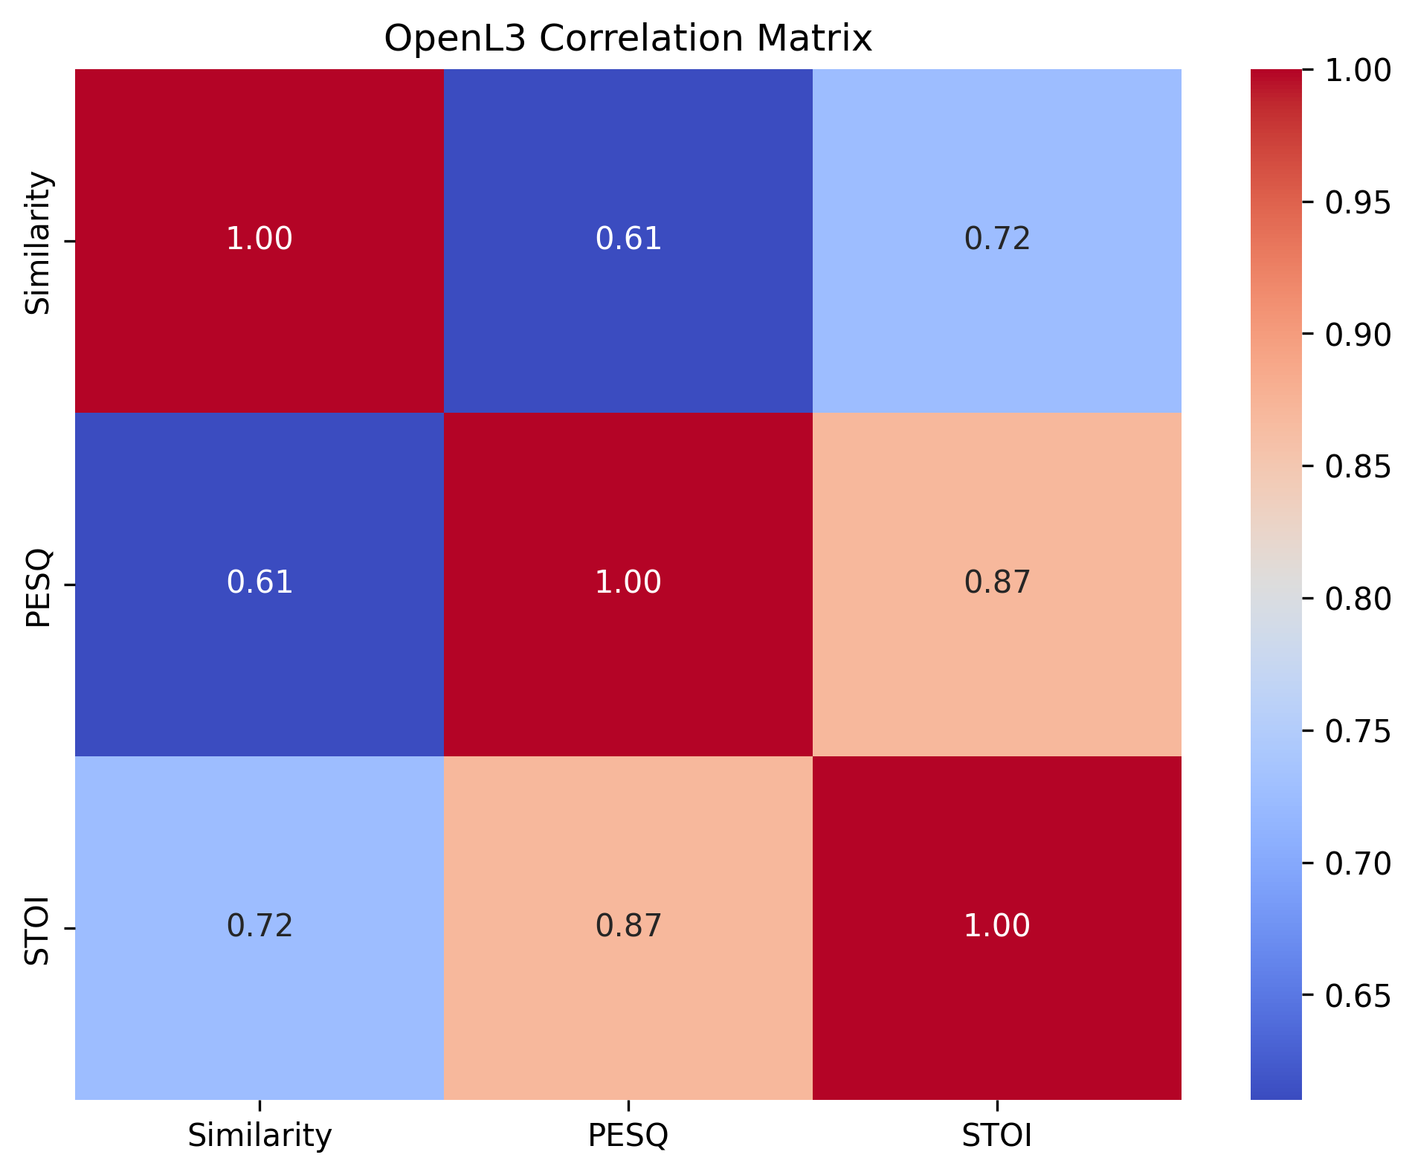
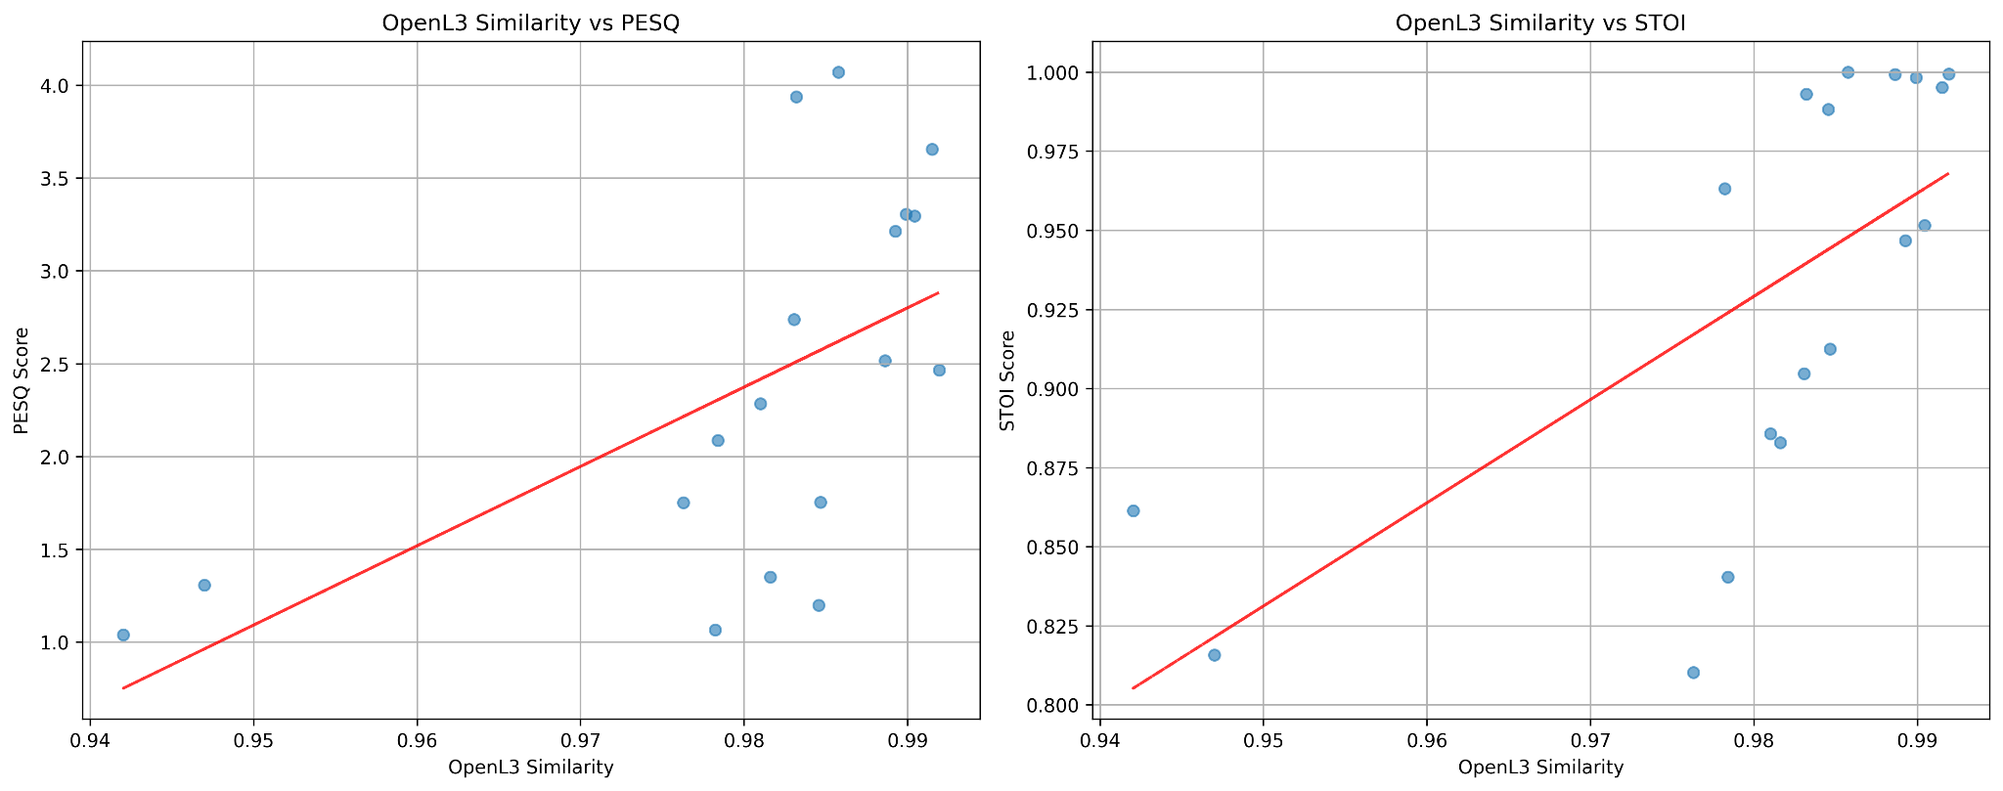
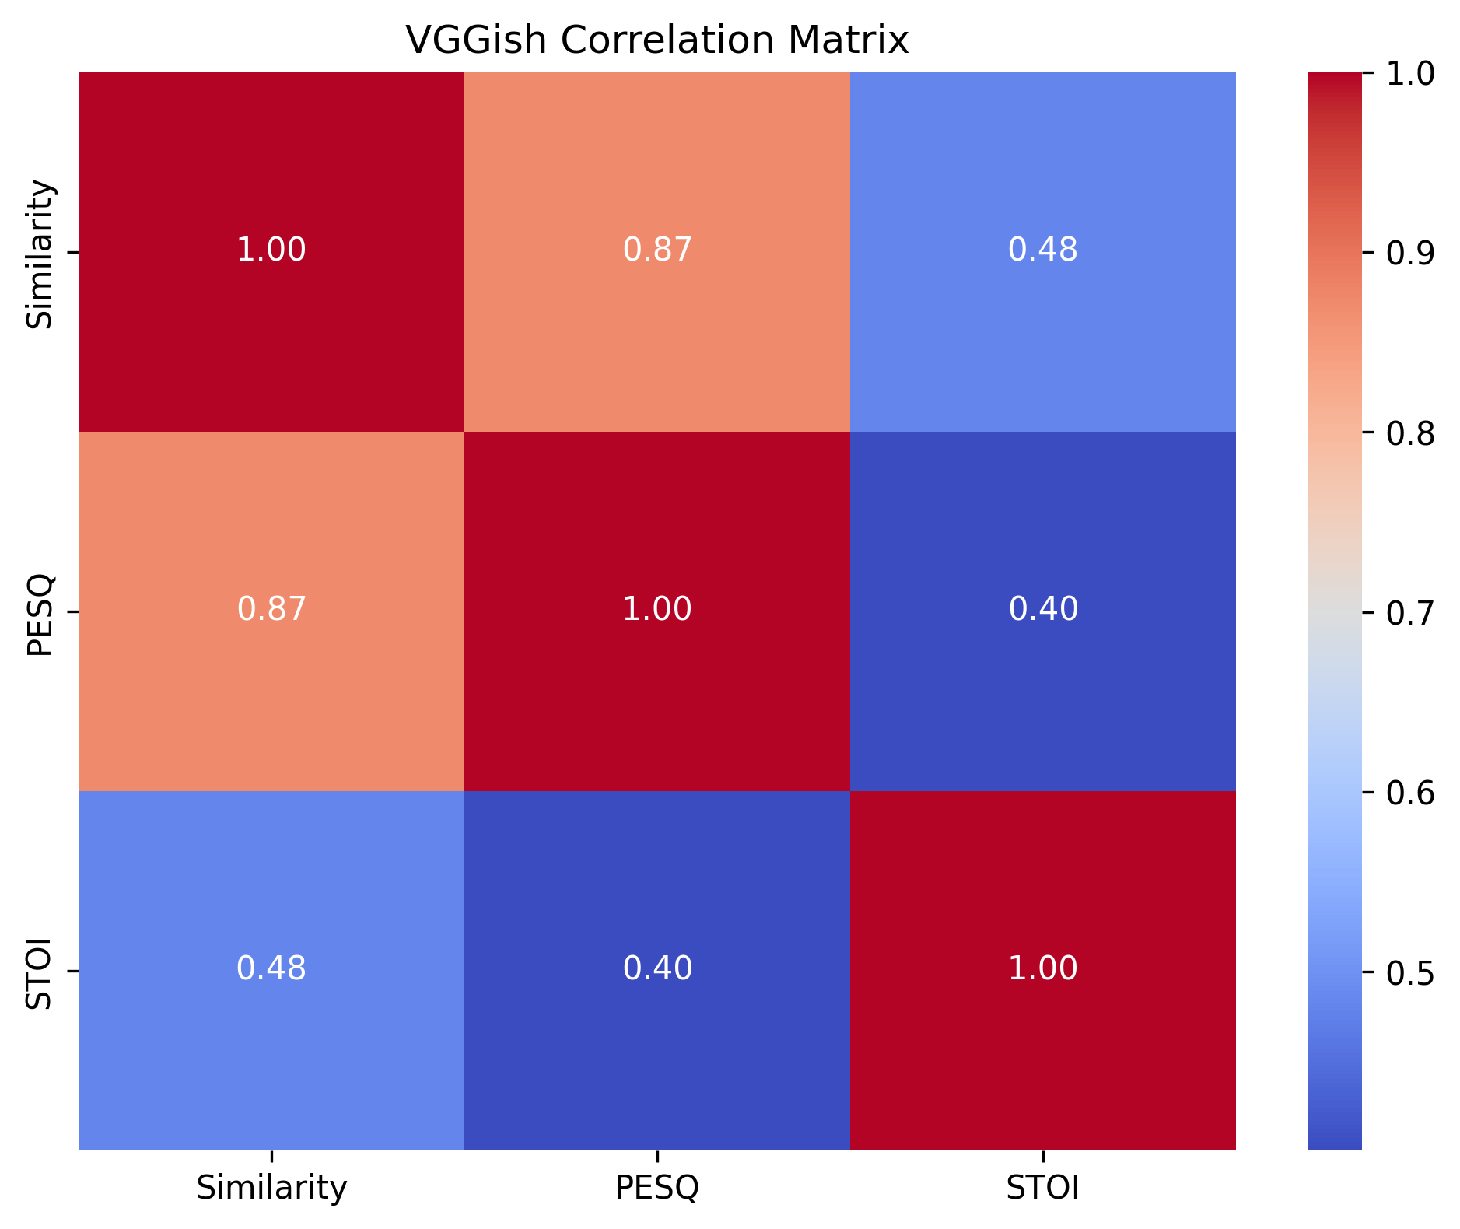
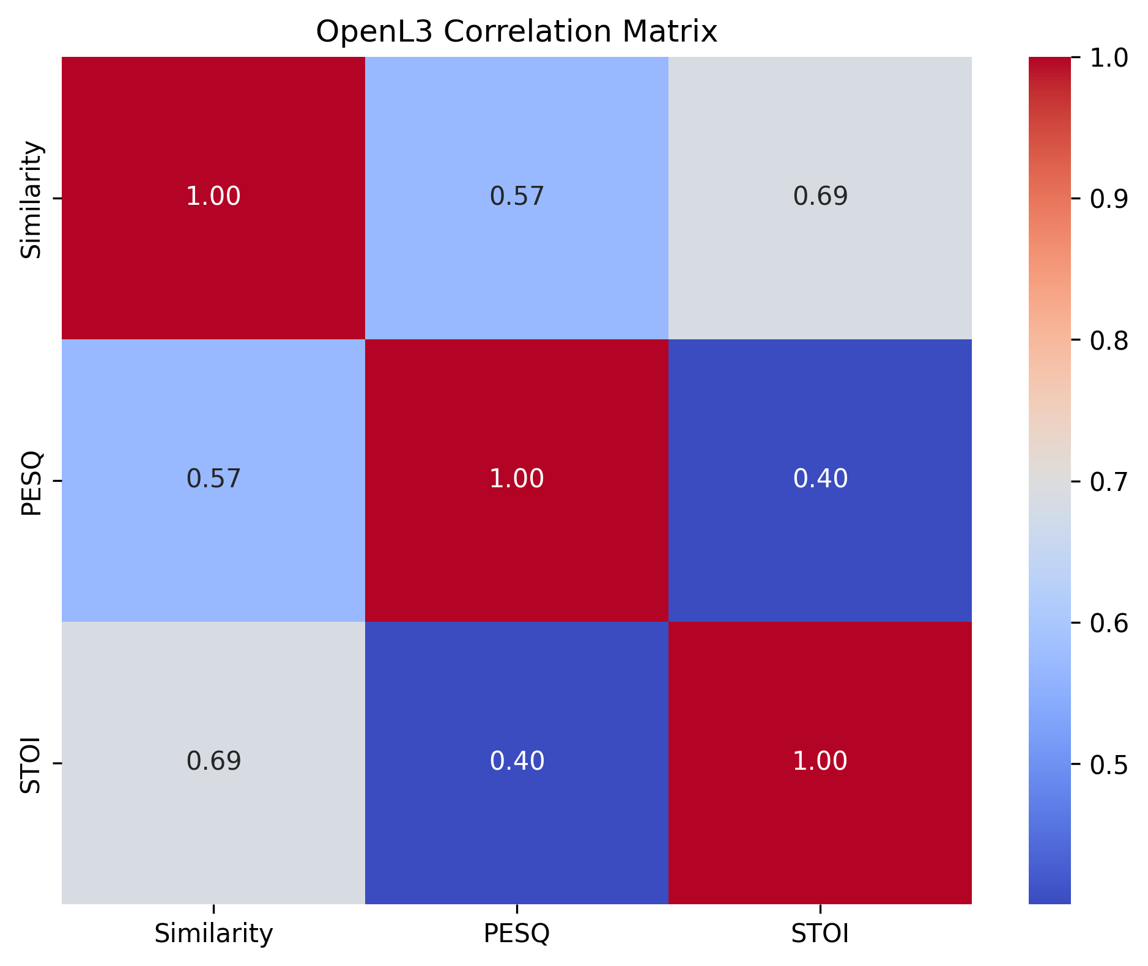
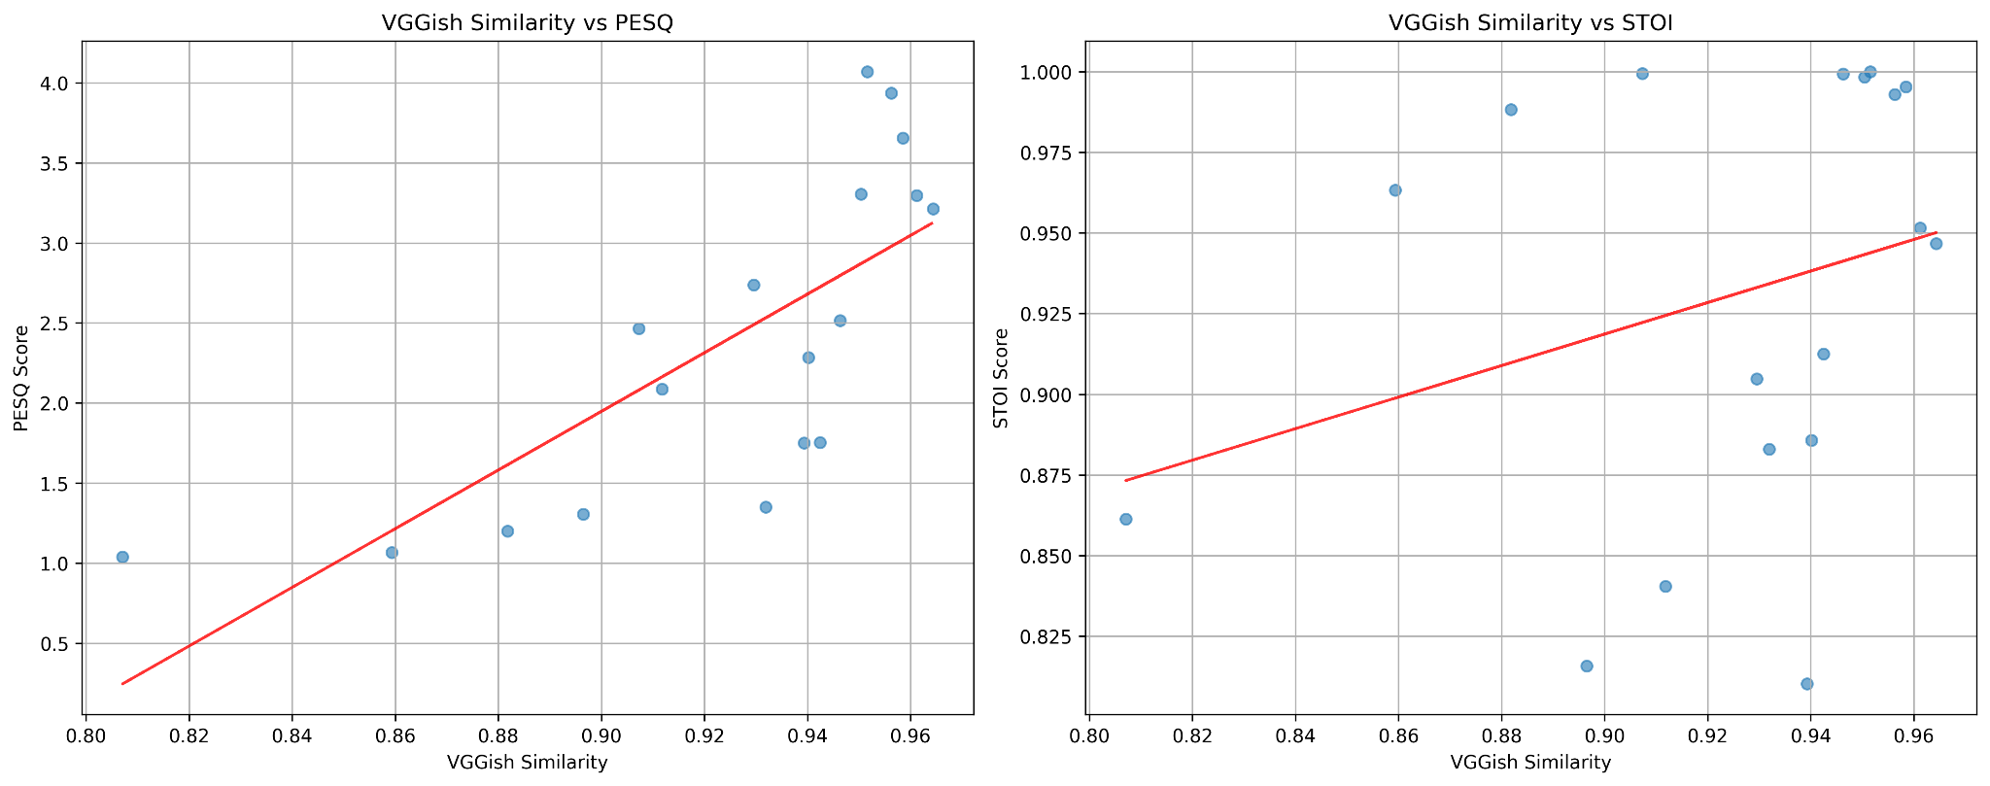
Results – Correlation Analysis

Slide 9
Results – Correlation Analysis
OpenL3:
PESQ correlation: 0.583
STOI correlation: 0.670
VGGish:
PESQ correlation: 0.746
STOI correlation: 0.298
Suggests VGGish is more predictive of overall quality (PESQ)

Slide 10
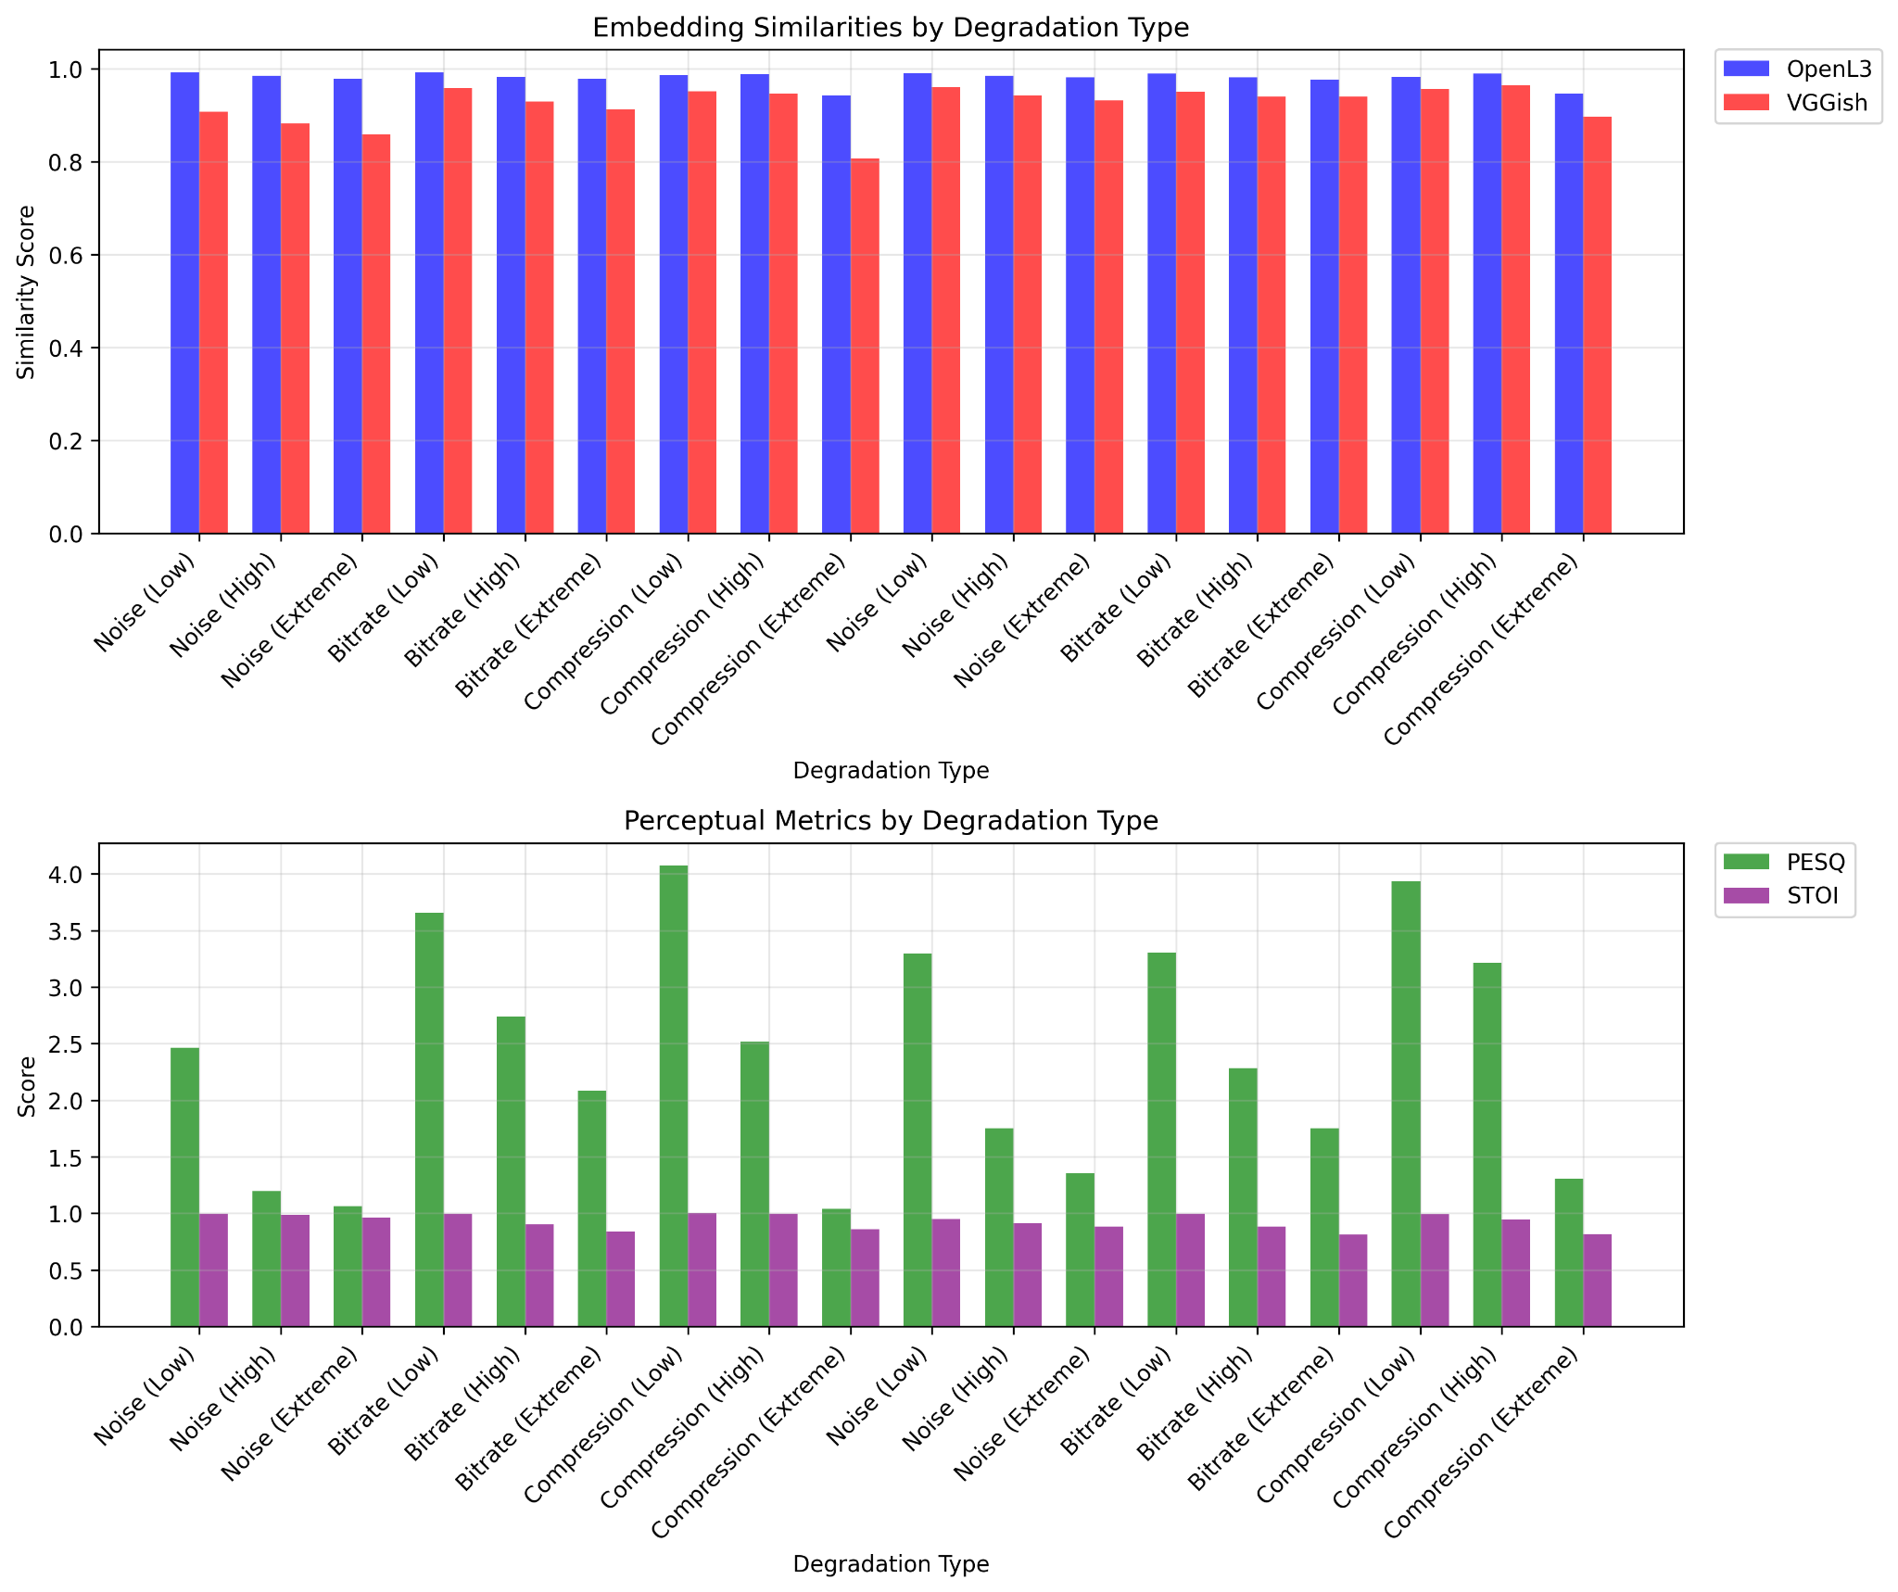
Results – Degradation Comparison
Compression (High) yields best perceptual and similarity scores
Noise (Extreme) yields worst scores
All metrics degrade as noise or compression increases

Slide 11
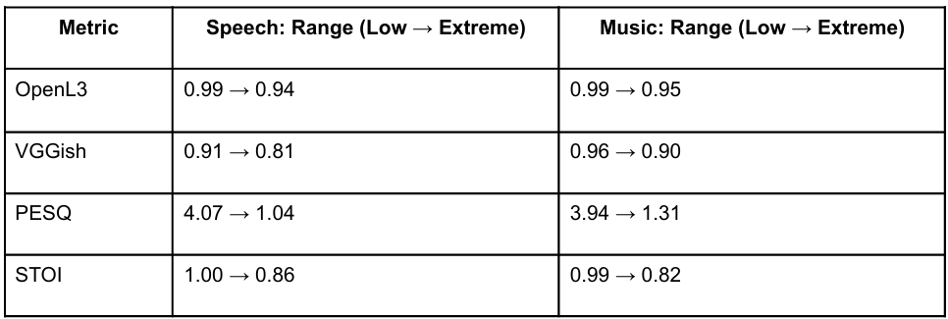
Comparative Analysis
VGGish embeddings strongly align with PESQ, weak with STOI
OpenL3 moderately aligns with both PESQ and STOI
Traditional metrics still essential, but neural metrics offer scalable insight
Embedding-based analysis beneficial for perceptual learning tasks

Slide 12
Conclusion
Neural embeddings can approximate perceptual audio loss
VGGish performs best in capturing PESQ-related degradation
Developed framework supports reproducible and scalable evaluation
Result visualizations improve interpretability of metric behavior
Applicable for training neural models with perceptual awareness

Slide 13
References
[1] ITU-T Recommendation P.862, "Perceptual Evaluation of Speech Quality (PESQ): An objective method for end-to-end speech quality assessment of narrow-band telephone networks and speech codecs," International Telecommunication Union, 2001 (https://github.com/ludlows/python-pesq)
[2] Taal, C. H., Hendriks, R. C., Heusdens, R., & Jensen, J. (2011). "An Algorithm for Intelligibility Prediction of Time–Frequency Weighted Noisy Speech," IEEE Transactions on Audio, Speech, and Language Processing, 19(7), 2125–2136 (https://github.com/mpariente/pystoi)
[3] Cramer, J., Wu, H., Salamon, J., & Bello, J. P. (2019). "Look, Listen, and Learn More: Design Choices for Deep Audio Embeddings," IEEE International Conference on Acoustics, Speech and Signal Processing (ICASSP), pp. 3852–3856 (https://github.com/marl/openl3)
[4] Hershey, S., Chaudhuri, S., Ellis, D. P. W., Gemmeke, J. F., Jansen, A., Moore, R. C., Plakal, M., Platt, D., Saurous, R. A., Seybold, B., Slaney, M., Weiss, R. J., & Wilson, K. (2017). "CNN Architectures for Large-Scale Audio Classification," IEEE International Conference on Acoustics, Speech and Signal Processing (ICASSP), pp. 131–135 (https://github.com/harritaylor/torchvggish)
[5] Salamon, J., & Bello, J. P. (2017). "Deep Convolutional Neural Networks and Data Augmentation for Environmental Sound Classification," IEEE Signal Processing Letters, 24(3), 279–283.

