Slide 1
VC Seminar Project
Image-Compression using Lapped Transform
Suprabha Ghosh - 64365
Ismail Artun Altinel - 64722
Tarun Devidas Ramani - 66160

Slide 2
Introduction
Goal: Analyze and compare the performance of DCT and Lapped Transform in terms of compression efficiency and image quality
Key Matrics
Compression Ratio: Measures data reduction effectiveness
LPIPS: Assesses perceptual quality by comparing deep feature representations

Slide 3
Discrete Cosine Transform (DCT)
DCT Logic
Converts spatial domain (pixels) to frequency domain
Concentrates important data in lower frequencies
Quantizes coefficients, compressing data by reducing less important components
Code Logic
Loads and converts image to float32.
Clipping and Saving: Ensures valid pixel values, converts to uint8, and saves.

Slide 4
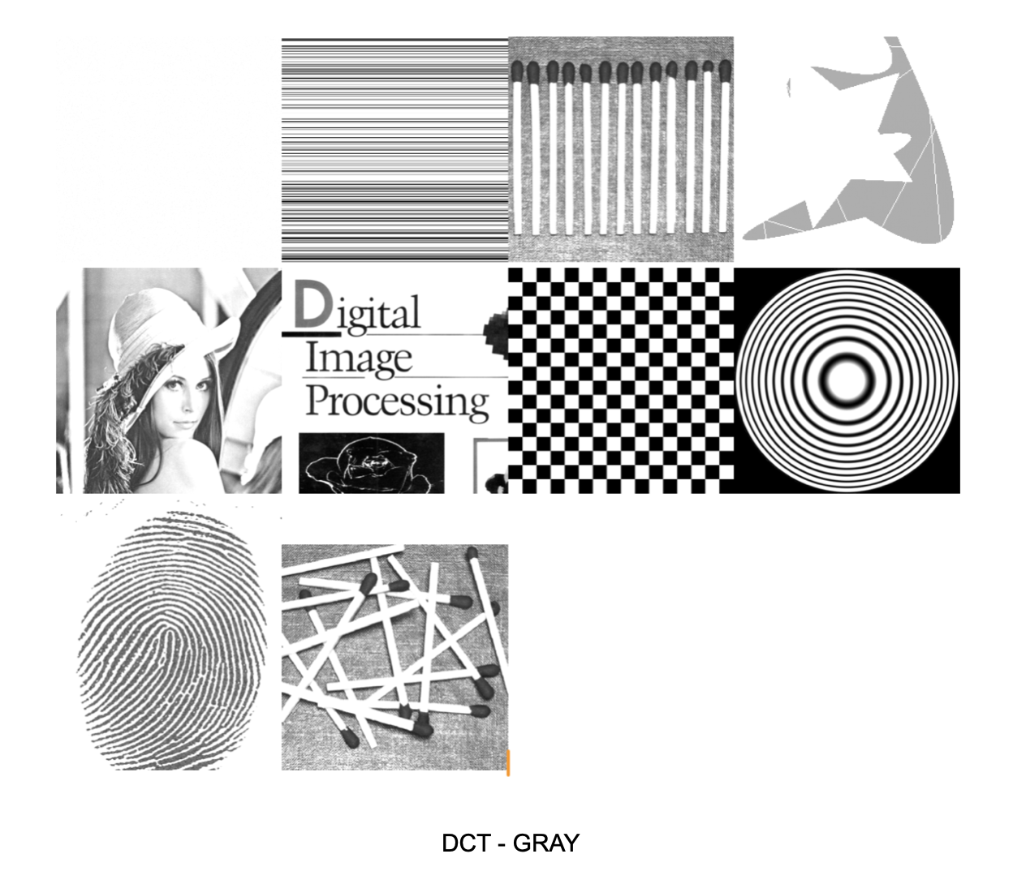
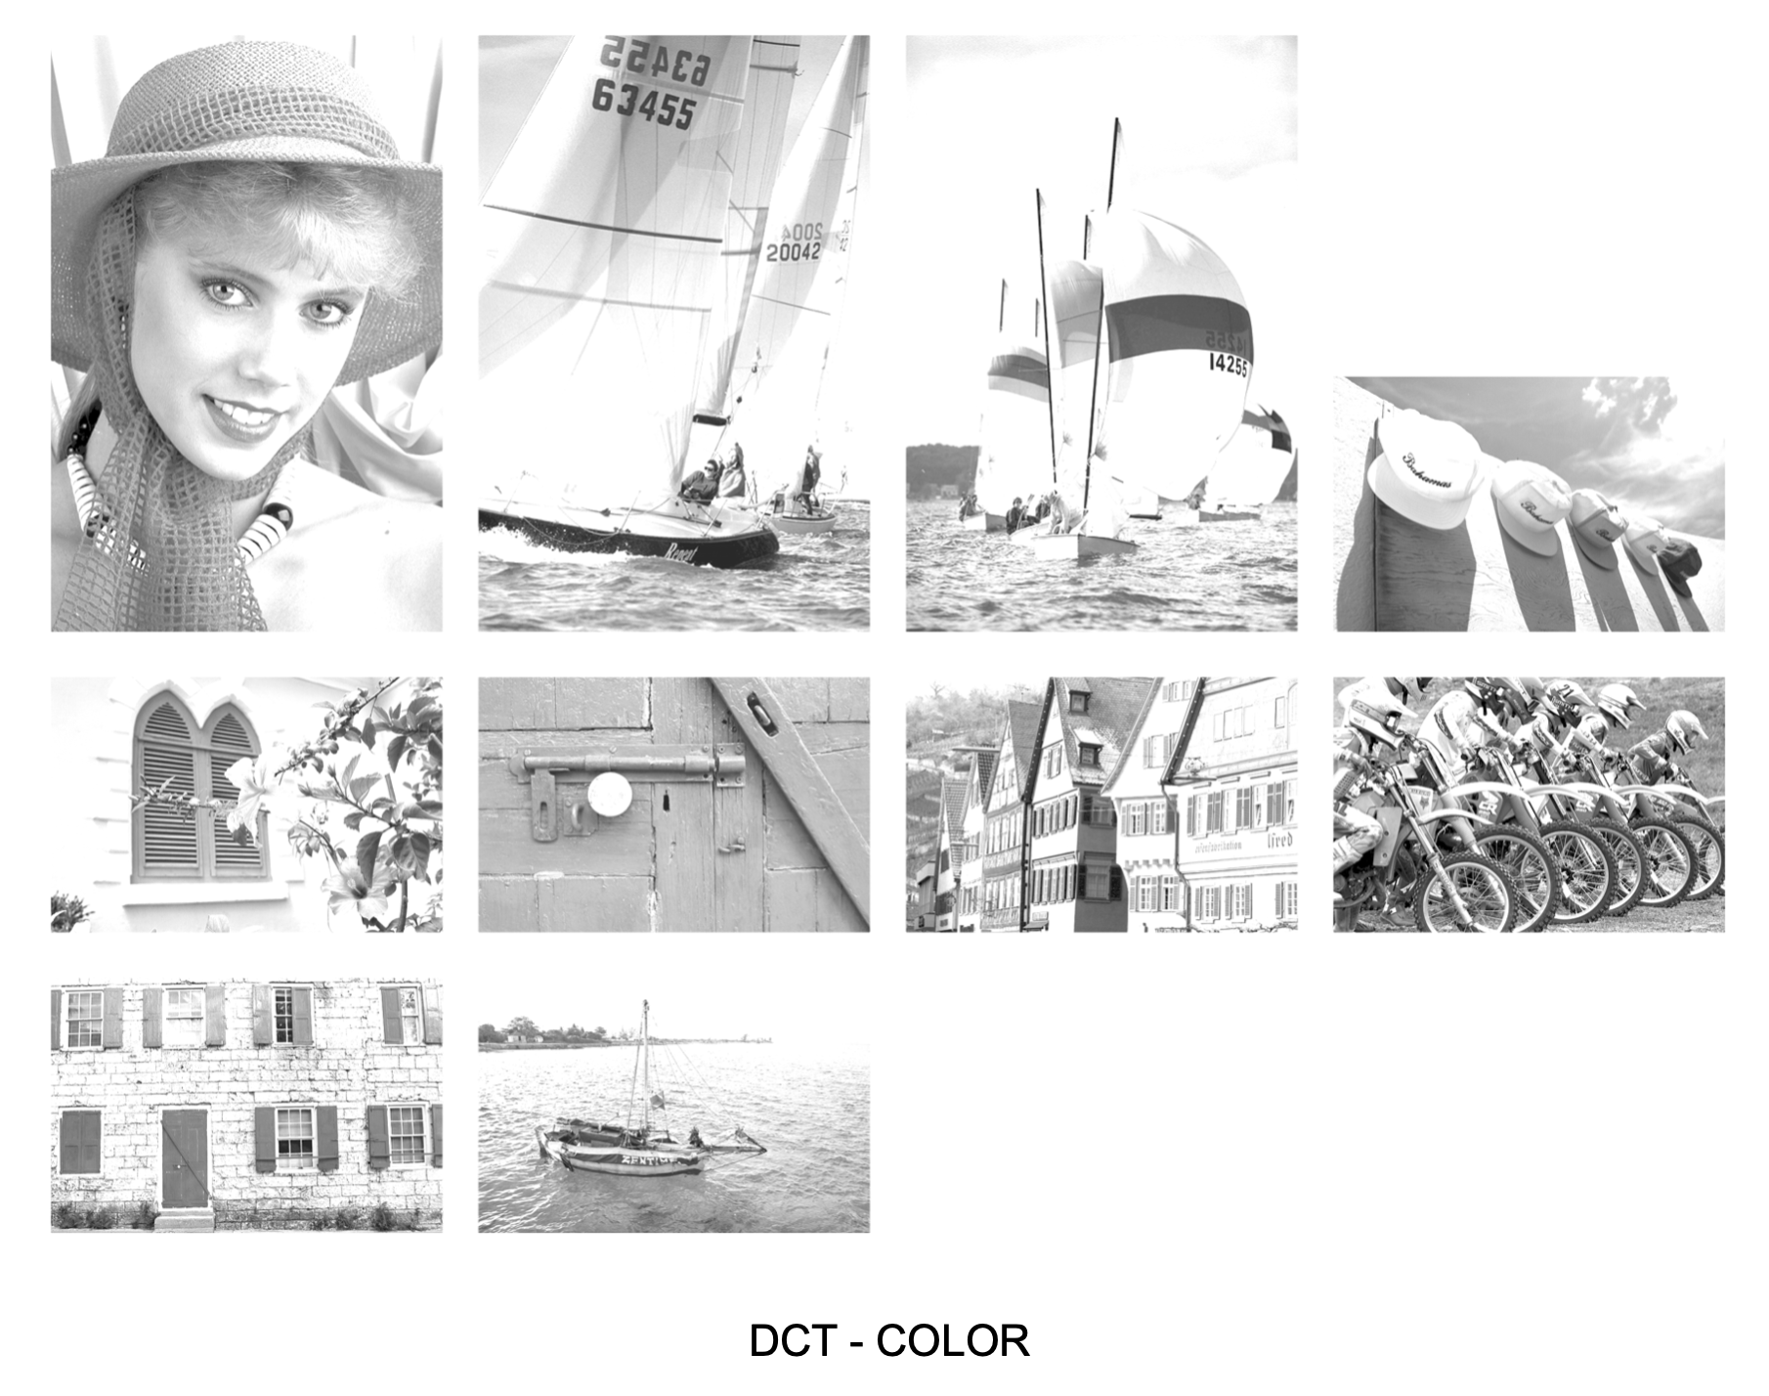
Discrete Cosine Transform (DCT)

Slide 5
Lapped Transform
Purpose: Reduces block artifacts with overlapping blocks
Overlapping Blocks: Smooths transitions between blocks
Frequency Domain: Transforms image data, focusing on low frequencies
Redundancy Reduction: Efficient compression, high visual quality
Code Steps: Load, pad, DCT, inverse DCT, average, save

Slide 6
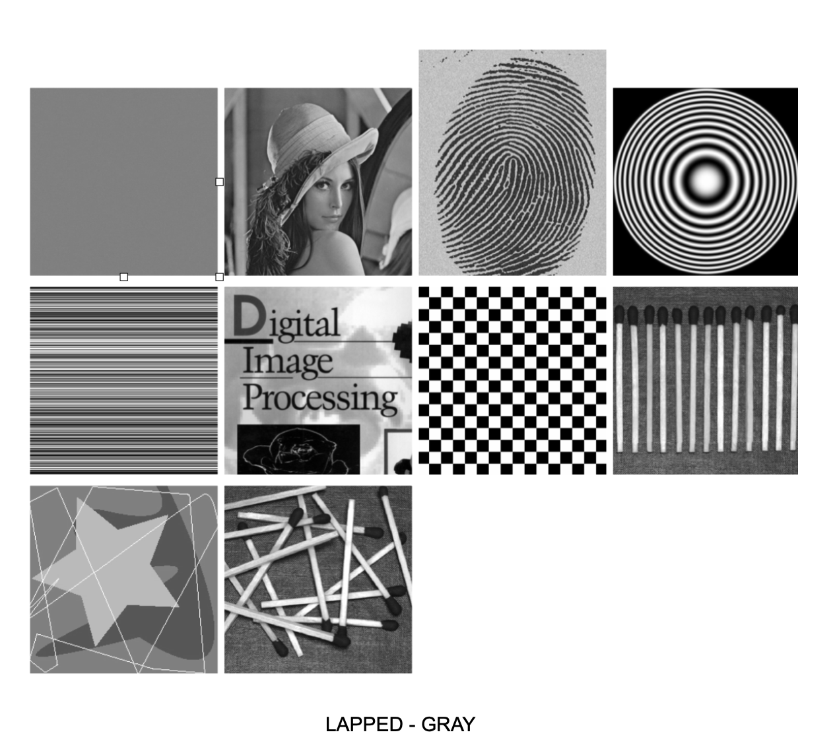
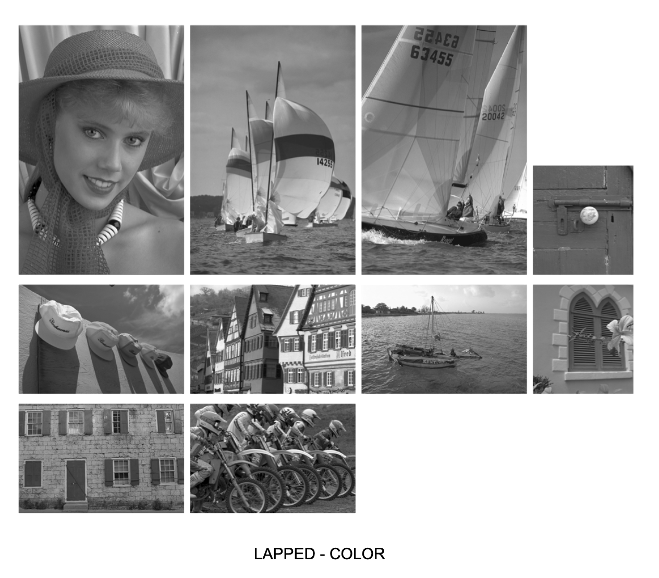
Lapped Transform

Slide 7
Compression Ratio
Definition: Measures compression; ratio of original to compressed file size
Importance: Evaluates data reduction for storage and transmission
Code Logic: Iterate files, get sizes, calculate DCT and Lapped Transform ratios
Output: List of filenames, sizes, and ratios for analysis

Slide 8
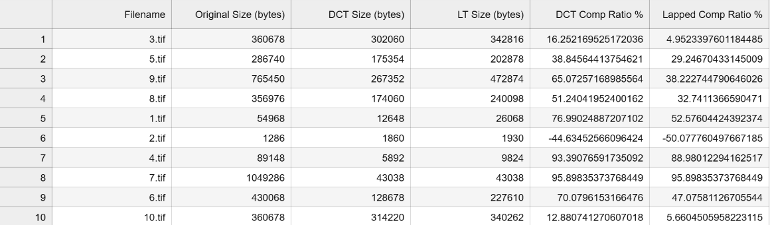
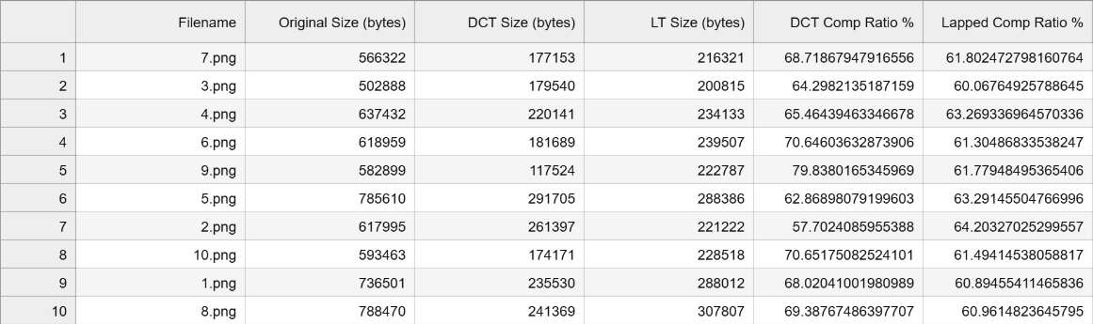
Compression Ratio
Grayscale Images
Color Images

Slide 9
Learned Perceptual Image Patch Similarity
Measures perceptual similarity; lower values indicate higher similarity
Compares features from images using a neural network
Calculates LPIPS score based on feature map differences
Initialize, process images, compute LPIPS, and store results
Returns a DataFrame with filenames and LPIPS scores

Slide 10
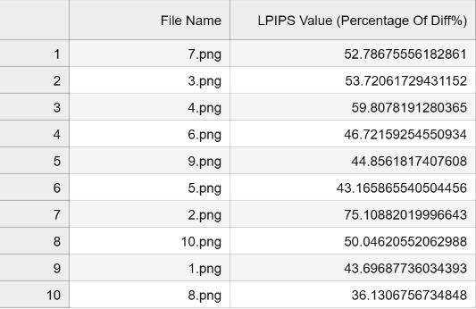
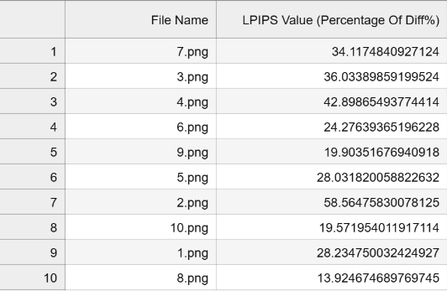
Learned Perceptual Image Patch Similarity
Color DCT
Color Lapped

Slide 11
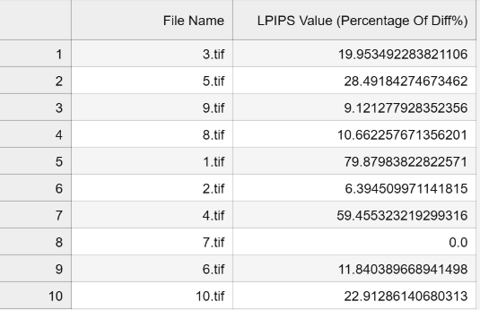
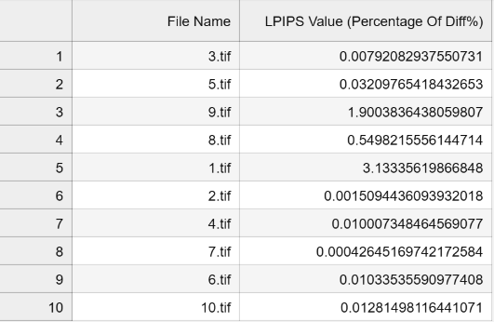
Learned Perceptual Image Patch Similarity
Gray DCT
Gray Lapped

Slide 12
Task 4: Listening Experiment Management
Findings
DCT provides higher compression but may introduce artifacts
Lapped Transform balances compression with visual quality
Recommendation
Use Lapped Transform for high visual quality
Choose DCT for smaller file sizes

Slide 13
Thank You
Suprabha Ghosh - 64365
Ismail Artun Altinel - 64722
Tarun Devidas Ramani - 66160

