Slide 1
STUDENT EXCHANGE / TECHNICAL PROGRESS REVIEW
Student Exchange | Progress Review
A working account/admin foundation, a polished preview, and a clear integration backlog
BUY. SELL. CONNECT.
From a backend repository to a
24 OCT
visible student marketplace
2026
experience.
Technical checkpoint:
implementation +
Students reuse affordable campus essentials. Administrators maintain
evidence + next gates
accounts, schools, access and abuse controls.
Tristan Roa • Robert (Andrew) Quaife • Alex Pyankov
Robert Richardson • Thomas Phommarath
Design understanding: goals → requests → identity → persistence → evidence.
Application f91b923 · branch 14c9386 · review 24 Oct 2026
S01
Notes:
Open with the actual state: account and administrator workflows are implemented and fixture-tested; the website marketplace remains a local preview. Both application builds pass, but the suite is not entirely green. This review covers concrete source, fresh tests, browser evidence and team-reported contributions. The original proposal document/date and final presentation deadline were not supplied. Do not claim percentage completion or production readiness.
Evidence: Application f91b923 · branch 14c9386 · review 24 Oct 2026

Slide 2
STUDENT EXCHANGE / TECHNICAL PROGRESS REVIEW
Current status: the foundation works; the market is still a preview
Separate implementation, fixture verification, browser behavior and live deployment claims
2 / 2
116
PREVIEW
Application builds pass
Tests passed
Marketplace boundary
Frontend typecheck + Vite build;
One failing accessibility expectation;
Search, detail, messages and offers
.NET 9 build: zero warnings/errors.
one live test intentionally skipped.
use sample/local browser state.
Integration implemented
Final integration gate
Registration, login, profile, logout and administration use Node →
Connect authenticated, persistent listings; verify the
ASP.NET contracts; supplied screenshots show deployed admin views.
service-token contract on the deployed stack.
Implemented and tested against fixtures does not establish current production deployment readiness.
Fresh build/test logs; browser-checks.json; Website/docs/live-validation.md
S02
Notes:
State the evidence precisely. npm run build and dotnet build both pass. Vitest has 118 registered cases: 116 passed, one failed, one opted-out live case. Local Chromium verifies six sample cards, three after the Textbooks filter, local message/offer updates and no horizontal overflow on the 390-pixel home page. This is not a new Azure or Render live verification. The failure is an accessible-list label mismatch. The offer form also has a separately observed min/step defect.
Evidence: Fresh build/test logs; browser-checks.json; Website/docs/live-validation.md

Slide 3
STUDENT EXCHANGE / TECHNICAL PROGRESS REVIEW
Problem, users and project goals
A campus exchange workflow supported by account identity and administrative control
Students
Administrators
Delivery stakeholders
Discover items by category or query;
Maintain users, schools and admin
A consistent implementation,
inspect details; manage a school-linked
membership; inspect/clear attempt
explainable design, traceable
account; eventually connect with a real
records; request target session
contributions, test evidence and a
seller.
sign-out.
credible final demonstration.
Current boundary: web UI + Node adapter + ASP.NET API + SQLite. Mobile web is ongoing. Payment
processing and live seller delivery are outside the implemented flow.
The product goal is a usable student exchange; the demonstrated catalog currently contains six illustrative records.
Website/src/App.tsx; data/listings.ts; admin.mjs; team role input
S03
Notes:
The problem and current product intent are derived from the implemented UI: help students find affordable books, supplies, electronics and campus-living goods. Stakeholders are students, administrators, the implementation team and review stakeholders. Do not invent institution partnerships or research participants. The UI explicitly says payment/pickup is arranged directly; there is no platform checkout integration. Thomas is working on the mobile web experience, not a separately verified native application.
Evidence: Website/src/App.tsx; data/listings.ts; admin.mjs; team role input

Slide 4
STUDENT EXCHANGE / TECHNICAL PROGRESS REVIEW
What changed: a verified repository comparison
Proposal comparison is limited because the original proposal artifact and date were not supplied
11 Oct · repository baseline
24 Oct · source update
24 Oct · design artifacts
Backend and API documentation
Website + Node adapter + admin
25 UML diagrams and 18 DFDs now
present. This is the available
console + tests added; listing endpoint
document current data, interaction and
comparison point, not a verified
and schema/config refinements added.
deployment boundaries.
proposal baseline.
Plan implication
Observed adjustment / constraint
Browser/backend contract
Node adapter handles backend GET bodies and protects credentials.
Marketplace breadth
Visible messaging/offer UI exists before live listing persistence.
Role boundaries
Andrew reports website work in addition to his original backend role.
Proposal-date scope comparison remains pending; repository changes and team-delivered artifacts are documented.
Git compare 2307809 (11 Oct) → f91b923 (24 Oct); team-reported contributions
S04
Notes:
The dates are repository checkpoints, not asserted proposal dates. The October 11 snapshot had the backend and API documentation. The October 24 source update adds the website, adapter, UI/HTTP tests, deployment configuration and listing endpoint, with schema/config changes. Later October 24 commits add UML and DFD design atlases. The user independently reports the team contributions since the proposal. No claim is made that all source was authored on the commit date or that all changes were planned scope changes.
Evidence: Git compare 2307809 (11 Oct) → f91b923 (24 Oct); team-reported contributions

Slide 5
STUDENT EXCHANGE / TECHNICAL PROGRESS REVIEW
Functional requirements: concrete acceptance and status
Status describes the current source and evidence, rather than an estimated completion percentage
ID / capability
Acceptance condition
Current status
FR1 · discovery
Filter by query/category and open details.
Local preview verified: 6 cards → 3 textbooks.
FR2 · accounts
Register; login; restore/edit profile; logout.
Implemented; local HTTP/UI fixtures pass.
FR3 · administration
Enforce levels and valid target scope.
Implemented; admin UI + wire fixtures pass.
FR4 · listings
Create/read/delete persisted, owned listings.
Direct API exists; website + schema integration missing.
FR5 · communication
Send durable messages/offers to a real seller.
Messaging/offer UI only; no delivery or storage.
FR6 · mobile web
Usable account/marketplace experience on phones.
Work ongoing; 390 px home-page check passes.
A visible control is not a completed end-to-end feature unless its server and retained-data path exist.
Source routes; test-summary.json; browser-checks.json; PROCESS-SPECS.md
S05
Notes:
Walk through each requirement and the precise status. Account/admin implementation is supported by fixture tests; listing integration is not complete. The user interface has contact/offer previews but no persistence or seller delivery. StudentExchange does not process payments in its current product copy. Proposal-specific additions/removals cannot be formally mapped without that artifact.
Evidence: Source routes; test-summary.json; browser-checks.json; PROCESS-SPECS.md

Slide 6
STUDENT EXCHANGE / TECHNICAL PROGRESS REVIEW
Non-functional requirements: evidence and remaining limits
Observed controls are separated from acceptance work still needed
Requirement
Implemented / observed
Remaining acceptance
Credential isolation
Node-only tokens; HttpOnly cookie; field projection.
Replace reversible password storage; verify deployed
behavior.
Data integrity
Unique account email/token; declared relationships.
Versioned Listings schema; explicit FK enforcement check.
Reliability
Safe upstream errors; saved-write/readback handling.
Deployed migration smoke test; restart/session
expectations.
Usability / accessibility
Keyboard/card behavior; responsive home at 390 px.
Repair accessible-list label; audit account/admin/mobile
views.
Performance / operations
Bounded upstream deadlines; /healthz process check.
Measure latency/load; verify service auth and DB
readiness.
Security, accessibility, integrity and deployment readiness still need explicit final acceptance checks.
api.mjs; client-ip.mjs; Sql.cs; Env.cs; browser/tests/build evidence
S06
Notes:
These are requirements relevant to the current system, not claims of original proposal wording. Credentials remain server-side and cookies are HttpOnly; same-origin checks and explicit response projections reduce exposure. Important unresolved risks include reversible password storage, listing endpoint authorization and database integrity assumptions. There are bounded request deadlines, but no load/performance result or production SLA. A single Render instance is consistent with in-memory sessions; scaling requires a shared store.
Evidence: api.mjs; client-ip.mjs; Sql.cs; Env.cs; browser/tests/build evidence

Slide 7
STUDENT EXCHANGE / TECHNICAL PROGRESS REVIEW
Completed implementation: what is actually present
Feature delivery, integration evidence and remaining edge are explicit
Workstream
Completed artifact / behavior
What remains
Frontend
Browse/detail UI; account forms; admin console; local messaging.
Live marketplace and full mobile/accessibility
acceptance.
Backend / API
Account/profile/token, school, role and block-management
Listing auth/ownership and deployment
operations.
acceptance.
Adapter
Same-origin routes; session Map; service-token forwarding.
Current Azure/Render smoke test and production
readiness.
Data / infrastructure
Eight-table DDL; configurable account DB; Render manifest.
Listings migration, path alignment, FK/runtime
checks.
Design / verification
UML + DFD atlases; fresh builds and 116 passing cases.
One failed assertion, offer input issue, final
acceptance run.
The strongest completed vertical slice is account and administrator management; persistent marketplace activity is the main remaining
slice.
Website/src and server; Backend/Controllers and Components; user contribution report
S07
Notes:
The implementation is substantial: the student site and account/admin adapter, backend account/school/admin/attempt operations, local HTTP fixture coverage, a production build and deployment configuration exist. Eight account/security tables are declared. ListingController adds three operations on a separate path but lacks a declared Listings schema. The design atlases explain current behavior. This review does not assert that configuration equals deployed production readiness.
Evidence: Website/src and server; Backend/Controllers and Components; user contribution report

Slide 8

STUDENT EXCHANGE / TECHNICAL PROGRESS REVIEW
Website evidence: the current frontend running locally
Captured from the current production bundle served by the Node website server
Observed in Chromium
6 sample listings render
3 remain after Textbooks
No browser script errors
390 px home: no overflow
Accounts/admin use fixture
evidence here; no new live
backend run is claimed.
The UI is demonstrable today; screenshot evidence is scoped to local preview behavior.
Local Chromium capture; npm run build; assets/website-home.png
S08
Notes:
This screenshot is the actual current frontend bundle, not the repository WebsiteDesign mockup. The account backend was intentionally unconfigured for this capture; it demonstrates the local marketplace UI only. Browser checks found six cards, three after the Textbooks filter, no script errors and no horizontal overflow at 390 pixels on the home page. That limited mobile observation does not establish full mobile acceptance or completion of Thomas’s ongoing work.
Evidence: Local Chromium capture; npm run build; assets/website-home.png

Slide 9
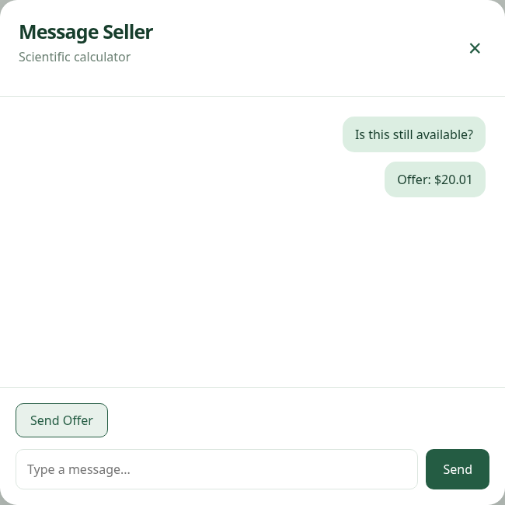
STUDENT EXCHANGE / TECHNICAL PROGRESS REVIEW
Messaging UI: local interaction and the remaining delivery gap
Robert Richardson’s messaging UI changes local App state
What works
Open message dialog; append a local
message; preview a positive offer.
What is missing
Seller delivery and persistence. Fix
whole-dollar step validation and
isolate conversation state by listing.
Next integration contract: authenticated sender + seller/listing identity + durable message/offer records.
App.tsx form handlers; local browser capture; team-reported attribution
S09
Notes:
Robert Richardson is credited by the team for messaging UI. The browser capture submits a message and an offer of $20.01. Both become local strings in one shared messages array. There is no seller delivery, persistent conversation or per-listing conversation store. A whole-dollar offer such as $20.00 is blocked by native HTML validity because min=0.01 and step=1 have incompatible alignment for whole-dollar values; the JS positive-number check is never reached in that case. The proposed correction is step=0.01 with positive amount validation. No source code was changed during the review.
Evidence: App.tsx form handlers; local browser capture; team-reported attribution

Slide 10
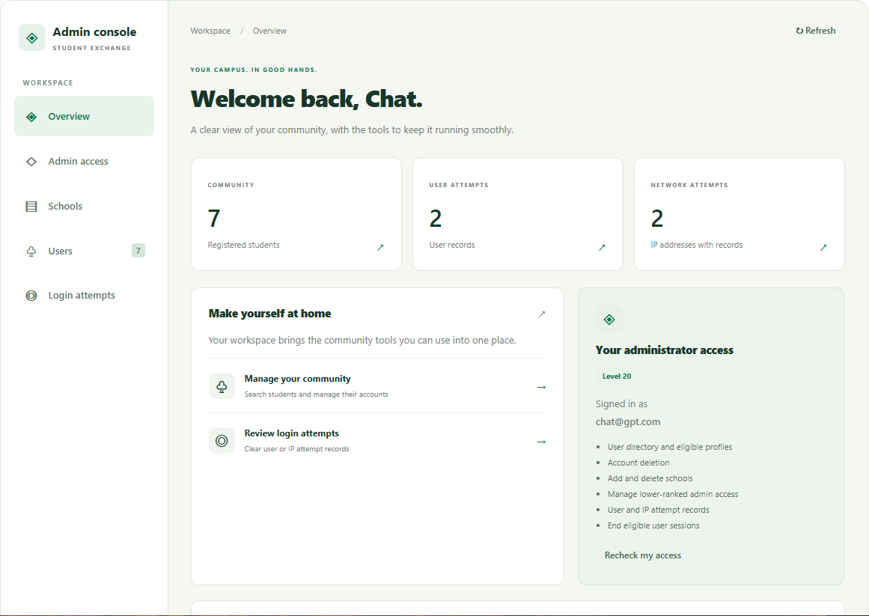
STUDENT EXCHANGE / TECHNICAL PROGRESS REVIEW
Deployed admin console: overview and access context
Team-supplied capture from studentexchange.onrender.com/admin
7 students displayed
Snapshot count; not a permanent
project metric.
2 user + 2 IP records
Attempt observations; not necessarily
active blocks.
Level 20 shown
Permission context is visible in the
supplied capture.
The deployed console exposes community and attempt information under a visible administrator context.
User-provided admin overview screenshot; team-confirmed Render deployment
S10
Notes:
The team provided a screenshot of the deployed /admin page, showing an authenticated overview with seven registered students, two user-attempt records and two IP/network-attempt records at the capture moment. The displayed administrator context is Level 20. This is stronger visual evidence of an authenticated deployed admin page than configuration alone. It does not independently establish all mutations, current source revision, current counts or every permission path. Attempt-record counts are observations, not proof that every record is an active block. Preserve that distinction when speaking. Browser chrome is outside the presentation crop; the original screenshot remains unchanged.
Evidence: User-provided admin overview screenshot; team-confirmed Render deployment

Slide 11
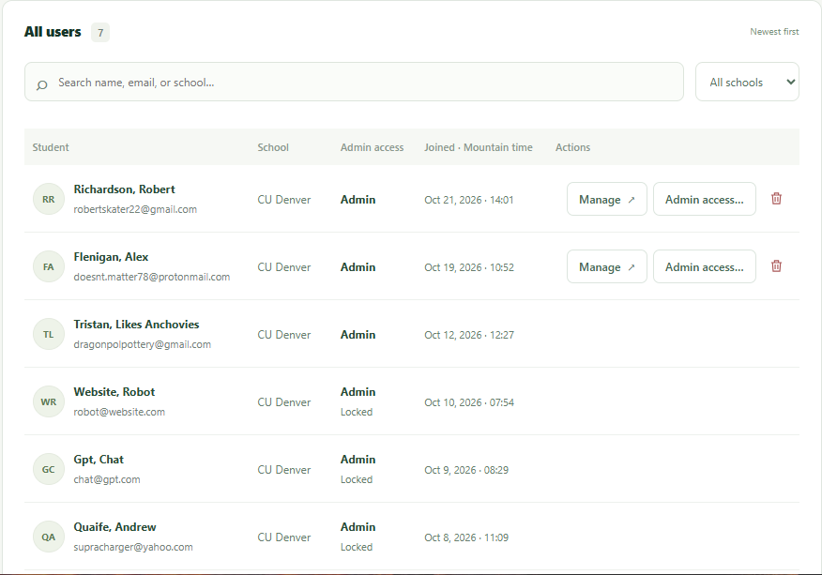
STUDENT EXCHANGE / TECHNICAL PROGRESS REVIEW
Deployed user directory: visible management capabilities
Team-supplied Users view with search, school filter, role/lock indicators and actions
Find and filter
Search by name/email/school; school
dropdown.
Review access context
Admin/locked indicators and joined
timestamps.
Manage eligible targets
Manage, admin-access and delete
controls are visible.
The directory screenshot, source contracts and passing admin fixtures provide complementary evidence.
User-provided admin Users screenshot; server/admin.mjs and api.mjs; backend Users controller
S11
Notes:
The second deployed screenshot shows the Users view with seven total users, name/email/school search, school selection, admin status and locked indicators, joined timestamps and management controls. Describe visible UI affordances as evidence of the directory view; do not claim every action was clicked or that a screenshot proves authorization enforcement. Fixture tests support the corresponding contracts and permission checks. The source shows caller/target separation and rank/locked guards. Avoid presenting personal account details as product requirements; the slide focuses on capability and structure. The original source is retained and cropping is applied only in the presentation layout.
Evidence: User-provided admin Users screenshot; server/admin.mjs and api.mjs; backend Users controller

Slide 12
STUDENT EXCHANGE / TECHNICAL PROGRESS REVIEW
Current architecture: browser → adapter → API → data
A same-origin website adapter bridges a body-authenticated backend API
«client»
«server · deployed on Render»
«service · deployed on Azure»
«retained data»
React + TypeScript
Node website adapter
ASP.NET Core API
SQLite records
Browser UI and hooks
HTTPS
Static dist/ + API routes
HTTPS JSON
Controllers + auth helpers
SQL
Configured Env._dbPath
Opaque cookie ID
Session Map + service token
Application/IP/user checks
8 declared tables
fetch /api/*
Origin + field/response checks
Parameterized account SQL
Listings: separate path
Identity boundary
Independent listing path
Browser: cookie ID. Node: visitor access_token + service
Direct /api/Listing CRUD is present, but it is not invoked by the
admin_token. Backend: caller and selected target remain
website adapter and lacks a supplied table migration.
distinct.
The adapter is necessary for both protocol compatibility and keeping shared/user credentials out of the browser.
Website/server/app.mjs, api.mjs, render.yaml; Backend/Program.cs, Sql.cs, Env.cs, Listing.cs
S12
Notes:
The browser calls the Node website origin for static assets and /api routes. Node translates body credentials and GET bodies, retains opaque-cookie session mappings and a service admin token in memory, and uses HTTPS to the configured ASP.NET service. Shared helpers read the configured SQLite account database. ListingController bypasses the shared Sql helper and independently uses ../Data.db. The team confirms the backend is deployed on Azure and the website at https://studentexchange.onrender.com. This review does not independently establish the deployed source revision or current full workflow acceptance. There is no third-party OAuth, payment or messaging service integration in the source.
Evidence: Website/server/app.mjs, api.mjs, render.yaml; Backend/Program.cs, Sql.cs, Env.cs, Listing.cs

Slide 13
STUDENT EXCHANGE / TECHNICAL PROGRESS REVIEW
Walk one request: reading a signed-in profile
How the request, identity and data move across our layers
1 · Browser
GET /api/profile + opaque cookie; no credentials in localStorage.
2 · Node adapter
Cookie ID → session Map → visitor token; add server-owned envelope.
3 · ASP.NET + SQLite
Validate app/IP/token; select user and school; produce profile data.
4 · Browser-safe result
Return email, first_name, last_name, school; expire true invalid sessions.
GET bodies are an upstream contract constraint; the browser-side contract remains a normal same-origin request.
src/api/accounts.ts; hooks/useAccount.ts; server/api.mjs; Register.cs; AppAuthJson.cs
S13
Notes:
Use a profile read to explain the consequential design. Browser fetch sends GET /api/profile with an opaque HttpOnly cookie, no body token. Node looks up the 12-hour local session and selects the stored backend user token. The forwarding client supplies app_access, verified IP and a cached login-issued service admin_token. Node http(s).request can send the backend GET JSON body; browser fetch cannot. AppAuthJson validates app/IP and visitor token; Register reads user/school and returns profile data. Node projects the four permitted public fields. No password, user token or service token reaches the browser.
Evidence: src/api/accounts.ts; hooks/useAccount.ts; server/api.mjs; Register.cs; AppAuthJson.cs

Slide 14
STUDENT EXCHANGE / TECHNICAL PROGRESS REVIEW
UML use cases: goals and implemented boundaries
The important distinction is preview interaction versus account/admin integration
Student Exchange system
Browse sample
«extend»
Preview messages
Manage users, roles,
listings
and offers
schools and attempts
Visitor
Register / log in
Read / update profile
and log out
Signed-in student
Administrator
Use cases describe user goals; backend service identity is infrastructure rather than a human admin actor.
Adapted from docs/uml D02/D03; source App.tsx and server/api.mjs
S14
Notes:
This is a readable selected use-case view, not an attempt to put every endpoint on one slide. A signed-in student also has visitor capability, shown by generalization. Browse and local message/offer preview are available without the account flow. Register/login and profile/logout are backed by the adapter/API implementation. Admin goals are capability-gated and target-scoped. The boundary covers Student Exchange; the users are outside it. The next slide’s actual class model and subsequent sequence must agree with these goals.
Evidence: Adapted from docs/uml D02/D03; source App.tsx and server/api.mjs

Slide 15
STUDENT EXCHANGE / TECHNICAL PROGRESS REVIEW
UML class view: shared credentials and request inheritance
These are actual C# request types, not invented service/entity classes
AppAuthJson
+ app_access : string?
+ access_token : string?
+ ip, admin_token, to_user : string?
+ ValidateApp(...) : IActionResult? {static}
+ ValidateToken(...) : IActionResult? {static}
Register.Info
LogIn.Info
Admin.Info
+ email, first_name, last_name : string?
+ email : string?
+ level : int?
+ password, school : string?
+ password : string?
+ locked : int?
The inherited access_token is the acting user token; admin_token is a separate service forwarding token.
Backend/Components/AppAuthJson.cs; Controllers/Register.cs, LogIn.cs, Admin.cs
S15
Notes:
Explain that AppAuthJson combines body fields with static validation operations in the current code. Register.Info, LogIn.Info and Admin.Info inherit those fields. Nullable request properties support per-operation handling; they do not mean that required registration/login fields are optional at runtime. These DTOs differ from the database tables and from Node’s browser-safe TypeScript contracts. The schema model follows on separate slides. This design also exposes a coupling trade-off: validation and request shape share a class.
Evidence: Backend/Components/AppAuthJson.cs; Controllers/Register.cs, LogIn.cs, Admin.cs

Slide 16
STUDENT EXCHANGE / TECHNICAL PROGRESS REVIEW
UML sequence: login establishes a website session
Prepared forwarding identity is assumed; its renewal rules are covered in the appendix
Browser / UI
Node adapter
ASP.NET API
SQLite
POST /api/login {email, password}
POST /LogIn + server envelope
Read identity/attempts; select or write token
User + eligible token / error
201 access_token
GET /Register with JSON token body
Public profile / read error
Store token under opaque session ID
200 profile + HttpOnly cookie ID
A backend login response alone is insufficient; profile projection succeeds before Node creates the browser session.
docs/uml D10; api.mjs /api/login; LogIn.Post; Register.Get
S16
Notes:
Time flows downward. Backend login verifies credentials/attempt admission, reuses or issues a token and returns it only to Node. Node then uses GET /Register with the token in the JSON body to obtain a public profile. Only a validated profile permits local session creation. The browser receives a projected profile and opaque HttpOnly cookie, not the backend token. The Node self-message denotes the local Map write. Backend token validity and local session validity are separate clocks. Failed login/profile read is an alternative result; it does not establish the new Map entry.
Evidence: docs/uml D10; api.mjs /api/login; LogIn.Post; Register.Get

Slide 17
STUDENT EXCHANGE / TECHNICAL PROGRESS REVIEW
Database core: one school, many users, optional admin membership
UML-style relational model of four declared tables; these are not ORM entity classes
User
Admins
Schools
id : Integer {PK}
email : Text {unique, encrypted}
1
0..1
user_id : Integer {unique, FK}
id : Integer {PK}
1
0..*
first_name, last_name : Text
level : Integer = 0
name : Text {unique}
password : Text {encrypted}
locked : Integer = 0
short_name : Text? {unique}
school_id : Integer {FK}
datetime : Text?
1
0..*
Access_Token
Account SQL uses Env._dbPath,
selected through path.env and
id : Integer {PK}
.env2. No migration initializer is
user_id : Integer {FK}
token : Text {unique}
present.
expiry : Text
Declared constraints explain intended relationships; actual foreign-key enforcement still needs a runtime check.
DB_Schema.txt; Register.cs; LogIn.cs; Components/Sql.cs
S17
Notes:
The declared account core includes Schools, User, Admins and Access_Token. User.school_id is required; an account can have zero or one Admins row and many access tokens. Email/token uniqueness matters to lookup and issuance. The schema declares RESTRICT for school/user and user/admin relationships and CASCADE for tokens, but the connection does not explicitly enable foreign keys. Do not claim these runtime effects were verified. Password and email values are deterministically reversibly encrypted in the current code, which is a security debt rather than a recommended password strategy.
Evidence: DB_Schema.txt; Register.cs; LogIn.cs; Components/Sql.cs

Slide 18
STUDENT EXCHANGE / TECHNICAL PROGRESS REVIEW
Security data: attempts are observations, not always blocks
Four more declared tables track IP identity, user/IP association and attempt windows
User {reference}
1
0..*
User_Has_IPs
0..*
1
IP
id : Integer {PK}
user_id : Integer {FK}
id : Integer {PK}
ip_id : Integer {FK}
ip : Text {unique, encrypted}
1
{unique (user_id, ip_id)}
datetime : Text?
1
0..*
0..*
Blocked_Users
Blocked_IPs
id : Integer {PK}
Window semantics
id : Integer {PK}
user_id : Integer {FK}
Five-minute observation window; count ≥ 10 blocks.
ip_id : Integer {FK}
count : Integer
User threshold 10 revokes tokens. Repeated
count : Integer
expiry : Text
expiry : Text
attempts can extend expiry.
Token records, attempt windows and process-local lock metadata have different purposes and retention rules.
DB_Schema.txt; Users.cs; IP.cs; docs/dfd P35/P43/P44
S18
Notes:
These complete the eight-table declared schema. Multiple historical attempt rows may exist, so draw 0..* rather than assuming a unique per-user row. User_Has_IPs has NOT NULL foreign keys and a unique pair. The active time window and count determine blocking, not merely table membership. A successful first observation can have count -1. At user threshold 10, existing tokens are revoked; clearing attempts later does not recreate them. IP blocks do not directly revoke tokens. Process-local identity locks serialize related updates but do not coordinate multiple instances.
Evidence: DB_Schema.txt; Users.cs; IP.cs; docs/dfd P35/P43/P44

Slide 19
STUDENT EXCHANGE / TECHNICAL PROGRESS REVIEW
Listing integration: two contracts currently stop short of a vertical slice
The visible catalog and the direct listing API are separate implementations
Website contract today
API contract today
Listing[] constant: id, title, category, price, condition, school,
GET/POST/DELETE /api/Listing. SQL expects title, description,
cover, label. App holds message/offer strings. No listing
gap
price, category, user_id, datetime. UserId comes from the
fetch route.
request body.
Missing connection
Concrete next implementation
Schema + storage
Versioned Listings DDL; align with the account database path.
Identity + authorization
Derive owner from authenticated context; enforce delete ownership.
Adapter + UI
Agree a DTO, map fields and replace sample data with real reads/writes.
Final vertical slice: signed-in owner creates a persisted listing; another browser retrieves it; unauthorized deletion fails.
Website/data/listings.ts, App.tsx, server/api.mjs; Backend/Listing.cs; DB_Schema.txt
S19
Notes:
Tristan is credited with the Listing endpoint; Andrew’s reported website work excludes that endpoint and messaging UI. Describe the gap without dismissing delivered code: the current website imports six samples with visual fields such as condition/cover/label, whereas the backend expects Listings title/description/price/category/user_id/datetime and joins User. The adapter exposes no listing route. Listings is absent from the supplied schema and the controller selects ../Data.db independently. CRUD lacks shared auth/ownership checks. These need one agreed schema/DTO/security contract before demonstrating live marketplace persistence.
Evidence: Website/data/listings.ts, App.tsx, server/api.mjs; Backend/Listing.cs; DB_Schema.txt

Slide 20
STUDENT EXCHANGE / TECHNICAL PROGRESS REVIEW
Three identities and two expiry clocks
Browser session, visitor token and service identity serve different purposes
Data item
Held / used where
Meaning
se_session
Browser cookie ↔ Node Map
Random opaque ID; fixed 12-hour local session.
access_token
Node memory → backend JSON
Visitor or human-admin identity; backend 21/3-day
lifetime.
admin_token
Node service cache → backend envelope
Login-issued service-admin proof for IP forwarding.
to_user + sudo_id
Backend selected-user context
Target selector plus preserved original caller provenance.
Restart / scaling
Node restart loses local sessions; independent replicas need shared session state.
Service privilege transports identity; it does not turn an ordinary visitor into a human administrator.
api.mjs sessions/forwarding client; AppAuthJson.ValidateApp/ValidateToken; Env.cs
S20
Notes:
Keep these three identities separate. se_session is an opaque cookie ID. Node maps it to the visitor access_token. Separately, a configured service account logs in and its admin access token becomes admin_token for trusted IP forwarding. Human admin authorization comes from the visitor’s own token and Admins level; it is not conferred by the service token. to_user is a selector for an eligible target while sudo_id/caller level retain provenance. Local Map expiry is 12 hours; backend ordinary/admin tokens last 21/3 days. Public school reads and login admission have different checks from token-authenticated actions.
Evidence: api.mjs sessions/forwarding client; AppAuthJson.ValidateApp/ValidateToken; Env.cs

Slide 21
STUDENT EXCHANGE / TECHNICAL PROGRESS REVIEW
Technology decisions: constraints, benefits and trade-offs
Protocol compatibility, client state and single-instance storage shape the design
Choice
Why it fits this implementation
Trade-off / consequence
React 19 + TypeScript + Vite
Interactive hooks/forms; typed client contracts; fast
Local state is not persistence; accessibility can
production bundle.
regress with JSX changes.
Node.js 24 adapter
Supports upstream GET bodies; retains credentials;
Extra network hop; in-memory sessions; service
one browser origin.
identity lifecycle.
C# / ASP.NET Core · .NET 9
Typed controllers and existing account/admin
Body-credential contract and static-helper coupling
validation paths.
need deliberate handling.
SQLite + parameterized SQL
Portable relational prototype with
Versioned schema, one coherent path and verified
account/school/security relationships.
FK/concurrency behavior.
Render + Azure configuration
Static UI/API adapter separate from backend
Configuration/health alone does not prove
deployment.
cross-service readiness.
The Node adapter is the most consequential compatibility decision; local state and SQLite also impose explicit operating limits.
package.json; vite.config.ts; api.mjs; csproj; Sql.cs; render.yaml
S21
Notes:
Use precise reasons, not generic technology praise. React/TypeScript fits a stateful UI and explicit browser contracts. Node is consequential because browser fetch cannot send the upstream GET JSON body and shared credentials should stay off the client. ASP.NET supplies typed controller/validation infrastructure already present. SQLite fits a portable single-instance prototype but brings path, schema migration and concurrency/foreign-key obligations. Render hosting uses the existing Node manifest; Azure is the configured API destination. These explanations are inferred design fit, not a claim that a formal ADR or original team rationale exists.
Evidence: package.json; vite.config.ts; api.mjs; csproj; Sql.cs; render.yaml

Slide 22
STUDENT EXCHANGE / TECHNICAL PROGRESS REVIEW
Deployed: Azure backend + Render website
Team-confirmed hosting · https://studentexchange.onrender.com · workflow acceptance remains separate
Deployed Render website
Deployed Azure backend
Next acceptance evidence
https://studentexchange.onrender.com.
Team confirms the ASP.NET backend is
Current service-admin login;
Node hosts dist/ + /api. Manifest sets
deployed on Azure. Source includes
schema/path correctness; explicit FK
one instance and /healthz; hosting
account/admin controllers, configured
policy; browser + adapter + API smoke
confirmed by the team.
SQLite and daily cleanup.
test.
Release acceptance: verify one disposable account workflow and one authorized listing workflow with
cleanup, then confirm restart behavior and no credential exposure.
/healthz reports process/configuration presence; it does not prove service login, database readiness or marketplace integration.
render.yaml; server/index.mjs, app.mjs; Env.cs; Website/docs/live-validation.md
S22
Notes:
Render manifest specifies Node 24.19.0, npm ci/build, npm start, /healthz and one instance. Server-only backend/app_access/user/user_pass settings must be configured; the service user must actually be an admin under the deployed backend contract. The configured Azure URL identifies a destination, not proof of readiness. The team confirms Azure backend and Render website deployment. Historical October 8/9 live workflows preceded the October 10 service-token migration; those dated notes do not independently verify the currently deployed authentication contract. Account DB schema/config files and key pairing must exist. Rollback should preserve compatible configuration/schema. Do not display credentials or run privileged live mutations during this review.
Evidence: render.yaml; server/index.mjs, app.mjs; Env.cs; Website/docs/live-validation.md

Slide 23
STUDENT EXCHANGE / TECHNICAL PROGRESS REVIEW
Verification: current results and historical live evidence
Today’s check uses the pinned application source, local HTTP fixtures and Chromium
116
1
1
2
passed
failed
live test skipped
builds passed
Evidence level
What it establishes
Boundary of this evidence
Current fixtures
Adapter wire contracts, permissions, UI behavior.
Real Azure/Render configuration or production data.
Current local browser
Preview filtering/message/offer; 390 px home layout.
Seller delivery, persistence or full mobile acceptance.
Historical live report
Oct 8/9 account workflows under their then-current
Live success of the Oct 10 service-token migration.
contract.
Remaining verification work is specific: repair the failing assertion/markup contract, then test the current deployed identity and listing
path.
evidence/test-summary.json, browser-checks.json, build.log, dotnet-build.log; live-validation.md
S23
Notes:
The current test run registered 118 cases: 116 pass, one fail, one skipped. The passed breakdown is 84 server/helper tests and 32 UI tests. AccountPanel and AdminPage suites pass; App has two passes and one failed accessible-list expectation. The separately enabled live test was intentionally skipped. Frontend typecheck/production build and backend build pass. Browser checks use the local current build with backend account config absent. Earlier live reports establish only their dated contracts: October 8/9, before the October 10 service-token migration. The team has supplied screenshots of the authenticated deployed admin overview and user directory. Those confirm the visible deployed views at capture time; no new full workflow mutation/load test is represented as passing.
Evidence: evidence/test-summary.json, browser-checks.json, build.log, dotnet-build.log; live-validation.md

Slide 24
STUDENT EXCHANGE / TECHNICAL PROGRESS REVIEW
Major implementation risks: next integration priorities
Severity and proposed accountable roles are review recommendations, not completed fixes
Priority / issue
Concrete action and acceptance
Proposed owner
P0 · listing ownership
Authenticate create/delete; derive owner server-side; negative ownership tests.
Tristan + Andrew
P0 · listing data path/schema
Add a migration; select one intended database; verify relations and constraints.
Tristan + Andrew
P0 · password storage
Replace reversible passwords with salted password hashing; define account transition.
Andrew + Tristan
P1 · live identity contract
Verify configured service user, admin membership and forwarding expiry behavior.
Andrew + Tristan
P1 · operating limits
Verify FK settings; document restart/session loss and single-instance scope.
Andrew
Prioritize coherent persistence, authenticated ownership and current deployed workflow acceptance.
Listing.cs; DB_Schema.txt; DeterministicEncryption.cs; Sql.cs; api.mjs; team role report
S24
Notes:
Lead with the risks that could prevent a correct final demo. ListingController accepts UserId and delete ID without shared auth or ownership and uses an undeclared table on a separately resolved database path. Passwords are reversibly encrypted instead of stored with a dedicated salted password hash. The live service-token migration is unverified. These are implementation findings, not theoretical checklists. Proposed remediation ownership follows the user-supplied roles; it is not a claim that those tasks are already in progress. A class-project demonstration must still avoid presenting unauthenticated destructive listing operations as correct ownership behavior.
Evidence: Listing.cs; DB_Schema.txt; DeterministicEncryption.cs; Sql.cs; api.mjs; team role report

Slide 25
STUDENT EXCHANGE / TECHNICAL PROGRESS REVIEW
Two concrete quality issues found during this review
Fresh checks reveal actionable defects without rewriting the application during presentation work
Accessible catalog name
Offer amount validity
Observed: 1 App test fails because “Sample listings” is no
Observed: min=0.01 with step=1 rejects $20.00; $20.01
longer an accessible list name. Proposed fix: restore the
succeeds. Proposed fix: step=0.01, positive-value checks and a
intended label and retain a behavior-focused test. Owner
browser-level amount regression. Owner proposal: Robert
proposal: Andrew + frontend team.
Richardson + Andrew.
No app source was changed for this review. The reported build, suite and browser outcomes describe the current
implementation.
Use the failing accessibility expectation and whole-dollar offer case as focused regression acceptance tests.
src/App.test.tsx:20; App.tsx listing-grid and offer input; evidence files
S25
Notes:
Issue one: the test expects getByRole(list, name Sample listings), but the current ul.listing-grid has no accessible label. The fix should restore the intended accessible name, keeping a meaningful assertion, not simply deleting the test. Issue two: min=0.01 with step=1 makes $20.00 a native step mismatch; $20.01 succeeds and produces a local preview. Proposed fix: choose cent precision, positive validation and a browser test for whole-dollar and fractional values. These observations are separate from the 116 passed count. Both fixes belong in application work after this review; they were not silently applied to change the evidence.
Evidence: src/App.test.tsx:20; App.tsx listing-grid and offer input; evidence files

Slide 26
STUDENT EXCHANGE / TECHNICAL PROGRESS REVIEW
Individual contributions since the proposal
Original roles and completed work, confirmed by the team
Team member / original role
Personally completed (team-reported)
Current status
Tristan Roa · Lead / Backend
UML diagrams; backend commenting; Listings endpoint.
Completed artifacts reported.
Robert (Andrew) Quaife · Backend
Remaining backend; website except messaging UI.
Website responsibility
expanded beyond original role.
Alex Pyankov · Materials / PowerPoint
Previous PowerPoint presentation.
Prior presentation deliverable
reported.
Robert Richardson · Frontend
Messaging UI.
Local UI implemented; server
delivery not complete.
Thomas Phommarath · Frontend
Mobile web development underway.
Mobile web work ongoing.
The contribution record is explicit; repository commit authorship alone is not used to assign individual credit.
User-confirmed names, roles and contributions; source verifies artifacts, not individual authorship
S26
Notes:
Ask each person to state their row. Tristan: “I completed UML diagrams, backend comments and the Listings endpoint.” Andrew: “I completed the other backend work and the website except the Listings endpoint and messaging UI.” Alex: “I prepared the previous PowerPoint.” Robert Richardson: “I completed the messaging UI.” Thomas: “I am still working on the mobile web app; no separate completed mobile deliverable was reported.” These are user-supplied contribution claims, not deductions from a shared Git identity. Andrew’s website delivery is an explicit expansion beyond the original backend role. Do not credit Alex with implementation or Tristan with all backend code.
Evidence: User-confirmed names, roles and contributions; source verifies artifacts, not individual authorship

Slide 27
STUDENT EXCHANGE / TECHNICAL PROGRESS REVIEW
Current work and proposed next ownership
Thomas’s mobile web work is ongoing; proposed next assignments are labeled for team agreement
Member
Confirmed current work
Proposed next deliverable
Tristan
Not separately specified.
Lead listing schema/auth contract and integration acceptance.
Andrew
Not separately specified.
Connect adapter/UI to authenticated listing storage; hash/contract work.
Alex
Not separately specified.
Finalize review narrative, evidence and milestone contribution records.
Robert Richardson
Not separately specified.
Fix offer amount UX; define per-listing conversation/persistence contract.
Thomas
Mobile web app work ongoing.
Complete account/admin/detail/mobile checks and record results.
Confirm ownership and dates at the next team check-in; do not infer work-in-progress from a job title.
Team input; current implementation findings; proposed final-delivery plan
S27
Notes:
Be candid about the difference between a reported current assignment and a proposed next assignment. The team only explicitly supplied ongoing mobile web work for Thomas. For the other members, completed work is known but their current tasks were not specified. The proposed assignments connect the existing role strengths to remaining acceptance work; do not present these as tasks already underway or approved. Tristan as lead should agree owners/dates, Andrew lead integration, Alex package evidence/notes, Robert Richardson own messaging UX and Thomas mobile acceptance.
Evidence: Team input; current implementation findings; proposed final-delivery plan

Slide 28
STUDENT EXCHANGE / TECHNICAL PROGRESS REVIEW
Next steps: three gates before the final presentation
Dependency order is proposed; calendar dates require the final-presentation deadline
Gate 1 · Persisted
Gate 2 · Acceptance evidence
Gate 3 · Final readiness
marketplace
Owner proposal: Andrew + Robert +
Owner proposal: Tristan + Alex + all.
Owner proposal: Tristan + Andrew.
Thomas. Green regression suite;
Freeze verified build; rehearse account
Authenticated create/read/delete; one
whole-dollar offer fix; mobile matrix;
+ listing flow; update UML/ER and
schema/path; website adapter/DTO;
service-token/deployed smoke test with
per-person contribution delta; keep
owner-derived identity; unauthorized
cleanup.
recovery data.
deletion rejected.
If durable messaging cannot meet the deadline, agree and disclose a preview-only boundary; do not imply delivery
that the system cannot perform.
Finish a coherent, tested slice first; add breadth only after its acceptance conditions pass.
Implementation gaps + current verification; proposed acceptance plan
S28
Notes:
This is a dependency plan, not invented calendar commitments. Gate 1 completes a persistent authorized listing vertical slice with a declared schema and coherent database path. Gate 2 fixes quality/security blockers and runs current integration/mobile/authorization checks, including the live service-token migration with disposable data and cleanup. Gate 3 freezes a known working build and rehearses a bounded final demonstration with evidence and contribution deltas. Dates and effort cannot be honestly derived without the final deadline; Tristan should anchor this plan after the team supplies it.
Evidence: Implementation gaps + current verification; proposed acceptance plan

Slide 29
STUDENT EXCHANGE / TECHNICAL PROGRESS REVIEW
Design consistency: one capability across every layer
Requirements, models, routes, storage and evidence must tell the same story
Capability
Model + request path
Data + evidence
Profile edit
Use case → DTO inheritance → PATCH /api/profile → PATCH/GET
User + Schools; saved-write/readback
/Register.
alternatives tested.
Target administration
Admin actor → fresh permissions → caller token + exact
Admins.level/locked + selected User; wire/UI
to_user.
fixtures pass.
Marketplace discovery
Browse use case → App state → imported Listing[] filter.
Six bundled samples; local Chromium 6 → 3
textbooks.
Live listing CRUD
Separate ListingController API exists; website mapping missing.
Expected Listings table absent from DDL;
final integration gate.
A model is accurate when it explains the current boundary and exposes gaps, rather than concealing them.
UML/DFD atlases; source contracts; fresh verification
S29
Notes:
This slide demonstrates design understanding rather than a diagram inventory. Profile editing maps from the use case to Register.Info and AppAuthJson, through PATCH /api/profile and PATCH/GET /Register, to User/Schools and readback-aware tests. Administration uses the caller token and to_user target with Admins rank/locked data; fresh permissions are enforced at adapter and backend. Listing discovery currently maps to imported samples, not a Listings query. The deliberate mismatch is shown as an integration backlog, preventing the team from pretending the diagramed future exists today.
Evidence: UML/DFD atlases; source contracts; fresh verification

Slide 30
STUDENT EXCHANGE / TECHNICAL PROGRESS REVIEW
Progress review walkthrough and final-demo acceptance
Use a short, truthful walkthrough tied to implementation evidence
Progress review · 2–3 minute walkthrough
Final · acceptance demonstration
1. Show the actual built page and sample filter. 2. Show local
Disposable account + persistent listing; correct owner identity;
messaging/offer preview. 3. Explain the account
second-browser read; unauthorized delete rejected; authorized
request/identity path. 4. Show build/test results and the known
cleanup; verified deployed token flow.
failures.
Decision to make now: confirm deadline, current task ownership and a realistic messaging persistence
boundary.
Final readiness means a repeatable cross-layer workflow with correct persistence and permissions, supported by evidence.
Local build screenshots + test/build artifacts; proposed final acceptance
S30
Notes:
For this progress review, show the local UI, six samples, category filtering and a local message/offer preview; explain rather than hide that messages stay in memory. Walk through the login sequence and profile request, then show fresh build/test evidence with the one known failure. Save the full live demonstration for final: a disposable student account, persisted owner-authenticated listing, another browser read, rejected unauthorized deletion, allowed cleanup and evidence that no secrets reach the browser. Do not perform live destructive operations just to decorate this review. End by naming ownership and the three gates, not claiming completion percentages.
Evidence: Local build screenshots + test/build artifacts; proposed final acceptance

Slide 31
STUDENT EXCHANGE / APPENDIX · TECHNICAL DETAIL
Appendix | route and permission reference
Browser routes translate into current backend body contracts
Browser contract
Backend operation
Permission / detail
POST /api/register; /api/login
POST /Register; POST /LogIn + GET /Register
Register does not log in; Node creates cookie only after
profile.
GET/PATCH /api/profile
GET/PATCH /Register
Valid session/user token; PATCH has separate readback.
POST /api/logout
DELETE /LogIn
Idempotent/qualified confirmation; local cleanup.
GET/DELETE /api/admin/users
GET /Users; DELETE /Register
Admin ≥ 10; deletion requires to_user.
GET/PATCH /api/admin/profile
GET/PATCH /Register with to_user
Admin ≥ 10 + lower-rank/locked-target guards.
GET/DELETE /api/admin/blocked
GET/DELETE /Blocked
Admin ≥ 20; email XOR ip_addr for clearing.
POST/PATCH/DELETE /api/admin
Same verbs /Admin
Admin > 0; assigned level below caller; locked requires
30.
GET/POST/DELETE /api/admin/schools
Same verbs /Schools
Admin ≥ 10 for website management.
Website/server/api.mjs, admin.mjs; Backend controllers and AppAuthJson
S31
Notes:
Use when asked a precise API question. Shared app and service forwarding fields are supplied by Node. Public Schools GET is parameterless in the backend even when the adapter sends a body. Token-protected GET bodies require Node transport. Admin profile/deletion use caller token and to_user; blocked selectors email/IP are separate from to_user. Backend directory level visibility begins at 27 but the UI projection uses 30. Admin DELETE logout can mask validation failure. This table is selective; the complete source/DFD route register is linked in the evidence README.
Evidence: Website/server/api.mjs, admin.mjs; Backend controllers and AppAuthJson

Slide 32
STUDENT EXCHANGE / APPENDIX · TECHNICAL DETAIL
Appendix | three edge cases that reveal design understanding
Protocol adaptation, saved writes and qualified revocation each require distinct handling
Forwarding token expired
Write saved; readback fails
Logout success is qualified
A marked backend rejection precedes
PATCH already committed. Return a
Backend 200 may mask
the operation. Renew the service login
saved notice with profile:null; preserve
token-validation failure. Local
once; share concurrent refresh;
current UI and allow reload. Do not
cookie/session cleanup and a target
preserve visitor token and request
repeat a password write automatically.
sign-out request are different claims
fields. Do not replay arbitrary errors.
from proven backend revocation.
Different failure semantics must produce different client behavior; “retry everything” is incorrect.
api.mjs upstream/forwarding/profile/logout; AppAuthJson.cs; LogIn.cs
S32
Notes:
Explain three non-obvious cases. Forwarding token expiry is explicitly recognized as pre-operation rejection and permits a single coalesced service-token renewal/retry; ordinary server, forbidden or visitor-expired errors do not permit replay. A committed profile write followed by a failed read returns saved status with profile null and should not silently repeat a password update. Logout returns success even on certain backend token-validation failures; the UI must not certify target revocation. These are precisely the sort of details that show the team understands its implementation, beyond the names of frameworks.
Evidence: api.mjs upstream/forwarding/profile/logout; AppAuthJson.cs; LogIn.cs

Slide 33
STUDENT EXCHANGE / APPENDIX · CONTRIBUTIONS
Appendix | milestone contribution record
Current review delta is team-reported; proposal date and earlier per-milestone dates are unconfirmed
Current review contributor
Completed / reported delta
Evidence basis
Tristan Roa
UML; backend comments; Listings endpoint.
Team statement; matching
artifacts exist.
Robert (Andrew) Quaife
Other backend + website except messaging UI.
Team statement;
implementation exists.
Alex Pyankov
Previous PowerPoint presentation.
Team statement; exact earlier
milestone/date unconfirmed.
Robert Richardson
Messaging UI.
Team statement; App message
handlers/browser preview.
Thomas Phommarath
Mobile web development remains underway.
Team statement; narrow
home-page browser check only.
At every later milestone, record an artifact/test result per person—or explicitly record no new completed artifact.
Team responses in this conversation; CONTRIBUTIONS.csv; repository comparison
S33
Notes:
This is the short contribution record for the current review milestone, with the previous milestone named as the proposal but its date unconfirmed. It does not redistribute all work over guessed historical dates. For every later gate, each person must add one artifact or result completed since the prior milestone plus the task currently owned. Do not use commit counts to divide contribution percentages: current repository commits use a shared Andrew identity and can aggregate team work. Alex’s previous presentation is a separately reported prior deliverable; its exact date and whether it was the proposal deck are not confirmed.
Evidence: Team responses in this conversation; CONTRIBUTIONS.csv; repository comparison

Slide 34
STUDENT EXCHANGE / APPENDIX · EVIDENCE
Appendix | evidence, limitations and presentation handoff
Evidence sources, verified hosting and remaining planning confirmations
Verified here
Team supplied
Still to confirm
Current source; frontend and backend
Five names/roles; Tristan’s
Original proposal artifact/date and
builds; 116/1/1 test result; local
UML/comments/endpoint; Andrew’s
approved changes; final deadline; most
UI/filter/preview checks; eight declared
backend/website scope; Alex’s prior
current assignments; deployed revision
tables; selected UML/architecture
deck; Robert’s messaging UI; Thomas’s
and full workflow acceptance.
consistency.
ongoing mobile web work;
Azure/Render deployment and the
website URL.
Presenter handoff: each member owns their contribution statement; technical claims remain linked to source and check
evidence.
Source f91b923; branch 14c9386; fresh local verification; team statements
S34
Notes:
Explain the provenance. Repository source supports technical claims; fresh command logs and browser output support verification claims; the team’s two replies support names, roles and contributions. Earlier live results are explicitly dated and predate migration. The exact original proposal wording/date, formal change approvals, final presentation date and most current personal assignments remain unavailable. Thus the deck states current goals and repository change evidence rather than inventing a proposal delta, and labels next assignments as proposals. Materials include editable native diagrams, actual local screenshots, notes, evidence summaries, a contribution CSV and reproducible source.
Evidence: Source f91b923; branch 14c9386; fresh local verification; team statements

