Slide 1
Financial Indicators App & Ip geo-location
BY Robert (Andrew) Quaife

Slide 2
Problem
The problem is two-fold.
To automate the shopping cart system using a website. A website is a better way to do business rather than by word of mouth or going door to door. It also gives the ability to automate the process, simplifying the process, rather than manual intervention.
API IP Geolocation: The ability to know what country the client is coming from. Many malicious attacks come from foreign countries. IP Geolocation would minimize these attacks and fraudulent orders.

Slide 3
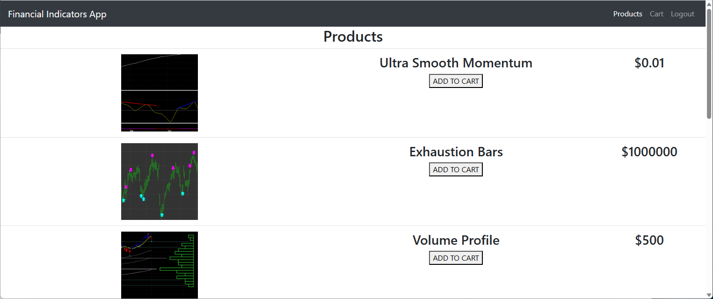
solution
One solution is an automated website to not only automate the process, but to create one central place for customers to go to, and market to the world.
The second solution is to create an API to Geolocate the IP address of the client to minimize malicious use and fraud from executing orders during the checkout process. The user of the website is able to choose and modify which counties are granted and the rest are denied.
Both of these solutions are used in the App.

Slide 4

Overcoming Challenges
ERROR: 1,000,000 Errors Found!
The biggest challenge was right from the start. When trying to test the REACT site in the browser it would not work. However, after emailing the professor I found the solution. I am used to accessing the database from the frontend from the use of .NET and PHP. However, with Node JS this did not look like it was going to work. So, I wrapped Mongo DB into the API and communicated with the API from the front end. This method more aligned with the class work and worked for the final project.

Slide 5
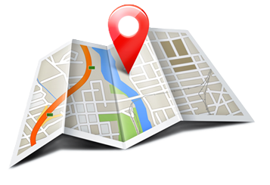

Biggest highlights
I have a couple of highlights to think of:
GeoLocation API: worked quite well and I did not have to mess around with it at all. The user of the API has the ability to add or remove granted countries through the API and database. Items DB: the items do have their own database and through the API they can be viewed, added, modified and deleted. Of which actions will also display on the REACT site automatically.

Slide 6

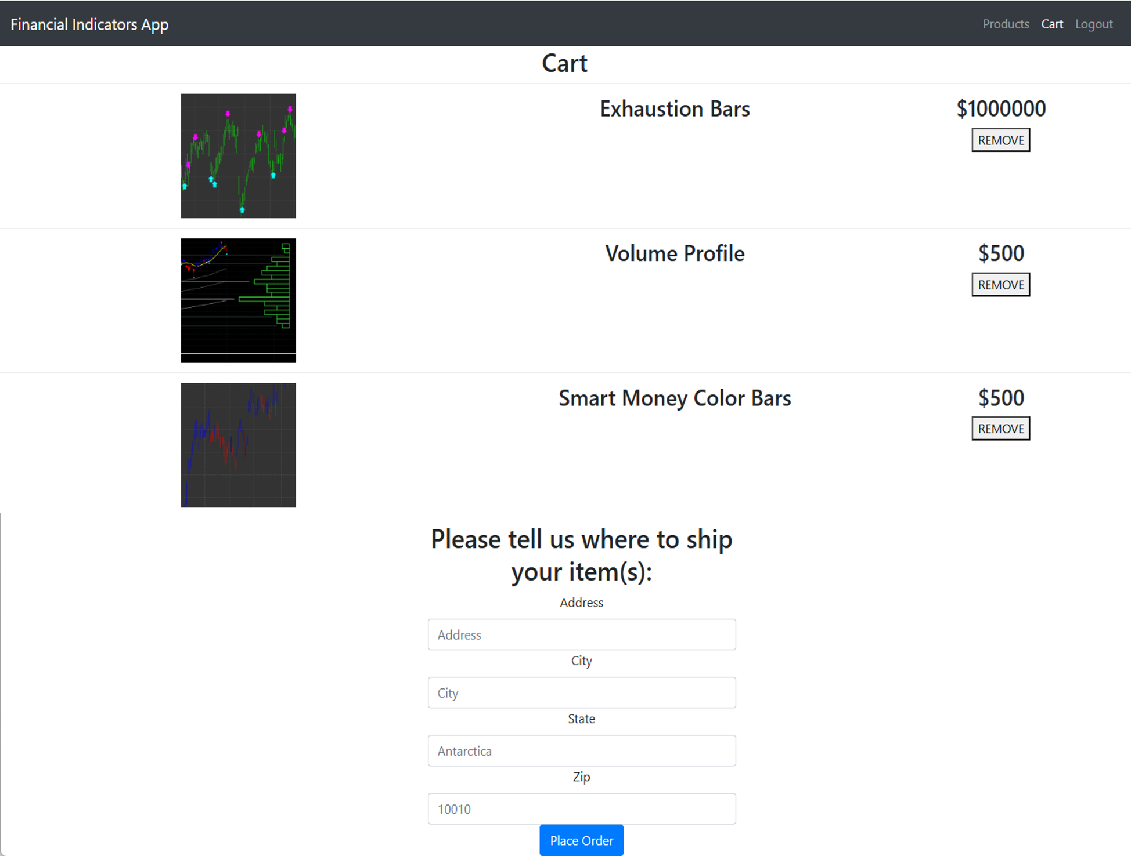
Construction
REACT SITE DESCRIPTION
The site is a toy model that sells financial technical indicators. You can add items to your cart, remove items, and checkout after an address is included.
During checkout it will locate the country in which your IP address is in. Currently, United States and United Kingdom are allowed. If the IP address is not in those two countries it will add a deny flag to the order and display to user. You can add, delete, and modify the countries that are allowed.
API DESCRIPTION
This web service Grants/ Denies IP addresses of the client. The countries are specified by the user. It also holds Orders and items for sale for the Financial Indicator App site.
You can send a request to see if an IP address is Granted or Denied, and display, add, modify and delete granted countries.
Also, Order and items can be displayed, added, modified, and deleted.

Slide 7
Basic Presentation

Slide 8
AGENDA
Topic one
Topic two
Topic three
Topic four
Topic five

Slide 9
The Power of Communication

Slide 10
Overcoming nervousness

Slide 11
Engaging the audience
Techniques for connecting
Make eye contact with your audience to create a sense of intimacy and involvement
Weave relatable stories into your presentation using narratives that make your message memorable and impactful
Encourage questions and provide thoughtful responses to enhance audience participation
Use live polls or surveys to gather audience opinions, promoting engagement and making sure the audience feel involved

Slide 12
Selecting Visual Aids

Slide 13
Effective delivery techniques
Voice modulation
Body language
This is a powerful tool in public speaking. It involves varying pitch, tone, and volume to convey emotion, emphasize points, and maintain interest:
Pitch variation
Tone inflection
Volume control
Effective body language enhances your message, making it more impactful and memorable:
Meaningful eye contact
Purposeful gestures
Maintain good posture
Control your expressions

Slide 14
Navigating Q&A Sessions
Preparing for questions
Maintaining composure
Know your material in advance
Anticipate common questions
Rehearse your responses
Maintaining composure during the Q&A session is essential for projecting confidence and authority. Consider the following tips for staying composed:
Stay calm
Actively listen
Pause and reflect
Maintain eye contact

Slide 15

Speaking Impact
Your ability to communicate effectively will leave a lasting impact on your audience
Effectively communicating involves not only delivering a message but also resonating with the experiences, values, and emotions of those listening

Slide 16
Dynamic delivery
METRIC | MEASUREMENT | TARGET | ACTUAL
Audience attendance | # of attendees | 150 | 120
Engagement duration | Minutes | 60 | 75
Q&A interaction | # of questions | 10 | 15
Positive feedback | Percentage (%) | 90 | 95
Rate of information retention | Percentage (%) | 80 | 85
Learn to infuse energy into your delivery to leave a lasting impression
One of the goals of effective communication is to motivate your audience

Slide 17
Final tips & takeaways
Practice makes perfect
Continue improving
Consistent rehearsal
Strengthen your familiarity
Refine delivery style
Pacing, tone, and emphasis
Timing and transitions
Aim for seamless, professional delivery
Practice audience
Enlist colleagues to listen & provide feedback
Seek feedback
Reflect on performance
Explore new techniques
Set personal goals
Iterate and adapt

Slide 18
Speaking engagement metrics
IMPACT FACTOR | MEASUREMENT | TARGET | ACHIEVED
Audience interaction | Percentage (%) | 85 | 88
Knowledge retention | Percentage (%) | 75 | 80
Post-presentation surveys | Average rating | 4.2 | 4.5
Referral rate | Percentage (%) | 10 | 12
Collaboration opportunities | # of opportunities | 8 | 10

Slide 19
THANK YOU
Brita Tamm
502-555-0152
brita@firstupconsultants.com
www.firstupconsultants.com

