Slide 1

Financial Indicators App & Ip geo-location
VIDEO
BY Robert (Andrew) Quaife

Slide 2
Problem
The problem is two-fold.
To automate the shopping cart system using a website. A website is a better way to do business rather than by word of mouth or going door to door. It also gives the ability to automate the process, simplifying the process, rather than manual intervention.
API IP Geolocation: The ability to know what country the client is coming from. Many malicious attacks come from foreign countries. IP Geolocation would minimize these attacks and fraudulent orders.

Slide 3
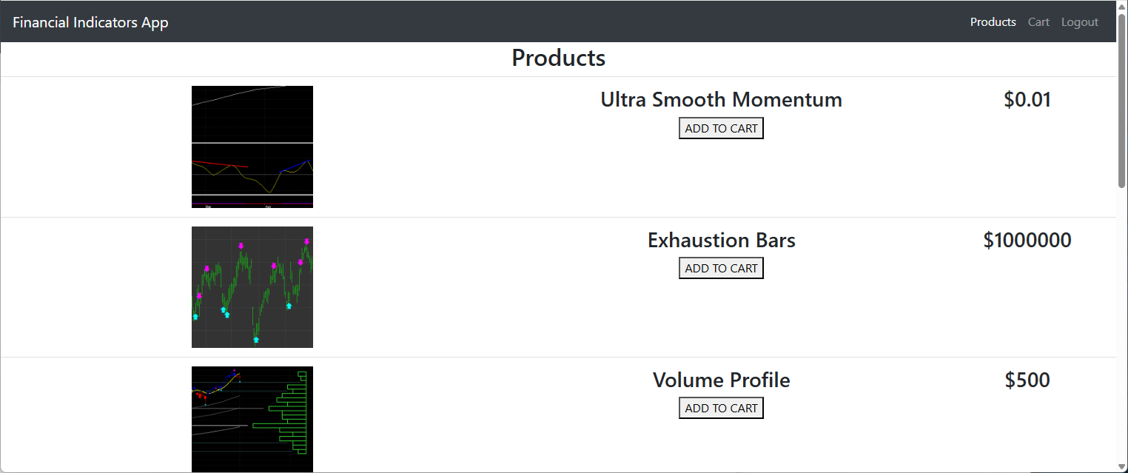
solution
One solution is an automated website to not only automate the process, but to create one central place for customers to go to, and market to the world.
The second solution is to create an API to Geolocate the IP address of the client to minimize malicious use and fraud from executing orders during the checkout process. The user of the website is able to choose and modify which counties are granted and the rest are denied.
Both of these solutions are used in the App.

Slide 4

Overcoming Challenges
ERROR: 1,000,000 Errors Found!
The biggest challenge was right from the start. When trying to test the REACT site in the browser it would not work. However, after emailing the professor I found the solution. I am used to accessing the database from the frontend from the use of .NET and PHP. However, with Node JS this did not look like it was going to work. So, I wrapped Mongo DB into the API and communicated with the API from the front end. This method more aligned with the class work and worked for the final project.

Slide 5


Biggest highlights
I have a couple of highlights to think of:
GeoLocation API: worked quite well and I did not have to mess around with it at all. The user of the API has the ability to add or remove granted countries through the API and database. Items DB: the items do have their own database and through the API they can be viewed, added, modified and deleted. Of which actions will also display on the REACT site automatically.

Slide 6

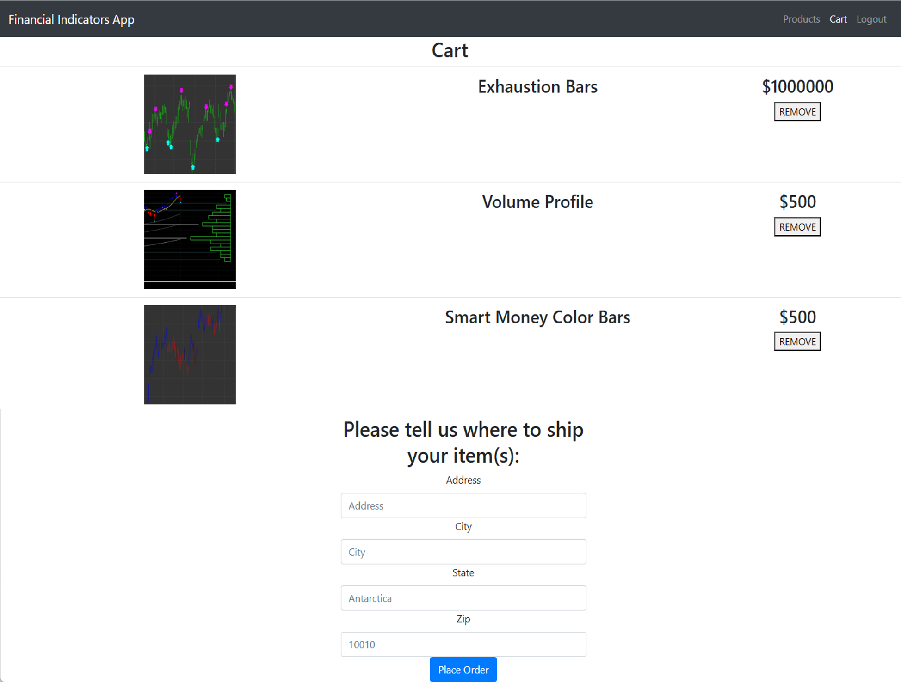
Construction
REACT SITE DESCRIPTION
The site is a toy model that sells financial technical indicators. You can add items to your cart, remove items, and checkout after an address is included.
During checkout it will locate the country in which your IP address is in. Currently, United States and United Kingdom are allowed. If the IP address is not in those two countries it will add a deny flag to the order and display to user. You can add, delete, and modify the countries that are allowed.
API DESCRIPTION
This web service Grants/ Denies IP addresses of the client. The countries are specified by the user. It also holds Orders and items for sale for the Financial Indicator App site.
You can send a request to see if an IP address is Granted or Denied, and display, add, modify and delete granted countries.
Also, Order and items can be displayed, added, modified, and deleted.

Slide 7
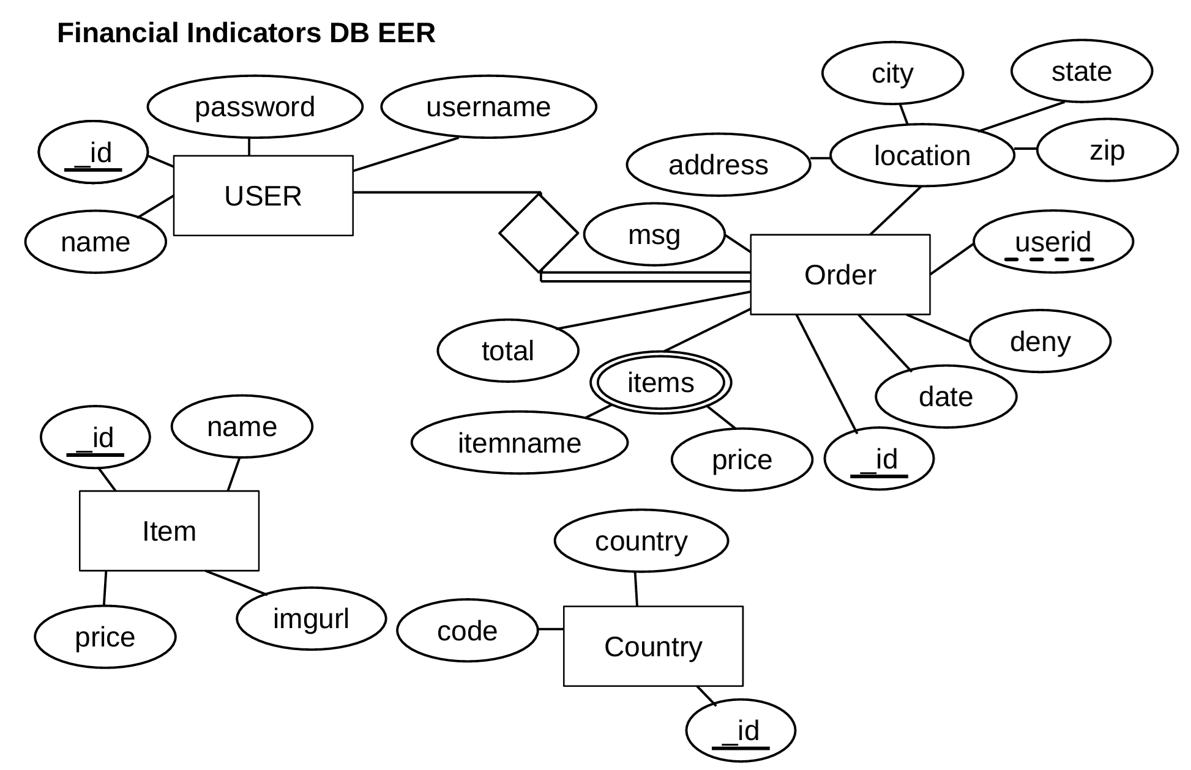
Construction cont 2

Slide 8

Construction cont 3
REACT SITE
PACKAGES: REACT, Yarn, React-Dom, React-bootstrap, Redux, Redux-Thunk …
Deployment: yarn build yarn start
API
PACKAGES: Bcrypt, Cors, Express, Mongoose, Passport, Dotenv …
Geoip-Country: Used to get country code from given IP address.
Deployment: npm install node server.js

Slide 9
CONSTRUCTION CONT 4
API INSTRUCTIONS
Create Account Sign-In: send the request and json body to: https://webapi-finalproject-api.onrender.com/signup
Json Body Example: { "name": "batman", "username": "batman2", "password": "penguin“ }
Sign-in request (be sure to save the JWT token): https://webapi-finalproject-api.onrender.com/signin
Json Body Example: { "username": "batman2", "password": "penguin“ }
Grant/ Deny IP Address: NOTE: be sure to add you JWT token to the header for all requests. "Authorization": [Your JWT token from sign in]
Send GET request to: https://webapi-finalproject-api.onrender.com/geo/[Your IP Address]
Here is a list of allowed countries: https://webapi-finalproject-api.onrender.com/geo
You can add & delete the list of granted countries: https://webapi-finalproject-api.onrender.com/geoedit/[Country Code]
Orders:
NOTE: be sure to add you JWT token to the header for all requests. "Authorization": [Your JWT token from sign in]
GET all orders or POST order: https://webapi-finalproject-api.onrender.com/orders
Example JSON Body for POST request: { "userid": "[User ID]", "deny": false, "address": "1039 Pena Ave", "city": "Somewhere", "state": "Antarctica", "zip": 10010, "items": [ {"itemname": "TestItem", "price": 0.01}, {"itemname": "TestItem2", "price": 10000000000} ], "total": 10000000000, "msg": "Test Message“ }
GET specific order: https://webapi-finalproject-api.onrender.com/orders/[Order Id]
Modify & Delete order: https://webapi-finalproject-api.onrender.com/orders/[Order Id]

Slide 10
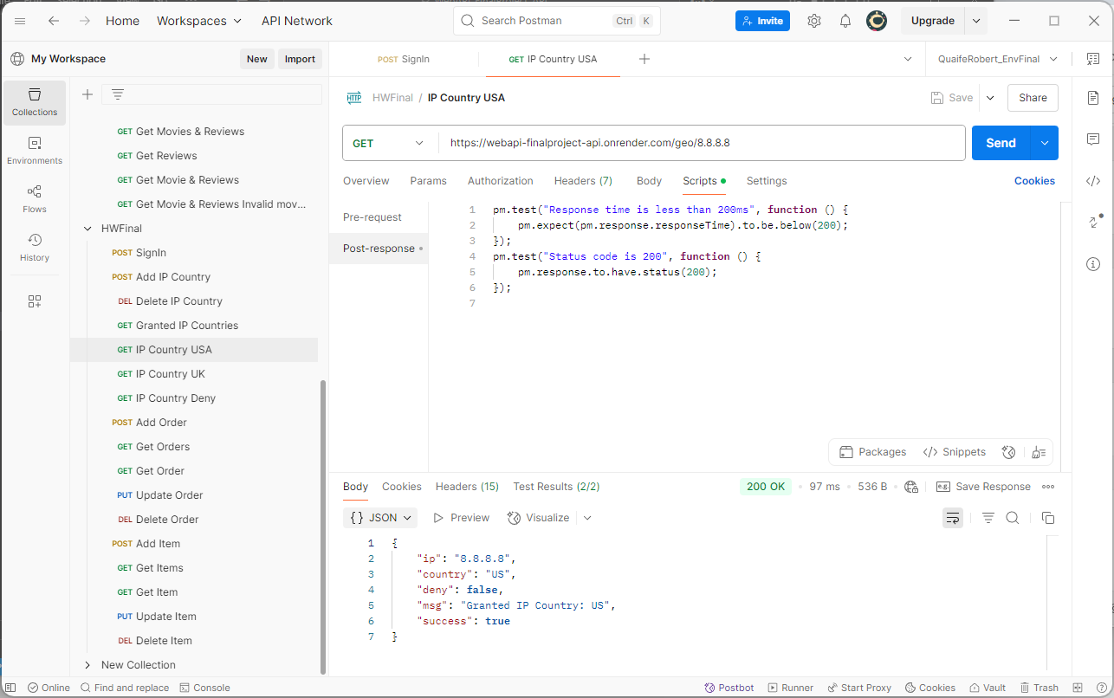
CONSTRUCTION CONT 5
Items:
NOTE: be sure to add you JWT token to the header for all requests. "Authorization": [Your JWT token from sign in]
Send GET (All Items) & POST request to: https://webapi-finalproject-api.onrender.com/items
Example JSON Body for POST request: { "name": "Item Test", "price": 50, "imgurl": "/myimg.png“ }
GET, Modify, & Delete item: https://webapi-finalproject-api.onrender.com/items/[Item ID]

Slide 11


Future Development
The most obvious development would be to add a payment system. It is hard to sell things without receiving payment!
For this final project I was thinking of developing a charting system that would display say stock data as a candlestick chart. Then the indicators you buy would be made available in the browser on the chart. However, that would be quite ambitious, and I can not be spending that much time on the project.
Next, would be a product page for each item. That way the user could read the description and see more images of the indicators.
Free trials are commonly used in business. That way the user would have a period of time to try it out.
Finally, adding icons to the text buttons and links to help with visual appeal.

Slide 12


Links
VISIT THE SITE: https://webapi-finalproject-react.onrender.com
API Repository: https://github.com/supracharger/WebAPI_FinalProject_API
Site Repository: https://github.com/supracharger/WebAPI_FinalProject_REACT
THANK YOU

