Slide 1
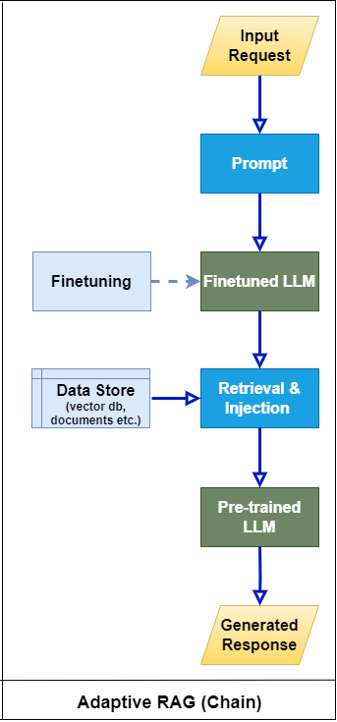
Prompt engineering -> SFT -> RAG
Using moderator
input
Summarizer
preprocess
Query
engine
Re-prompt
List of search
LLM
output
Which of these queries are meaning full
memory
evaluate
generate
Prompt building

