Slide 1
A Project Stage-II (CS802PC) on IMAGE BASED PLANT DISEASE PREDICTION AND ADVISING PESTICIDES
By
HT. No : 20261A05E6 Name : K. Supraja
Under the Guidance of
Mr. Y. Pavan Narasimha Rao
Department of CSE
2023-2024

Slide 2
CONTENTS
Abstract
Problem Statement
Literature Survey
Design
Results
Conclusion

Slide 3
ABSTRACT
Economy contributes the most for the productivity of the agriculture. In agricultural field, the disease in plants is more common and the detection of disease in plants has become more feasible due to the above reason. These days 's plant disease detection has acquired enlarging scrutiny in surveilling crops of large and various fields.
We can identify or spotting the leaf diseases for detection for surveillance and monitoring experts is the standard approach for detection. The plants get seriously affected if the proper control hasn't been taken and this represents the quality of the pants the production of the plants will be affected.
Detection of disease through some mechanized technique and methodology is efficient and constructive because it decreases an outsized toil of surveilling in the large cultivation. In the premature phase we can detect the symptoms of the plant diseases since their first appearance on their leaves of the plants.
By using a Convolutional Neural Network (CNN) algorithm, we can identify and classify different diseases affecting plant leaves in an automated manner. The CNN model is able to learn distinct visual features and patterns that correspond to different types of plant leaf diseases. This allows for effective disease detection and classification, which is crucial for early identification and management of plant health issues.

Slide 4
PROBLEM STATEMENT
The main thing of the problem is to identify the disease of a plant by the developed model which is made with large data sets, machine learning algorithms and deep learning algorithms. Overall, the aim is to develop a robust and accurate plant species identification system that can assist botanists, researchers, farmers, and environmentalists in their work.

Slide 5
LITERATRE SURVEY
S.No | Year | Authors | Titles | Techniques | Merits | Demerits
1 | 2022 | Vijaya Kumar Reddy Kokatam , Arockia Selva kumar Arockia Doss | Prediction of Corn and Tomato Plant Diseases Using Deep Learning Algorithm | CNN, Transfer learning(VGG16),Image Processing, Supervised Learning,Classification algorithms | Identifies plat diseases early, enabling timely intervention Sending notifications to farmers time to time | Farmers may not have knowledge of smart phones and a internet connection. Data quality must be accurate to predict.
2 | 2022 | Aswath M, Sowdeshwar S, Saravanan M , Satheesh K Perepu | Advanced machine Learning Frame-Work for efficient Plant Disease Prediction | Deep Learning, CNN, NLP, concept Drift, twitter platform | Assistance is provided by nearly experts to farmers. Treatment reduces uses of pesticides. | Dataset data must be accurate to predict the disease. Much info is received in which wrong info may be given by targeted users.
3 | 2019 | Vishal Pallagani , Vedant Khandelwal , Bharath Chandra, Venkanna Udutalapally , Debanjan Das , Saraju P. Mohanty | A Deep-Learning based Framework for Accurate Prediction of Diseases of Crops in Smart Agriculture | Deep Convolutional Neural network(DNN) | The model provides high accurate predictions. These algorithms can learn and extract features from row image data-automation. | Requires adequate hardware resources for these models. Models may have limitations to unseen data.
4 | 2018 | Shima Ramesh, Mr. Ramachandra Hebbar, Niveditha M, Pooja R, Prasad Bhat N, Shashank N , Mr. P V Vinod | Plant Disease Detection Using Machine Learning | Random Forest | RF algorithm provide accurate and robust predictions(complex data). Use of HOG represent the efficient characteristics of leaf images. | Understanding the decision making process of model is difficult. Expensive to handle large datasets.

Slide 6
DESIGN
Input
Image
Pre-Process
Feature
Extraction
dataset
Train/Test
CNN
Healthy Leaf
Disease Leaf With Precautions

Slide 7
ALGORITHM
CNN:
Convolutional Neural Networks (CNNs) are a type of deep learning model that are particularly effective for processing and analyzing visual data, such as images and videos. The key components are:
Convolutional Layers: Apply learnable filters to detect low-level features like edges and shapes.
Pooling Layers: Reduce spatial size to control overfitting and reduce parameters.
Fully Connected Layers: Classify the input based on the features detected by the earlier layers.
CNNs are trained on large datasets of labeled images, using backpropagation to update the weights of the filters and fully connected layers.
They have become a fundamental building block for many state-of-the-art computer vision models, excelling at tasks like image classification, object detection, and semantic segmentation.

Slide 8
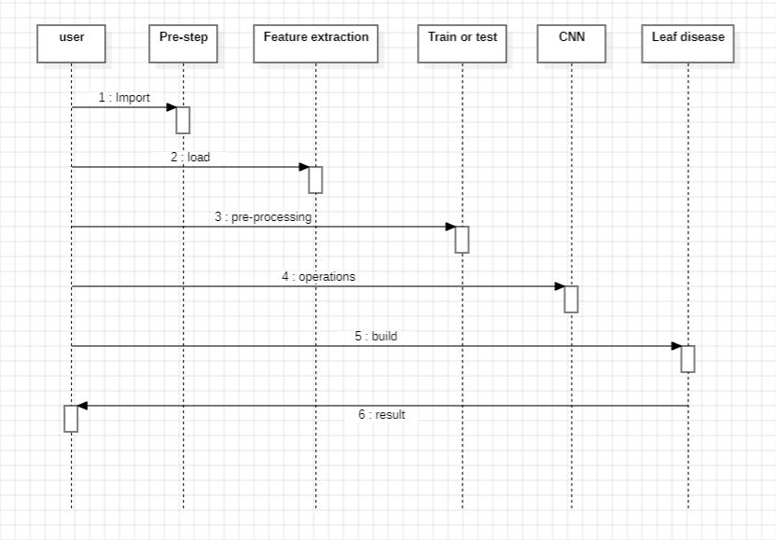
SEQUENCE DIAGRAM

Slide 9
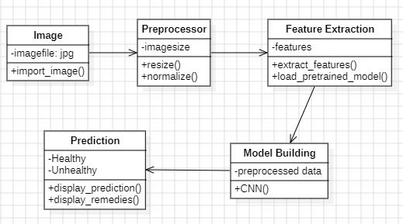
CLASS DIAGRAM

Slide 10
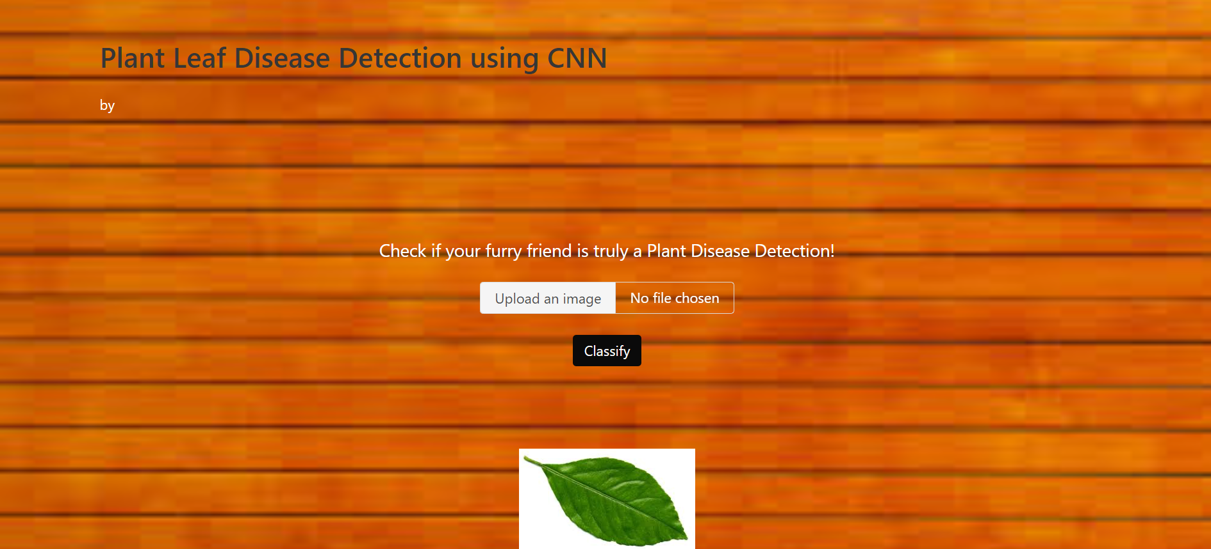
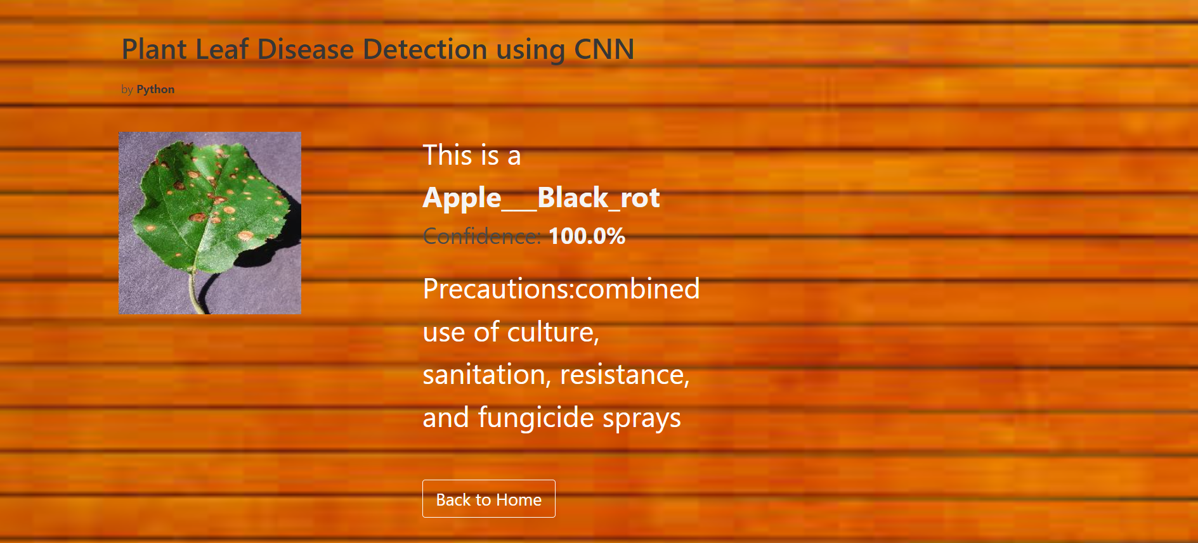
RESULTS

Slide 11
CONCLUSION
In conclusion the project aims to develop an image-based solution for detecting plant diseases and recommending appropriate pesticides. The system uses a Convolutional Neural Network (CNN) model to classify plant leaf images into different disease categories. Once the disease is identified, the system provides recommendations to treat the disease. The project has been successfully implemented and tested, demonstrating the effectiveness of the image-based disease prediction and pesticide recommendation approach. The system can assist farmers and agricultural experts in early detection and management of plant diseases, leading to improved crop yields and reduced losses. Future work may focus on expanding the dataset, enhancing the model's accuracy, and integrating the system with mobile applications for wider accessibility to farmers.

Slide 12
THANK YOU

