Slide 1
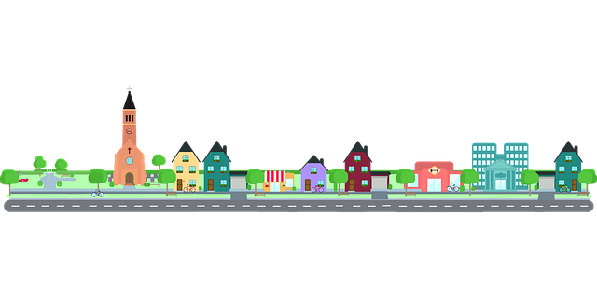
COMMUNITY MANAGEMENT SYSTEM
Team Members
SUPRAJA (002191644)
SOWMIKA (002922551)
VIVEK (002921511)

Slide 2

PROBLEM STATEMENT
Technology has evolved in many ways. Today we have wonderful applications and helpline available in the market that are helpful for people.
For example, Developed cities in world has their own application to raise grievance complaints, in order to contact emergency department we can contact Police or hospital through helpline numbers.
But all these are individual sectors and each has their own procedures to contact them.

Slide 3
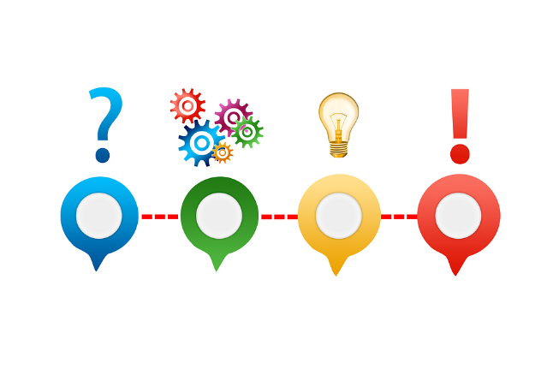
CONTINUE…
Still there are few other areas we need to improve in terms of helping people. Recently due to Covid, people around the globe are severely affected financially.
There was no proper communication channel between residents and Government/NGO’s.
Due to this people are affected with lack of medicines, food and money.

Slide 4

IMPROVED SOLUTION
In order to resolve all the mentioned challenges, we come up with an application where we have integrated all the sectors in one place.
Now using our proposed solution residents can raise their requests such as Grievance requests, Emergency requests and Covid help requests from a common platform.

Slide 5

ABOUT ECOSYSTEM
The main purpose of our ecosystem is to help residents in a network. In order to achieve this we have developed a Java Swing application where residents can raise requests directly to the particular organizations for all the household and other problems using one common platform.
In our application residents can raise requests for the following categories: Grievance maintenance request, Emergency request and Covid Help requests.

Slide 6

CONTINUES…
Each request is further classified into more types based upon enterprise.
Each enterprise has different organizations. For example Grievance enterprise has Water supply Org, Street Light Org , Garbage Removal Org and police department org.
Like wise Emergency and Covid help enterprises has their own organizations to fulfill resident requests.

Slide 7
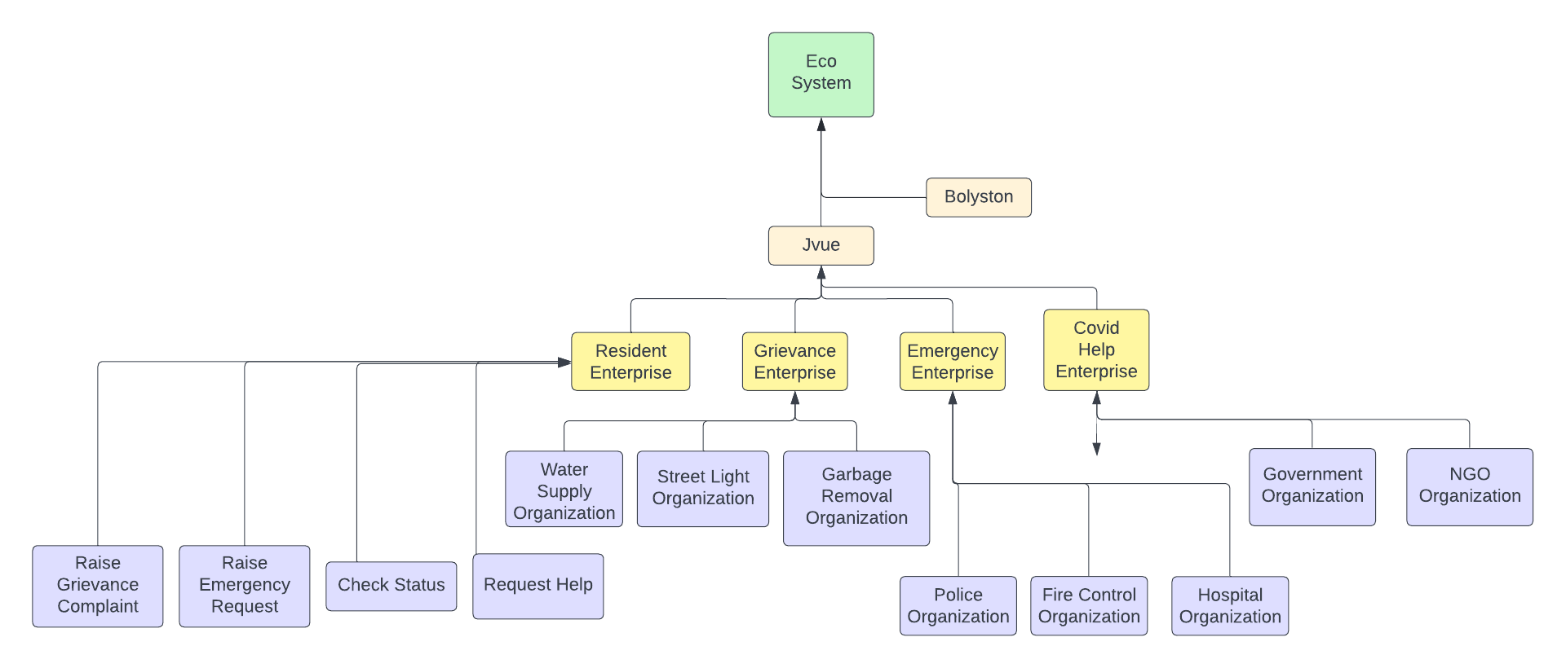
HIERARCHY STRUCTURE

Slide 8
THANK YOU

