Slide 1
STOCK PRICE PREDICTION
Raamkumar
Sanjay Jain
Shashank Goswami
Supraja Ravipati

Slide 2
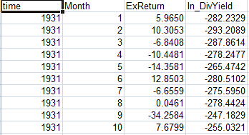
Understanding the data
Excess Returns: Excess return, is a measure of how much a fund has under or outperformed the benchmark against which it is compared.
Greater Excess Returns -> Better the stock to invest
Dividend yield: Dividend yield is a method used to measure the amount of cash flow you're getting back for each dollar you invest in
Stock price
Dividend
Dividend yield
20$
1$
5%
ABC
40$
1$
2.5%
XYZ

Slide 3
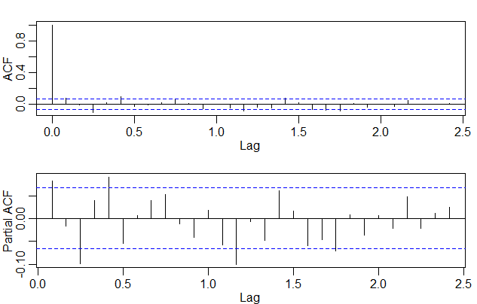
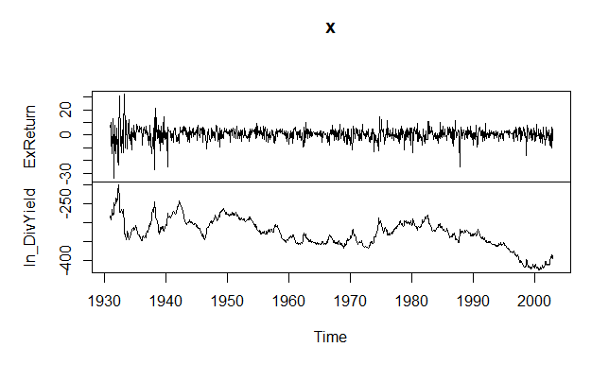
Preprocessing
Correlation plots
Time series Plot
Initial Hypothesis: AR(2)

Slide 4
MODELS USED
Sarima
sarima(with additional variables)
prophet

Slide 5
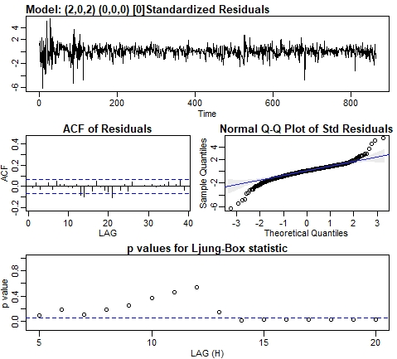
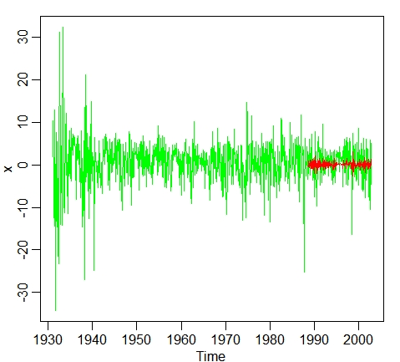

SARIMA
Model Chosen
SARIMA(2,0,2)x(0,0,0)
Prediction Vs Actual
MSPE

Slide 6
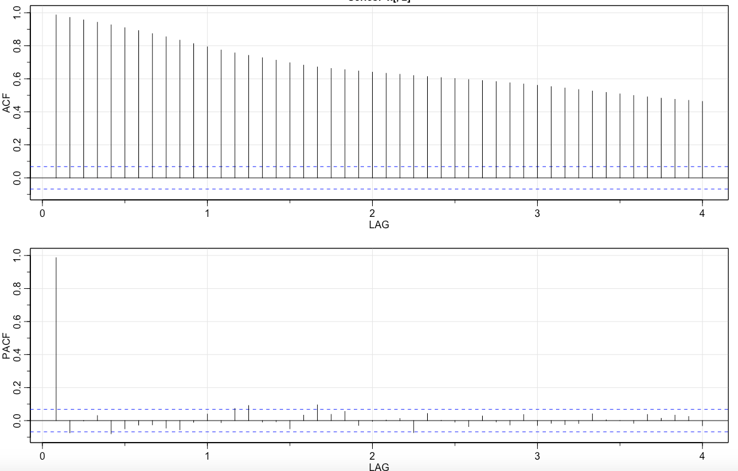
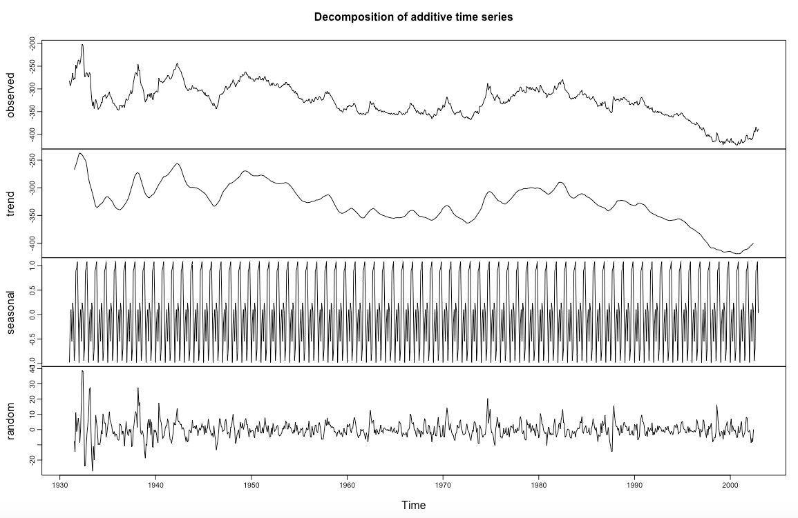
SARIMA with additional variable (Dividend Yield)
Time Series Plot
Correlation Plots

Slide 7
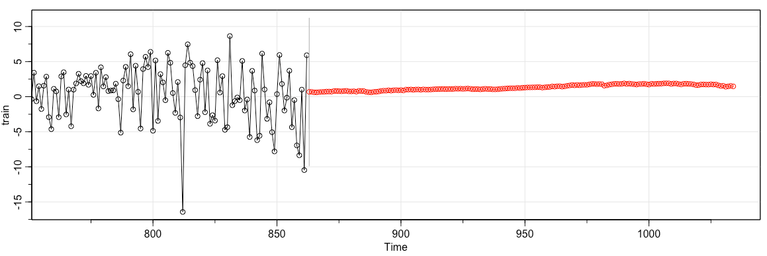
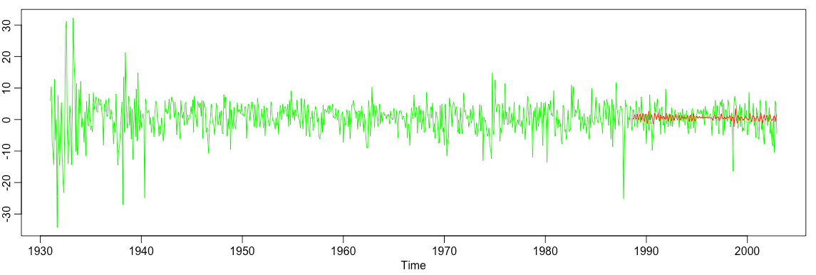
SARIMA MODEL PREDICTIONS(Additional Variable)
Model Chosen
SARIMA(2,0,2)x(0,0,0)
Prediction Plot
MSPE
1.407
Prediction Vs Actual

Slide 8
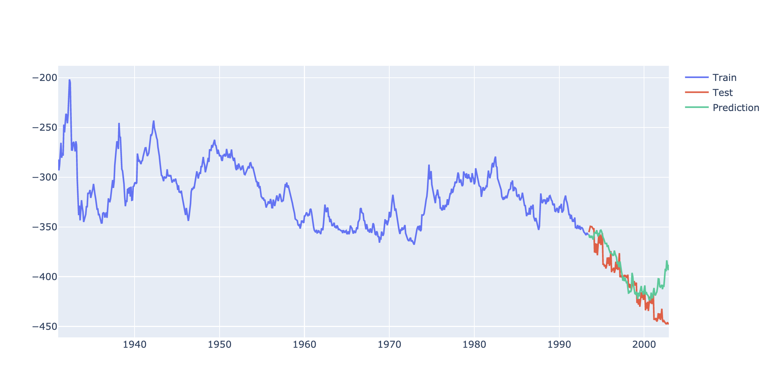
PROPHET - Dividend Yield Prediction

Slide 9
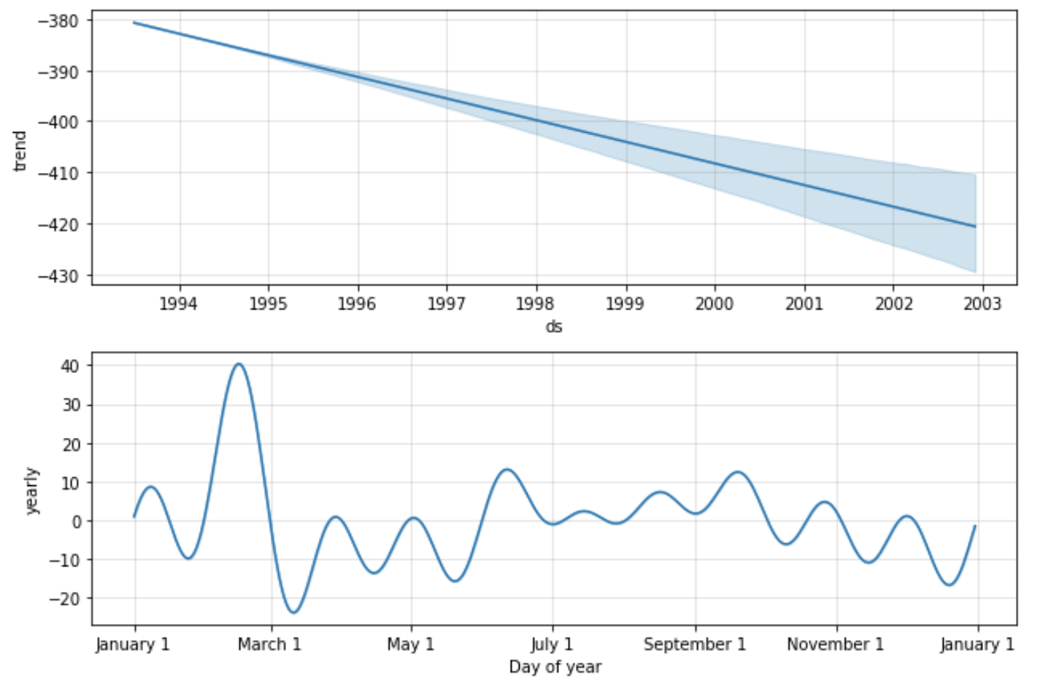
Prophet - Dividend Yield (Components)

Slide 10
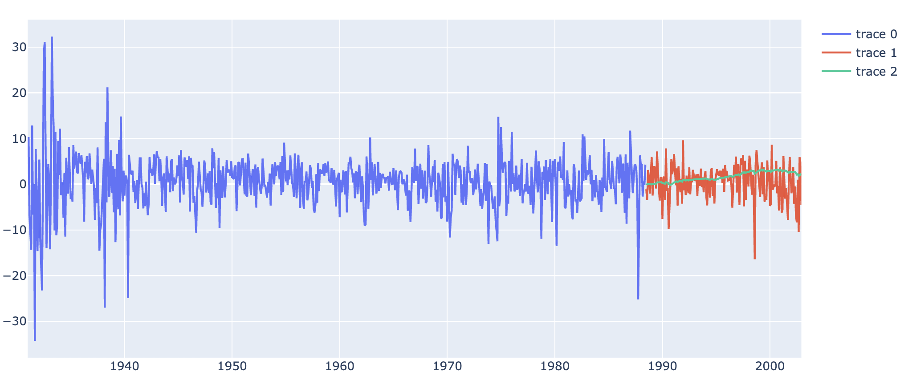

PROPHET - ExReturn with Dividend as Additional Variable

Slide 11
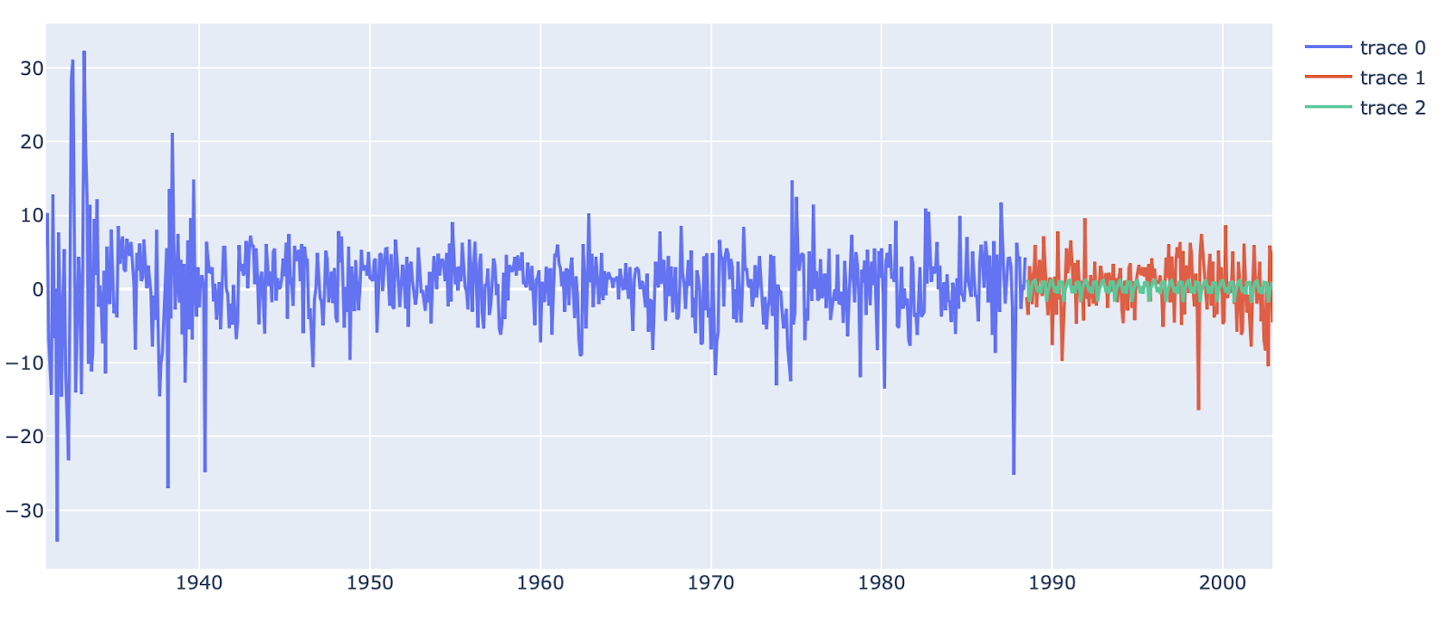

PROPHET - Excess Return Prediction

Slide 12
CONCLUSION & SCOPE FOR IMPROVEMENT
Based on MSPE, PROPHET performs better in predicting excess return without additional variable, SARIMA is performing the best in predicting excess return with additional variable.
Can try for better results by using deep learning models such as LSTM

Slide 13
THANK YOU

