Slide 1

Data Analysis Essentials
Cornerstone Project
Stock Market Data Analysis System
Frontend Dashboard & Data Analytics
Presented by
Md.Samreen (25B11AI750)
U.Supraja(25B11AI172)
A.B.S.Tripura Sundari(25B11AI020)
V.Deepika (25B11AIC44)
Department of Artificial Intelligence & Machine Learning

Slide 2




Contents
• Abstract
• Introduction
• Existing System & Limitations
• Proposed System
• Dataset Description
• Requirements
• Methodology
• Frontend Dashboard
• Expected Outputs
• Project Workflow
• Conclusion

Slide 3
ABSTRACT
Stock Market Data Analysis System analyzes stock market data using Python and data analysis techniques.
The system performs data cleaning, handles missing values and duplicates, and analyzes stock prices, trading volume, and price trends.
Statistical analysis and visualizations such as line charts, bar graphs, and histograms provide meaningful insights into stock market data.
The frontend dashboard presents important stock market metrics in a simple visual form.

Slide 4
Introduction
Stock markets generate a large amount of data every day.
Stock data contains useful information about opening price, closing price, high price, low price, and trading volume.
Raw stock market data may contain missing values and duplicate records.
Python-based data analysis helps clean and process this information.
The project uses Pandas, NumPy, Matplotlib, and Seaborn.

Slide 5
Existing System
Stock market data is generally stored as raw datasets or databases.
Analysis of large stock datasets may require manual effort.
Finding stock price trends can be difficult.
Missing and duplicate records may affect data quality.
Limited analysis makes it difficult to identify important market patterns.

Slide 6
Limitations of Existing System
1. Manual analysis is time-consuming.
2. Large stock market datasets are difficult to handle manually.
3. Missing and duplicate records can affect analysis.
4. Stock price movements are not easily visualized.
5. Identifying market trends and patterns can be difficult.
6. Manual processing can result in errors.
7. Limited analytical techniques reduce the usefulness of the data.

Slide 7
Proposed System
• Dataset loading and data exploration
• Data cleaning and missing-value handling
• Duplicate removal and data preprocessing
• Statistical analysis of stock prices
• Stock-wise price analysis
• Trading volume analysis
• Data visualization
• Frontend dashboard for summary metrics

Slide 8
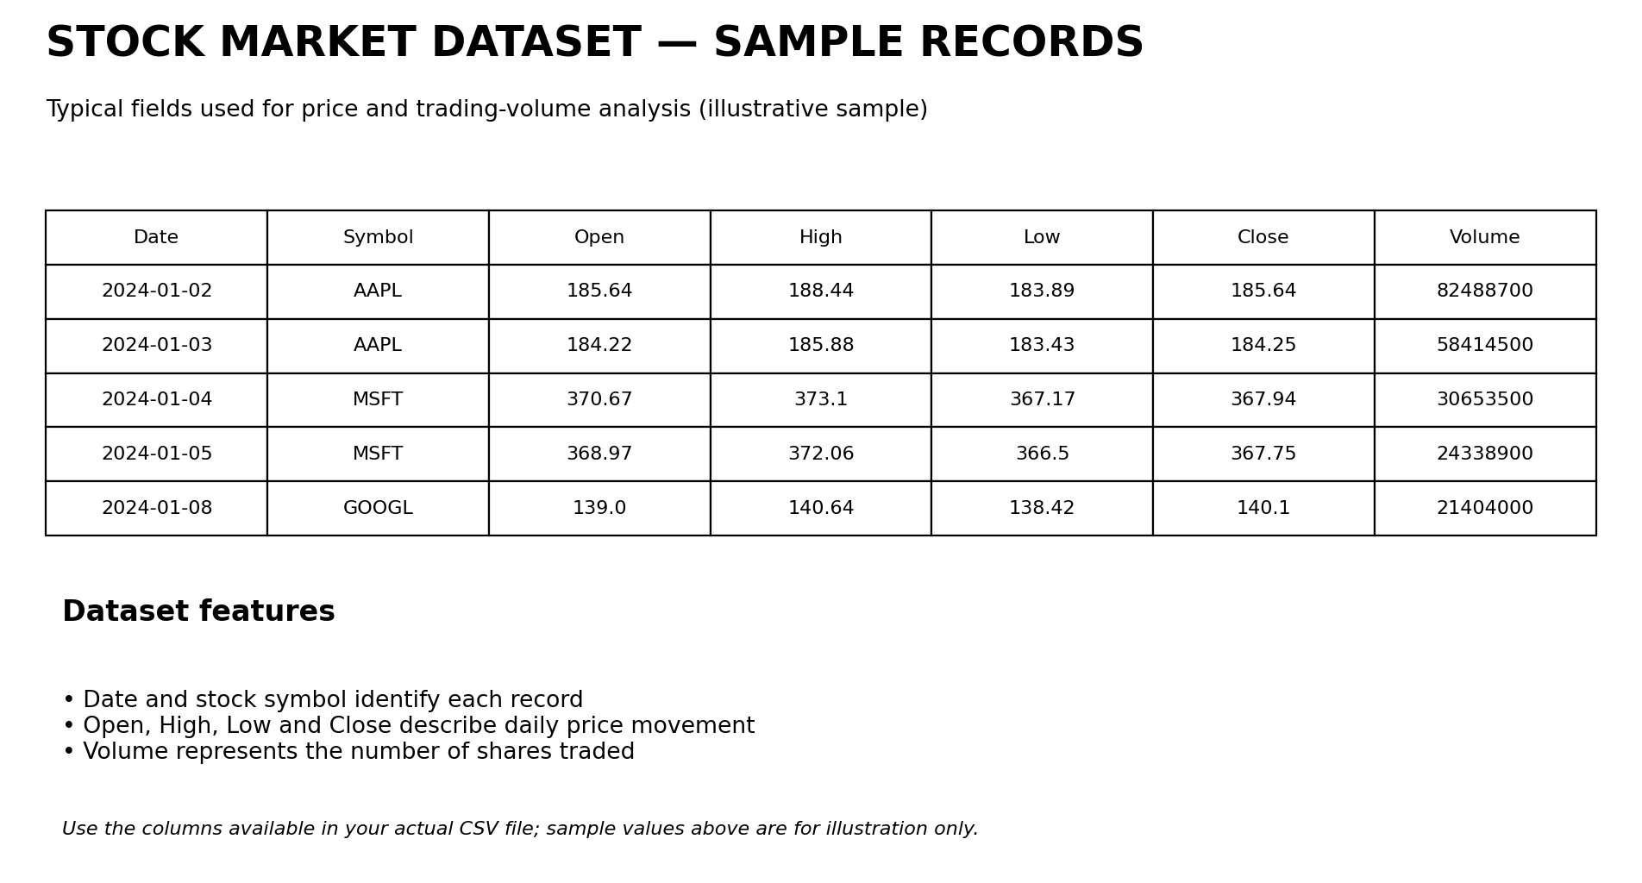
DATASET DESCRIPTION
Stock market dataset used for analysis

Slide 9
REQUIREMENTS
Hardware Requirements
Processor: Intel i3 or above
RAM: Minimum 4 GB
Storage: 20 GB
Software Requirements
Windows
Python
Google Colab
Pandas
NumPy
Matplotlib / Seaborn

Slide 10
METHODOLOGY
Module 1 – Dataset Loading
Import required Python libraries.
Load the stock dataset using Pandas.
Module 2 – Data Exploration
Check dataset size and structure.
Identify column names and data types.
Module 3 – Data Cleaning
Identify and handle missing values.
Remove duplicate records.
Module 4 – Data Preprocessing
Convert date columns into the correct format.
Prepare stock market data for analysis.

Slide 11
METHODOLOGY
Module 5 – Exploratory Data Analysis (EDA)
• Analyze stock price distribution.
• Explore trading-volume patterns.
Module 6 – Stock Market Analysis
• Analyze stock price movements.
• Compare opening and closing prices.
• Identify price and volume trends.
Module 7 – Data Visualization
• Create line charts and bar charts.
• Use a pie chart only when comparing stock categories or shares.
Module 8 – Advanced Visualization
• Use histograms to analyze price distribution.
• Use heatmaps to examine correlations between numerical attributes.

Slide 12
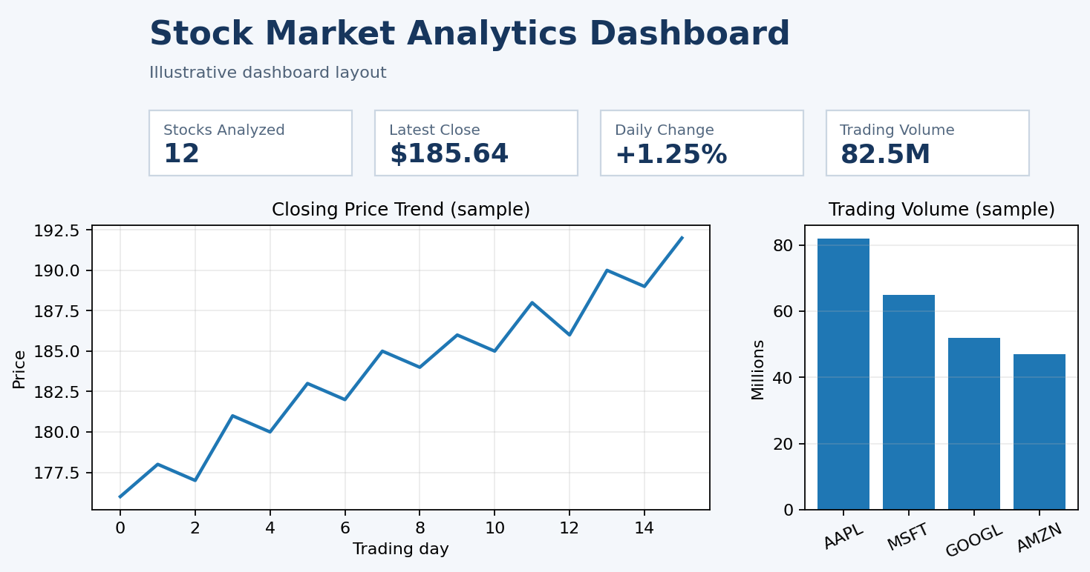
Output Screens
Stock Market Dashboard
Sample Stock Dataset
Dashboard metrics may include stocks analyzed, latest closing price, price change, and trading volume.

Slide 13
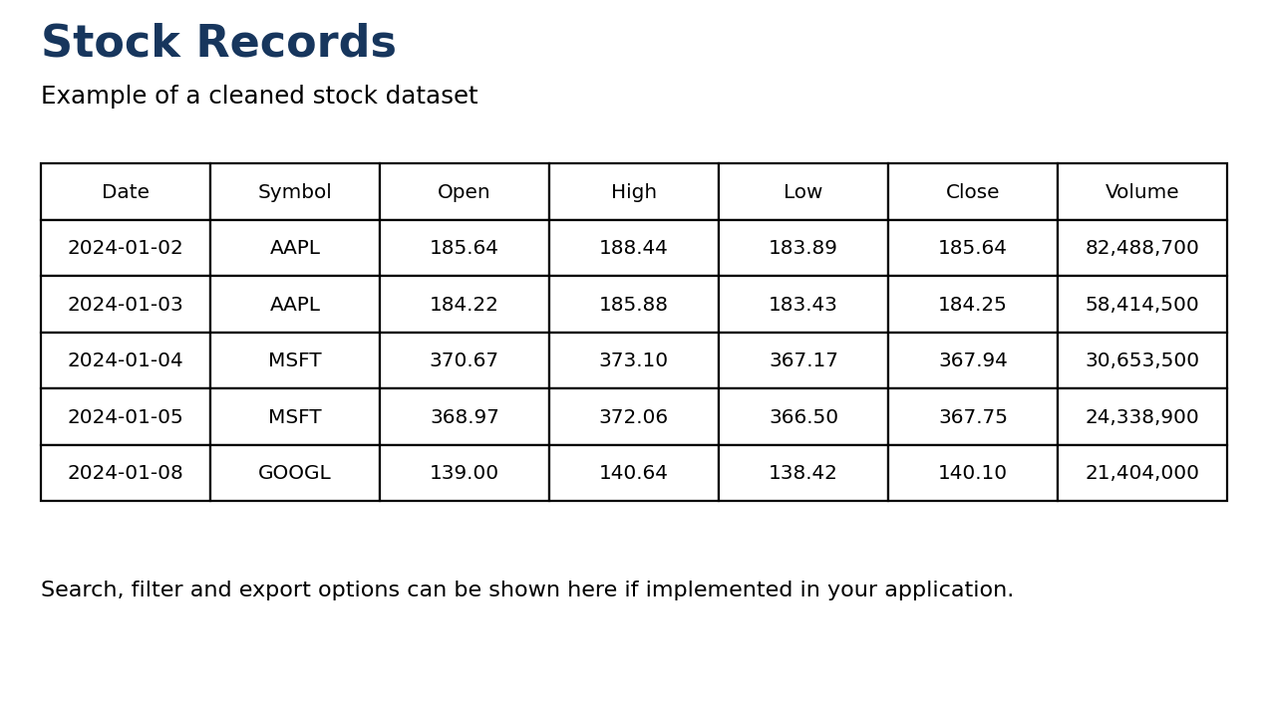
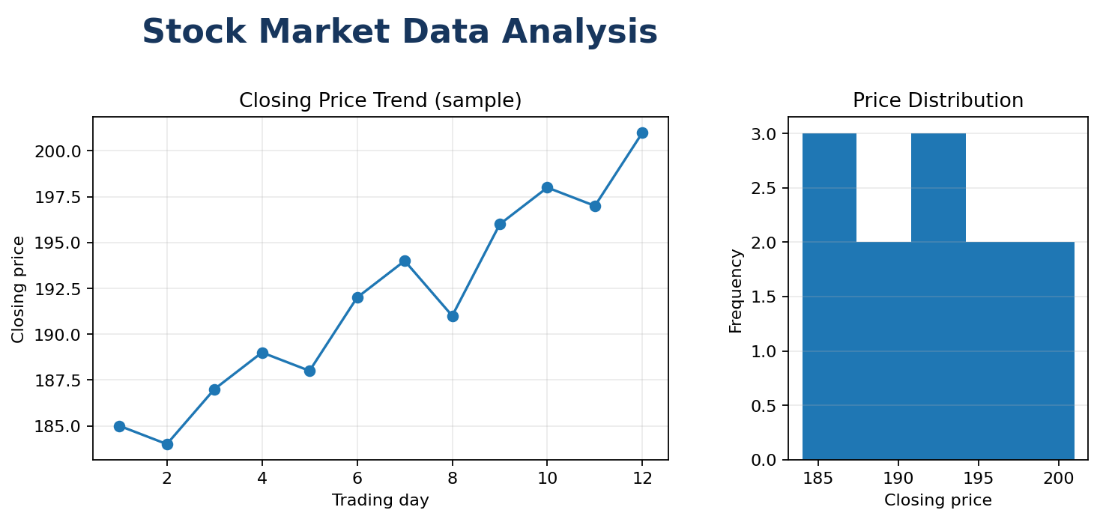
Output Screens
Stock Records
Stock Data Analysis
Illustrative outputs: replace these visuals with screenshots from your working project if they differ.

Slide 14
Project Workflow
CSV Dataset
↓
Load Dataset
↓
Data Cleaning
↓
Data Preprocessing
↓
Exploratory Data Analysis
↓
Stock Market Analysis
↓
Visualization
↓
Frontend Dashboard
↓
Stock Market Insights

Slide 15
CONCLUSION
The system demonstrates a complete stock market data analysis pipeline using Python.
Data cleaning and preprocessing improve the quality of analysis.
•Charts and the frontend dashboard make stock price trends easier to understand.
• The project provides a foundation for future stock market data analytics and applications.
Future scope: larger datasets, live stock market data integration, advanced analytics, and machine-learning-based stock price prediction.

Slide 16
THANK
YOU

