Slide 1
360 Degree feedback software for the government of India related News Stories in Regional Media using Artificial Intelligence/Machine learning
CSE7101- Capstone Project
Review-1
Batch Number: COM_02
Under the Supervision of,
Dr. Pallavi M
Assistant Professor
School of Computer Science and Engineering
Presidency University
Roll Number | Student Name
20221COM0049 | Thakkola Suprathika
20221COM0022 | Yerramsetty Poojitha
20221COM0048 | Siva Bhaskar Kora
Name of the Program: COM
Name of the HoD: Dr. Pallavi R
Name of the Program Project Coordinator: Ms. Benitha Christinal J
Name of the School Project Coordinators: Dr. Sampath A K , Dr. Geetha A

Slide 2
Content
Problem Statement
Objectives
Background and Related work for title Selection
Analysis of Problem Statement
Innovation or Novel Contributions
Git-hub Link
Timeline of the Project
References

Slide 3
Problem Statement Number: PSCS_35
Organization: Ministry of Information and BroadcastingCategory (Hardware / Software / Both) : Software
Problem Description:
The project aims to automate the feedback system for the Government by leveraging AI/ML to analyze government-related news stories in regional media.
It will crawl media websites, categorize news (positive/neutral/negative), notify authorities for negative sentiment, and enable timely interventions.
The platform will cover many languages (Hindi, English, regional), media sources (~200 regional sites), and handle print/electronic/social media.
It will automate data collection (via OCR for physical clippings), tagging, and reporting using sentiment analysis and tonality metrics.

Slide 4
Objectives
Automate classification of news into positive, negative, neutral.
Build multilingual NLP system for Indian regional languages.
Integrate OCR for scanned newspapers.
Department-wise news categorization.
Provide real-time alerts (SMS, Email, App notification).
Deliver structured feedback reports for government departments.

Slide 5
Background and Related Work
Existing manual or semi-automated feedback loops are slow and lack granularity.
Recent advances in NLP and sentiment analysis allow automated classification from multiple resources.
Prior works: News sentiment analysis platforms, government e-feedback systems, use of OCR and AI for document processing.
Why is this important?
Real-time feedback enables governmental responsiveness.
Automates adherence to SDG 4 (Quality Education) and SDG 9 (Industry, Innovation, Infrastructure).
Covers information dissemination across India's linguistic diversity and multiple regional media.

Slide 6
Analysis of Problem Statement
Technology Stack Components:
Web scraping (Python – BeautifulSoup/Scrapy/Requests)
NLP & Sentiment Analysis (NLP libraries – NLTK, spaCy, BERT, etc.)
OCR (Tesseract, Google Vision)
Backend – Django/Flask
Database – PostgreSQL/MySQL
Frontend – React/Angular for reporting dashboard

Slide 7
Analysis of Problem Statement (contd...)
Software and Hardware Requirements:
Software: Python, NLP libraries, OCR tools, Web scraping frameworks.
Hardware: Server/PC with at least 8 GB RAM, GPU recommended for training ML models.

Slide 8
SDG Mapping
SDG 4 – Quality Education → Knowledge dissemination, NLP-driven awareness
SDG 9 – Industry, Innovation & Infrastructure → AI-powered media monitoring & digital governance
Innovation / Novel Contribution:
End-to-end multilingual feedback system.
Integration of OCR for scanned clippings.
Real-time alerts for negative news.
Department-level categorization of news content.

Slide 9
Github Link
The Github link provided should have public access permission.
Github Link
https://github.com/suprathika22/CSE7101-Capstone-PSCS_35

Slide 10
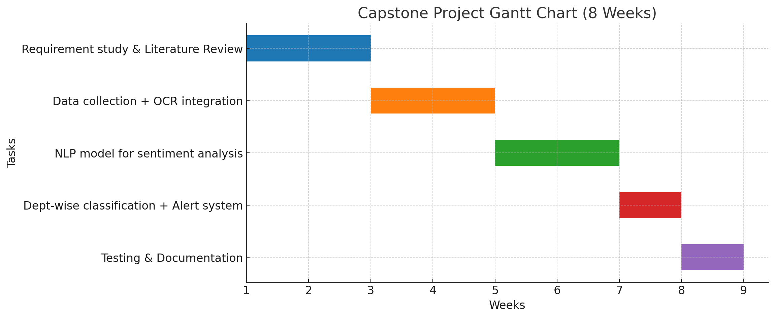
Timeline of the Project (Gantt Chart)

Slide 11
References (IEEE Paper format)
R. Smith, “An overview of the Tesseract OCR engine,” in Proc. 9th Int. Conf. Document Analysis and Recognition (ICDAR), Curitiba, Brazil, 2007, pp. 629–633.
D. K. Sharma, A. Kumar, and A. Joshi, “Multilingual sentiment analysis: Building and evaluating resources for Indian languages,” IEEE Access, vol. 10, pp. 45210–45225, 2022.
S. Smitha, “Applications of OCR Technology in Indian Languages,” Proc. Indian Language Technology Conf., 2021.

Slide 12


