Slide 1
intel Galileo Gen2: the First Sketch
TYWu

Slide 2
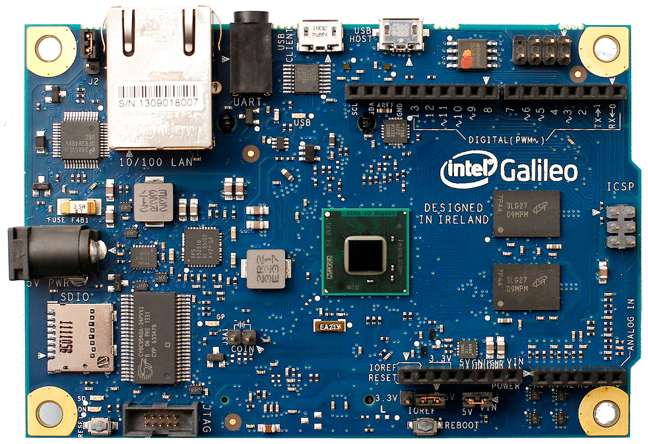
Introduction
Galileo

Slide 3
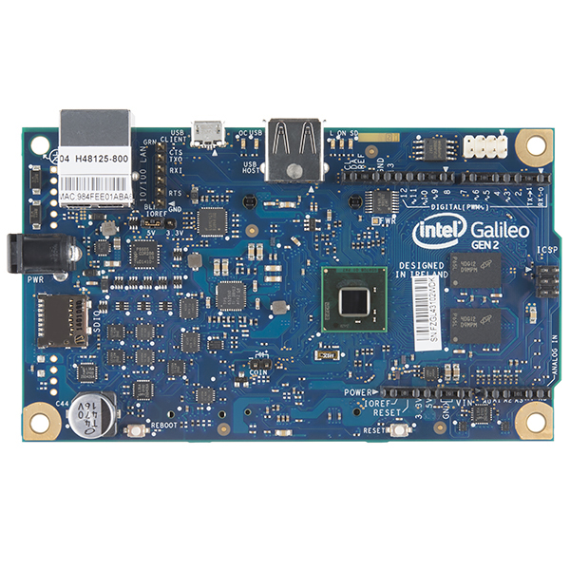
Introduction
Galileo GEN2

Slide 4
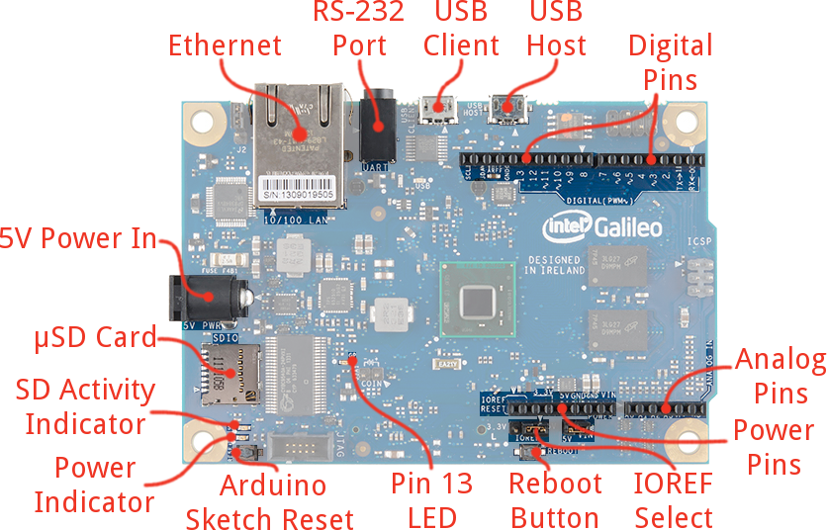
Introduction
Galileo GEN2

Slide 5
Introduction
Vin
  The input voltage to the Galileo board when it's using an external power source (as opposed to the supply connected at the power jack).
  You can supply voltage through this pin, or, if supplying voltage via the power jack, access it through this pin.
  Warning: The voltage applied to this pin must be a regulated 5V supply otherwise it will damage the Galileo board.

Slide 6
Introduction
Warning: You must use a power supply to power the board! You will damage the board if you power it with a USB cable.
  Connect the 12 V power cable to the Intel® Galileo Gen 2 board and to a power outlet.
  Always connect the power before any other connection. The Power LED shown above (board label = ON) will turn on.

Slide 7
Introduction
Features
  Intel® Quark™ SoC X1000 application processor
    a 32-bit, single-core, single-thread, Intel® Pentium® processor instruction set architecture (ISA)-compatible
    operating at speeds up to 400 MHz.

Slide 8
Introduction
Features
  Support for a wide range of industry standard I/O interfaces,
    including a full-sized mini-PCI Express slot
    100 Mb Ethernet port
    microSD slot
    USB host port
    USB client port.

Slide 9
Introduction
Features
  256 MB DDR3
  512 kb embedded SRAM
  8 MB NOR Flash
  8 kb EEPROM standard on the board
  support for microSD card up to 32 GB.

Slide 10
Introduction
Features
  Hardware and pin compatibility with a wide range of Arduino Uno R3 shields
  Programmable through the Arduino integrated development environment (IDE) that is supported on Microsoft Windows, Mac OS, and Linux host operating systems.
  Support for Yocto 1.4 Poky Linux release.

Slide 11
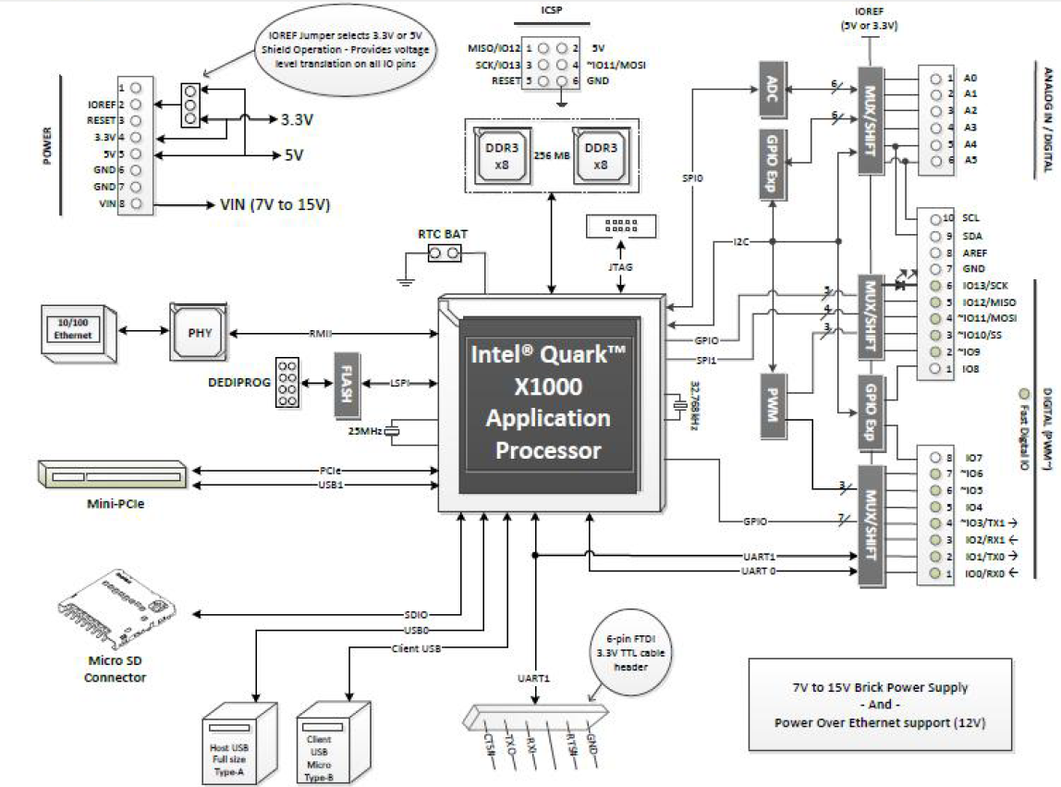
Introduction
Block Diagram

Slide 12
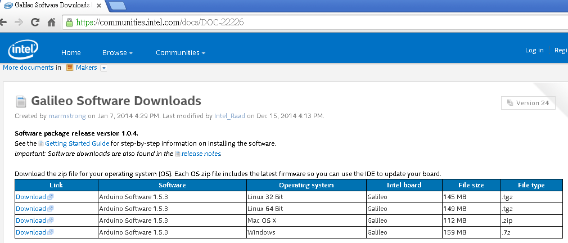
Software Download/Setup
Download the Arduino IDE for Galileo
  https://communities.intel.com/docs/DOC-22226

Slide 13
Software Download/Setup
Install the Arduino IDE for Galileo
Windows users should unzip the file to the top directory of your drive (e.g. C:/). You can leave the unzipped directory as named (arduino-1.5.3), or rename it to something descriptive, just make sure there are no spaces in the name of the directory.

Slide 14
Driver Installation
(The First Step!) Connect the power supply to the Galileo.
Connect a micro-B USB cable from the Galileo’s USB Client port to an available USB socket on your computer

Slide 15
Driver Installation
Upon connecting the board, Windows will automatically attempt to install the driver and, unsurprisingly, it will fail. We’ll have to manually install the driver.

Slide 16
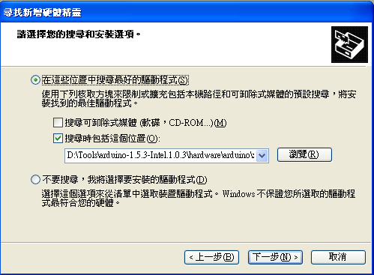
Driver Installation
Next Steps
  On the first window that pops up, click Browse my computer for driver software.
  And on the next page select Browse… and navigate to the hardware\arduino\x86\tools folder within your Arduino Galileo software installation. Then click Next.

Slide 17
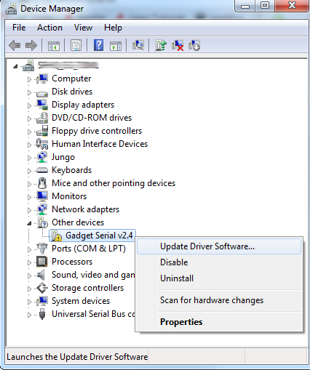
Driver Installation
Open up the Device Manager. (Either Start →Run→devmgmt.msc, or go to the Control Panel, select System and click Device Manager.)

Slide 18
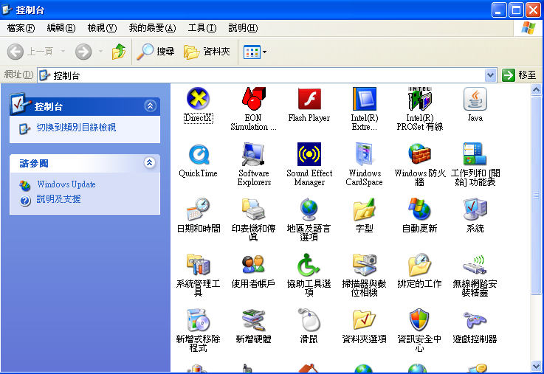
Running Arduino Galileo IDE
Change Locality

Slide 19
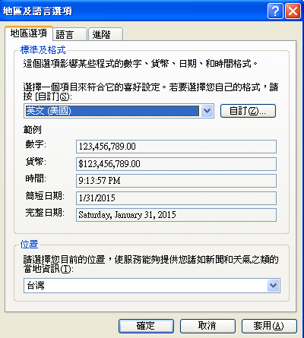
Running Arduino Galileo IDE
Change Locality

Slide 20
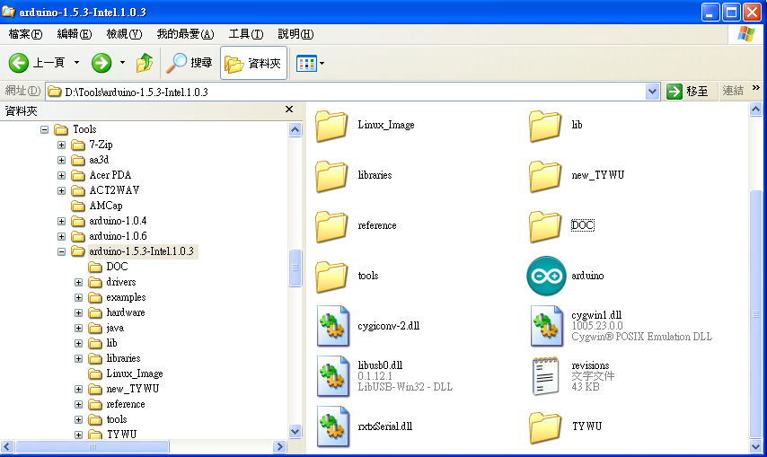
Running Arduino Galileo IDE
Open Arduino APP

Slide 21
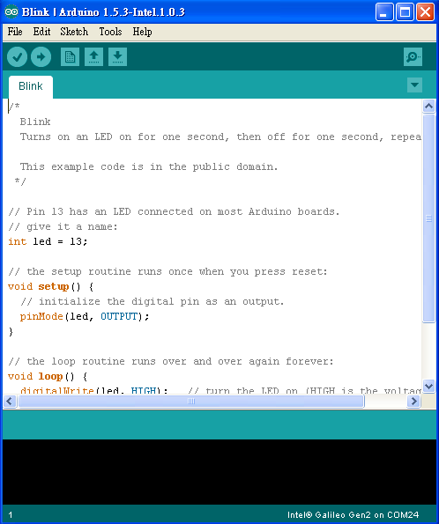
Running Arduino Galileo IDE
Select
  File→Examples→Basics→Blink

Slide 22
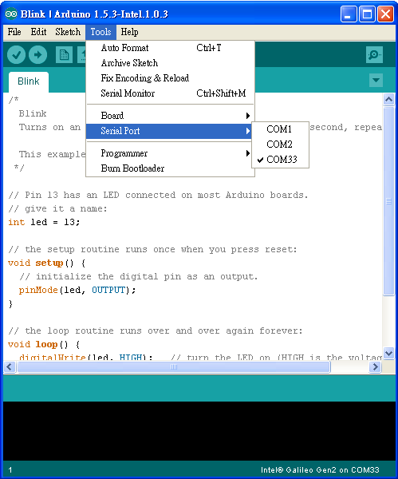
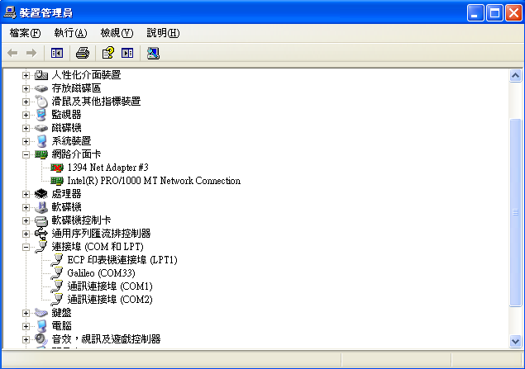
Running Arduino Galileo IDE
Select
  Tools→Serial Port→COMxxx

Slide 23
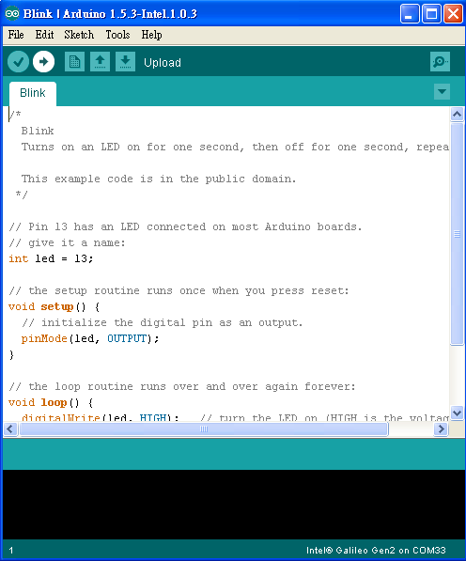
Running Arduino Galileo IDE
Upload your Sketch

Slide 24
Running Arduino Galileo IDE
Result
  https://www.youtube.com/watch?v=TJQUMU3mLL8

Slide 25
Running Arduino Galileo IDE
DO NOT Update Firmware
  因韌體更新失敗而造成Galileo無法開機者，死當！

Slide 26
References
https://learn.sparkfun.com/tutorials/galileo-getting-started-guide?_ga=1.175151777.2095379488.1416564981
http://akizukidenshi.com/download/ds/intel/Galileo_GettingStarted_329685_007.pdf

