Slide 1
IEEE 802.15.4
Notes:
http://www.inf.tu-dresden.de/~mn7/lehrprojekt/callaway02zigbee.pdf

Slide 2
Introduction
Until recently the main concentration In wireless was on high throughput.
Some applications for home automation, security, agriculture,industrial etc. have relaxed throughput requirements with low power consumption and low cost.
Existing standards are not suitable because of high complexity, power implications and high cost.

Slide 3
Applications
Home automation
heating, ventilation, and air conditioning, security, lighting, and the control of objects.
Industrial
detecting emergency situations, monitoring machines
Automotive
automotive sensing, such as tire pressure monitoring;
Agriculture
sensing of soil moisture, pesticide, herbicide, and pH levels.
Others
Controlling consumer electronics, PC peripherals etc.
Data rate needed ranges from 115.2 kb/s to less than 10 kb/s.

Slide 4
IEEE 802.15.4
IEEE 802.15.4 task group began to develop a standard for LR-WPAN.
The goal of this group was to provide a standard with ultra-low complexity, cost, and power for low-data-rate wireless connectivity among inexpensive fixed,portable, and moving devices.
Notes:
Very low cost is needed because deployed applications are envisioned to be composed of possibly numerous, inexpensive, and disposable devices.

Slide 5
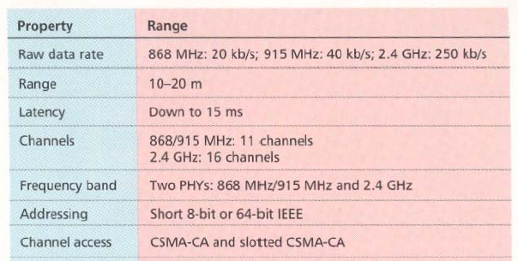
General characteristics

Slide 6
Approaches for low power:
In order to achieve the low power and low cost goals established by IEEE 802.15.4 the following approaches are taken
Reduce the amount of data transmitted
Reduce the transceiver duty cycle and frequency of data transmissions
Reduce the frame overhead
Reduce complexity
Reduce range
Implement strict power management mechanisms (power-down and sleep modes)

Slide 7
IEEE 802.15.4 introduction
IEEE 802.15.4 deals with only PHY layer and portion of Data link layer.
The higher-layer protocols are left to industry and the individual applications.
The Zigbee Alliance is an association of companies involved with building higher-layer standards based on IEEE 802.15.4. This includes network, security, and application protocols.

Slide 8
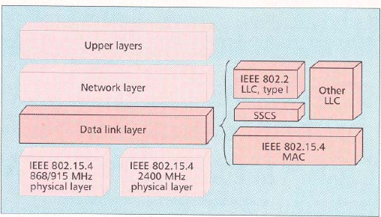
IEEE 802.15.4 in ISO-OSI layered network model

Slide 9
Network layer
The services which network layer provides are more challenging to implement because of low power consumption requirement.
Network layer over this standard are expected to be self configuring and self maintaining to minimize total cost of user.
IEEE 802.15.4 draft standard supports multiple network topologies including star and peer to peer topology.
topology selection is application dependent. PC peripherals may require low latency connection of star topology while perimeter security which needs large coverage area may require peer to peer networking.

Slide 10
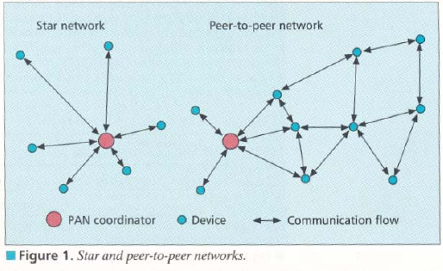
Star and Peer to Peer topologies.

Slide 11
Data link layer.
IEEE 802 splits DLL into MAC and LLC sublayers.
LLC is standardized and is common in 802.3,802.11,802.15.1.
features of the IEEE 802.15.4 MAC are association and disassociation, acknowledged frame delivery, channel access mechanism, frame validation, guaranteed time slot management, and beacon management.

Slide 12
MAC
MAC provides data and management services to upper layers
The MAC management service has 26 primitives whereas 802.15.1 has about 131 primitives and 32 events,
802.15.4 MAC is of very low complexity, making it very suitable for its intended low-end applications, albeit at the cost of a smaller feature set than 802.15.1 (e.g., 802.15.4 does not support synchronous voice links).

Slide 13
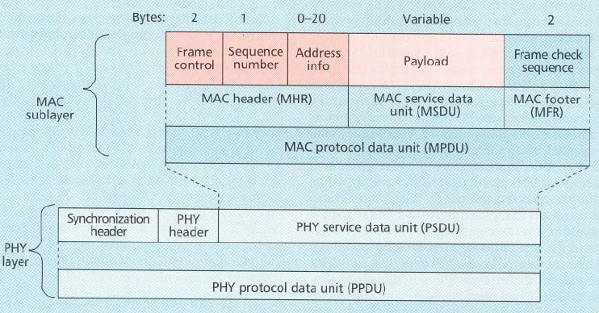
MAC frame format

Slide 14
MAC frame
Frame control field indicates the type of MAC frame being transmitted, specifies the format of the address field, and controls the acknowledgment.
Multiple address types : 64 bit physical address and short 16 bit network assigned address are provided.
Address field size may vary from 0 to 20 bytes.
Payload field is variable with condition size of mac frame <= 127 bytes.
FCS is used for integrity check using 16 bit CRC.

Slide 15
Superframe
Certain applications require dedicated bandwidth to achieve low latency for this it can operate in optional superframe mode
PAN coordinator, transmits superframe beacons in predetermined intervals which is divided into 16 time slots
The channel access in the time slots is contention-based but PAN coordinator may assign time slots to a single device requiring dedicated bandwidth or low-latency transmissions. These assigned time slots are called guaranteed time slots (GTS) and together form a contention-free period.

Slide 16
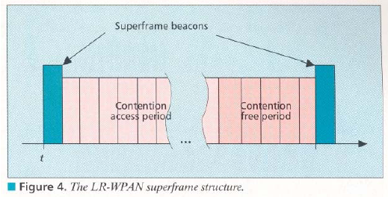
Superframe structure

Slide 17
Other MAC features
In a beacon-enabled network with superframes, a slotted carrier sense multiple access with collision avoidance (CSMA-CA) mechanism is used.
In others standard CSMA-CA is used I.e it first checks if another device is transmitting in the same channel if so backs off for certain time.
MAC confirms successful reception of data with an acknowledgement.
The IEEE 802.15.4 draft standard provides for three levels of security: no security of any type ,access control lists (non cryptographic security) and symmetric key security, employing AES-128.

Slide 18
PHY layer
This standard provides 2 PHY options with frequency band as fundamental difference.
2.4 GHz band has worldwide availability and provides a transmission rate of 250 kb/s.
The 868/915 MHz PHY specifies operation in the 868 MHz band in Europe and 915 MHz ISM band in the United States and offer data rates 20 kb/s and 40 kb/s respectively.
Different transmission rates can be exploited to achieve a variety of different goals.

Slide 19
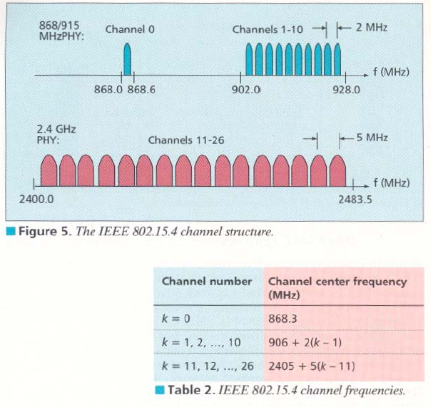
Channel structure

Slide 20
Channelization
27 frequency channels are available across all the 3 bands.
This standard includes the necessary things to implement dynamic channel selection to avoid interference.
The PHY layers contain several lower-level functions, such as receiver energy detection, link quality indication, and channel switching, which enable channel assessment.
These functions are used by the network to establish its initial operating channel and to change channels in response to a prolonged outage.

Slide 21
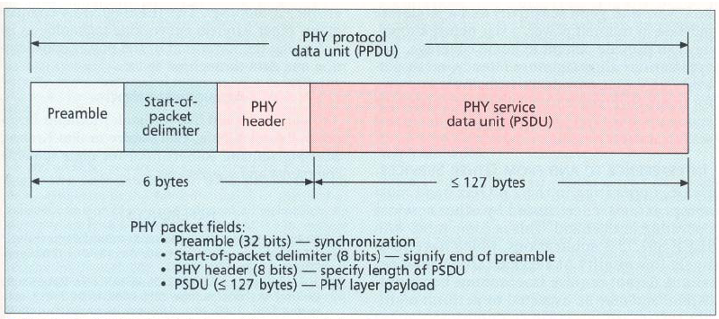
PHY layer packet structure

Slide 22
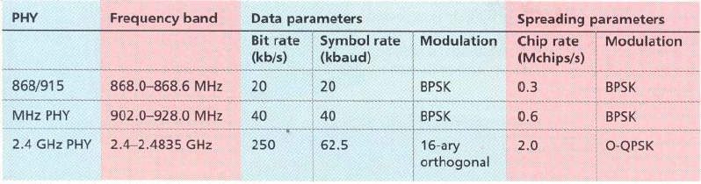
Modulation

Slide 23
Interference
Interference is common in 2.4 GHz band because of other services operating in that band
IEEE 802.15.4 applications have low QOS requirements and may need to perform multiple retries for packet transmissions on interference.
Since IEEE 802.15.4 devices may be sleeping as much as 99.9 percent of the time they are operational, and employ low-power spread spectrum transmissions, they should be among the best of neighbors in the 2.4 GHz band.

Slide 24
Bluetooth vs IEEE 802.15.4.
Bluetooth based WPAN
Few devices
Data range is 10m to 100m
Data rate is nearly 1Mb/s
Power consumption is a low.
Battery life is low.
Star only.
IEEE 802.15.4 LR-WPAN
Many devices
Data range is nearly 10m
Data rate is 20 kb/s,40kb/s,250kb/s.
Power consumption is ultra low.
Battery lasts years.
peer to peer,Star.

Slide 25
ZIGBEE alliance.
The Zigbee Alliance is an association of companies involved with building higher-layer standards based on IEEE 802.15.4. This includes network, security, and application protocols.
A rapidly growing, worldwide, non-profit industry consortium consisting of Leading semiconductor manufacturers, Technology providers, End-users.
An Organization with a mission to define reliable, cost-effective, low-power, wirelessly networked, monitoring and control products based on an open global standard.The

Slide 26
ZIGBEE alliance
now?
Targeted at home and building automation and controls, consumer electronics, PC peripherals, medical monitoring, and toys
Primary drivers are simplicity, long battery life, networking capabilities, reliability, and cost
Alliance provides interoperability, certification testing, and branding.
Six promoter companies– Honeywell, Invensys, Mitsubishi, Motorola,Samsung and Philips
A rapidly growing list (now almost 60 participants) of industry leaders worldwide committed to providing ZigBee-compliant products and solutions

Slide 27
ZIGBEE advantages
over proprietary solutions?
Product interoperability
Vendor independence
No more having to invest resources to create a new proprietary solution from scratch every time
Companies now can leverage these industry standards to instead focus their energies on finding and serving customers.

Slide 28
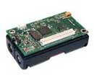
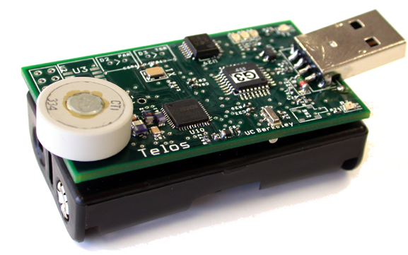
MicaZ Telos

Slide 29
Micaz Telos
Telos module is programmed through the onboard USB connector.
New single board design with USB for ultra low power
Hardware link-layer encryption and authentication
Micaz follows mica line with 51 pin connector and compatibility with previous sensor boards and applications.
wireless Communications with Every Node as Router Capability

Slide 30
MicaZ TELOS
Small patch antenna connects through MMCX connector. MMCX connector allows for remote antenna.
Maintains compatibility with previous mote generations/sensors
Get 15.4 to people quickly to start work with it
Programming and data collection via USB
Fast wakeup from sleep.
Telos has two antenna options
New architecture = new low power mechanisms.
Telos leverages emerging wireless protocols and the open source software movement.

Slide 31
MicaZ vs TELOS
MicaZ (AVR)
  0.2 ms wakeup
  30 μW sleep
  6 mW active
  45 mW radio
  250 kbps
  2.5V min
    2/3 of AA capacity
Telos (TI MSP)
  0.006 ms wakeup
  2 μW sleep
  0.5 mW active
  45 mW radio
  250 kbps
  1.6V min
    7/8 of AA capacity
On a pair of AA batteries with a 1% duty cycle using TDMA or low power listening:
0.01 * (active current) + 0.99 * (sleep current) = avg current
battery capacity / avg current = lifetime
258 days
584 days

Slide 32
Conclusions
The requirements of home automation,security etc could be fulfilled with the IEEE 802.15.4 and bluetooth would not be useful for these purposes.
With the standardization of the MAC and PHY almost complete, the focus is now on the upper protocol layers and application profiles.
This also provides help for certain devices which need dedicated bandwidth to achieve low latency requirements by operating in optional superframe mode.
Many devices can exist in each network.
Multiple network topologies are supported including star, peer to peer.
Battery lasts for years because of low duty cycle,low overhead,low data rate,strict power management mechanisms.

