Slide 1
IEEE 802.16
MAC and PHY Specifications for Broadband WMAN
長庚大學資工系 陳仁暉
Tel : (03) 211-8800 ext. 5990
E-mail: jhchen@mail.cgu.edu.tw

Slide 2

Part Source : Roger B. Marks, National Institute of Standards and Technology Boulder, Colorado, USA
Chair, IEEE 802.16 Working Group http://WirelessMAN.org
Resources

Slide 3
Broadband Access to Buildings
Metro Ethernet
  802.11 Wireless Ethernet
First/Last mile access
  Fast local connection to network
  Target Applications (similar as DSL and CableModem)
    Data
    Voice
    Video distribution
    Real-time videoconferencing
High-capacity cable/fiber to every user is expensive
  Network operators demand it
  Business and residential customers demand it

Slide 4
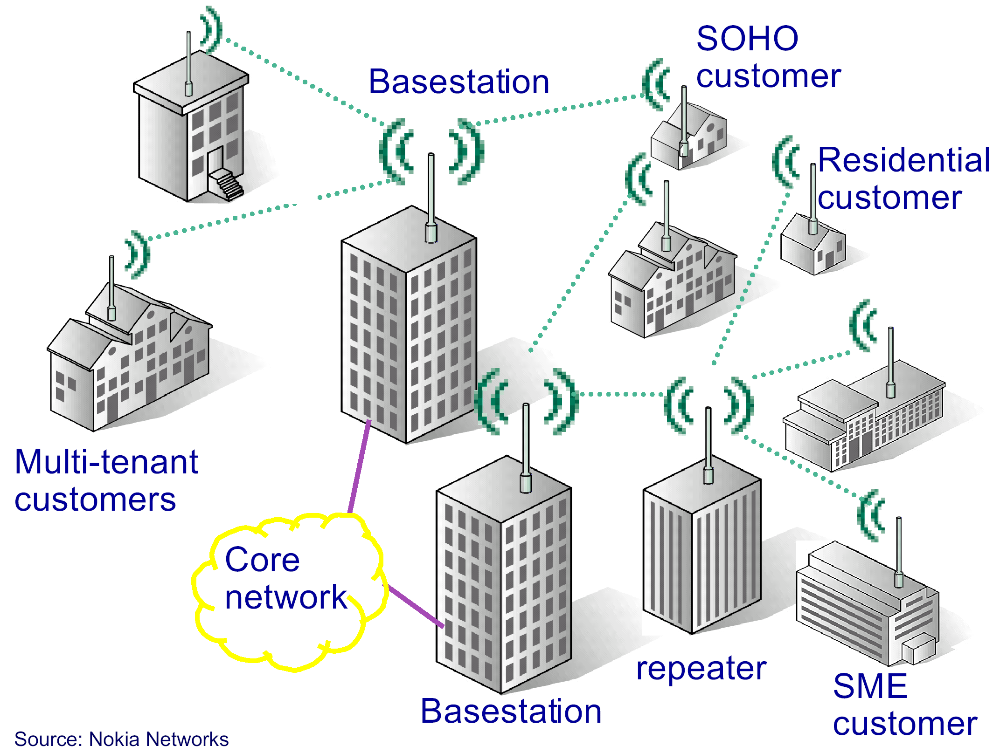
Wireless Metropolitan Area Network

Slide 5
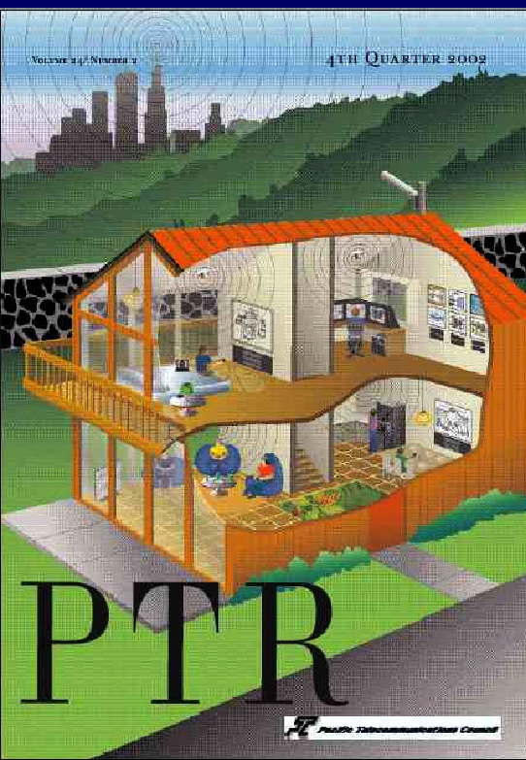
Application

Slide 6
Features (1/2)
Broad bandwidth
  Up to 134.4 Mbit/s in 28 MHz channel (in 10-66 GHz) (UWB ?)
    32Mb/s - 134.4Mb/s
    20/25/28MHz per channel
  line of sight is required and multipath is negligible (short wavelength).
Supports multiple services simultaneously with full QoS
  Efficiently transport IPv4, IPv6, ATM, Ethernet, etc.
  Wireless transportation system.
Bandwidth on demand (frame by frame)
  Similar to HIPERLAN Type II (frame-based protocol)
  Centralized control
MAC designed for efficient used of spectrum
Comprehensive, modern, and extensible security ()tensions to mobility are coming next.

Slide 7
Features (2/2)
Supports multiple frequency allocations from 2-66 GHz in 802.16 (10-66GHz) and 802.16a (2-11GHz)
  Single carrier (SC) for line-of-sight situations
  OFDM and OFDMA for non-line-of-sight situations
    OFDMA : orthogonal frequency division multiple access
Access schemes:
  TDD (time division duplex) and FDD (frequency division duplex)
Link adaptation: Adaptive modulation and coding
Point-to-multipoint (star) topology and mesh network extension
Support for adaptive antennas and space-time coding (in 802.16a)
Extensions to mobility. (IEEE 802.16e started from Jan. 2003) ()tensions to mobility are coming next.

Slide 8
IEEE 802.16 Standard and amendments
Fixed Broadband Wireless Access (FBWA) Systems
Air Interface (MAC and PHY)
  Band 10-66GHz (ranges 1/2/3 : 10-23.5GHz/23.5-43.5GHz/43.5-66GHz) 25/28MHz per channel
  line-of-sight (LOS) requirement
  One PHY
    WirelessMAN-SC (Single Carrier)
  Point-to-Multipoint Topology (Star)
  TDD/FDD with burst profile option (depending on SNR)
  Completed in October 2001
  Published in April 2002
Followup interoperability projects
  802.16c (Profiles): published in Jan 2003
  802.16.1 (PICS): in ballot; completion expected Mar 2003
    PICS : Protocol Implementation Conformance Statement
  802.16.2 (“10-66GHz Coexistence of FBWA Systems”)
    Focus on 23.5 to 43.5 GHz (local multipoint distribution service (LMDS), millimeter wave, etc.,)
    WiMAX submitted proposal in Jan 2003

Slide 9
IEEE 802.16a Standard
“Medium Access Control Modifications and Additional Physical Layer Specifications for 2–11 GHz”
  Band 2-11GHz
  Non-line-of-sight (NLOS) requirement and Multi-path issue
  Near-LOS
  License-exempt band 5-6 GHz (802.11a and HIPERLAN II)
  Three PHYs
    WirelessMAN-SC2 (single carrier)
    WirelessMAN-OFDM (multiple carriers with 256-point transform)
      is mandatory for license exempt bands
    WirelessMAN-OFDMA (multiple carriers with 2048-point transform)
      Multiple access is provided by addressing a subset of the multiple carriers to individual receivers.
  Advanced Antenna Systems (AAS) is optional
  Add mesh network topology (MAC)
  provide automatic repeat request (ARQ) – retransmission (MAC)
  Completed in November 2002 and Approved April 2003
IEEE 802.16e (mobility) first meeting in 2004 D5
IEEE 802.16.2a (coexistence including 2-11GHz)

Slide 10
IEEE 802.16a Standard
license-exempt bands below 11 GHz
  The PHY and MAC introduce mechanisms such as dynamic frequency selection (DFS) to detect and avoid interference.

Slide 11
IEEE 802.16-2004 Standard
IEEE Std 802.16™-2004
  “Air Interface for Fixed Broadband Wireless Access Systems” - IEEE 802.16d
  Approved 24 June 2004
  This standard revises and consolidates IEEE Std 802.16-2001, IEEE Std 802.16a™-2003, and IEEE Std 802.16c™-2002.
IEEE Std 802.16f
  MIB (Management Information Base)
IEEE Std 802.16g
  System/resource/handover Management
  Interoperability

Slide 12
IEEE 802.16e
Enhance IEEE 802.16-2004
PHY is similar to 802.16-2004
  Focus on 2-6GHz
  1.75-20MHZ per channel
  Enhance OFDMA PHY
    Supports 2048-point, 1024-point, 512-point and 128-point FFT
Data rate
  10Mhz/channel, OFDM-64QAM provides 30Mbps
Max. moving speed : 120km/h
Range : several Kms
Chip appears in 2006
vs. IEEE 802.20
  Below 3.5GHz
  Max. moving speed : 250Km/h (high-speed train)
  vs. 3G

Slide 13
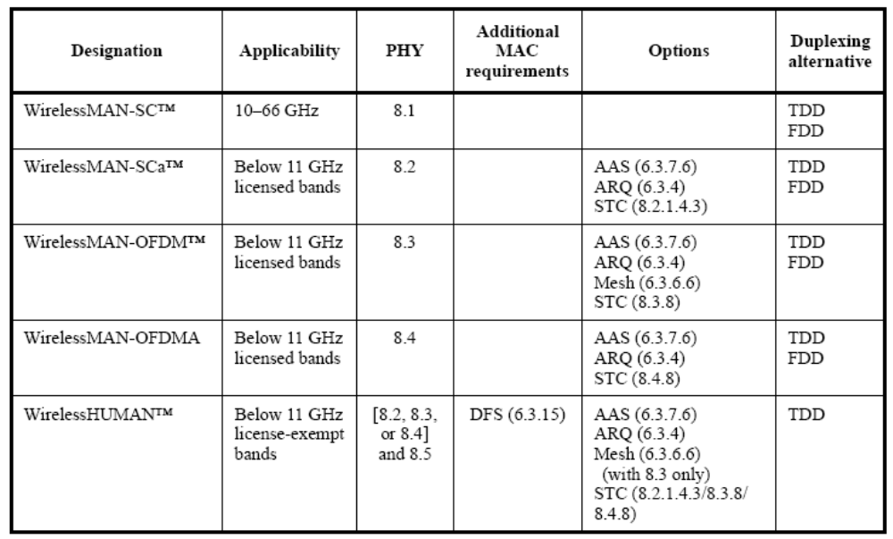
802.16 Air Interface

Slide 14
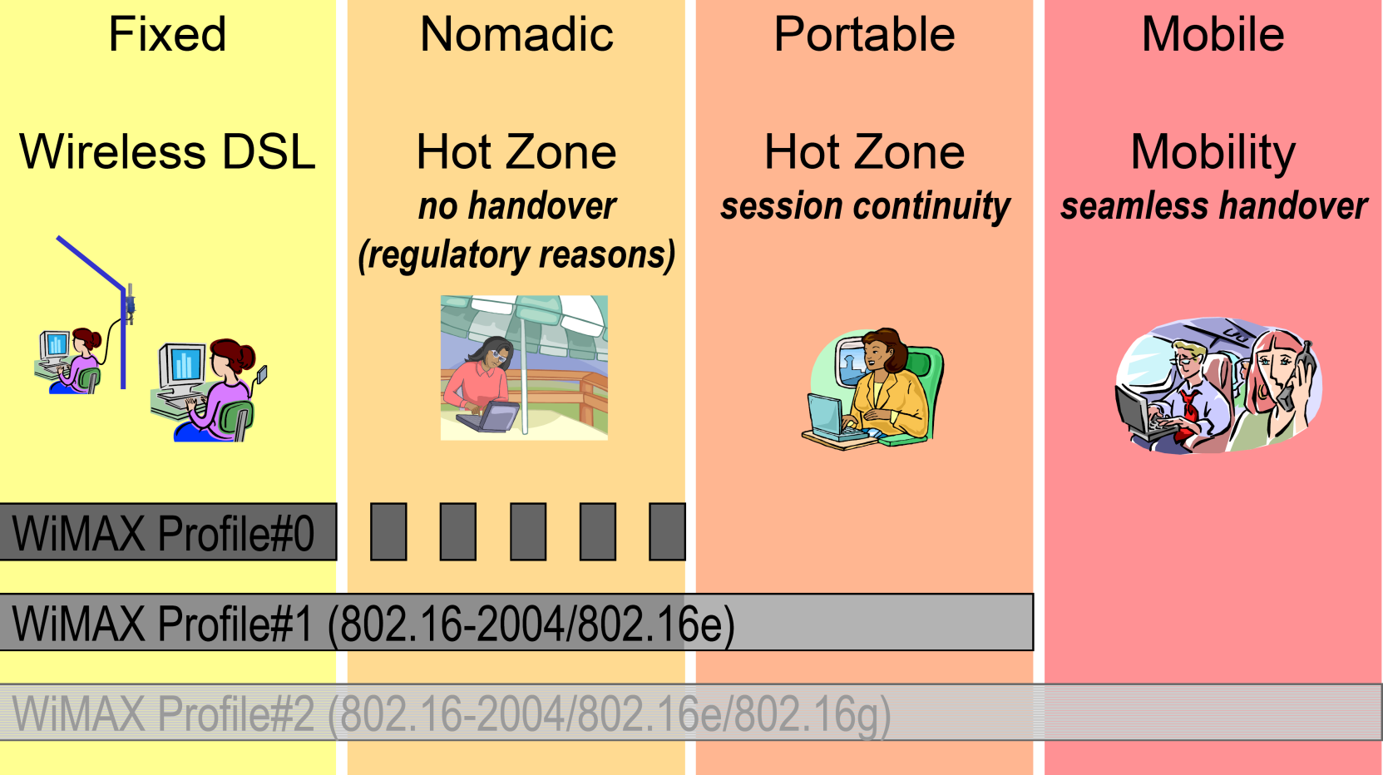
WiMAX Evolution
Source : Siemens, 2004

Slide 15
WiMAX Forum
WiMAX (Worldwide Interoperability for Microwave Access)
  Like WECA in IEEE 802.11 WLAN
Mission:
  To promote deployment of BWA by using a global standard and certifying interoperability of products and technologies.
Principles:
  Support IEEE 802.16x
  2-66 GHz (16a : 2-11 GHz and 16 : 10-66GHz)
  Propose access profiles for the IEEE 802.16 standard
  Guarantee known interoperability level
  Open for everyone to participate
Developing & submitting baseline test specs

Slide 16
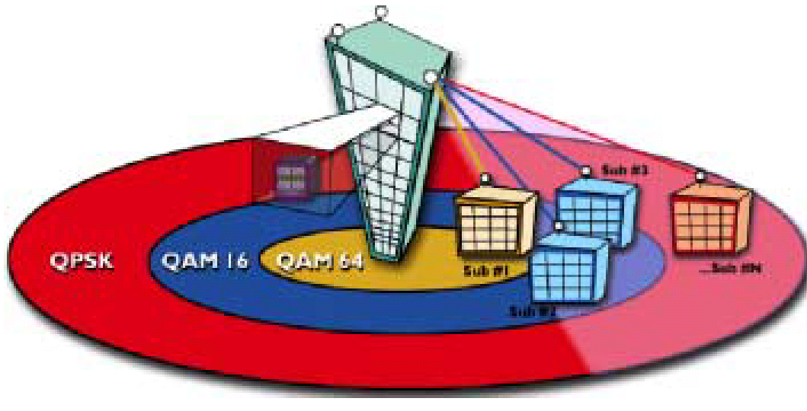
Point-to-Multipoint configuration
Two components
  Subscriber Stations (SSs)
    SS typically serves a building (business or residence)
  Base Station (BS)
    connected to public networks
    BS serves Subscriber Stations
    provide SS with first-mile(or last mile) access to public networks
Compared to a Wireless LAN
  Multimedia QoS
  not only contention-based
  connection-oriented
  Many more users
  Much higher data rates
  Much longer distances

Slide 17
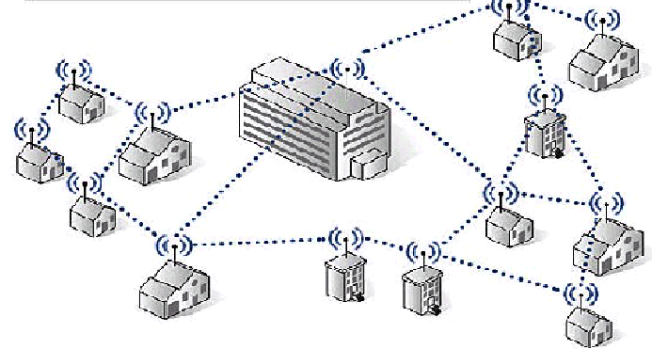
Mesh Topology (defined in 802.16a)
Dynamic topology
  Self-organizing network
  More complicated

Slide 18
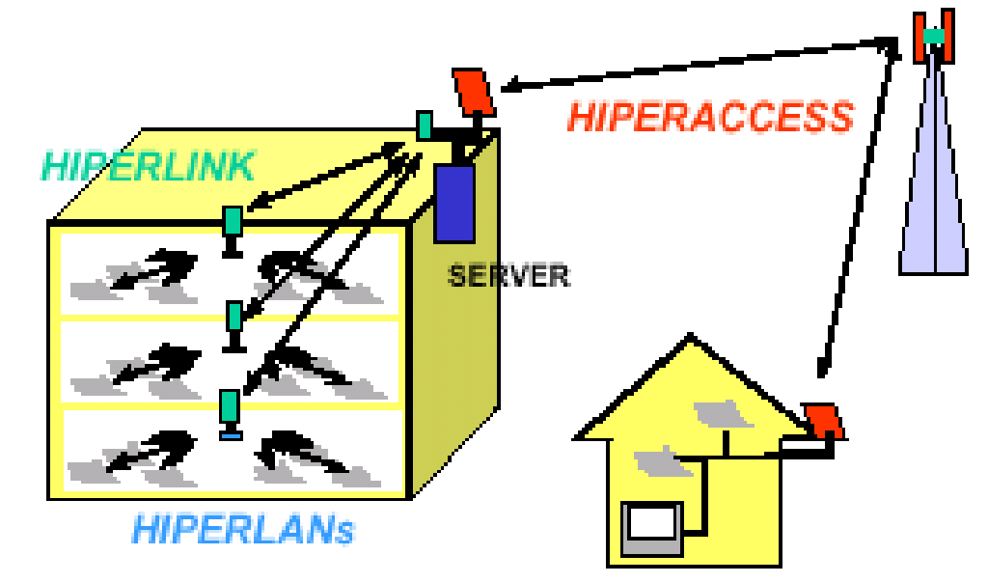
IEEE 802.16 vs. ETSI
Frequent communications between 802.16 WG and ETSI (European Telecom Standards Institute)
ETSI HIPERACCESS
  Above 11 GHz (outdoor , 11- 40GHz, 5Km, 25Mb/s)
  ETSI began first, but IEEE finished first
  802.16 has encouraged harmonization
ETSI HIPERMAN
  Below 11 GHz (outdoor)
  IEEE began first
  Healthy cooperation
  Harmonized with 802.16a OFDM
HIPERMAN
ETSI HIPERLAN
  5GHz (indoor/outdoor)
  6-54Mb/s
  Irrelative with 802.16
ETSI HIPERLINK
  17GHz (150m, point-2-point)
  155Mb/s (OC3)
  Irrelative with 802.16

Slide 19
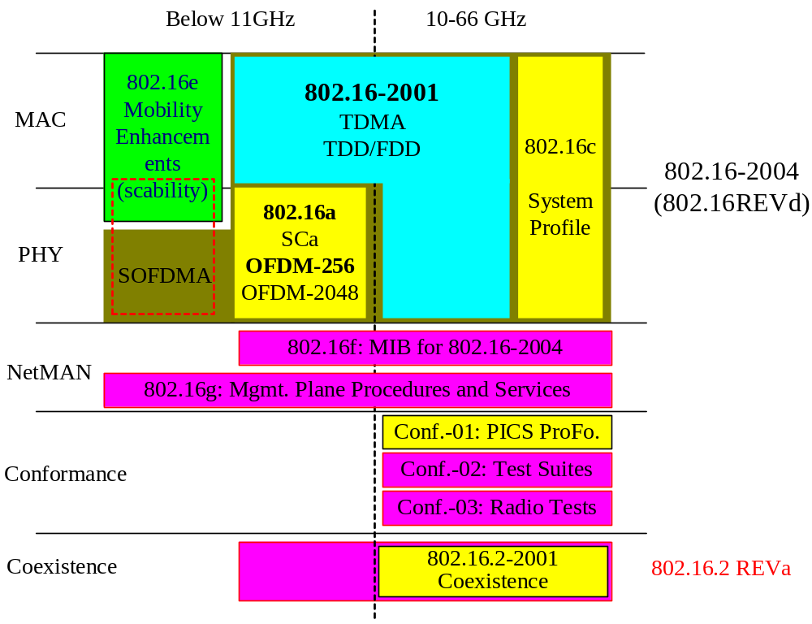
IEEE 802.16 Working Group

Slide 20
MAC Overview
Connection-oriented
Supports difficult user environments
High bandwidth, hundreds of users per channel
For variable Continuous and burst traffic
Very efficient use of spectrum
Protocol-Independent core (ATM, IP, Ethernet, …)
Balances between stability of contentionless and efficiency of contention-based operation
Negotiate the burst profile between sender and receiver
Flexible QoS offerings
  CBR, rt-VBR, nrt-VBR, BE, with granularity within classes
Supports multiple 802.16 PHYs

Slide 21
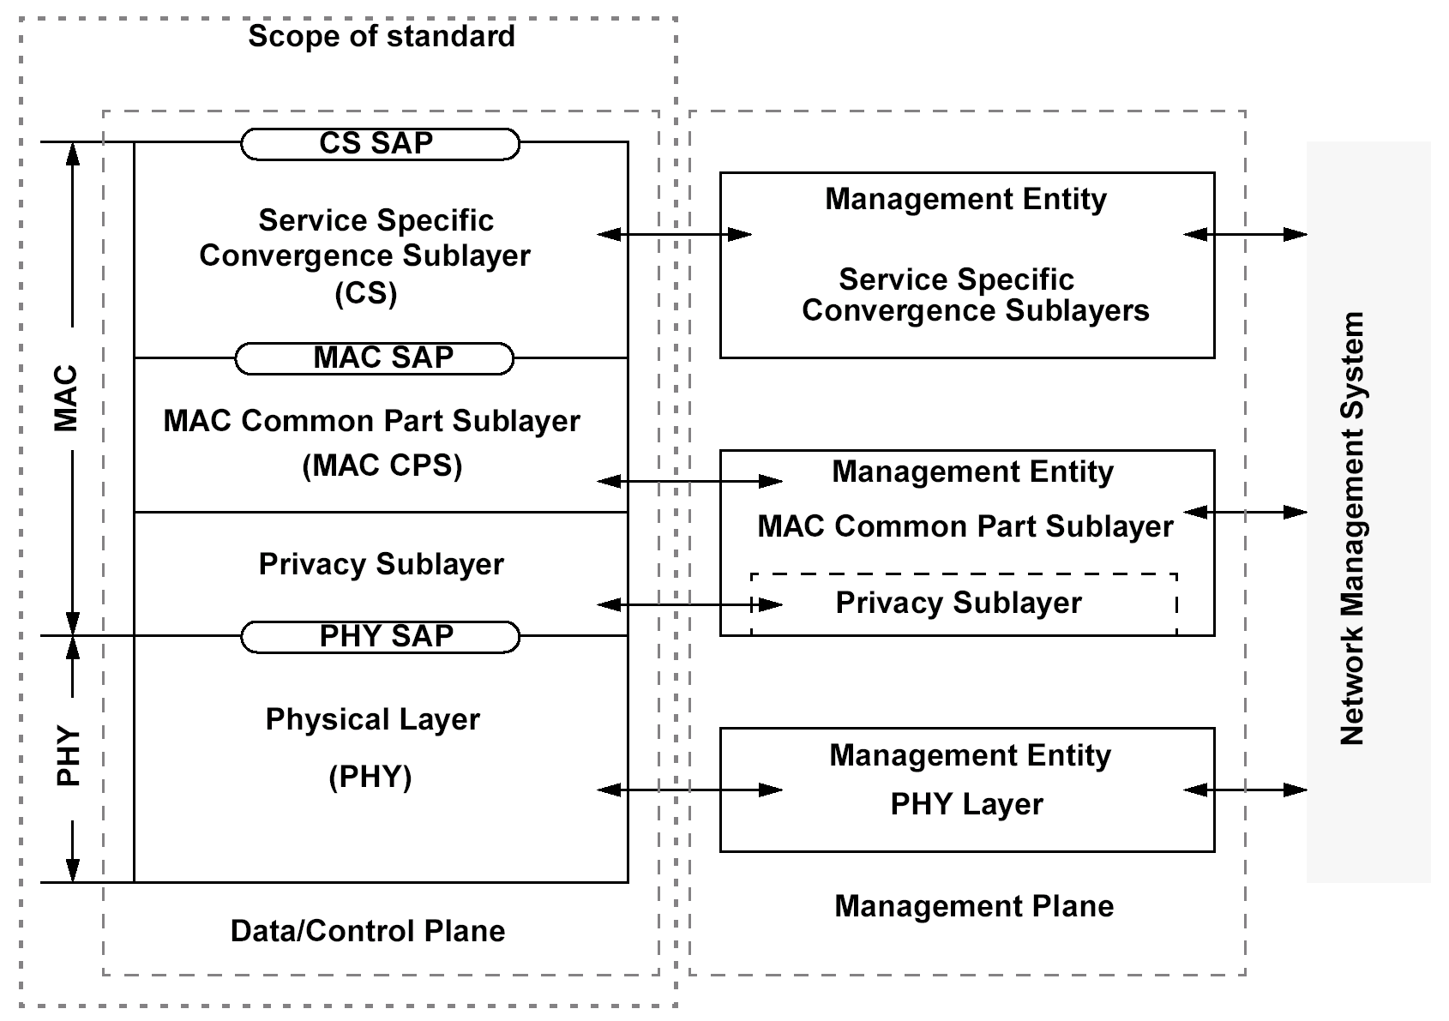
Protocol Stack
ATM
packet
SSCS
Packet convergence
Sublayer (PCS)
(security sublayer 16-2004)

Slide 22
802.16 MAC Reference Model
Convergence Sublayer (CS)
  Mapping external network data into MAC SDU
    Classifying external network SDU
    Associating to MAC connection ID
    Payload header suppression
Common Part Sublayer (CPS)
  Core MAC functionality
    System access
    Bandwidth allocation
    Connection establishment
    Connection maintenance
Security Sublayer
  Authentication
  Security key exchange
  Encryption
PHY
  Multiple sections
    Each appropriate to a frequency range and application

Slide 23
Service Specific Convergence Sublayer (SSCS)
The CS performs the following functions:
  accepting higher-layer PDUs from the higher layer
  performing classification of higher-layer PDUs
  processing (if required) the higher-layer PDUs based on the classification
  delivering CS PDUs to the appropriate MAC SAP
  receiving CS PDUs from the peer entity
Currently, two CS specifications are provided
  Asyncronous Transfer Mode (ATM) CS
  Packet CS
    Such as IP, PPP, Ethernet, etc.,
  Other CSs may be specified in the future.

