Slide 1

Chapter 14
Wireless LANs
14.<number>
Copyright © The McGraw-Hill Companies, Inc. Permission required for reproduction or display.

Slide 2
14-1 IEEE 802.11
IEEE has defined the specifications for a wireless LAN, called IEEE 802.11, which covers the physical and data link layers.
Wireless ethernet
Wireless Fidelity (Wi Fi)
Topics discussed in this section:
Architecture
MAC Sublayer
Physical Layer
14.<number>

Slide 3

Note
A BSS without an AP is called an ad hoc network;
a BSS with an AP is called an infrastructure network.
14.<number>

Slide 4
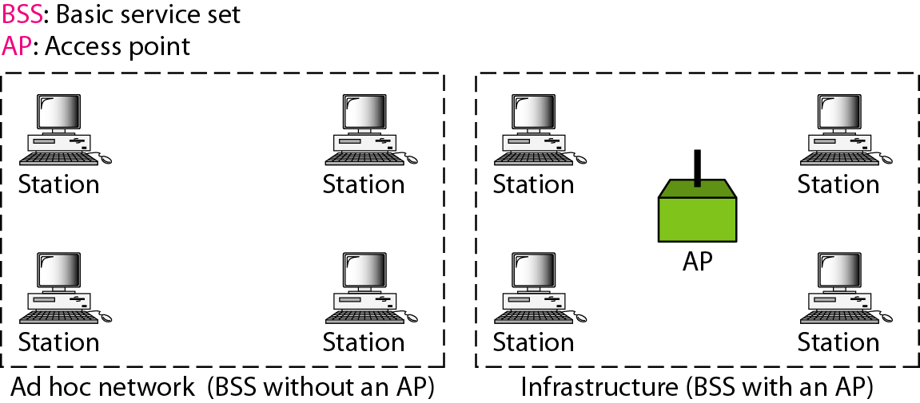
Figure 14.1 Basic service sets (BSSs)
14.<number>

Slide 5
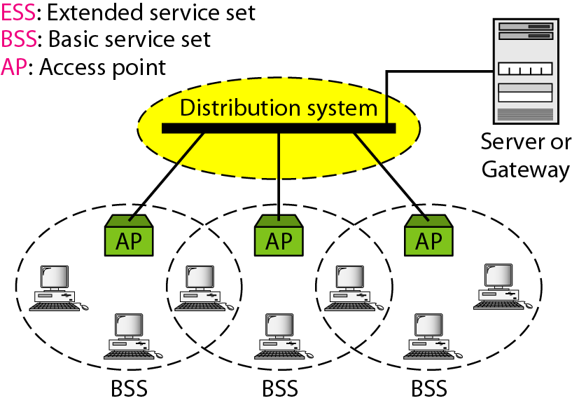
Figure 14.2 Extended service sets (ESSs)
14.<number>

Slide 6
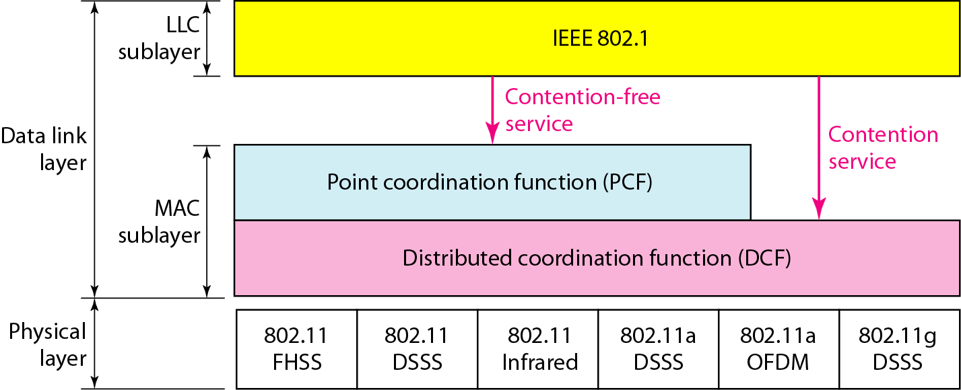
Figure 14.3 MAC layers in IEEE 802.11 standard
14.<number>

Slide 7
DISTRIBUTED COORDINATION FUNCTION(DCF)
  CSMA / CA
  DISTRIBUTED INTERFRAME SPACE(DIFS)
  REQUEST TO SEND (RTS)
  SHORT INTERFRAME SPACE (SIFS)
  CLEAR TO SEND (CTS)
  NETWORK ALLOCATION VECTOR(NAV)
POINT COORDINATION FUNCTION(PCF)
  Only in infrastructure method
  PIFS – PCF IFS
14.<number>

Slide 8

Figure 14.4 CSMA/CA flowchart
14.<number>

Slide 9
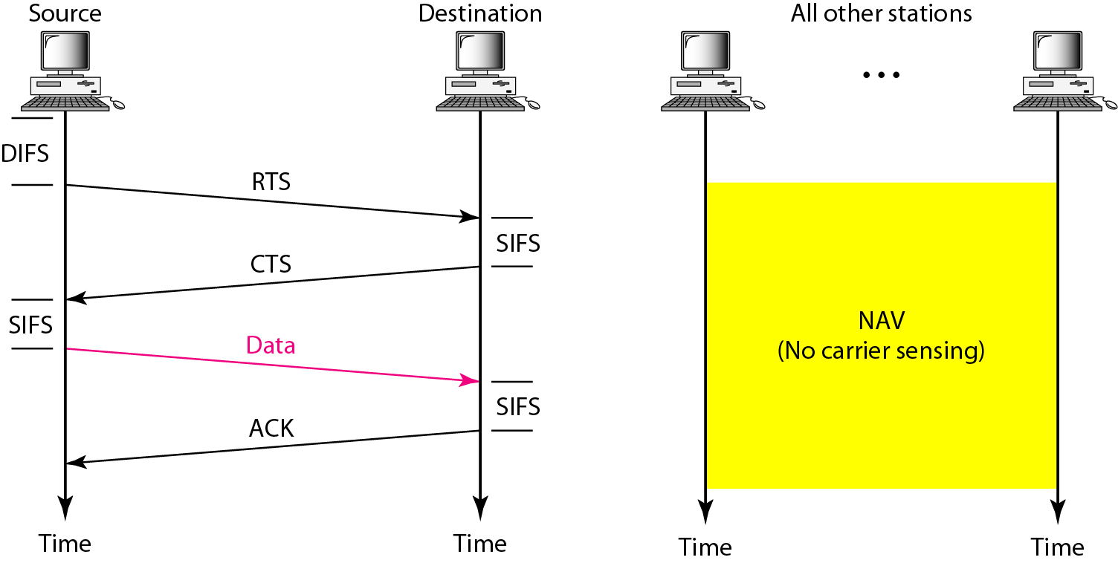
Figure 14.5 CSMA/CA and NAV
14.<number>

Slide 10
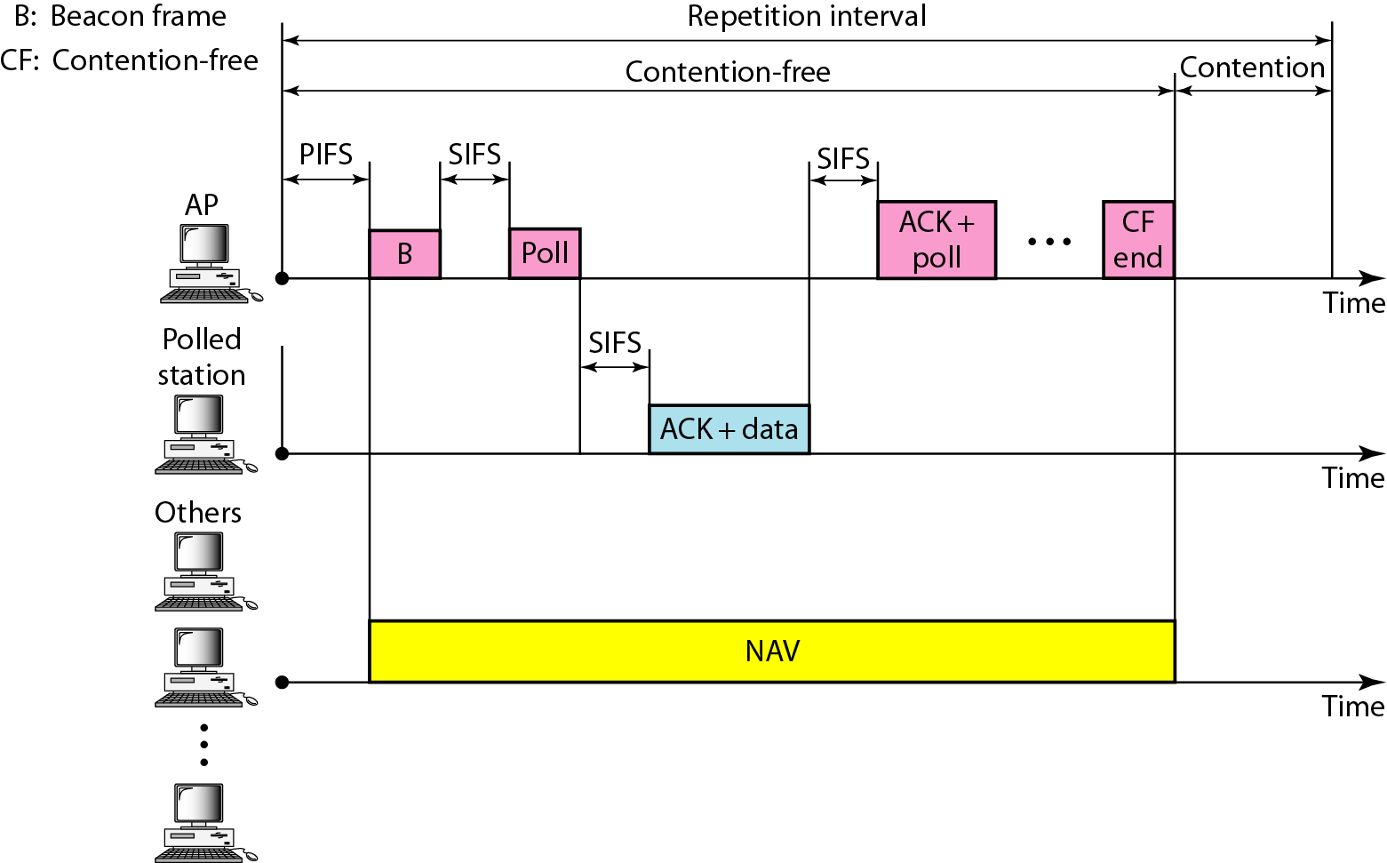
Figure 14.6 Example of repetition interval
14.<number>

Slide 11

Figure 14.7 Frame format
D- Duration – to set the value of NAV
SC – Sequence Control – First 4 – Fragment no. , last 12 – Seq no
FCS – Error detection scheme
14.<number>

Slide 12
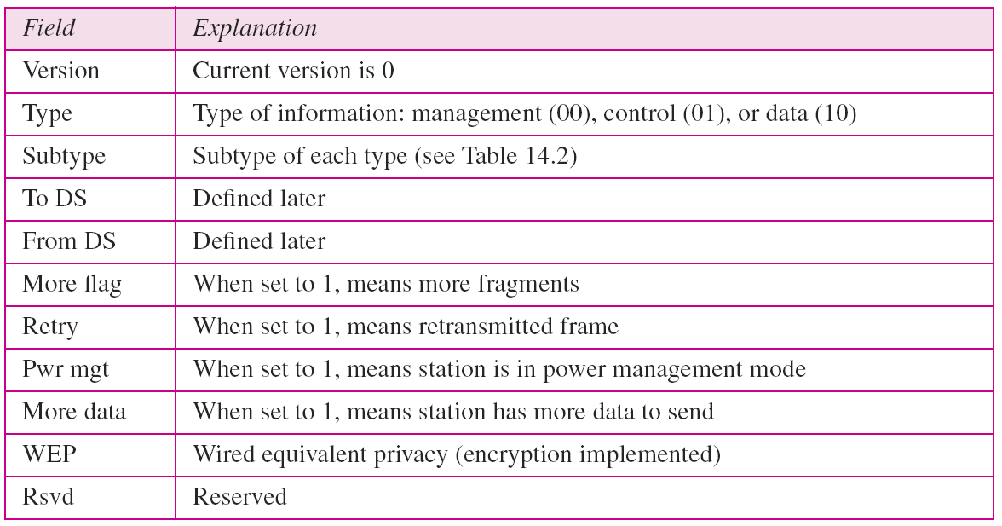
Table 14.1 Subfields in FC – frame control field
14.<number>

Slide 13
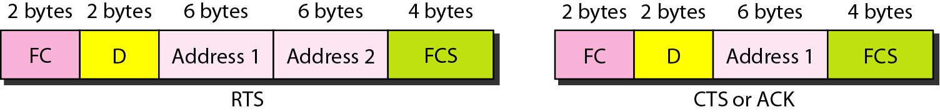
Figure 14.8 Control frames
14.<number>

Slide 14
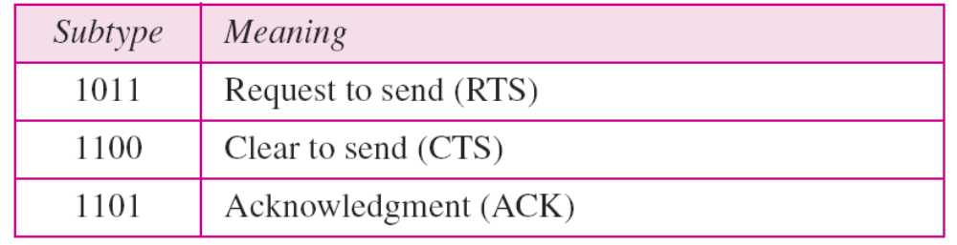
Table 14.2 Values of subfields in control frames
14.<number>

Slide 15
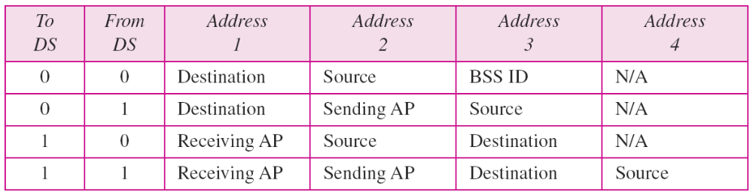
Table 14.3 Addresses
Next device
Previous device
Final Dest
Original source
14.<number>

Slide 16
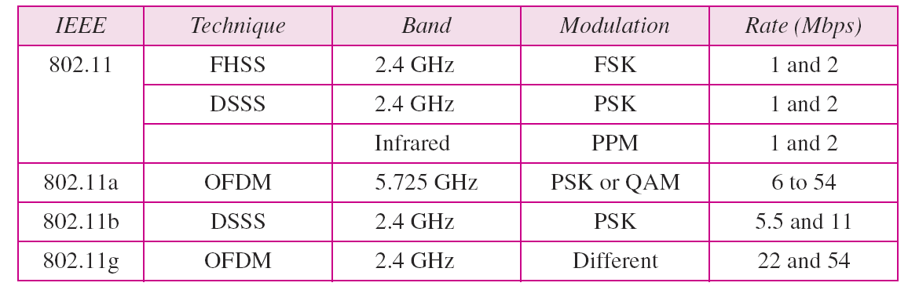
Table 14.4 Physical layers
FHSS – Frequency hopping spread spectrum
DSSS – Direct Sequence spread spectrum
OFDM – Orthogonal frequency division multiplexing
14.<number>

Slide 17
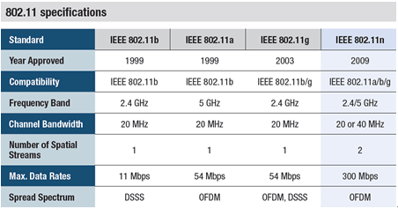
14.<number>

Slide 18
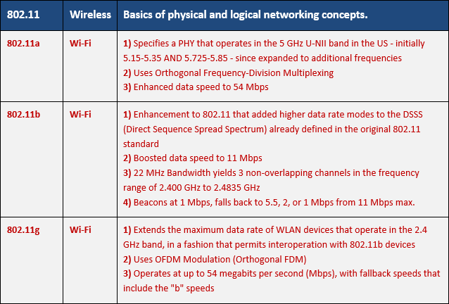
14.<number>

