Slide 1

Delhi E-Micromobility Planner
NETWORK PLANNING PROGRAMME · NCT DELHI
Methodology: the data, the models and how the platform was built
Notes:
This deck explains how the Delhi E-Micromobility Planner was built: the data it uses, every processing and optimisation step, and how the web platform turns the results into tools for planners and riders.

Slide 2






What this deck covers
01
02
03
Problem
Data
Scoring
The adoption gap and the single research question
Analysis grid and OSM road network, and how they were prepared
Seven sub-indices, suitability and site screening
04
05
06
Optimisation
Platform
Limits
Hubs, battery-swap stations and calm corridors on the road network
Architecture, pages, and the planner and user tools
Assumptions, limitations and next steps
Notes:
Six parts. The core of the methodology is in Data, Scoring and Optimisation; the Platform section shows how the outputs are served to planners and riders.

Slide 3
The problem: demand and safe, serviced supply do not meet
96.5%
66%
RESEARCH QUESTION
How should a shared e-micromobility service provider in Delhi locate its hubs, battery-swap stations and riding corridors to capture the most short-trip demand that is safe and practical to serve, when 96.5% of high-demand neighbourhoods have no shared e-bike service, 66% have no safety facility and 69% carry above-median traffic stress?
of high-demand cells have no shared e-bike service
of high-demand cells have no safety facility
69%
12.1
of high-demand cells have above-median traffic stress
trips per battery charge, so swaps must be planned
Notes:
Problem statement: latent short-trip demand sits in dense, high-stress neighbourhoods that lack shared service, safe riding space and battery infrastructure. Yulu zones cover only 37 of 2227 cells. The question is framed as one optimisation question that the rest of the method answers.

Slide 4
Evidence: safety and supply do not rise with demand
0.40 → 0.57
Mean traffic stress rises from the lowest to the highest demand quintile
2.7%
of top-demand cells (Q5) have a Yulu zone; supply is concentrated in a few cells
Notes:
Cells are split into five equal groups by the CLEDS e-bike demand score. The share of cells without a safety facility or non-motorised road falls with demand, but stays high, and traffic stress increases with demand. Existing shared supply is almost absent everywhere.

Slide 5
01 Data and preparation
Two inputs: an analysis grid of 2,227 hexagons and the OpenStreetMap road network with traffic-stress ratings

Slide 6

Two datasets feed every step
Analysis grid
Road network
fd2c6989-17_grid_work_2_0_with_corrected_UMVI.csv + sri.gpkg
sup.gpkg · layer 04_highway_filtered_clip_43n
2,227 hexagons of 0.66 km², 1,470 km², EPSG:32643
About 120 indicators per cell
Demand: CLEDS e-bike demand, population, POIs, night lights
Access: FAI, POIs within 10 min, intersections, POI diversity
Safety & comfort: low-stress share, slope, NMR, safety points, sidewalks, trees
Context: OMAS, Yulu zones, socio-economic index, land use, UMVI/NMSI/MIRI
149,135 OpenStreetMap ways, EPSG:32643
23,269 km of road in 8 classes, trunk to service
Traffic stress per way: low or high (2,085 km high, 9.0%)
Fields: highway, Length_m, Stress, osm_id
Used for coverage, station distances, corridors, van loops and every route in the app
Notes:
The grid carries the scoring indicators; the road network carries all distances and routes. Both are in UTM zone 43N, so distances are in metres without reprojection.

Slide 7
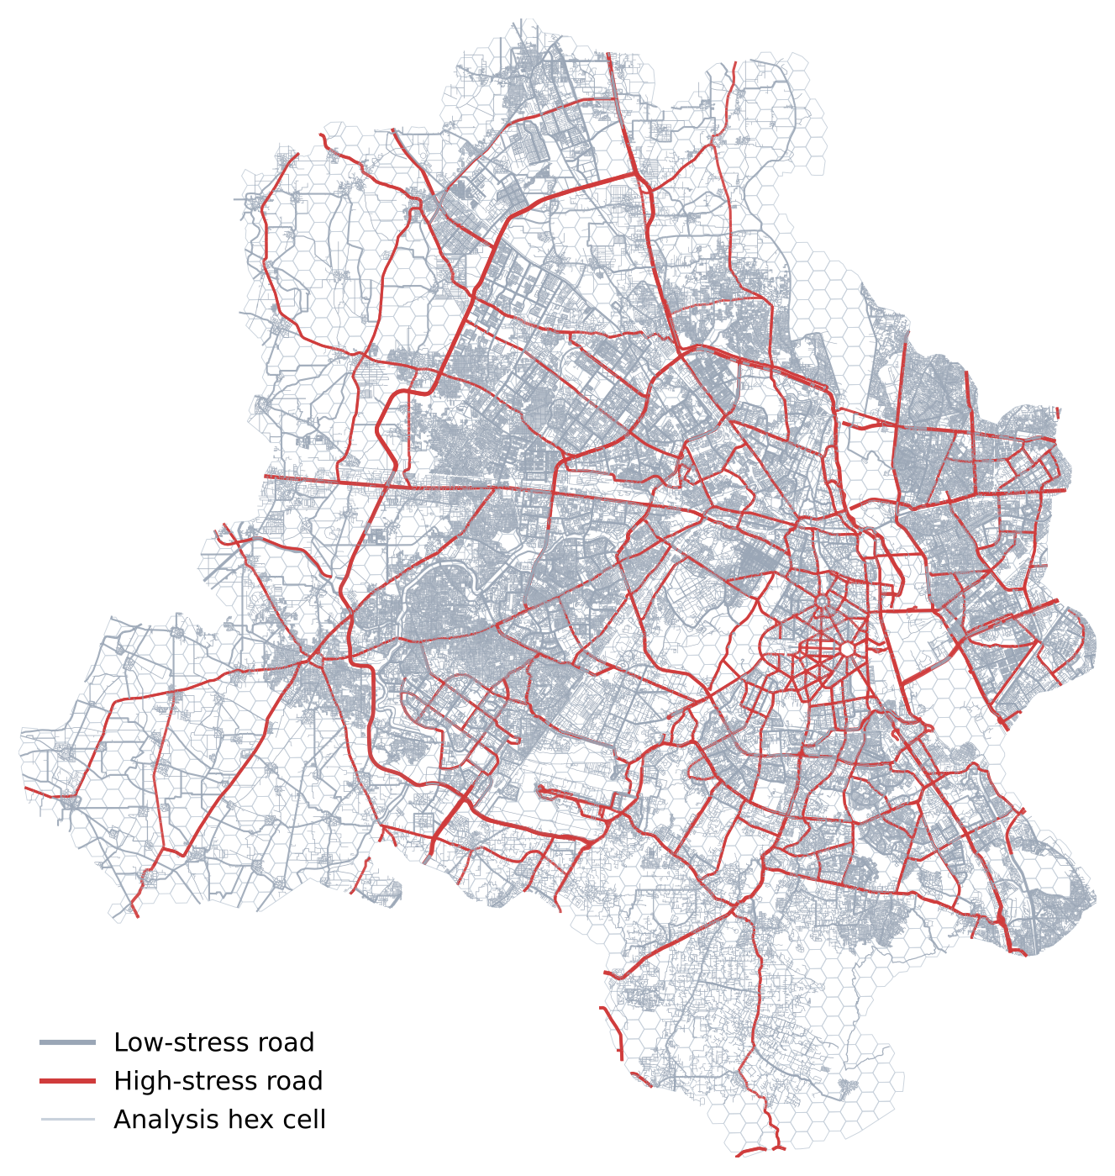
Study area: NCT Delhi on the hex grid and road network
19.8 million residents (population_mean × cell area)
Residential streets are 63% of the network; trunk, primary and secondary roads 9%
Notes:
High-stress roads (red) form the arterial skeleton. Residential streets dominate by length, which is why calm routes are usually available at a small detour.

Slide 8
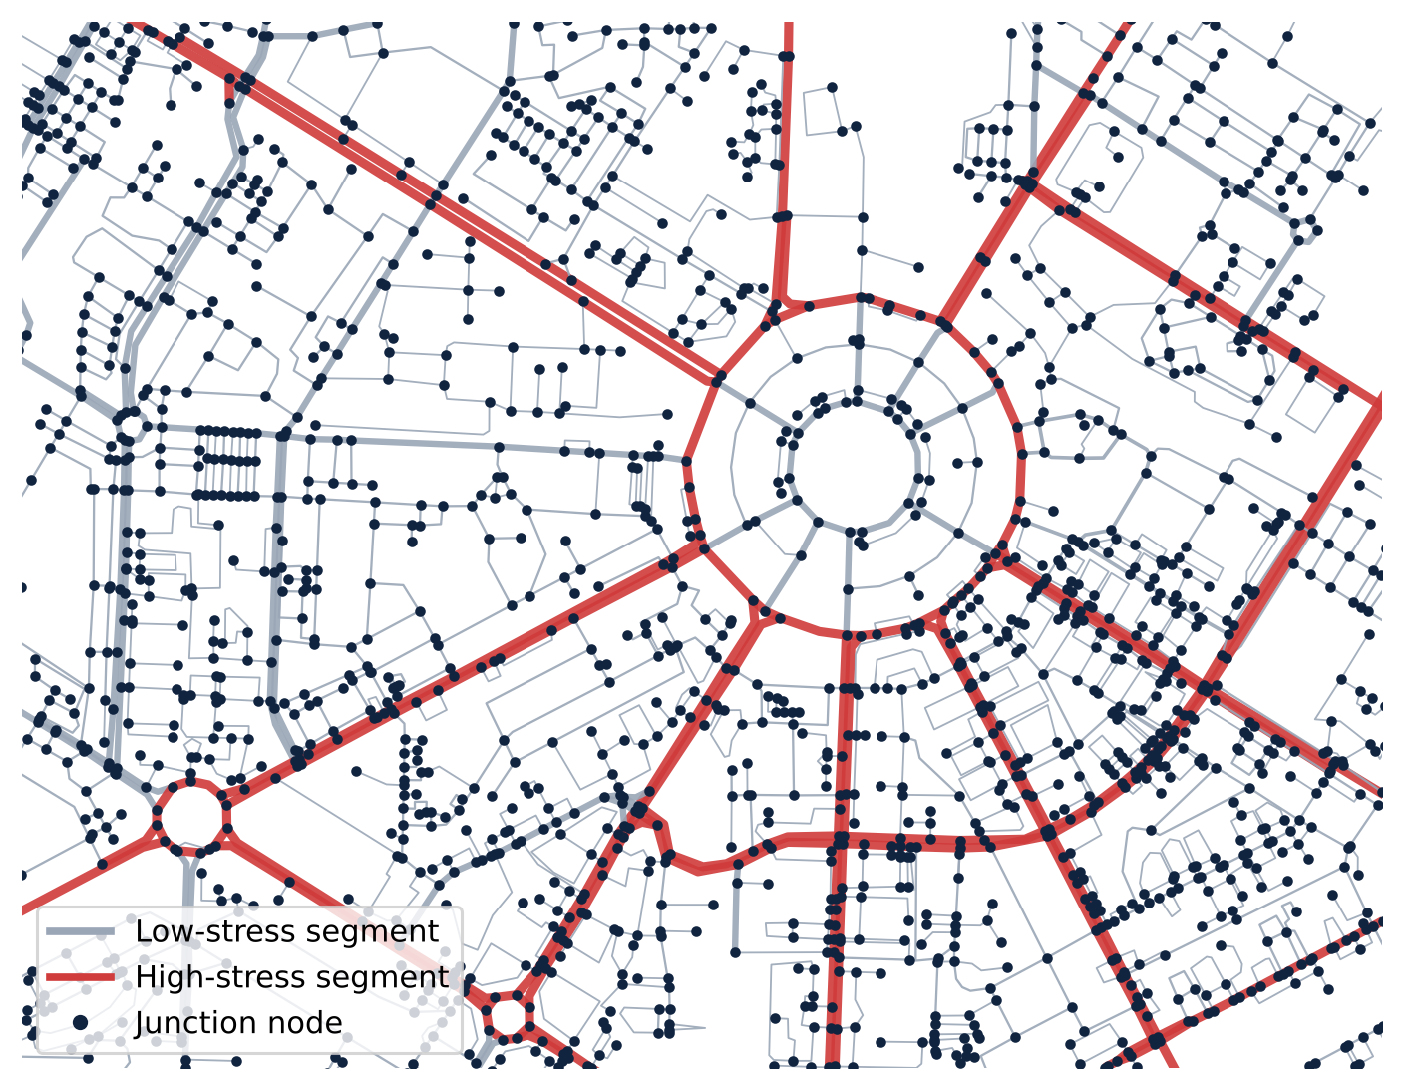
Preparation: from raw layers to a routable graph
1
Join
Grid CSV joined to hex geometry on Grid_ID; all 2,227 rows match
2
Derive
Population, built-up / water / green shares, heavy-traffic load from street-view counts
3
Normalise
Every input percentile-ranked to 0–1 so skewed counts do not dominate
4
Node
149,135 ways split at shared OSM vertices: 263,746 junctions
5
Connect
Largest connected component kept: 99.6% of junctions
6
Simplify
Same-class chains merged, geometry simplified to 6 m: 246,003 junctions, 345,601 segments
7
Snap
Each cell centre snapped to its nearest junction: median 61 m; 124 cells over 500 m from a road
Junction graph around Connaught Place
Notes:
Steps 1–3 prepare the grid; 4–7 turn the OSM ways into a graph where every junction is a node and every road segment an edge with length, class and stress. Snapping links the two datasets.

Slide 9
02 Scoring and screening
Seven sub-indices describe each cell; a weighted blend gives the suitability score the optimiser maximises

Slide 10
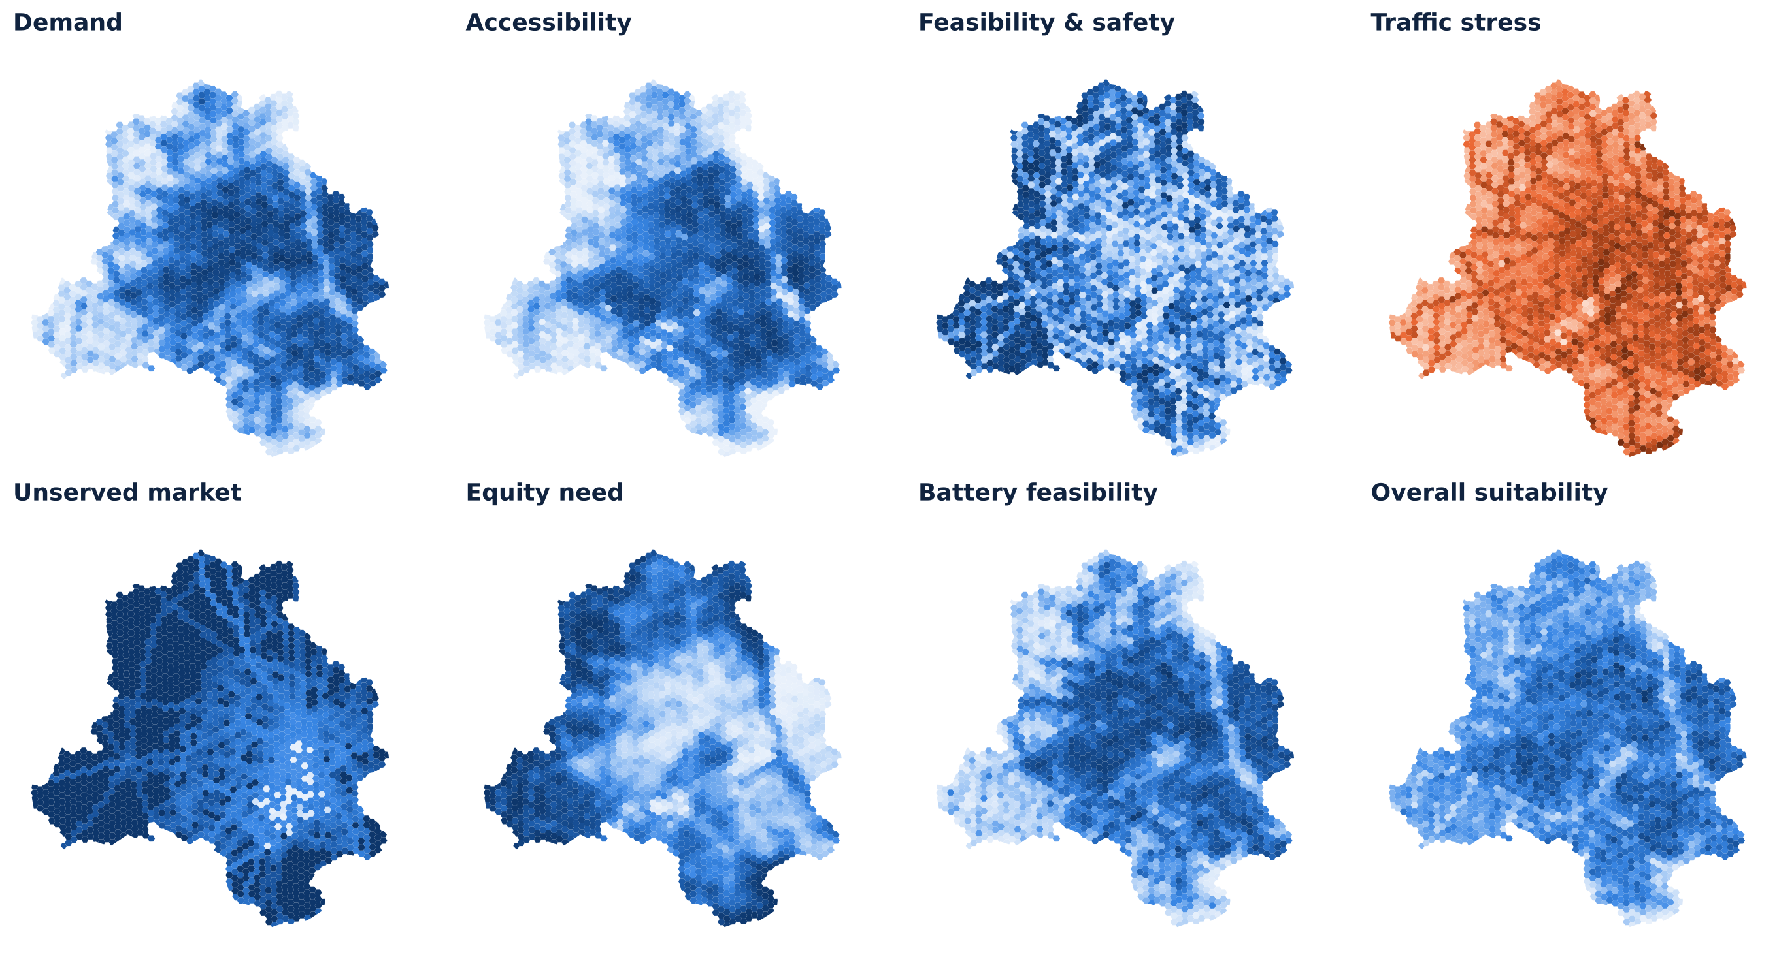
Seven sub-indices, each on a 0–1 scale
Notes:
Demand: 0.40 CLEDS + 0.25 population + 0.20 POI count + 0.15 night lights. Accessibility: 0.30 FAI + 0.30 POIs within 10 min by e-bike + 0.20 intersection density + 0.20 POI diversity. Feasibility: low-stress share, flatness, NMR infrastructure, safety points, sidewalks, trees, low heavy traffic. Traffic stress is the inverse of calm-road indicators. Unserved market: low OMAS and no Yulu zone. Equity: inverse socio-economic index. Battery feasibility: built-up share, night lights, warehouses and roads, infrastructure index.

Slide 11
Suitability score, site screening and weight scenarios
Scenario | D | A | F | G | E
Balanced | 0.35 | 0.25 | 0.25 | 0.1 | 0.05
Demand-led | 0.55 | 0.25 | 0.15 | 0.05 | 0
Safety-first | 0.25 | 0.2 | 0.45 | 0.05 | 0.05
Equity & white-space | 0.25 | 0.2 | 0.2 | 0.2 | 0.15
SUITABILITY
S = 0.35 D + 0.25 A + 0.25 F + 0.10 G + 0.05 E
Hard screens for a hub site
Built-up share ≥ 10 %
Road length in the cell ≥ 3 km
Water share < 25 %
Not in the steepest 3 % of cells
1,563
The balanced weights set the base plan. The other three test whether hub locations depend on the weighting (see Robustness).
of 2,227 cells pass and can host a hub
Notes:
D demand, A accessibility, F feasibility and safety, G unserved market, E equity. Screens are applied only to candidate hub sites; every cell still counts as demand.

Slide 12
03 Optimisation on the road network
Hub siting, battery-swap stations, calm corridors and van loops, all measured by road distance

Slide 13
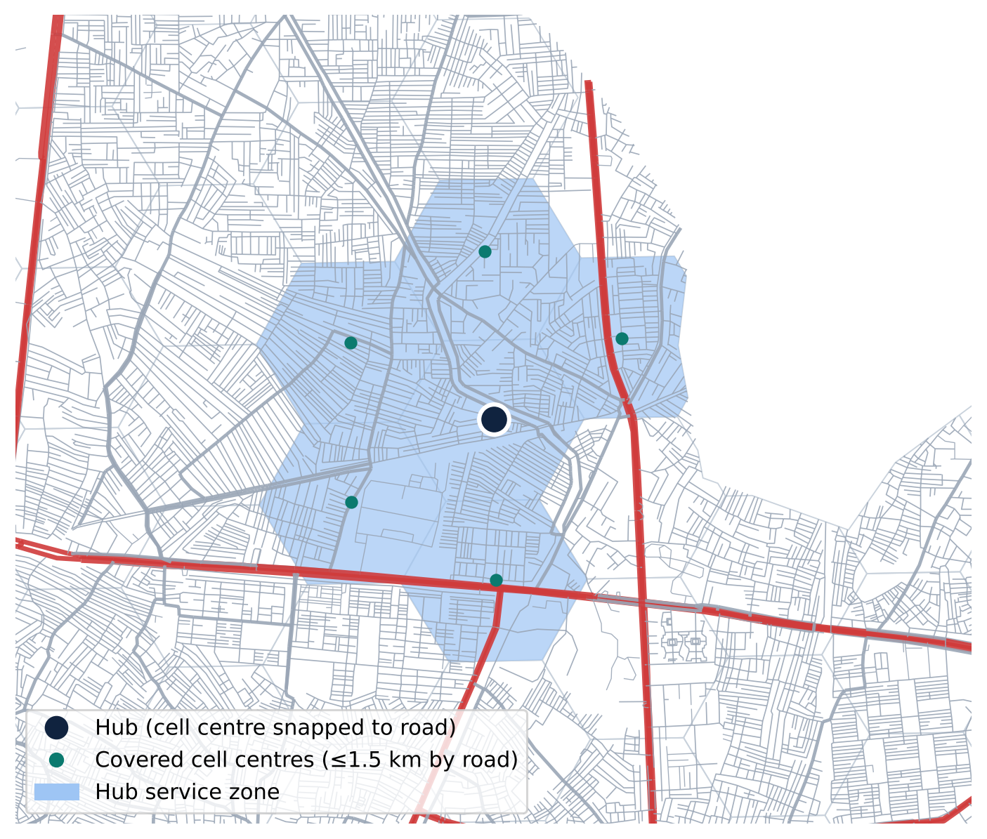
A hub serves cells within 1.5 km by road
Each cell centre is snapped to the road graph
Road distance between cell centres = snap distance + shortest path + snap distance
Cell i is covered by a hub in cell j when that distance ≤ 1.5 km
Computed with Dijkstra from every cell (SciPy, 1.55 km search limit)
On average a hub covers 3.6 cells (about 2.4 km²)
Why road distance: a river, rail line or arterial can make a neighbouring cell far to reach even when it is close in a straight line.
Notes:
This replaces the straight-line 1 km radius of the first version. Cells farther than 1.5 km from any road are left unserved.

Slide 14
Hub siting: maximal covering location model
FORMULATION
maximise Σᵢ wᵢ yᵢ
subject to yᵢ ≤ Σⱼ∈Nᵢ xⱼ
Σⱼ xⱼ = p, xⱼ ∈ {0,1}, 0 ≤ yᵢ ≤ 1
wᵢ = suitability × trip potential of cell i
Nᵢ = eligible cells within 1.5 km by road
Solved exactly with HiGHS: 77.5% of weighted demand covered
Greedy heuristic: 75.6% (used for live re-runs in the app)
p = 148: the first hub that adds under 0.2 %
Notes:
MCLP picks p hub cells to maximise suitability-weighted trip potential within each hub service zone. The curve is from the greedy method; the exact solve at p=148 is shown in the title.

Slide 15
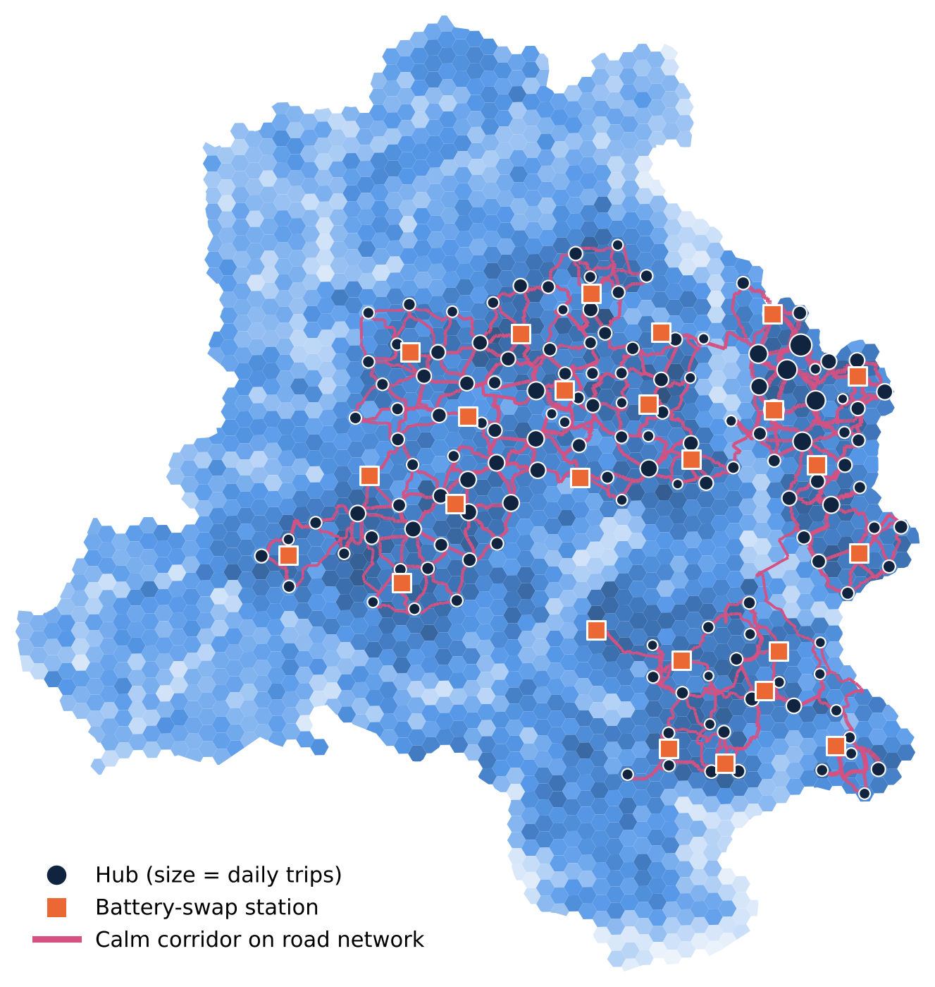
Result: 148 hubs and 25 swap stations
148
68.4%
hubs (exact optimum)
of residents within 1.5 km of a hub by road
51,893
10,451
trips a day captured, of 70,273 potential
e-bikes at 5 trips per bike a day
65.0%
25
of high-demand cells covered
battery-swap stations
Notes:
Trip potential = population × 1.3 trips × 45% short trips × 0.5% adoption, scaled by demand score. It is a planning estimate, not observed ridership.

Slide 16
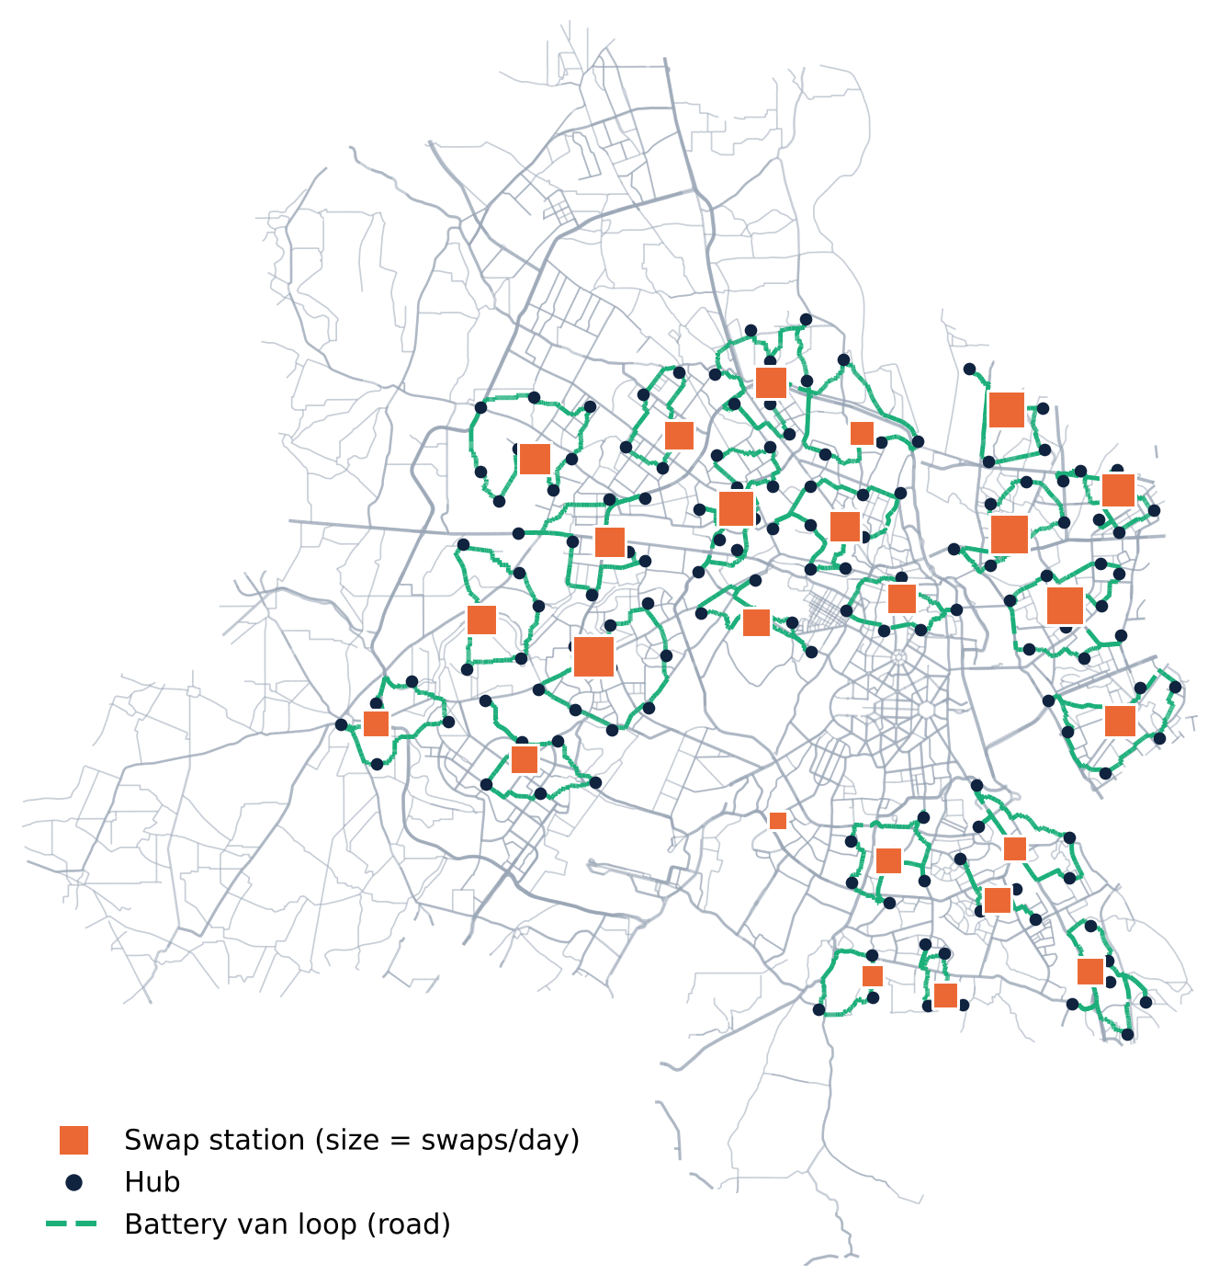
Battery-swap stations and energy
66 Wh
12.1
4,281
3,804 kWh
per trip
3 km × 22 Wh/km
trips per charge
1 kWh × 0.8 usable
swaps per day
charging per day
at 90 % efficiency
Capacitated p-median
Minimise Σ swaps × road distance from hub to station
Each hub served by exactly one station within 4 km by road
No station over 400 swaps a day; candidates in the top 60 % of battery feasibility
Result: 25 stations, mean 2.52 km hub-to-station
Van loops solved on road distance (nearest neighbour + 2-opt): 430 km a day
Notes:
Battery pool: 1.5 packs per bike is the rule of thumb; sizing from station stock gives a leaner pool. All parameters can be changed live in the Planner > Battery & stations page.

Slide 17
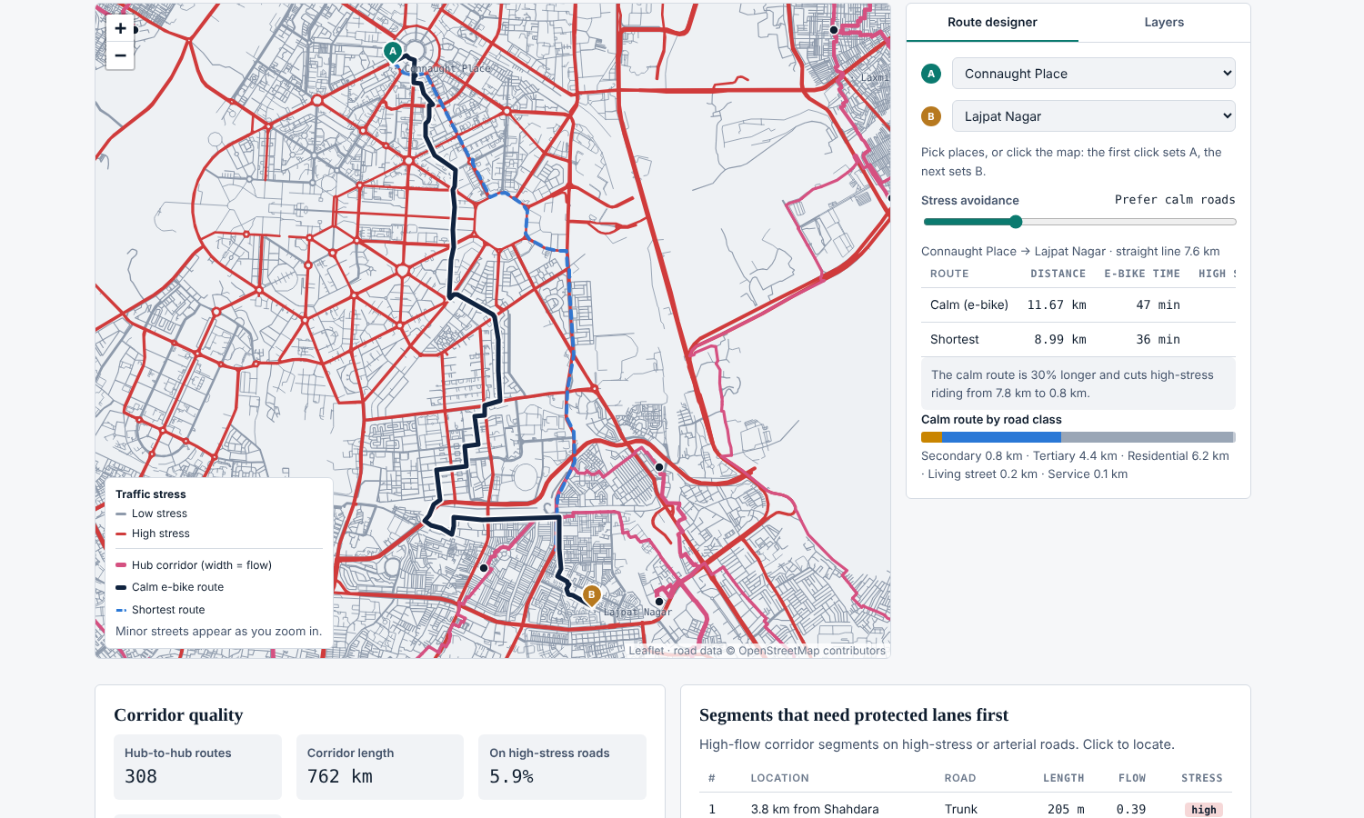
Calm corridors and route planning on the road network
E-BIKE ROUTE COST PER SEGMENT
length × (1 + 1.5·high-stress) × class factor
class factor: trunk 1.8 · primary 1.4 · secondary 1.15 · tertiary 1.05 · service 1.1 · others 1.0
Each hub links to its 3 strongest partner hubs 1–6 km away (gravity = trips × trips ÷ distance²)
Least-cost paths found with Dijkstra; flow loaded on each segment
Lane priority = √flow × road risk (high stress, arterial class)
308
762 km
5.9%
+6.5%
hub-to-hub routes
of calm corridor
on high-stress roads
longer than the shortest path
Route designer: Connaught Place → Lajpat Nagar. Calm route 11.7 km vs shortest 9.0 km; high-stress riding drops from 7.8 km to 0.8 km.
Notes:
The same cost function runs in the browser for the route designer and the rider journey planner, with a slider that scales the stress penalty.

Slide 18
Robustness: do hub locations depend on the weights?
Scenario | Weighted coverage | Population covered | Same cell as balanced
Balanced | 77.5% | 68.4% | 148 / 148
Demand-led | 79.4% | 68.3% | 134 / 148
Safety-first | 76.3% | 68.3% | 116 / 148
Equity & white-space | 75.5% | 68.4% | 120 / 148
142 / 148
hubs are robust: every scenario puts a hub within 1.5 km by road
Exact cells shift between scenarios because neighbouring hexes score almost the same
Coverage stays between 68 % and 69 % of residents in every scenario
Robust hubs are the first to pilot
Notes:
Each scenario is re-solved exactly. Robustness is judged at the neighbourhood level, not the exact cell.

Slide 19
04 The platform
How the model outputs become a multi-page web tool for planners and riders

Slide 20

Architecture: offline models, live routing in the browser
Inputs
Python pipeline
Packaged outputs
Web platform
Grid CSV + hex GeoPackage
OSM road GeoPackage
GeoPandas, SciPy Dijkstra
PuLP + HiGHS solver
Indices, MCLP, p-median, corridors
Model JSON: cells, hubs, stations, corridors, metrics
Road graph: 246k junctions, gzip binary, 3.3 MB
Leaflet maps, canvas road renderer
Dijkstra / A* routing in the browser
Greedy re-optimisation live
Heavy optimisation runs once, offline; the browser only loads results and the compressed road graph
Routing, nearest-facility search and greedy re-optimisation run live in the viewer's browser, so no server is needed
Single self-contained page of about 6.6 MB
Notes:
Separating offline optimisation from live routing keeps the page fast: the exact MCLP and p-median solves take minutes, while a single route in the browser takes milliseconds.

Slide 21
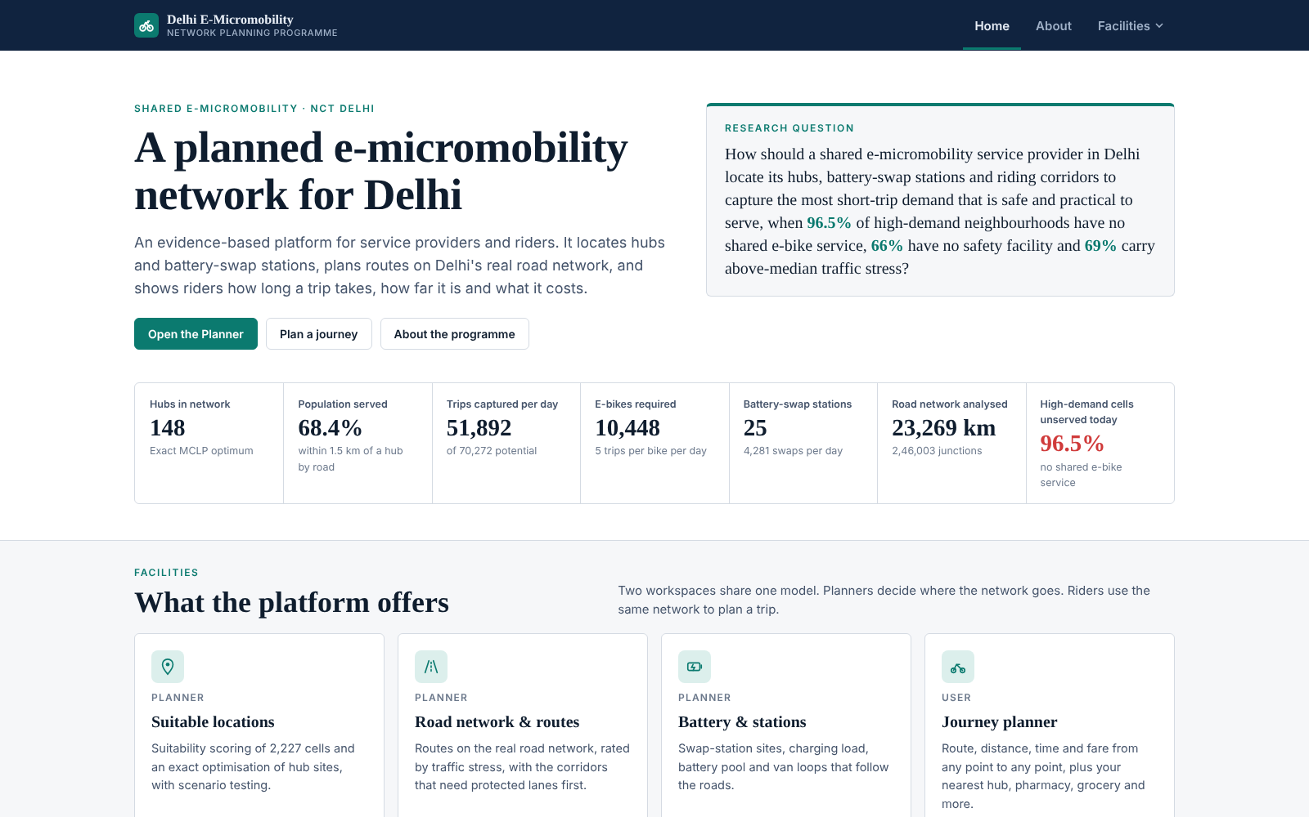
Site structure: Home, About and Facilities
Home
Research question, headline metrics, entry points
About
Challenge, data, methodology, limits
Facilities › Planner
Suitable locations · Road network & routes · Battery & stations · Roll-out & KPIs
Facilities › User
One page is shown at a time. The top bar switches pages; the Planner has its own sub-tabs. Maps load only when their page is opened.
Journey planner · Nearest facilities
Notes:
Navigation mirrors the two audiences: planners (service providers, city agencies) and users (riders).

Slide 22

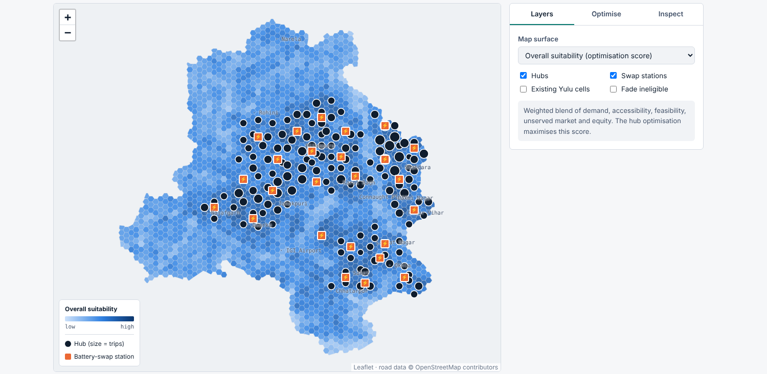

Planner: suitable locations workspace
Layers
13 map surfaces: suitability, each sub-index, trip potential, robustness, service zones
Optimise
Change weights, hub count and adoption, then re-run hub placement in about 50 ms
Inspect
Click a cell, hub or station for scores, raw indicators and its serving hub
Notes:
The other Planner tabs follow the same pattern: map on the left, console on the right, tables below.

Slide 23
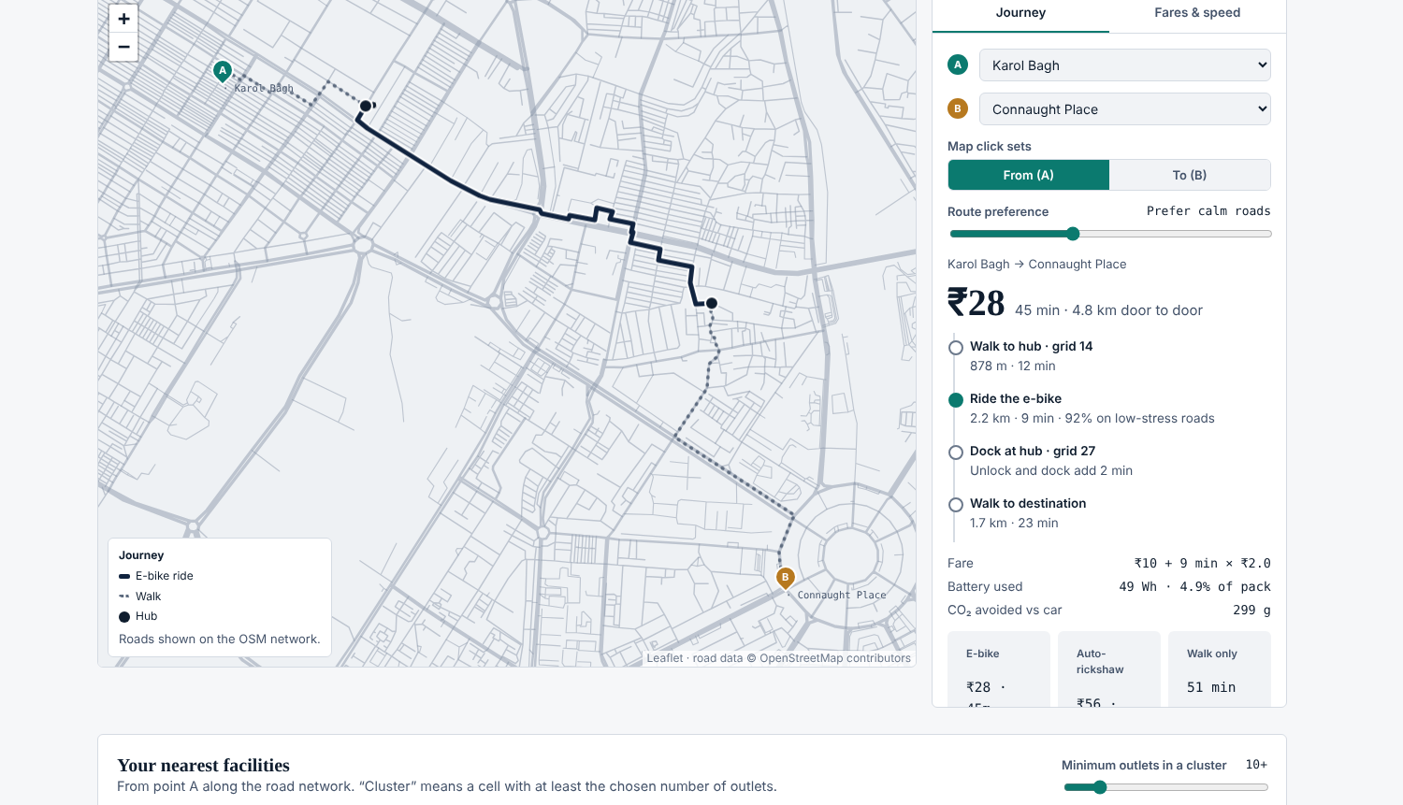
User: journey planner method
1
Snap
Start and destination snapped to the nearest road junction
2
Find hubs
Dijkstra on walking distance until the nearest hub is reached, at each end
3
Ride
A* on the e-bike cost between the two hubs (calm-route slider)
4
Compare
Walk-only route and auto-rickshaw fare on the shortest road distance
5
Price
Fare = unlock + ₹/min × ride time; time = walks + 2 min + ride
Example: Karol Bagh → Connaught Place, ₹28, 45 min door to door, 2.2 km ride on 92 % low-stress roads.
Notes:
Speeds: walking 4.5 km/h, e-bike 15 km/h by default. Tariffs are illustrative and editable in the Fares & speed tab.

Slide 24
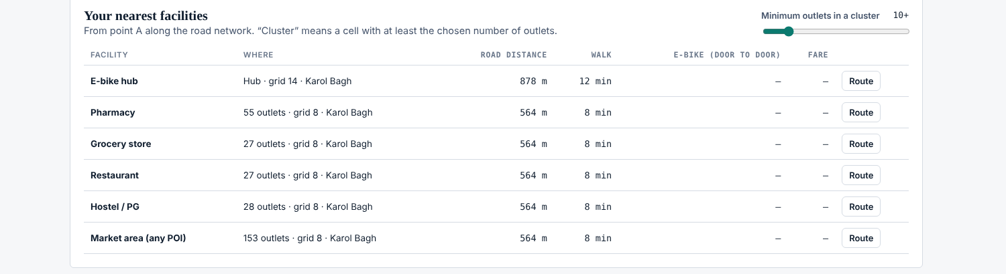
User: nearest facilities by road distance
One walking Dijkstra from point A, out to 7 km
Targets: hubs and cells holding a cluster of pharmacies, grocery stores, restaurants, hostels/PGs or any POIs
Cluster size is a slider (minimum outlets in a cell)
For each nearest facility: road distance, walk time, and e-bike time and fare when riding beats walking
Route button draws the full journey on the map
POIs are counted per cell, so a route ends at the road point nearest the cell centre
Notes:
In dense areas most facilities are within walking distance; the e-bike column fills in for larger clusters further away.

Slide 25
Assumptions and limitations
Demand is estimated
Roads are two-way
Trip potential comes from population, trip rates and an adoption share. Replace it with operator trip logs when available.
The road file has no one-way or turn restrictions, so routes may use roads against their legal direction.
POIs by cell
Fares are illustrative
Facilities are cell counts, not points; routes end at the road point nearest the cell centre.
E-bike and auto-rickshaw tariffs are editable planning values, not published prices.
Weights are judgement
124 cells off-network
Index weights are set by judgement; the scenario test shows which hubs do not depend on them.
Cells more than 500 m from a road cannot be served by any hub.
Notes:
None of these change the structure of the method; each can be improved by swapping in better data.

Slide 26
Next steps
Calibrate demand with real trips, add one-way rules and point POIs, then pilot the robust hubs
Calibrate
Refine the network
Pilot
Replace estimated trips with operator logs and re-run the optimiser
Add one-way and turn rules from OSM; point-level POIs
Open the 142 robust hubs in phases with their swap stations
Notes:
Close on the actions: calibration, network refinement and a phased pilot.

