Slide 1

Delhi E-Micromobility Planner
NETWORK PLANNING PROGRAMME · NCT DELHI
Methodology, data and contribution
Research question: How should a shared e-micromobility provider in Delhi locate hubs, battery-swap stations and riding corridors to capture the most safe, practical short-trip demand, when 96.5% of high-demand neighbourhoods have no shared e-bike service, 66% have no safety facility and 69% carry above-median traffic stress?
Notes:
The whole method answers one optimisation question. The three percentages come from the grid data and define the adoption gap.

Slide 2
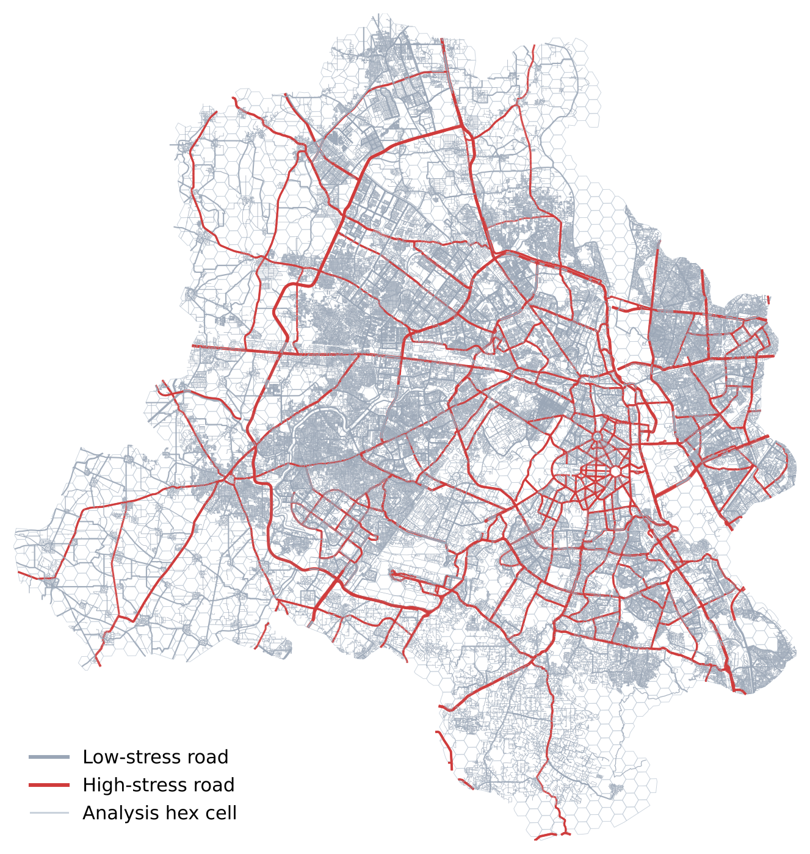


Data: an analysis grid and the road network
Analysis grid
Road network
grid CSV (corrected UMVI) + sri.gpkg
sup.gpkg · OpenStreetMap
2,227 hexagons, 0.66 km² each
About 120 indicators per cell
Demand, access, safety, comfort, land use, OMAS, Yulu, socio-economic
149,135 ways, 8 road classes
23,269 km, 9.0% rated high-stress
Every distance and route uses it
PREPARATION
Join grid to geometry · percentile-rank inputs to 0–1 · split ways at shared OSM vertices · keep the largest connected network (99.6 %) · merge and simplify to 246,003 junctions and 345,601 segments · snap each cell centre to the road (median 61 m)
2,227
19.8 M
23,269 km
246,003
grid cells
residents
of road
junctions
Notes:
Both datasets are in UTM 43N. 124 cells lie more than 500 m from any road and cannot be served.

Slide 3
Methodology: nine steps in four stages
Diagnose
Score & screen
Optimise
Operate
1
Frame the problem
3
Sub-indices
5
Site hubs
8
Fleet & battery
Demand quintiles vs supply, safety, stress
D, A, F, stress, G, E, battery B
MCLP, 1.5 km road coverage, HiGHS
Trips → bikes, swaps, kWh, van loops
2
Prepare data
4
Screen sites
6
Swap stations
9
Stress-test
Join, derive, rank, build road graph
Built-up, roads, water, slope → 1,563 eligible
Capacitated p-median, ≤4 km, ≤400/day
4 weightings → robust hubs
7
Corridors
Calm least-cost paths between hubs
Suitability S = 0.35D + 0.25A + 0.25F + 0.10G + 0.05E E-bike route cost length × (1 + 1.5·high-stress) × class factor
Notes:
D demand, A accessibility, F feasibility and safety, G unserved market, E equity. Class factors: trunk 1.8, primary 1.4, secondary 1.15, tertiary 1.05, service 1.1, others 1.0.

Slide 4
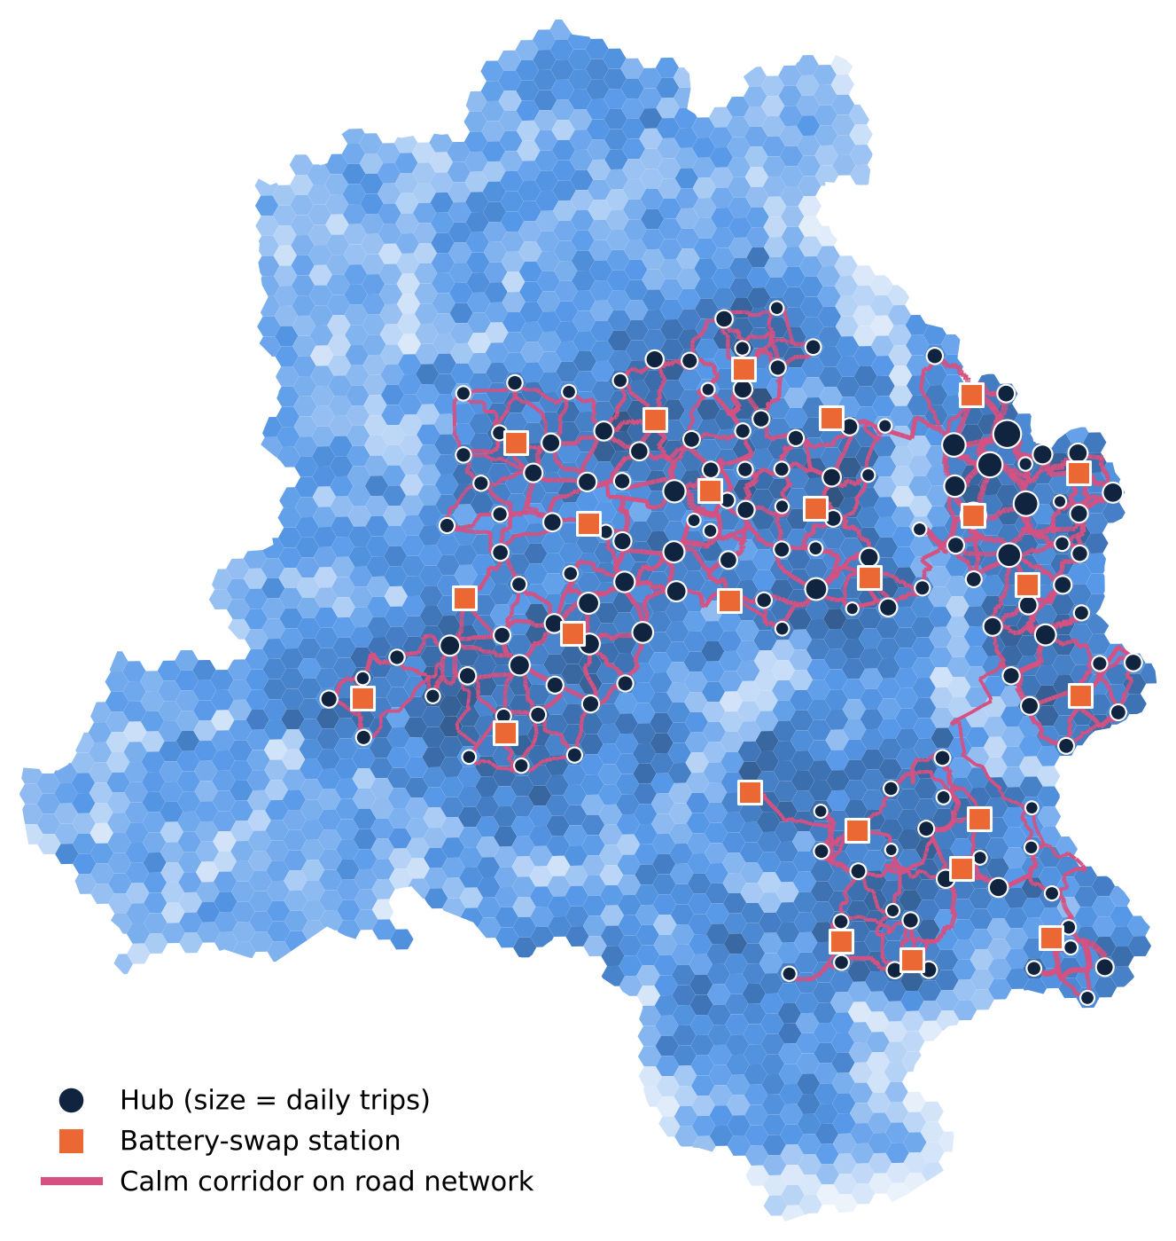
Optimisation models and results
Hub siting (MCLP)
max Σ wᵢyᵢ s.t. yᵢ ≤ Σⱼ∈Nᵢ xⱼ, Σxⱼ = p
Nᵢ = cells within 1.5 km by road. p = 148 at the knee of the coverage curve; exact 77.5% vs greedy 75.6%
Swap stations (p-median)
min Σ swapsₕ × road distanceₕₛ
One station per hub, ≤ 4 km, ≤ 400 swaps/day → 25 stations, mean 2.52 km
Corridors & van loops
Dijkstra on calm cost; NN + 2-opt tours
762 km of corridor, 5.9% high-stress; 430 van-km/day
148
68.4%
51,893
4,281
142/148
hubs
residents served
trips/day
swaps/day
robust hubs
Notes:
Trip potential is a planning estimate: population × 1.3 trips × 45 % short trips × 0.5 % adoption, scaled by demand. Robust hubs keep a hub within 1.5 km by road under all four weightings.

Slide 5
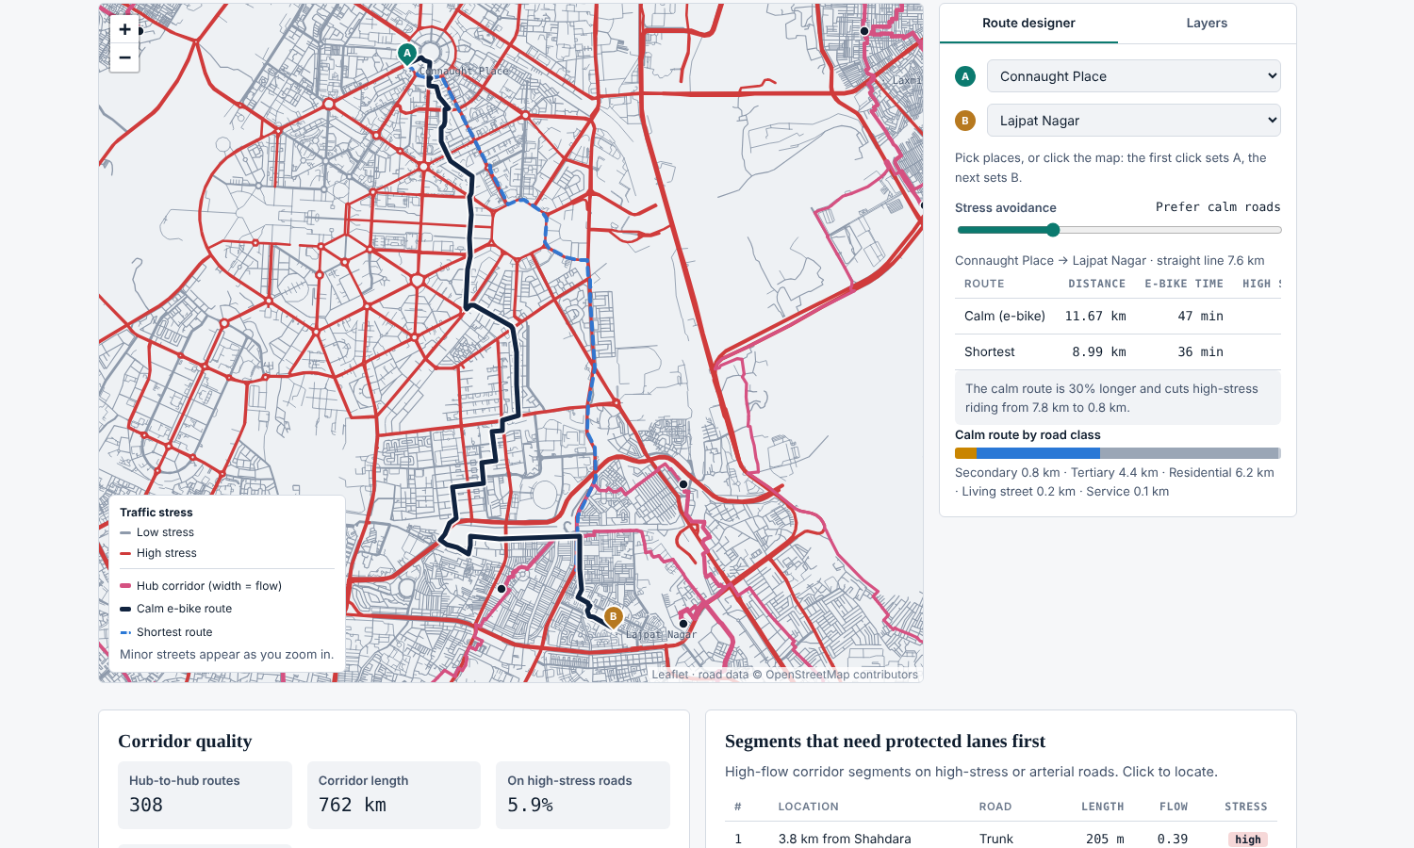



Platform: planner and user tools on one model
Planner
Suitable locations · road network & routes · battery & stations · roll-out & KPIs; live re-optimisation
User
Journey planner (walk–ride–walk, time, distance, fare) and nearest facilities by road
Build
Python (GeoPandas, SciPy, PuLP + HiGHS) offline; browser runs Dijkstra/A* on a 3.3 MB compressed road graph
Route designer: calm route vs shortest route on the OSM network
Notes:
Pages: Home, About, Facilities (Planner with four sub-pages, User). One self-contained page; no server needed.

Slide 6





Contribution
Quantified adoption gap
Road-network coverage
Battery logistics in the siting
Turns the grid into one evidence-backed research question: supply, safety and stress mismatched with demand
Hub service zones, station distances and van loops measured on 23,269 km of real roads, not straight lines
Swap stations, charging load and battery pool planned together with the hubs
Stress-aware routing
Robust, transparent plan
One tool, two audiences
Calm corridors keep 94% of riding on low-stress roads for +6% distance, and rank protected-lane priorities
Exact optimisation plus scenario testing: 142 of 148 hubs hold under every weighting
Planners site and size the network; riders get route, time, fare and nearest facilities from the same model
Limits: trip potential is estimated, roads are routed both ways, POIs are per cell and fares are illustrative.
Notes:
Next steps: calibrate demand with operator trip logs, add one-way rules and point POIs, and pilot the robust hubs.

