Slide 1
Topic 9: Data Analytics Using Python
Pariss Youngblood
Course: [Course Name]
Instructor: [Instructor Name]

Slide 2
Installation & Verification
Installed with: pip install pandas matplotlib python-pptx
Python: 3.9.6
pandas: 2.3.3
Matplotlib: 3.9.4
Add a screenshot of these version numbers from your terminal.

Slide 3
Basic Analysis Output
Dataset: 9,994 rows x 21 columns
Total Sales: $2,297,200.86
Average Profit: $28.66
Missing values: 0
Add a screenshot of this analysis from your terminal.

Slide 4
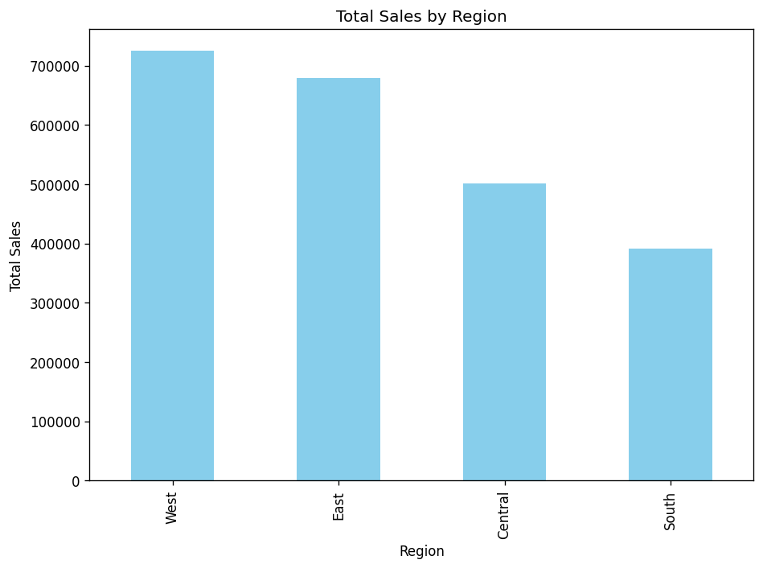
Total Sales by Region
West leads with $725,457.82 in sales.

Slide 5
Insights gained from analyzing the dataset
Sales concentrate by region: West is the top market at $725,457.82.
Across 9,994 orders, average Profit was only $28.66 per order.
High sales volume does not guarantee strong margins, hinting that discounting pressures profit.
The dataset is clean, so the metrics are reliable as-is.

Slide 6
How visualizations enhance data-driven decisions
Charts reveal patterns and outliers far faster than raw tables.
Ranking regions side by side shows where to focus spend.
Visuals communicate findings to non-technical stakeholders in seconds.
They expose trends that drive forecasting and resource allocation.

Slide 7
Additional analysis to explore further
Trend sales and profit over time to spot seasonality.
Break Profit down by Category and Sub-Category to find loss-making lines.
Correlate Discount with Profit to measure margin erosion.
Rank top customers and map sales by State for geographic insight.

