Slide 1

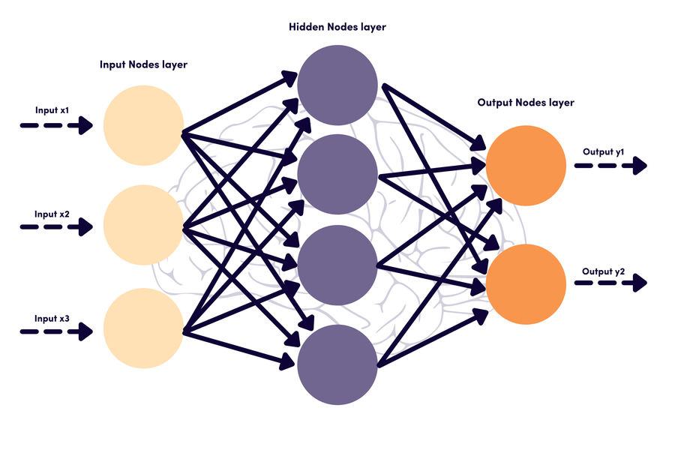
Innovation Lab
Deepfake Detection
Supreet Maurya
2201CS70
Under – Dr. Somnath Tripathy

Slide 2
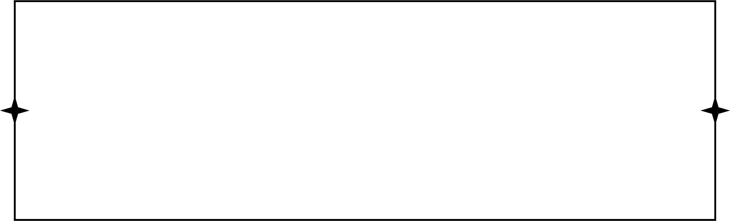



Objective
Given a input video we have to classify it as a REAL or FAKE
Solution
Two-stage analysis composed of a CNN to extract features at the frame level followed by a temporally-aware RNN network to capture temporal inconsistencies between frames introduced by the face-swapping process
Technologies Used

Slide 3
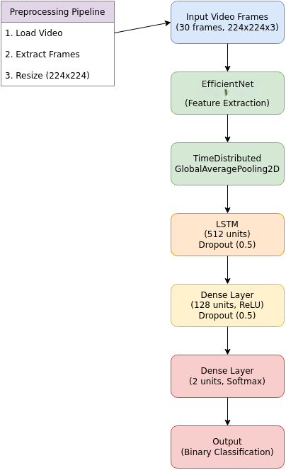
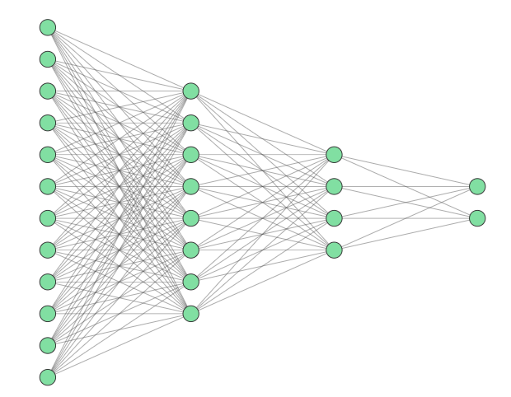
Architechture of model
Input Video
Frame Extraction
(OpenCV)
Efficient
Net
Pooling Layer
REAL
FAKE
Feature
Extraction
LSTM
512 nodes
(dropout=0.5)
Dense
128 nodes
(relu)
Dense
2 nodes
(softmax)
Dropout(0.5)

Slide 4
Pre-Processing
Assuming we have videos as inputs. First i extract the frames from the video using OpenCV.
From each video 30 frames are extracted and if video has less number of frames available then remaining frames are padded with blank frames
Resizing each frame to 224 * 224
Pass these frames to CNN
Convolutional LSTM
Given an image sequence, a convolutional LSTM is employed to produce a temporal sequence descriptor for image manipulation of the shot frame.
The network consists of two fully-connected layers and one dropout layer to minimize training over-fitting.
The convolutional LSTM can be divided into a CNN and a LSTM(Long Term Short Term Memory)

Slide 5
CNN for Feature Extraction
EfficientNetB7 is used for feature extraction.
The fully-connected layer at the top of the network removed to directly output a deep representation of each frame.
The 1280-dimensional feature vectors after the last pooling layers are then used as the sequential LSTM input.
LSTM for Sequence Processing
To recursively process a sequence in a meaningful manner 1280-wide LSTM unit with 0.5 chance of dropout is used
The LSTM is followed by a 512 fully-connected layer with 0.5 chance of dropout.
Finally, we use a softmax layer to compute the probabilities of the frame sequence being either pristine or deepfake.

Slide 6
Dataset Used
FaceForensic++ dataset is used to train and test the model.
This dataset has more than 1000 real and fake videos.
Parameter Settings
Each input set has exactly 50% videos of each class, which allows use to report our results in terms of accuracy .
Now there is no need to take into account biases due to the appearance frequency of each class or the need of using regularizing terms during the training phase
The optimizer is set to Adam for end-to-end training of the complete model.
By default the number of epoch is set to 100
Early Stopping is also used to avoid the over fitting.

Slide 7
Challenges and Solutions
The dataset was too huge because of videos, each video is atleast 5 to 10 Megabytes
To overcome this dataset was divided into subparts and then used for training
Lesser RAM availability on online platforms like Google Colab
Training was done in batches of videos
Batch size was set to 4.
Increasing the model accuracy.
Tried different number of frames and dropout values in different layers.
Adam Optimizer worked well.
Results
Accuracy of 86 percent is achieved

Slide 8
References
https://ieeexplore.ieee.org/document/8639163

