Slide 1

DEPARTMENT OF COMPUTER SCIENCE AND ENGINEERING
18CS84 : Internship / Professional Practice
“Artificial Intelligence and Machine Learning”
By Yohan V P: 2JH18cs098
Internal Guide Details
Name: Rajeshwari V Patil
Designation: Asst. Professor
Organisation: JCET, Hubballi
External Guide Details
Name: Aditya S K
Designation: Chief Tech. Officer (CTO)
Organisation: Tequed Labs

Slide 2
CONTENTS
Company Overview
Company products and services
Project description
Internship responsibilities
Training/Skills acquired
Challenges faced
Overall experience
Conclusions

Slide 3

COMPANY OVERVIEW
Tequed Labs Private Limited is an unlisted private company incorporated on 22 January, 2018. It is classified as a private limited company and is located in Bangalore, Karnataka
Tequed Labs is a research and development center and educational institute based in Bangalore started by
Mr. Aditya S K and Mr. Supreeth Y S.
focused on providing quality education on latest technologies and develop products which are of great need to the society.

Slide 4
COMPANY PRODUCTS AND SERVICES
SERVICES OFFERED
Android Development
Internet of things
Research and Development
Skill development
Machine Learning - Artificial Intelligence
Project Consultancy
Software Development
Hardware Design And Innovation

Slide 5
PROJECT DESCRIPTION
Title: MOVIE RECOMMENDATION SYSTEM
What is a recommendation system?
Simply put a Recommendation System is a filtration program whose prime goal is to predict the “rating” or “preference” of a user towards a domain-specific item or item.
the main focus of our recommendation system is to filter and predict only those movies which a user would prefer, given some data about the user him or her.

Slide 6
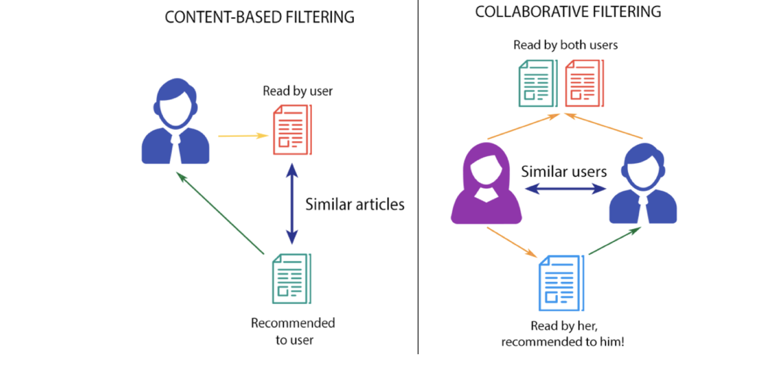
Content-based Filtering
This filtration strategy is based on the data provided about the items. The algorithm recommends products that are similar to the ones that a user has liked in the past.
Collaborative Filtering
This filtration strategy is based on the combination of the user’s behaviour and comparing and contrasting that with other users behaviour in the database.
The history of all users plays an important role in this algorithm.

Slide 7
INTERNSHIP RESPONSIBILITIES
Usage in different areas
Design Machine Learning systems
Implement appropriate machine learning algorithms for the job
Select appropriate datasets and machine learning tools
Plot graphs as and when required for analysis and results
Train and test models as and when required
Use appropriate machine learning libraries and frameworks

Slide 8
TRAINING/SKILLS ACQUIRED
Familiarity with ML Frameworks like Keras and libraries like OpenCV.
Hands on experience on ML tools like Jupyter Notebook, IDLE for python.
Learned to plot graphs for statistical analysis of data.
Learned Image processing using OpenCV, scikit-image.
Usage and processing, fetching of needed datasets from websites like Kaggle, MS datasets.
Learned to read and access files using pandas library to analyze data.

Slide 9
CHALLENGES FACED
Not enough training data:
for a child, to learn what an apple is, all it takes is to point to an apple and say apple repeatedly. Now the child recognizes all sorts of apples.
But it takes a lot of data for most of the algorithms to function properly. For a simple task, it needs thousands of examples to make something out of it, and for advanced tasks like image or speech recognition, may need more.
Poor Quality of data:
if training data has lots of errors, outliers, and noise, it will make it impossible for machine learning model to detect a proper underlying pattern. Hence, it will not perform well.
Irrelevant features:
Our training data must always contain more relevant and less to none irrelevant features.
The credit for a successful machine learning project goes to coming up with a good set of features on which it has been trained
Nonrepresentative training data:
To make sure that our model generalizes well, we have to make sure that our training data should be representative of the new cases that we want to generalize to.
If train our model by using a nonrepresentative training set, it won’t be accurate in predictions it will be biased against one class or a group.

Slide 10
OVERALL EXPERIENCE
Learning outcomes:
How to put my knowledge and skills into practice
my knowledge of artificial intelligence and machine learning helped me understand how various aspects of technology use them to their own advantage and how I could implement them on my own.
Enthusiasm is invaluable
As an intern, I discovered it’s essential to be enthusiastic and open to learning new skills, asking for more work and being curious to learn and ask questions.
This attitude will shows we enjoy being part of the team.
Having curiosity and enthusiasm also means that, as an intern, you get a lot out of what you’re doing, which opens lots of opportunities.

Slide 11
CONCLUSION
this internship has been an excellent and rewarding experience. I can conclude that there has been a lot I’ve learnt from my work with Tequed Labs.
However, the technical aspects of the work I have done are not up to the mark and could be improved provided enough time. As someone with no prior experience with Machine learning and artificial intelligence whatsoever I believe my time spent in research and discovering it was well worth it
I’ve learned the importance of are time-management skills and self-motivation

Slide 12
References
[1] https://www.python.org/downloads/
[2] https://cloud.google.com/dialogflow/docs
[3] https://jupyter.org/
[4] https://www.tableau.com/
[5] https://www.anaconda.com/products/distribution
[6] https://www.kaggle.com/datasets/vjchoudhary7/customer-segmentation-tutorial-in-python

Slide 13
THANK YOU

