Slide 1
GITHUB
PRESENTED TO: PRESENTED BY:
Shatrughan MODI Supreet kaur
(801731013)

Slide 2
What is GITHUB
A Web-based version control repository that offers all the features of the Git distributed version control system. GitHub provides Web browser and mobile interfaces to the repository and also includes bug tracking, feature requests and wikis for every project.

Slide 3
Topics Covered
Pull Requests
Merging
Wikis
Sharing Code Snippets, files etc.
Cloning
Forks

Slide 4
PULL Request
Open a Pull Request
Pull Requests are the heart of collaboration on GitHub. When you open a pull request, you’re proposing your changes and requesting that someone review and pull in your contribution and merge them into their branch. Pull requests show diffs, or differences, of the content from both branches. The changes, additions, and subtractions are shown in green and red.
As soon as you make a commit, you can open a pull request and start a discussion, even before the code is finished.
By using GitHub’s @mention system in your pull request message, you can ask for feedback from specific people or teams, whether they’re down the hall or 10 time zones away.
You can even open pull requests in your own repository and merge them yourself

Slide 5
MERGING
In this step, it’s time to bring your changes together merging your readme-edits branch into the master branch.
Click the green Merge pull request button to merge the changes into master.
Click Confirm merge.
Go ahead and delete the branch, since its changes have been incorporated, with the Delete branch button in the purple box.

Slide 6
WIKIS
GitHub Wikis are a place in your repository where you can share long-form content about your project, such as how to use it, how it's been designed, manifestos on its core principles, and so on.
Wikis are collaborative by design. By default, only collaborators on your repository can make changes to wikis, but you can configure this to be enabled for all users on public repositories.

Slide 7
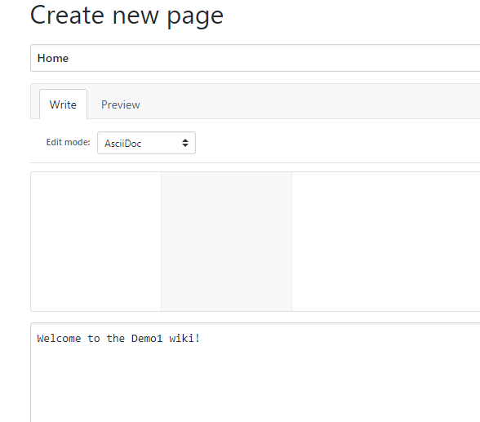

Slide 8
SHARING CODE SNIPPETS
For sharing code or other files without creating repositories, GitHub provides a feature called ‘Gists’.
Gist is very ease to use as there is no need to create and manage repositories for sharing code. Also, you can look for any code by searching in gist.

Slide 9
CREATING GIST
Sign in to GitHub.
Navigate to your gist home page.
Type an optional description and name for your gist.
Type the text of your gist into the gist text box.
Do one of the following:
To create a public gist, click Create public gist.
To create a secret gist, click Create secret Gist.

Slide 10
CLONING
When you create a repository on GitHub, it exists as a remote repository. You can clone your repository to create a local copy on your computer and sync between the two locations.

Slide 11
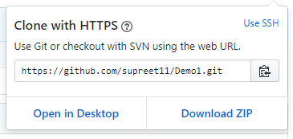
CLONING

Slide 12
FORKS
After using GitHub by yourself for a while, you may find yourself wanting to contribute to someone else’s project. Or maybe you’d like to use someone’s project as the starting point for your own. This process is known as forking.
Creating a “fork” is producing a personal copy of someone else’s project. Forks act as a sort of bridge between the original repository and your personal copy.

