Slide 1
Comparative Analysis of Supervised Learning on Recurrences of Breast Cancer
Group #: 8
Group Leader and ID: Supreeth Mohan (02036259)
Member Names and IDs:
VENKATA SAI SANDEEP KASIRAJU (02084046)
PAVAN KUMAR GUMMULURU (02121263)
DEEKSHA MALLAMPET (02120800)
ROSHNI PAL (02137180)

Slide 2

Why
Accuracy
Improve the accuracy of breast cancer recurrence predictions, which is vital for patient care and treatment planning.
Comparison: Supervised Learning Algorithms
Compare various supervised learning algorithms to identify the most effective approaches for this specific healthcare challenge.
Personalization
Contribute to personalized medicine by enabling the development of tailored treatment plans based on individual risk assessments.
What
Prediction
Utilize supervised learning techniques to analyze clinical data and predict the likelihood of breast cancer recurrence.
Comparison: Decision trees and XG Boost
Compare the performance of different supervised learning algorithms, including decision trees and XG Boost, to identify the most efficient model in terms of accuracy, sensitivity, and specificity.
Evaluation
Evaluate the models using real-world clinical data from patients who have undergone treatment for breast cancer, focusing on factors that contribute to recurrence, such as tumor characteristics, treatment types, and patient demographics.

Slide 3

HOW
Data Collection: Aggregate clinical records detailing patient demographics, tumor characteristics, treatment details, and outcomes.
Preprocessing: Process data to resolve missing values, normalize features, and encode categorical variables and mean of ranging value for features.
Feature Selection: Identify key features linked to breast cancer recurrence using statistical analysis and clinical insights.
Data Splitting: Partition the dataset into training and test sets with 50-50 and 80-20 splits to assess model performance.
Model Development: Train Classification Trees and XGBoost models on the processed data, fine-tuning parameters for optimal results.
Evaluation: Compute accuracy, sensitivity, specificity, PPV, and NPV from confusion matrices, and plot ROC curves with AUC metrics for each model across both data splits and datasets (training, test, and entire).
Comparison: Compare models based on performance metrics and ROC/AUC analysis to determine their efficacy in predicting breast cancer recurrence.
Interpretation: Discuss the implications of model findings, focusing on significant predictors and the impact of data splitting on model performance and reliability.

Slide 4
DATA SET DESCRIPTION
The dataset from the UCI Machine Learning Repository, titled "Breast Cancer Wisconsin (Diagnostic) Data Set," contains features computed from digitized images of fine needle aspirates (FNA) of breast masses. These features are used to classify the masses into two categories: malignant and benign. The dataset comprises a total of 569 instances, with 212 malignant and 357 benign cases.
https://archive.ics.uci.edu/dataset/14/breast+cancer
The variables in the dataset are as follows:
Class: no-recurrence-events and recurrence-events
Age: Age of the patient, categorized into different age groups.
Menopause: Indicates the menopausal status of the patient, with three categories.
Tumor Size: Size of the tumor, categorized into different ranges.
Inv-Nodes: Number of axillary lymph nodes involved, grouped into different ranges.
Node-Caps: Indicates whether the lymph nodes' capsules are present or not, with two categories: "yes" and "no."
Deg-Malignancy: Degree of malignancy of the tumor, with three levels: 1, 2, and 3.
Breast: Side of the breast affected by cancer, with two options: "left" and "right."
Breast-Quad: Quadrant of the breast where the tumor is located, with five categories: "left-up," "left-low," "right-up," "right-low," and "central."
Irradiate: Indicates whether the patient underwent radiation therapy, with two options: "yes" and "no."

Slide 5
PROPOSED DM TECHNIQUES:
1. Benchmark Model Development (Classification Trees)
Model Training: Train a Classification Tree model on a portion of the dataset. Use cross-validation to tune hyperparameters like tree depth and minimum samples per leaf to prevent overfitting.
Hyperparameter Tuning: Use grid search or random search combined with cross-validation to find the optimal set of parameters for the Regression model.
2. XGBoost Model Development
Model Training: Implement an XGBoost model, which is an ensemble method known for its performance and speed. XGBoost works well with imbalanced datasets, which is common in medical data.
Hyperparameter Tuning: Use grid search or random search combined with cross-validation to find the optimal set of parameters for the XGBoost model, including learning rate, number of estimators, max depth, and subsample ratios.
EVALUATION METRICS:
Dataset split (50-50 and 80-20)
Calculate performance metrics such as accuracy, sensitivity, specificity, positive predictive value (PPV), and negative predictive value (NPV) using confusion matrices.
Additionally, plot Receiver Operating Characteristic (ROC) curves and calculate the Area Under the Curve (AUC) metrics to assess the models' abilities to distinguish between patients with and without cancer recurrence.

Slide 6
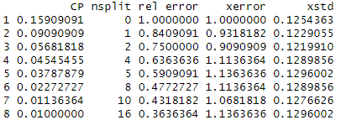
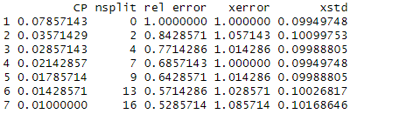
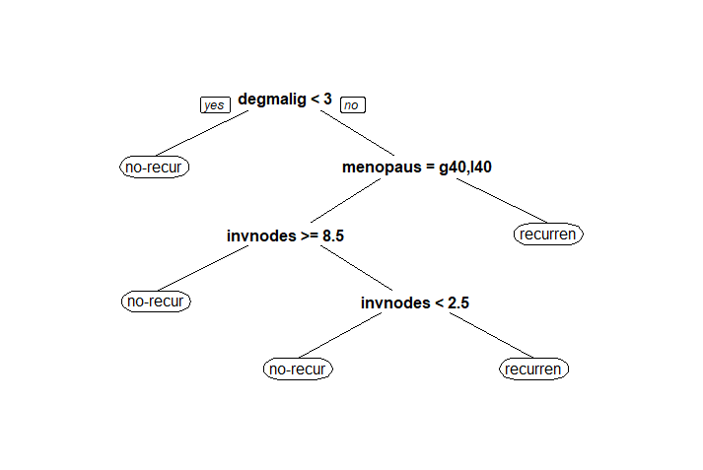
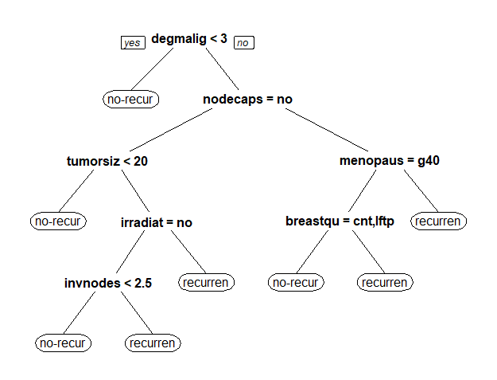
RESULTS:
Supervised Method - Classification Trees (50-50 and 80-20 Split)
CP TABLE:
CLASSIFICATION TREE:
From the classification tree we can tell that if the degree of malignancy is < 3, then we can confirm that there is no chance of cancer occurring again. If it is no, we can see that, it is using menopause as the feature variable, where , if age is not greater or less than 40 then it will reoccur. Else, if the age is greater that 40 and less than 40 it will take inv.node, the cell size, which further divides into size of node, if it is >8.5, then it will not occur else it will occur.
From the above CP table, we can tell that the alpha parameter chosen is 1.1136364 at np_split =4 and has value of 0.4545455

Slide 7
CONFUSION MATRIX: (50-50 and 80-20 Split)
Pruned Tree
Unpruned Tree
Effect of Pruning on Model Performance: Pruning the decision tree improves the model's ability to generalize by reducing overfitting.
Impact of Dataset Split on Prediction Accuracy: In the 50-50 split, where classes are balanced, the pruned tree achieves higher accuracy in predicting both "no-recurrence-events" and "recurrence-events" compared to the 80-20 split, indicating the influence of class distribution on model performance.
Balance Between Complexity and Performance: Pruning strikes a balance between reducing model complexity and maintaining predictive performance, resulting in a smaller, more interpretable tree that generalizes well to unseen data.
50-50 Split | 80-20 Split | No-Recurrence-events |  | Recurrence
No-Recurrence-events |  | 91 | 39 | 11 | 4
Recurrence |  | 27 | 9 | 14 | 6
50-50 Split | 80-20 Split | No-Recurrence-events |  | Recurrence
No-Recurrence-events |  | 83 | 38 | 19 | 5
Recurrence |  | 24 | 8 | 17 | 7

Slide 8
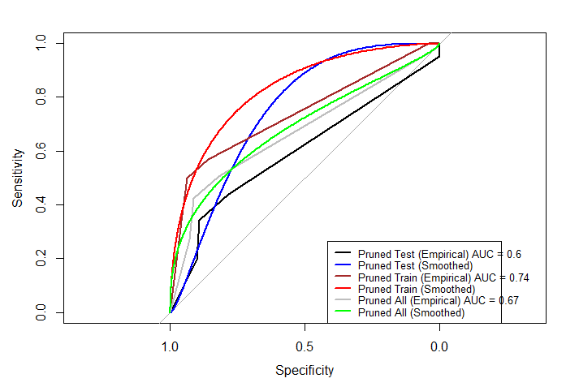
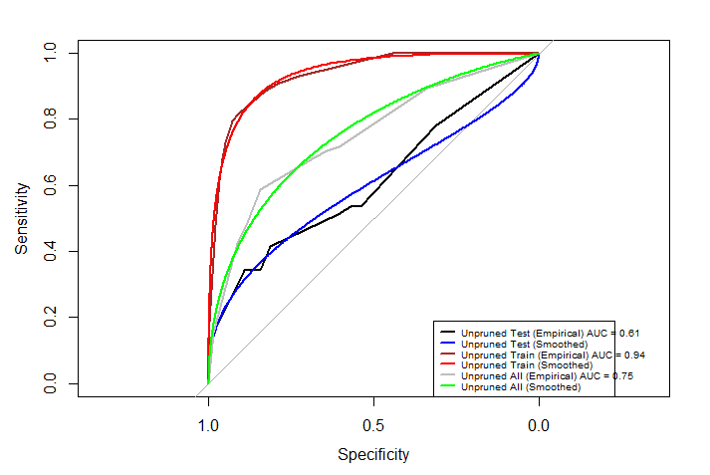
ROC CURVE FOR UNPRUNED AND PRUNED TREES 50-50 Split
Observation from graph:
Unpruned test AUC of 0.61 suggests modest discriminative ability, indicating potential need for model refinement or feature selection.
High unpruned train AUC of 0.94 indicates strong predictive performance on training data but raises concerns of overfitting.
Pruned test AUC of 0.60 indicates model performance like random chance, highlighting potential limitations of pruning process.
Pruned train AUC of 0.74 suggests improved generalization compared to unpruned model, albeit with reduced performance on training data.

Slide 9
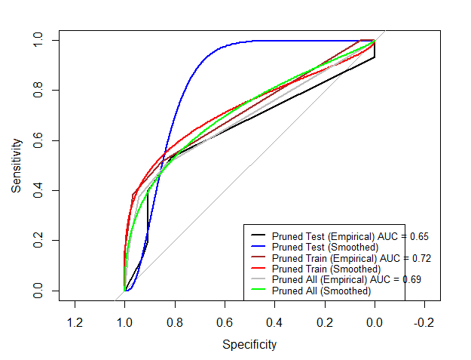
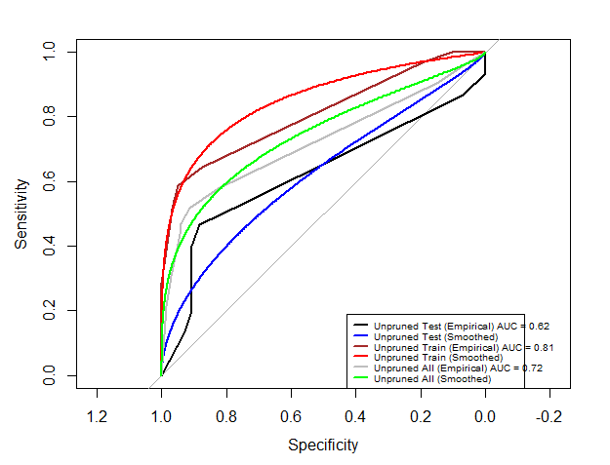
ROC CURVE FOR UNPRUNED AND PRUNED TREES 80-20 Split
Observation from graph:
Unpruned test AUC of 0.62 suggests models' discriminative ability, indicating potential need for model refinement or feature selection.
High unpruned train AUC of 0.81 indicates strong predictive performance on training data but raises concerns of overfitting.
Pruned test AUC of 0.65 indicates model performance like random chance, highlighting potential limitations of pruning process.
Pruned train AUC of 0.72 suggests improved generalization compared to unpruned model, albeit with reduced performance on training data.

Slide 10
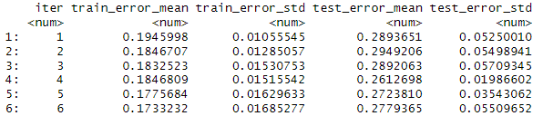
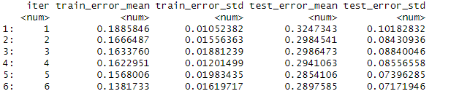
RESULTS:
Supervised Method – XG Boost(50-50 and 80-20 Split)
CP TABLE:(50-50 Split) (80-20 Split)
Confusion Matrix: XG Boost(50-50) (80-20 Split)
Class Imbalance Effect: In the 50-50 split dataset, class imbalance is more, compared to 80-20 split.
Challenges with Minority Class: In both splits, the model struggles to accurately predict recurrence events for the minority class.
Trade-off between Balanced and Imbalanced Data: While the 50-50 split achieves higher accuracy for the minority class, it sacrifices overall predictive performance compared to the 80-20 split.
From the table and finding best_rounds, we can tell that the alpha parameter chosen is 1.1775684 at np_split =5
and 0.16222951 at np_split=4
 | Predictions Train |  | Predictions Test |  | Predictions All
 | 0 | 1 | 0 | 1 | 0 | 1
0 | 80 | 2 | 75 | 2 | 155 | 4
1 | 20 | 8 | 26 | 8 | 46 | 16
 | Predictions Train |  | Predictions Test |  | Predictions All
 | 0 | 1 | 0 | 1 | 0 | 1
0 | 116 | 10 | 29 | 4 | 145 | 14
1 | 22 | 28 | 6 | 6 | 28 | 34

Slide 11
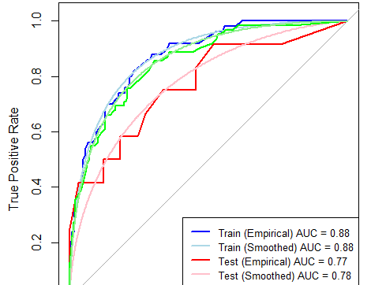
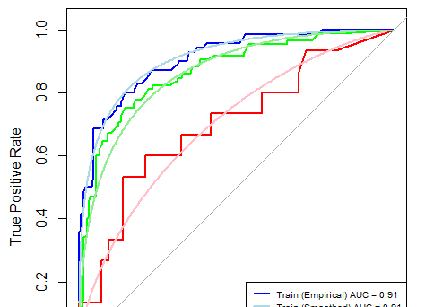
ROC Curves for XG Boost: (50-50 and 80-20 Split)
Observation from graph:
XG Boost on 80-20 split excels in discriminative ability (test AUC: 0.77) compared to 50-50 split (test AUC: 0.70), showing better class separation.
50-50 split model with higher training AUC (0.91) exhibits significant train-test gap, hinting at overfitting, while 80-20 split model demonstrates better generalization with a smaller gap.
Overall, while the 50-50 split model achieves better discriminative ability, it may suffer from overfitting, whereas the 80-20 split model demonstrates better generalization, especially after regularization.

Slide 12
Summary Table: (50-50 Split)
Unpruned Tree | Pruned Tree | XG Boost
Metric | Training | Testing | Full Dataset | Training | Testing | Full Dataset | Training | Testing | Full Dataset
Accuracy | 0.81 | 0.69 | 0.82 | 0.80 | 0.73 | 0.76 | 0.81 | 0.77 | 0.84
Sensitivity | 0.92 | 0.81 | 0.93 | 0.93 | 0.89 | 0.91 | 0.92 | 0.87 | 0.97
Specificity | 0.79 | 0.41 | 0.49 | 0.50 | 0.34 | 0.42 | 0.56 | 0.50 | 0.54
PPV | 0.91 | 0.77 | 0.81 | 0.80 | 0.77 | 0.78 | 0.94 | 0.82 | 0.83
NPV | 0.83 | 0.47 | 0.85 | 0.78 | 0.56 | 0.67 | 0.83 | 0.60 | 0.70
AUC | 0.61 | 0.94 | 0.75 | 0.60 | 0.74 | 0.67 | 0.91 | 0.70 | 0.87
Here's a summary of the comparison:
Accuracy: XG Boost achieves higher accuracy on both the testing set (0.77) and the full dataset (0.84) compared to unpruned trees (0.69 on testing and 0.82 on the full dataset).
Sensitivity: XG Boost demonstrates higher sensitivity across all datasets compared to unpruned trees.
Specificity: XG Boost also outperforms unpruned trees in specificity, achieving higher values across all datasets.
PPV and NPV: XG Boost shows comparable or higher Positive Predictive Value (PPV) and Negative Predictive Value (NPV) compared to unpruned trees.
AUC: XG Boost consistently achieves higher Area Under the Curve (AUC) values across all datasets compared to classification trees.
Overall, XG Boost demonstrates superior performance in terms of all metrics compared to unpruned trees. Therefore, based on the provided evaluation metrics, XG Boost appears to be the best method for breast cancer classification on this dataset.

Slide 13
Summary Table: (80-20 Split)
Unpruned Tree | Pruned Tree | XG Boost
Metric | Training | Testing | Full Dataset | Training | Testing | Full Dataset | Training | Testing | Full Dataset
Accuracy | 0.83 | 0.75 | 0.82 | 0.78 | 0.77 | 0.77 | 0.86 | 0.77 | 0.84
Sensitivity | 0.94 | 0.88 | 0.95 | 0.96 | 0.90 | 0.94 | 0.94 | 0.90 | 0.97
Specificity | 0.58 | 0.46 | 0.49 | 0.38 | 0.40 | 0.37 | 0.68 | 0.46 | 0.64
PPV | 0.83 | 0.82 | 0.82 | 0.78 | 0.81 | 0.78 | 0.87 | 0.82 | 0.86
NPV | 0.83 | 0.57 | 0.85 | 0.84 | 0.60 | 0.74 | 0.84 | 0.59 | 0.89
AUC | 0.62 | 0.81 | 0.72 | 0.65 | 0.72 | 0.69 | 0.88 | 0.85 | 0.85
Here's a summary of the comparison:
Accuracy: XG Boost achieves higher accuracy on both the testing set (0.77) and the full dataset (0.84) compared to unpruned trees (0.75 on testing and 0.82 on the full dataset).
Sensitivity: XG Boost demonstrates higher sensitivity across all datasets compared to unpruned trees.
Specificity: XG Boost also outperforms unpruned trees in specificity, achieving higher values across all datasets.
PPV and NPV: XG Boost shows comparable or higher Positive Predictive Value (PPV) and Negative Predictive Value (NPV) compared to unpruned trees.
AUC: XG Boost consistently achieves higher Area Under the Curve (AUC) values across all datasets compared to classification trees.
Overall, XG Boost demonstrates superior performance in all metrics compared to unpruned trees. Therefore, based on the provided evaluation metrics, XG Boost appears to be the best method for breast cancer classification on this dataset.

Slide 14
Conclusion:
XG Boost consistently outperforms unpruned and pruned decision trees in accuracy, sensitivity, specificity, PPV, NPV, and AUC values across all datasets.
Its superior predictive ability is crucial for personalized medicine and treatment planning, enabling clinicians to make informed decisions tailored to individual patient risks.
With higher accuracy and discriminative power, XG Boost emerges as the optimal method for predicting breast cancer recurrence on this dataset.

Slide 15

Summary of your group meet time and duration: Meeting format: In person Group meet time and duration: In-person, April 10th, 12:00 PM - 4:00 PM April 11, 1:00 PM – 9:00 PM April 13, 11:00 AM – 4:00 PM April 15, 10:00 AM – 6:00 PM Zoom, April 5th, 11:00 PM – 1:00 PM Average time in communication and discussion regarding assigned group work: ~2 Hours (via WhatsApp)

Slide 16
References:
References: quote the citations we used for your project.
RCART 24(S) for Classification Tree
https://www.geeksforgeeks.org/xgboost/
https://xgboost.readthedocs.io/
Lecture Slides 9 and 10.

Slide 17
THANK YOU

