Slide 1
CIS 602-7103
Big Data Project
Advanced Predictive Analytics in Healthcare Using Big Data
Subtitle: Predicting Healthcare Billing Amounts
Presented by
Group 2
Supreeth Mohan (36)
Kruthika Reddy Murthy (37),
Trina Xavier (66)

Slide 2
Project Overview
The objective of this project was to predict healthcare billing amounts using advanced analytics on a large dataset.
We used a cleaned dataset, which was exported from Amazon Redshift after data processing and feature engineering for further analysis and model development in jupyter lab.
Key features included in the analysis were age, length of stay, and medical condition, among others.

Slide 3
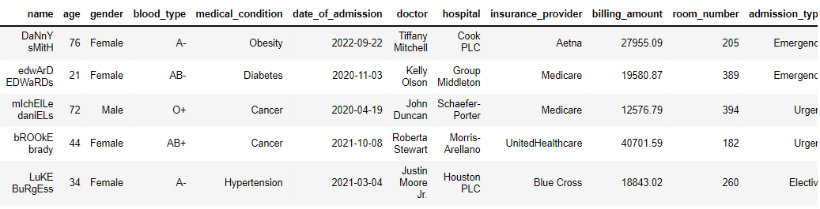
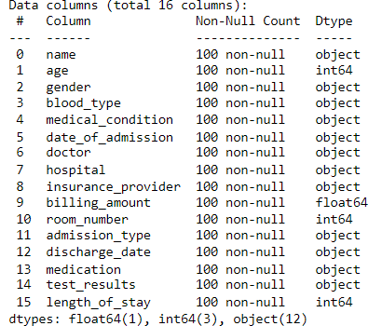
Dataset overview
Dataset taken from Kaggle
55,000 entries with 16 columns
Key features: age, length of stay, medical condition, admission type, etc.
Target variable: billing_amount.

Slide 4
Data Preparation and Preprocessing
The dataset was initially stored in Amazon S3.
For data cleaning and preprocessing, we utilized Amazon Redshift.
This process involved removing null values and irrelevant or erroneous entries.
We also performed feature engineering to create a new feature, 'Length of Stay.’
The cleaned and prepared data was then exported as a CSV file for model deployment.

Slide 5
Model Development and Evaluation
Linear Regression:
Served as the baseline model, evaluated with metrics such as Mean Squared Error (MSE) and R-squared.
Polynomial Regression:
Enhanced the model by including polynomial features to capture non-linear relationships.
Ridge Regression:
Applied regularization to improve the model’s performance.Key evaluation metrics include MSE, R-squared, Mean Absolute Percentage Error (MAPE), and prediction accuracy.

Slide 6
Results and Conclusion
The models demonstrated varying levels of effectiveness, with performance metrics showing how well each model predicted billing amounts.
Visualizations such as pair plots and correlation heatmaps helped in understanding feature relationships and model performance.
In conclusion, the models successfully predicted billing amounts with reasonable accuracy
Future work could involve refining models and exploring additional features for better predictions.

