Slide 1
Team 10
PhoniFide
Hands-free, voice-free learning
with eye movements
Supreme Constantine, Shradha Bhatia, Matthew Sanchez,
Sajan Patel, Miguel Gaido
Neurotech @ NC State BCI Hackathon · ANT Neuro track: Movement-Based Neurotech Applications
Notes:
Supreme

Slide 2
THE PROBLEM
Most learning tools assume you can read, type, tap, or speak.
Dyslexia
Kids learning phonics
Language learners
Speech differences
Paralysis / can't speak
sound–letter links are hard
can't read instructions yet
e.g. immigrants learning English
impediments, facial differences or injuries
e.g. ALS, Eyes-Open Coma
Those who need practice most get the fewest tools that work for them.
PHONIFIDE 02
Notes:
Supreme

Slide 3


THE MARKET
Millions of learners need alternative tools.
7.5M
Special Ed Students
15% of U.S. public school enrollment receiving IDEA services in 2022–2023.
7.0M
ADHD Diagnosis
11.7% of U.S. children ages 3–17 diagnosed as of 2024.
5.3M
English Learners
10.6% of U.S. public school students learning English in fall 2021.
32%
Learning Disabilities
Largest single category of IDEA service recipients in 2022–2023.
Traditional methods leave over 10 million students behind every day.
PHONIFIDE 02
Notes:
Supreme

Slide 4
THE SOLUTION
Learning controlled only by where you look.
MOVEMENT TRACK
No hands
No voice
No typing
Eye movement is the movement.
EEG headset picks up left/right eye movements (EOG): the strongest, most reliable signal it reads.
The one movement almost everyone keeps, even with ALS.
PHONIFIDE 03

Slide 5
HOW IT WORKS
Hear it. Look at it. Hold. Done.
1
2
3
4
5
6
7
Wear
Listen
Choices
Look + hold
Detect
Feedback
Adapt
EEG headset + headphones
“Which word starts with B?”
one far left, one far right
hold time adjustable, blinking is fine
electrodes near the eyes read direction
instant sound
missed words come back more often
Step 7 is the learning engine: practice adapts to each person.
PHONIFIDE 04

Slide 6
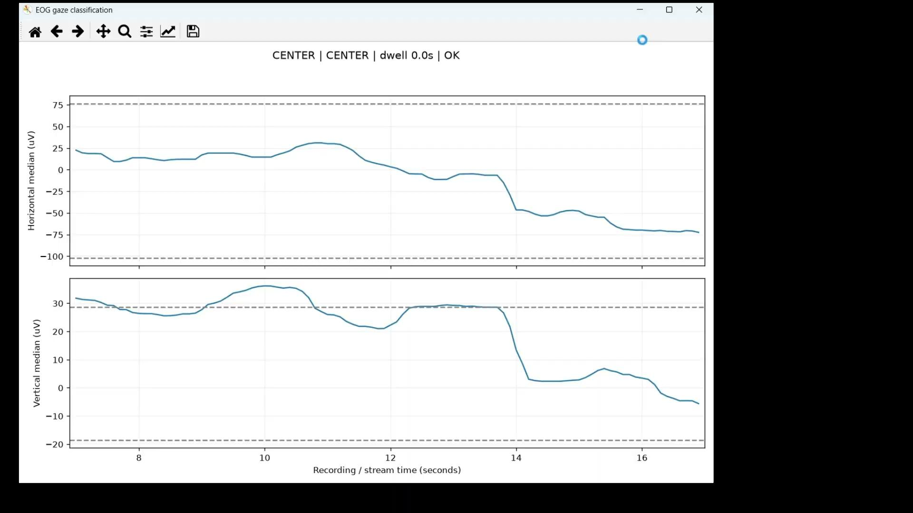
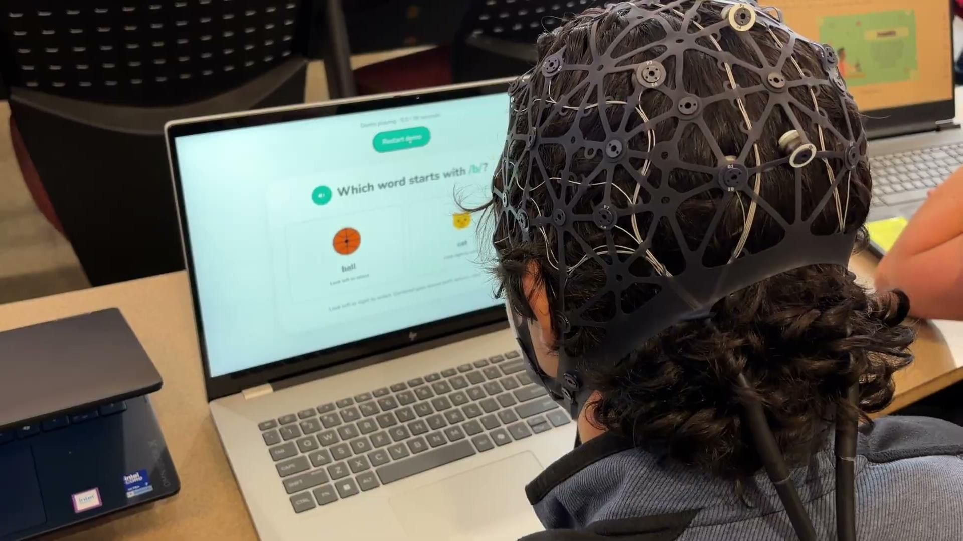
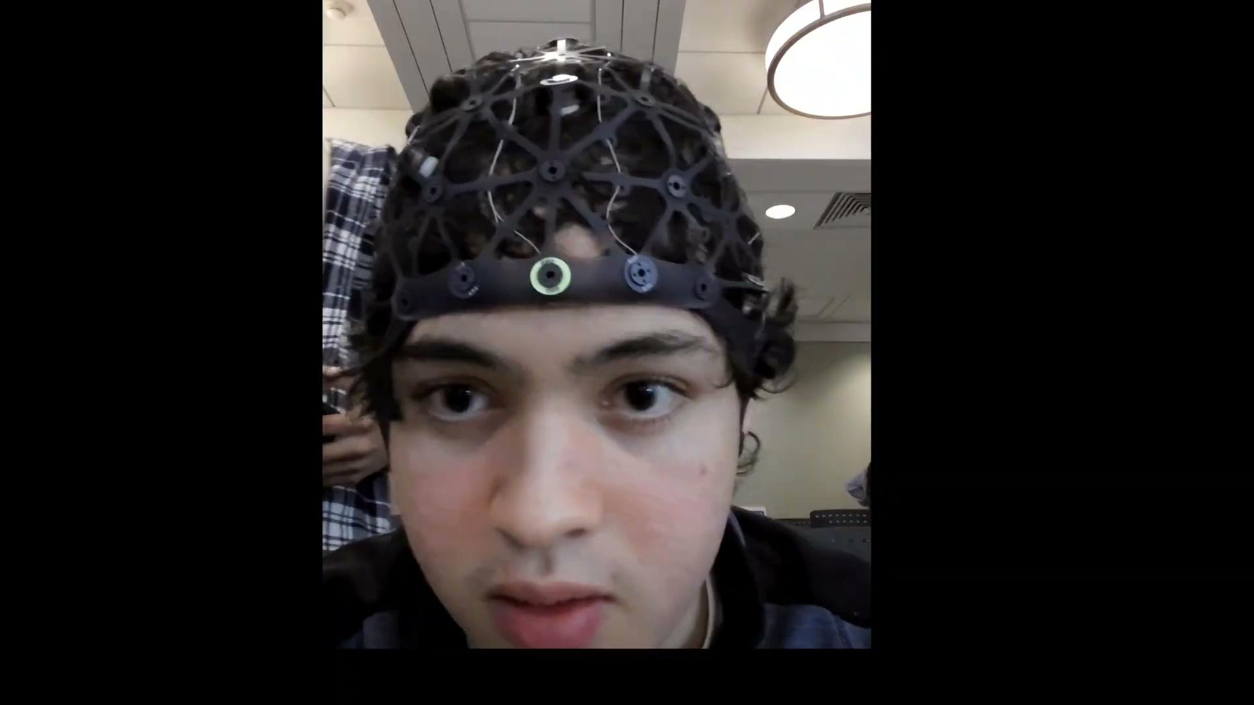
● LIVE DEMO

Slide 7
UNDER THE HOOD
From headset to answer, in real time.
eego
LSL
Python
Filter
Classify
Game UI
Report
24-ch EEG headset
live stream
pylsl
bandpass
horizontal EOG, left vs right
+ sound feedback
for the learner
per-user calibration baseline
RESULTS
from our data
Accuracy: 16 / 20 left-right trials

Slide 8
WHO IT HELPS
One game, five kinds of learners.
Dyslexia
Kids learning to read
Language learners
No speech, no hands
Teachers + parents
b / d
everything is spoken, no reading needed to play
hear a word, pick the spelling, sound, or meaning; instructions in their own language
left / right becomes yes / no and picking phrases: communication
a report of which words each learner struggles with
was / saw
pin / pen
PHONIFIDE 07

Slide 9
WHY EEG · WHY IT SCALES
Built for the real world, not just this room.
SCALES TO
WHY EEG, NOT A WEBCAM
Any LSL headset
Any language
Works in any lighting, any camera position
incl. cheaper headbands
spoken prompts
Reads the eyes’ electrical signal directly
4 choices
Quick calibration
add up / down
per user
Same headset can add focus + alertness signals a camera can’t see
Classrooms + clinics
Every learner
teacher dashboards
own missed-word list
PHONIFIDE 08

Slide 10
Learning that only needs
your eyes.
PhoniFide
Team 10 · Supreme Constantine, Matthew Sanchez, Sajan Patel, Shradha Bhatia, Miguel Gaido
Thank you · Questions?

