Slide 1
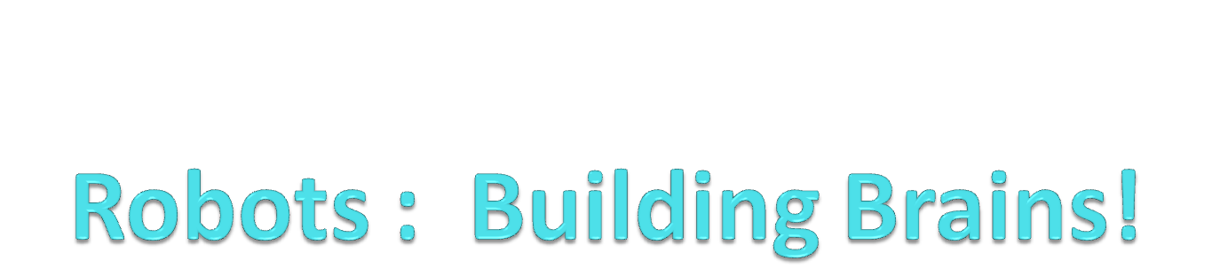

Slide 2
Programming the Robot
When we program our robots, we are becoming the brains of the machine – it can only do what we tell it to do.
Our robot, and computers in general, are powerful entities because they can be programmed to have different behaviors.
In order to make the robot do more interesting and powerful things, let’s learn more about the language it speaks – in our case, Python.

Slide 3
Basic Structure of the Robot Brain
The basic structure of the robot brain (aka Python program) is done by creating a new function – called “main”
def main():
<do something>
<do something>
...
Look familiar? – like any other function we’ve been working with?

Slide 4
Basic Structure of the Robot Brain
Typically, our robot programs will look something like this:
      from myro import *
      initialize(PORT #)
      <any other imports>
      <function definitions>
      def main():
      <do something>
      <do something>
      ...
      main()

Slide 5
Basic Structure of the Robot Brain
How about our dance?
      #file dance.py
      #Purpose: Simple dance routine
      #First import myro and connect to robot
      from myro import *
      initialize(PORT #)
      #Define the new functions ...
      def yoyo(speed, waitTime):
      forward(speed, waitTime)
      backward(speed, waitTime)
      stop()
      def wiggle(speed, waitTime):
      motors(-speed, waitTime)
      wait(waitTime)
      motors(speed, waitTime)
      wait(waitTime)
      stop()

Slide 6
Basic Structure of the Robot Brain
How about our dance? (continued)
      # The main dance program
      def main():
      print(“Running the dance program”)
      yoyo(0.5, 0.5)
      wiggle(0.5, 0.5)
      yoyo(1,1)
      wiggle(1,1)
      print(“...done”)
      main()

Slide 7
Print
The “print” command in Python will print the message to the screen.

Slide 8
Speaking “Pythonese”
We can control our robots with some elementary commands we’ve been talking about. But Python is a powerful programming language. Let’s learn more about what we can do with it!
myro is the library we are using to obtain the robot commands – there are many other useful libraries that come with Python. These libraries are made up primarily of functions (and some other stuff we’ll get to later)

Slide 9
Speaking “Pythonese”
You’ve written some functions (dance, jingle, shag, etc)
For each new function, you must give it a name with the def construct. Python has rules about these names.
  Names (aka Identifiers) must begin with a letter or the underscore(_) character and can be followed by any number of letters, digits, or underscores
  Names / Identifiers are case sensitive (myDog and Mydog are two DIFFERENT names)
  You can’t use words that have special meaning to Python as a name/identifier.

Slide 10
Speaking “Pythonese”
Some of the functions that you’ve written accept additional information (called parameters)
Parameters are used to customize the function – it will work in a similar way each time, but vary slightly based on the information sent into the function.
Your parameters also have names – it is usually nice if the names are meaningful, but they can be anything.
  The “speed” parameter in the yoyo function could just as easily be called “fred”, but then users wonder – “What’s a fred?”

Slide 11
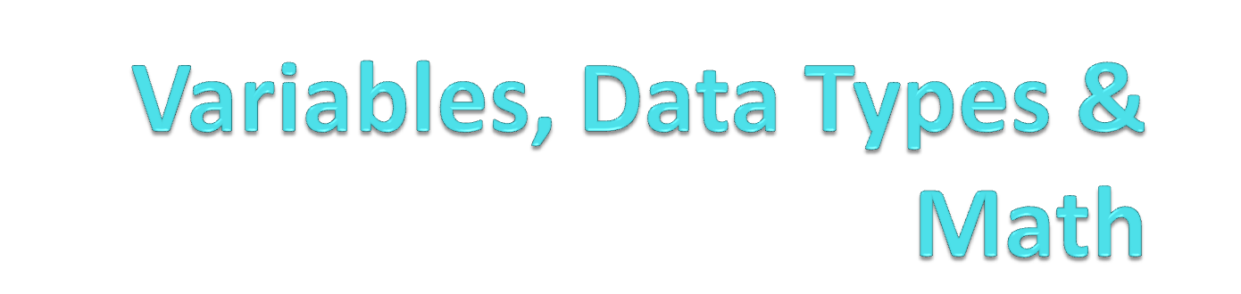

Slide 12
Variables
A variable is a name (identifier) that points to a value.
They are useful to store values, and to refer to changing values by the same name.
To create a variable, simply name it and assign it a value to point to with the assignment operator (single equal sign)‏
>>> myName = “Paige”
myName
“Paige”
Aug 29 2007

Slide 13
Variables
A variable name can be made up of letters, numbers, and the underscore ( _ ) character.
The first character must be a letter.
Variable names are case sensitive (myName and myname are different).
>>> myname = “Scribbler”
myname
“Scribbler”
myName
“Paige”
Aug 29 2007

Slide 14
Variables
>>> number1 = 3
>>> number2 = 2
>>> 3rdnumber = 5
Syntax Error: invalid syntax
>>> import = 7
Syntax Error: invalid syntax
number1
3
number2
2
Aug 29 2007

Slide 15
Using Variables
When python sees a variable name, it evaluates the variable (sees what it points to) and uses the value that the variable points to instead of the variable name.
>>> myName
‘Paige'
>>> number1
3
myName
“Paige”
number1
3
Aug 29 2007

Slide 16
Using Variables
If the python interpreter finds an identifier or variable name that has not yet been defined, it will return an error.
>>> aRandomName
NameError: name 'aRandomName' is not defined
myName
“Paige”
number1
3
Aug 29 2007

Slide 17
Using Variables
You can do math with variables that point to numbers.
The python interpreter evaluates the variables by checking to see what number (value) they are pointing to, and then uses that value for the math.
>>> 3 + 2
5
>>> number1 + number 2
5
number2
2
number1
3
Aug 29 2007

Slide 18
Using Variables
You can even store the answer in a new variable.
>>> answer = number1 + number 2
answer
number2
5
2
number1
3
Aug 29 2007

Slide 19
Using Variables
Variables can be re-assigned:
>>> print myName
‘Paige'
>>>
myName
“Paige”
Aug 29 2007

Slide 20
Using Variables
Variables can be re-assigned:
>>> print myName
‘Paige'
>>> myName = “Robot”
>>> print myName
'Robot'
myName
“Paige”
“Robot”
Aug 29 2007

Slide 21
Using Variables
Variables can be passed to functions as arguments
>>> forward( 1, 0.5)‏
Is equivalent to:
>>> speed = 1
>>> time = 0.5
>>> forward( speed, time)‏
The python interpreter passes the two variables (speed and time) to the forward() function. When the forward() function uses these variables, they evaluate to 1 and 0.5
speed
1
time
0.5
Aug 29 2007

Slide 22
Data Types
When values are stored in a computer, they have different data types.
So far, we have seen two types of values, Strings and Integers.
  Strings are made up of one or more characters.
  We place them in quotes to indicate that they are a string.
  >>> “Paige”
Integers are numbers without fractional components, such as -2, or 7.
Aug 29 2007

Slide 23
Data Types
Python has a special function called type() that returns the type of any value.
Strings and Integers are abbreviated 'str' and 'int'
>>> type(7)‏
<type 'int'>
>>> type( “Hi”)‏
<type 'str'>
Aug 29 2007

Slide 24
Data Types
When you use type() on a variable, python evaluates the variable to see what value it points at, and then gives that value to the type() function.
The type() function returns the type of the value.
>>> answer = 5
>>> type(answer)‏
<type 'int'>
>>> answer = “Paige”
>>> type(answer)‏
<type 'str'>
Aug 29 2007

Slide 25
Math with Integers
Python includes standard mathematical operators (addition, subtraction, multiplication and division) represented with (+, -, *, / )‏
>>> 3-2
1
>>> 7 * 5
35
>>>100 / 5
20
>>> 10 / 3
3
Aug 29 2007

Slide 26
Integer Division vs Floating Point Division
Wait! 10 / 3 = 3???
In Python, when you divide two integers, the interpreter truncates the answer to remove the fractional component!
If you want the answer to include fractional components, you need to divide floating point numbers.
A floating point number (such as 3.3) contains a fractional component that is separated from the integer component by a decimal point.
You define a floating point number simply by including a decimal point.
>>> type(3)‏
<type 'int'>
>>> type( 3.0)‏
<type 'float'>
Aug 29 2007

Slide 27
Integer Division vs Floating Point Division
>>> 10.0 / 3.0
3.33333333335
Only one of the numbers needs to be a floating point number for python to produce a floating point result
>>> 10 / 3.0
3.33333333335
Take home point: Always declare your numbers with a decimal point if you want a floating point result!
Aug 29 2007

Slide 28
Order of Operations
What result is stored in answer?
>>> answer = 5 * 10 + 2
Aug 29 2007

Slide 29
Order of Operations
What result is stored in answer?
>>> answer = 5 * 10 + 2
>>> print answer
52
Python follows normal mathematical rules for order of operations.
Multiplication and Division happen before Addition and Subtraction.
You can use parenthesis () to make parts of an expression evaluate first
>>> answer = 5 * ( 10 + 2)‏
>>> print answer
60
Aug 29 2007

Slide 30
Order of Operations
Note that the assignment operator (single equal sign) happens AFTER all of the other math operators.
This only matters if a variable appears on both sides of the assignment operator.
>>> answer = 10
>>> answer = answer + 5
10
answer
Aug 29 2007

Slide 31
Order of Operations
Note that the assignment operator (single equal sign) happens AFTER all of the other math operators.
This only matters if a variable appears on both sides of the assignment operator.
>>> answer = 10
>>> answer = answer + 5
>>> print answer
15
The Python interpreter evaluates the answer variable (on the right side of the assignment operator) and finds the integer value 10. It then adds 10 to 5, producing 15. Only then does it assign the 15 to the answer variable (on the left side of the assignment operator).
answer
10
15
Aug 29 2007

Slide 32
Math with Strings!
In normal math you can't do math with strings.
In python, the addition and multiplication (+,*) operators have been overloaded to have meaning when used with strings.
Adding two strings results in their concatenation
>>> “Hello” + “There”
'HelloThere'
>>> “Hello” + “ “ + “There”
'Hello There”
Aug 29 2007

Slide 33
Math with Strings!
Multiplication can be represented as multiple addition:
7 * 3 = 7 + 7 + 7 = 21
So multiplication of a string by a number can be represented as multiple concatenation:
“Boo!” * 3 = “Boo!” + “Boo!” + “Boo!” = “Boo!Boo!Boo!”
>>> “Boo!” * 3
'Boo!Boo!Boo!'
Aug 29 2007

Slide 34
Data Types MATTER!
>>> 3 + 5
8
>>> “3” + “5”
'35'
Notice the difference between adding two numbers and adding two single character strings!
Because operators can have different behaviours depending upon the data type of their operands, it is important to understand what data type the value you are working with is!
Aug 29 2007

Slide 35
Math with Variables
Any place where you have a value, you can instead use a variable that points to that value.
area = 3.14159 * 10 * 10
is equivalent to:
>>>pi = 3.14159
>>>r = 10
>>>area = pi * r * r
Any time a function returns a value, you can assign it to a variable to store it, and then use that variable later.
>>> robotName = getName()‏
>>> statement = “My Robots Name is: “ + robotName
>>> print statement
'My Robots Name is: Scribby'
Aug 29 2007

Slide 36
Summary
When stored in a computer, all values have an associated Data Type.
Data types we have seen so far (others exist):
  int – Integers, numbers without fractional parts
  str – Strings, represented by placing characters in “quotes”
  float – Numbers with fractional parts
Variables are names (identifiers) that can point to values.
The assignment operator (=) is used to make a variable point to a value.
Math in python uses many standard operators that you are familiar with (+,-,*,/), but sometimes these operators act differently depending upon the data type of the values they are working on.
Aug 29 2007

Slide 37

Dr. Paige H. Meeker

Slide 38
Senses
Humans rely on their senses to understand what’s going on in the world.
Touch, Vision, Hearing, Taste, and Smelling (sometimes Balance)
Inner Senses (we keep up with our “internal state” – what’s going on inside you and where everything is)

Slide 39
Robot’s Senses
Senses are important to robots, too. All robots come with internal and external senses.
Even though we don’t have our robots yet, we are going to learn a little about their senses and then some other Python tools that will help us tap into these senses later.
Typically, these include:
  Light sensors
  Temperature
  Touch
  Distance to other objects

Slide 40
Proprioception
Internal senses of the robots!
What’s “inside” the robot that it would need to keep up with?
  Stall – is it stuck?
  Time – how long does it do certain operations?
  Battery Level – is it out of juice?

Slide 41
Time
All computers have a built in computer clock; the scribbler is no different
Functions that use time:
  timeRemaining
  wait
  currentTime

Slide 42
Stalling…
Internally, the robot can sense when it is stalled when trying to move.
getStall()
This returns a true or false value (aka a Boolean value)

Slide 43
Battery Levels
Now, wouldn’t it make sense if the robot could sense it’s power levels?
getBattery() returns a value between 0 and 9 volts.
As the battery gets low, the robot’s behavior varies.

Slide 44
Randomness…
from random import *
Two functions:
  random()
    Returns a random number between 0.0 and 1.0
  randrange(A,B)
    Returns a random number between A and B-1
Being able to do things randomly is an important concept in computer science. Here, we can make random movements with our robot, draw random numbers from a virtual hat, or any other number of interesting things!

Slide 45
User Input
User input can be used in a variety of ways. Sometimes we need information from our users; other times, we just need TIME!
The example code in your chapter desires to stall the program until the user has placed a pen into the scribbler using the following code:
userInput = input(“Enter any number”)
Is this the best way?

Slide 46
Questions
askQuestion(“question here!!”)
  Pops up a dialog box with the question and two boxes labeled “Yes” and “No”
askQuestion(“question here!!”,[“option1”, “option2”, …])
  Pops up a dialog box with the question and boxes for each option
You can now use this to get information from the user in a graphical way.

Slide 47
Conditions
Conditions can be used in the while loops we’ve already seen – we just need a statement that will evaluate to “True” or “False”
Most programming languages have operators to help decide this: relational operators and logical operators.

Slide 48
Conditions
Relational Operators
  Less than (<)
  Greater than (>)
  Equal to (==)
  Less than or equal to (<=)
  Greater than or equal to (>=)
  Not equal to (!=)

Slide 49
Conditions
Logical Operators
  AND
  OR
  NOT

Slide 50
Making a List, and Checking it Twice
Ooops – wrong month. It’s not yet time for Santa. But, let’s talk about lists anyway.
Lists in programming languages are useful tools to gather a group of related information together for storage.
In Python, a list can be anything – numbers, letters, strings, Images, etc.
We have already seen a list today – anyone remember where?

Slide 51
Defining Lists
L = [] #this defines an empty list
Sevens = [7,14,21,28]
Fives = [5,10,15,20,25]
Names = [“Tom”, “Melody”, “Piper”, “Amber”, “Tango”]
Cities = [“Clinton”, “New York”]

Slide 52
Operations on Lists
len(L) #this will return the length of list “L”
Sevens + Fives #this will return the combined list:
[7,14,21,28,5,10,15,20,25]
Names[0] = Tom
Names[3:5] = [Piper, Tango]
Names.sort() = [Amber, Melody, Piper, Tango, Tom]
Names.reverse() = [Tom, Tango, Piper, Melody, Amber]
Names.append(“Cherry”) = [Tom, Tango, Piper, Melody, Amber, Cherry]
15 in Fives

Slide 53
Lists as Sequences
Lists can be used in for loops to perform repetitions:
Classes = [“INTD 110”, “CSC 201”, “ENG 110”]
for classes in Classes:
print classes
Strings are sequences:
ABC = “ABCDEFGHIJKLMNOPQRSTUVWXYZ”
for letter in ABC:
speak(letter)

Slide 54
Lists as Sequences
You can also convert sentences into lists by “splitting” up the words
sentence = “Can you play blackjack”
words=sentence.split()
words now contains a list: [“Can”, “you”, “play”, “blackjack”]

Slide 55
More on functions…
We’ve learned about writing functions
  We use the keyword “def” followed by the function name and any parameters. Then, indented, are the commands to issue for the function.
We’ve used functions that give us values in return – how do we write those?
  return <expression>

Slide 56
Returning Functions:
def triple(x):
return x*3
What value would this function return if x=4? x=100?

Slide 57
Checking Conditions:
if statement: this is a way to allow the program to make decisions based on conditions. For example:
if <CONDITION>:
<do something>
<do something>
etc…
If the condition is “True” then whatever is specified in the body of the if statement is carried out; if not, this code block is skipped.

Slide 58
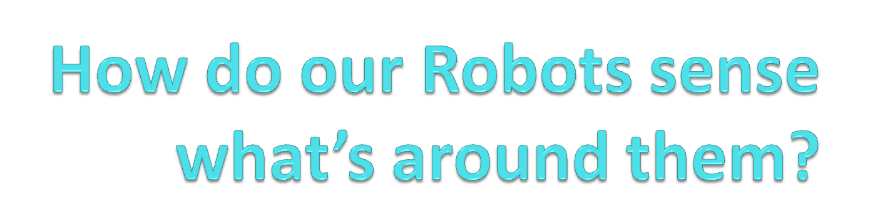
Dr. Paige H. Meeker
Some slides from Institute for Personal Robots in Education (IPRE)‏

Slide 59
Senses
Humans rely on their senses to understand what’s going on in the world.
Touch, Vision, Hearing, Taste, and Smelling (sometimes Balance)
Inner Senses (we keep up with our “internal state” – what’s going on inside you and where everything is)
Now that we have our robots, let’s take a look at how they “see/sense” the world around them…

Slide 60
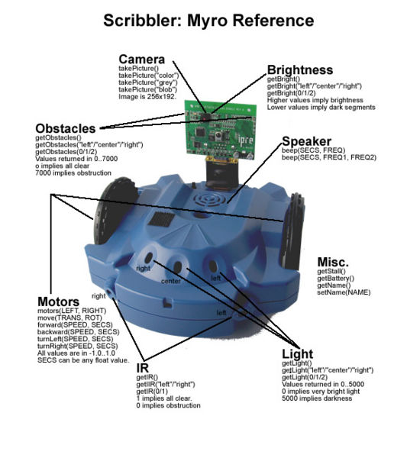

Slide 61
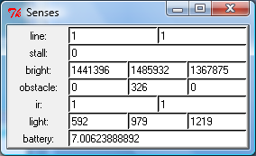
Python’s Senses
To get a quick, overall look at the behavior of the senses of the robot’s sensors, use the Myro function “senses()”
You will see the results of all the sensor calls in real time (except the camera)

Slide 62
IR Obstacle Sensors
The Scribbler has two IR obstacle sensors (under the light sensors) that return a binary value of 0 or 1.
The robot actually has 1 IR receiver located in the center, and two emitters located on the left and right side of the emitter.

Slide 63
IR Obstacle Sensors
Return value of: 0 – IR light is bouncing back to the receiver (off of an obstacle)‏

Slide 64
IR Obstacle Sensors
Return value of: 1 means that infrared light is not bouncing back to the receiver, so nothing is in front of the emitter/detector.

Slide 65
IR Obstacle Sensors
getIR() returns a list of two items [1,1]. You can also call getIR(“left”) to get just the left sensor, and similarly with getIR(“right”). The function also accepts 0 and 1 as the parameter to select which sensor value to return.

Slide 66
IR Obstacle Sensors
With the “senses()” function running, place various objects in front of the IR sensors and see what values are being reported. How near/far must an object be to be detected?

Slide 67

Light Sensors (3)‏
The scribbler has 3 light sensors pointing Left, Center and Right on the same side as the getIR sensors.
[45, 200, 430] = getLight()‏

Slide 68
Light Sensors (3)‏
Light sensor values range from 0 to 5000. Zero is very bright, 5000 is full dark.
getLight() returns a list of all 3 values.
getLight(“left” / “center” / “right”) or getLight(0/1/2) selects one value

Slide 69
Light Sensors (3)‏
Can we make the robot move using the light sensors?
Let’s type in the code on p. 105 -106 of your text (chapter 5) and play with the robot and a flashlight.

Slide 70
Internal Scribbler Sensors
getBattery() - returns battery voltage
getStall() - returns stall condition (0 or 1)‏
  This value changes to a 1 when the motors are working extra hard (possibly due to the robot hitting something and being unable to turn the wheels)‏
  Note that it takes a half second to re-set the stall sensor once the motors are turned off, so wait a bit before sampling it agian.
getName() - returns the robot's name (can be changed with setName(“newName”)‏

Slide 71
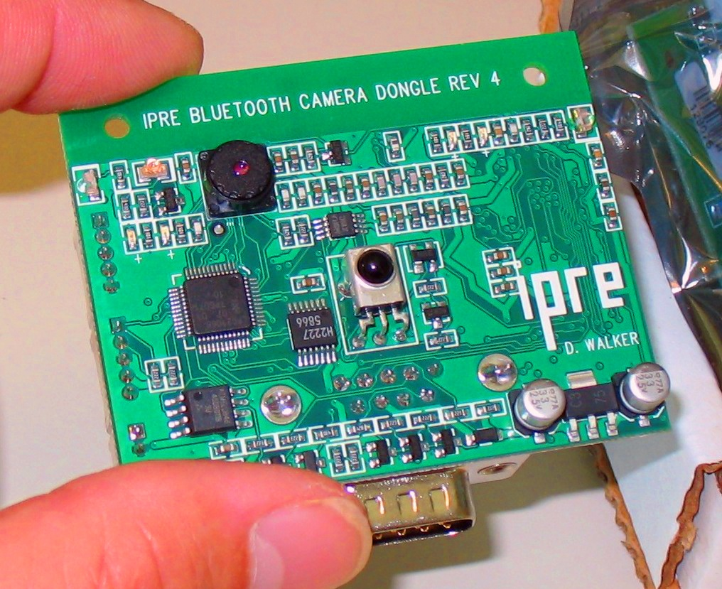
Fluke Board
The Fluke add-on board has its own IR obstacle sensors and a camera.

Slide 72
Fluke Board – IR Obstacle sensors
Myro uses the getObstacle() function to differentiate the IR sensors on the Fluke from the IR sensors on the Scribbler.
The fluke sensors are more sensitive than the Scribbler sensors Instead of just returning a zero or one, they return an integer value between zero and 7000.

Slide 73
Fluke Board – IR Obstacle sensors
The fluke has 3 IR emitters, one pointing forward...

Slide 74
Fluke Board – IR Obstacle sensors
The fluke has 3 IR emitters, one pointing forward...
And two pointing to the left and right.

Slide 75
Fluke Board – IR Obstacle sensors
The fluke has 3 IR emitters, one pointing forward...
And two pointing to the left and right.
They all bounce light back to a center mounted receiver.

Slide 76
Fluke Board – IR Obstacle sensors
Zero indicates no IR light is bouncing back from an obstacle.
[0,0,0] = getObstacle()‏

Slide 77
Fluke Board – IR Obstacle sensors
Larger numbers indicate that more IR light is bouncing back.
[0, 1842, 0] = getObstacle()‏

Slide 78
Fluke Board – IR Obstacle sensors
As with the Scribbler, you can select individual sensors to use (I recommend using the “center” sensor).
getObstacle(0 / 1 / 2)‏
getObstacle(“left” / “center” / “right”)‏

Slide 79
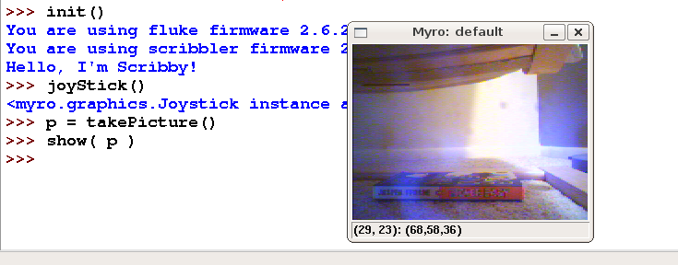
Fluke Board – Camera
You can take a picture using the camera on the Fluke board.
p = takePicture()
show(p)‏

Slide 80
Fluke Board – Camera
You can then save your photo as a .jpg (savePicture(picName, “name.jpg”)
You can turn a series of photos into an animated gif
  (type in code from p. 102, Chapter 5)

Slide 81
Fluke – Camera as a brightness sensor
Similar to the getLight() function on the Scribbler, the fluke allows you to use the camera as a “brightness” sensor with the getBright() function call.
getBright() returns a list of three values
getBright(0 / 1 / 2) or getBright( “right” / “center” / “left”) return a single value.
The numbers returned represent the sum of the luminance values of the pixels in the right/center/left of the camera, so they are quite large!
The lower the number, the darker that area of the camera is.

Slide 82
Robot Actuators
Beep
Motors
LED Lights

Slide 83
Speaker command – Beep
beep() - issues a random beep
beep(1) – random beep for 1 second
beep(1,800) – Beep at 800Hz for 1 second
beep(1,440,880) – two tone beep at 440 & 880Hz for 1 second.

Slide 84
Robot Actuators - Motors
Two motors (left,right) that can be set to a power level between -1 and 1.
-1 is full reverse
0 is stopped
1 is full speed forward.
Controlled directly with the motors(left,right) function.

Slide 85
Robot Actuators – Motors – Utility Functions
These functions make it easier to use the motors to do simple things:
  forward(speed, seconds) – Moves the robot forward at the specified speed for the specified seconds, and then stops.
  turnLeft(speed,seconds) – Turns the robot left at the specified speed and for the specified seconds, then stops.
  turnRight() and backward() are similar.

Slide 86
Robot Actuators – Motors – Utility Functions
The previous functions would all start the robot, go for a certain amount of time, and then stop the robot automatically.
You an also start the robot moving without specifying how long it should do so:
  forward(speed), turnLeft(speed), backward(speed), turnRight(speed), stop()‏
  Very important to call the stop() function when you want the robot to stop!
  The wait(seconds) function can be used to specify how long the robot should travel:
  forward(0.85)‏
  wait(1.5)‏
  stop()‏

Slide 87
Motor commands – Synchronous vs Asynchronous
What is the difference between these pieces of code?
  forward(0.85)‏
  wait(1.5)‏
  stop()‏
And...
  forward(0.85, 1.5)‏
Notes:
Synchronous – happening at the same time
Asynchronous – completing one action before starting the next

Slide 88
Motor commands – Synchronous vs Asynchronous
What is the difference between these pieces of code?
  forward(0.85)‏
  beep(1.5,880)‏
  stop()‏
And...
  forward(0.85, 1.5)‏
  beep(1.5,880)‏

Slide 89
Motor commands – Translate & Rotate
Other functions exist:
  translate(speed)‏
  rotate(speed)‏
These functions allow you to add together different types of motion, allowing the robot to move forward -- translate(1) while also turning—rotate(0.5).
stop() is equivalent to translate(0); rotate(0)‏

Slide 90
LED commands – setLED()‏
The Scribbler robot has 3 green LED lights.
You can control these three lights with setLED(position, value).
Position is a number: 0, 1, or 2 or a string “left”, “center”, or “right”
Value is either 0 (“off”) or 1 (“on”)‏
The center light blinks continuously, so unless you keep setting it's value, it will just start blinking again.

Slide 91
LED commands – setLEDFront() and setLEDBack()‏
The Fluke board has 2 user controlled red LED lights.
One on the front (small, near the camera) and one on the back (large, near the white GPIO connector)‏
You can control these three lights with setLEDFront(value) and setLEDBack(value) functions.
Value is either 0 (“off”) or 1 (“on”)‏
The back LED is VERY bright! And you can set it to half power with a 0.5 value, or quarter power with 0.25.

Slide 92
Go play with your robot!
Go play with your robot's sensors and actuators!

