Slide 1
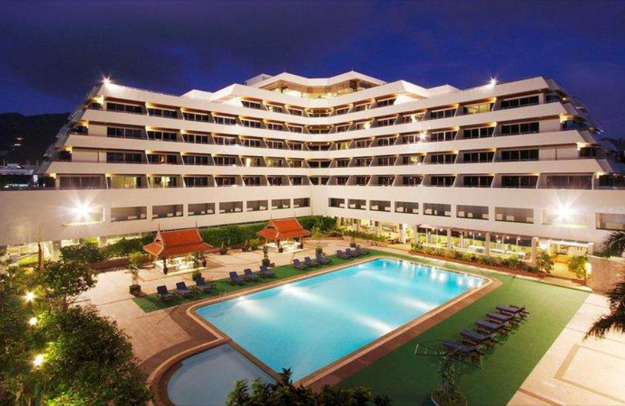

EDA of Hotel Bookings

Slide 2
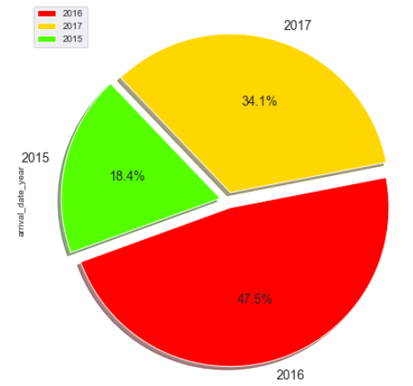
Which year recorded the highest & lowest bookings?
Year 2016 recorded the highest bookings, while year 2015 recorded the lowest bookings across both the hotels

Slide 3
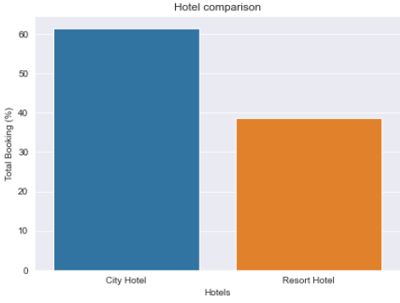
Which hotel gets booked more frequently?
More than 60% of the population booked the City Hotel

Slide 4
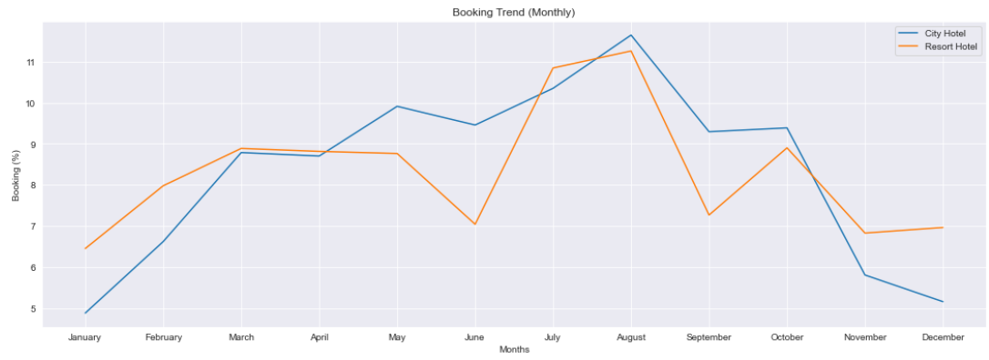
Which are the busiest & idle months for the hotels?
Most bookings were made from July to August. The least bookings were made at the start and end of the year.

Slide 5
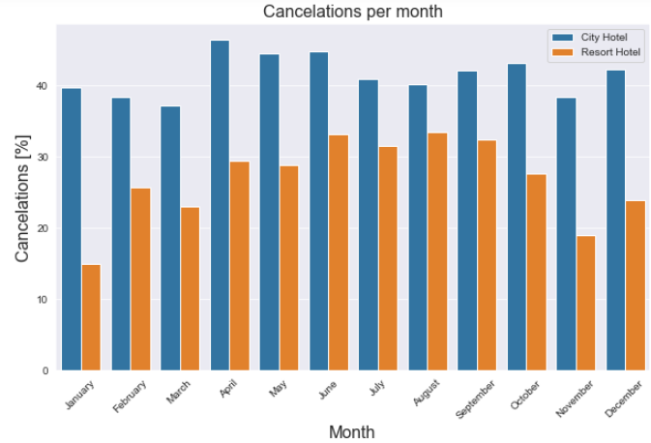
Which month has the highest number of cancelations?
For the City hotel the relative number of cancelations is around 40 % throughout the year and for the
Resort hotel it is highest in the summer and lowest during the winter.

Slide 6
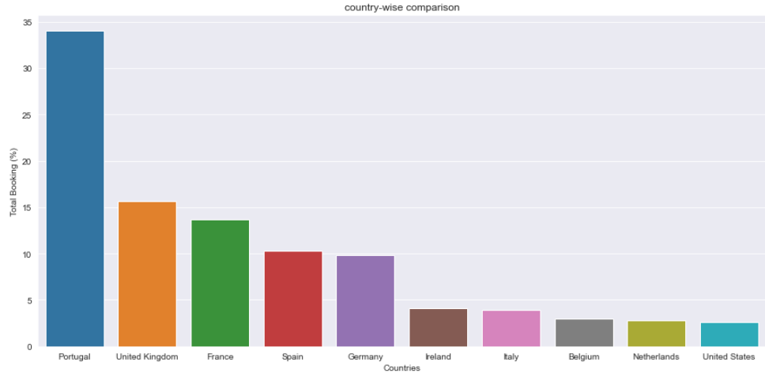
Which country makes the highest & lowest bookings?
Portugal, UK, France, Spain and Germany are the top countries from most guests come, more than 80% come from these 5 countries while least guests come from United States

Slide 7
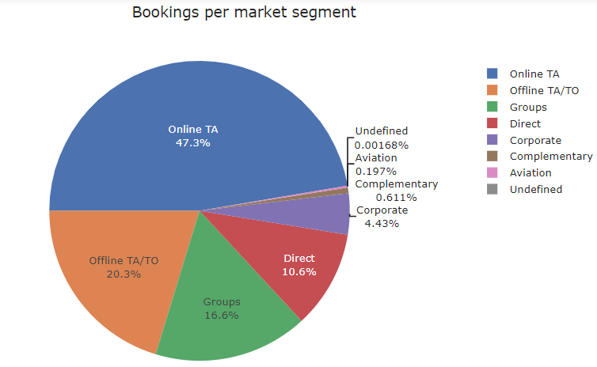
Which Market Segment makes the highest & lowest bookings?
Majority of the bookings are made through Online TA (47.3%) while lowest share of bookings come from the Aviation segment

Slide 8
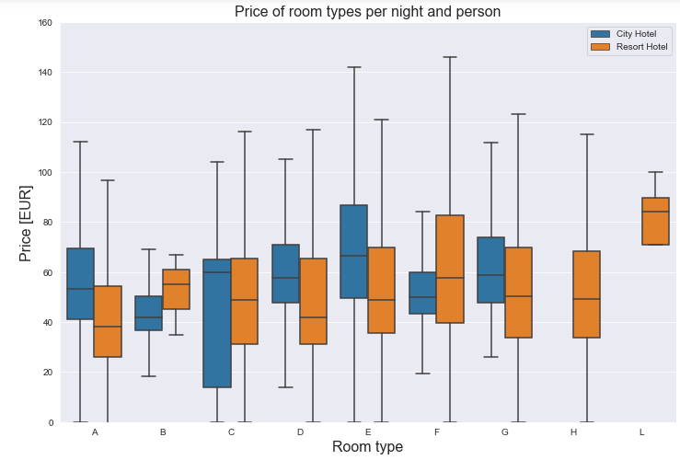
What is the avg price per room per night paid by both hotel’s guests?
Avg. price per room per night for City Hotel = 48 €
Avg. price per room per night for Resort Hotel = 59 €

Slide 9
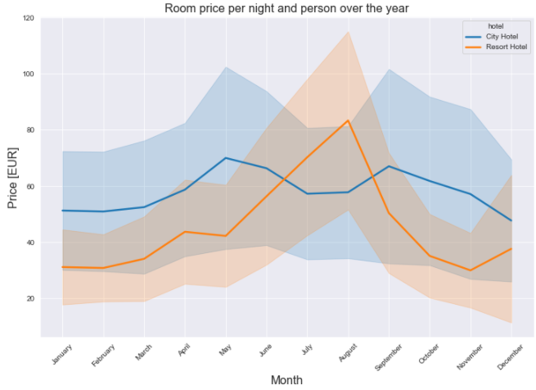
How does the price per night vary over the year for both hotels?
Prices in the Resort hotel are much higher during the summer while
The price of the city hotel varies less and is most expensive during spring and autumn seasons

Slide 10
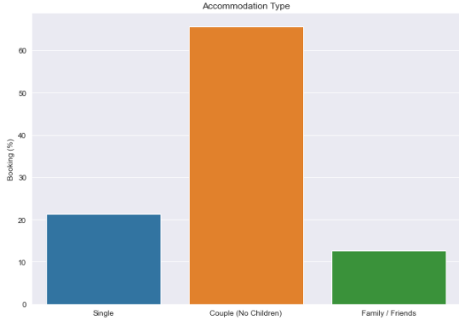
Which is the most popular accommodation type?
Couple (or 2 adults without children / babies) is the most popular accommodation type

Slide 11
The End

