Slide 1


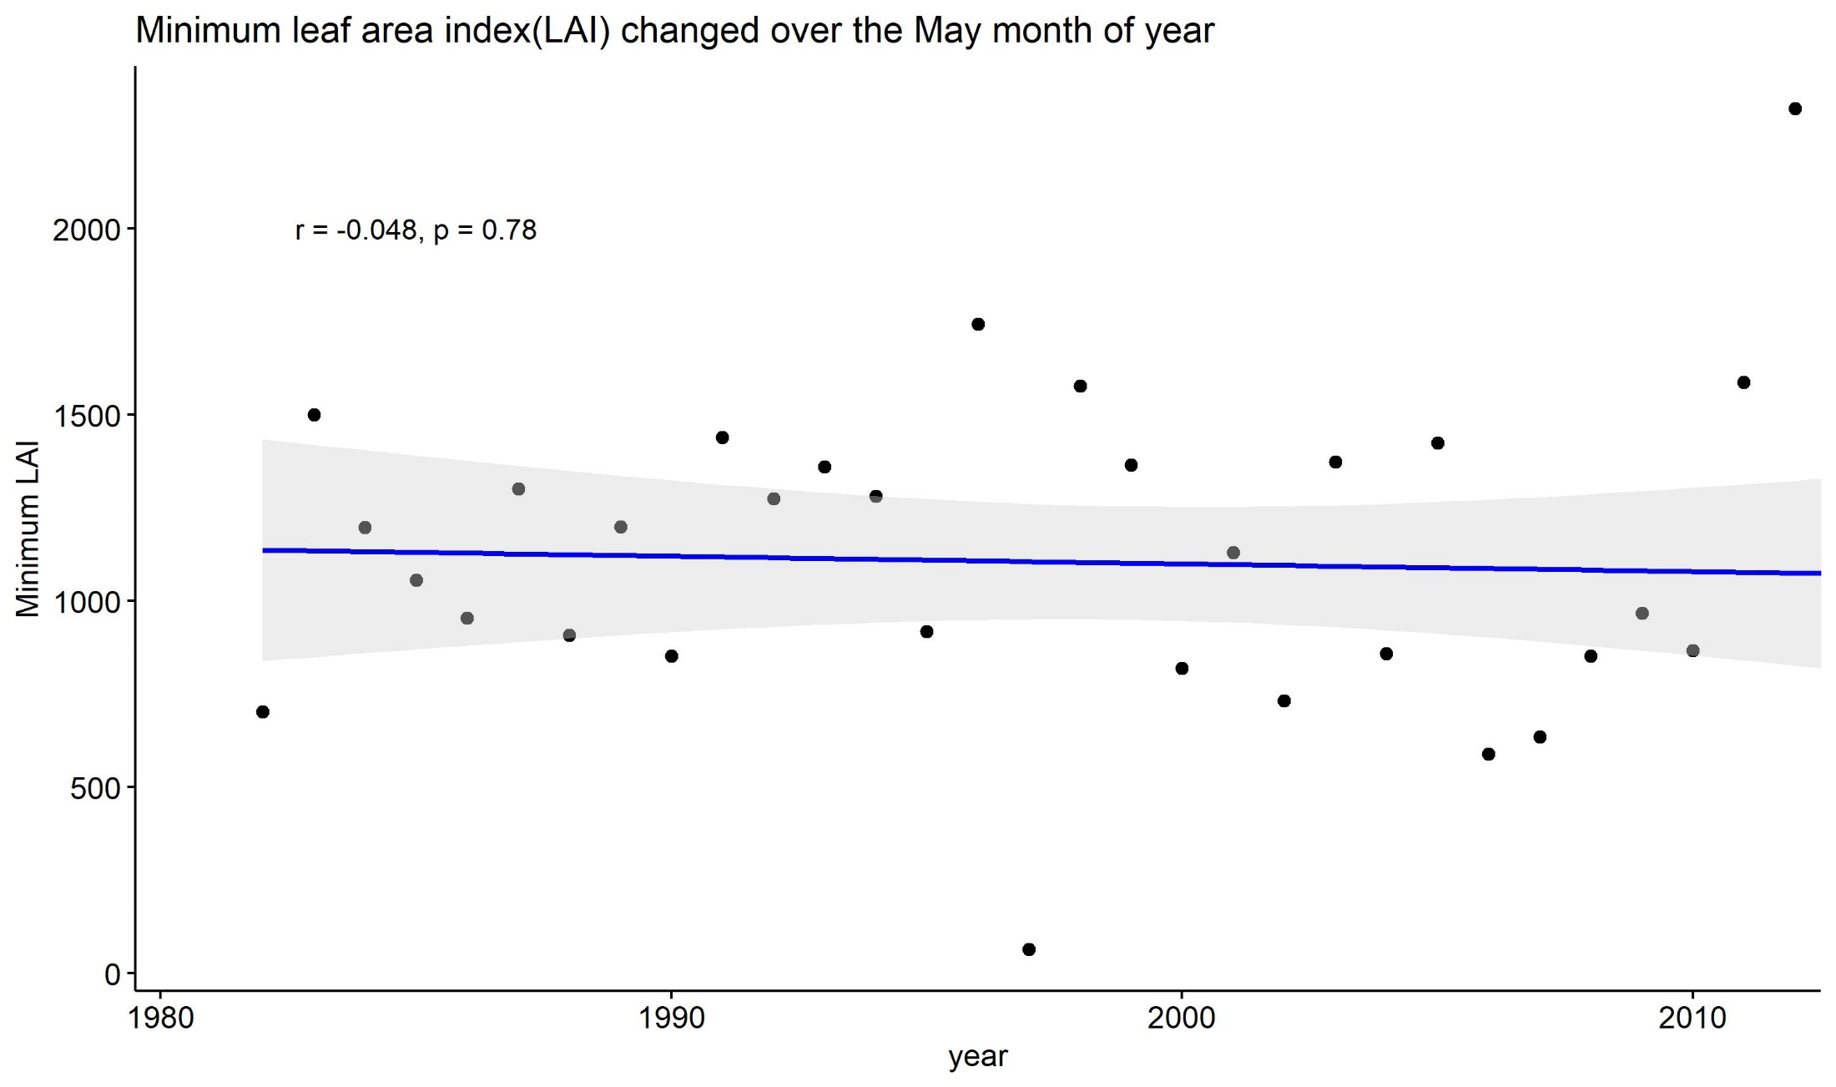
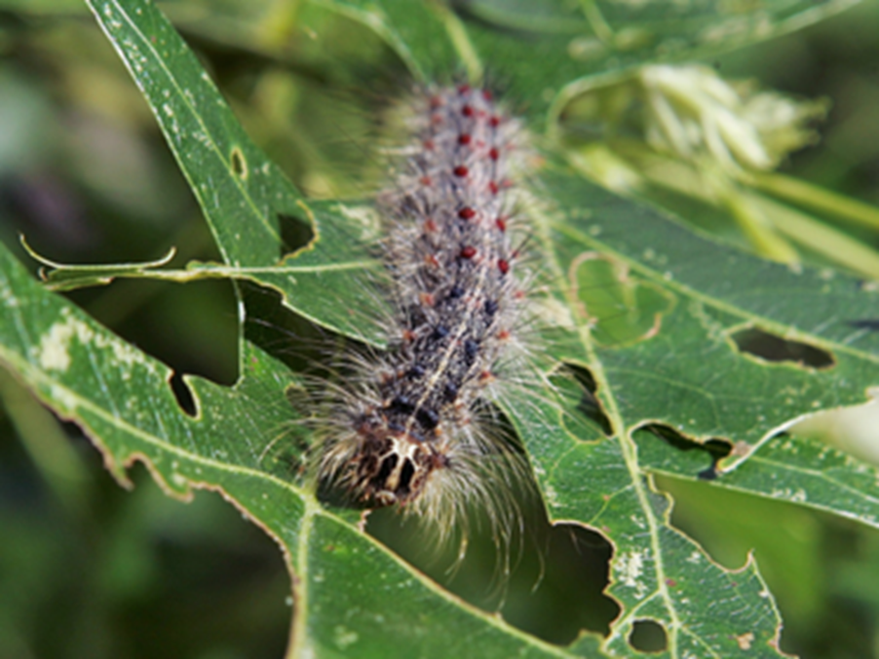

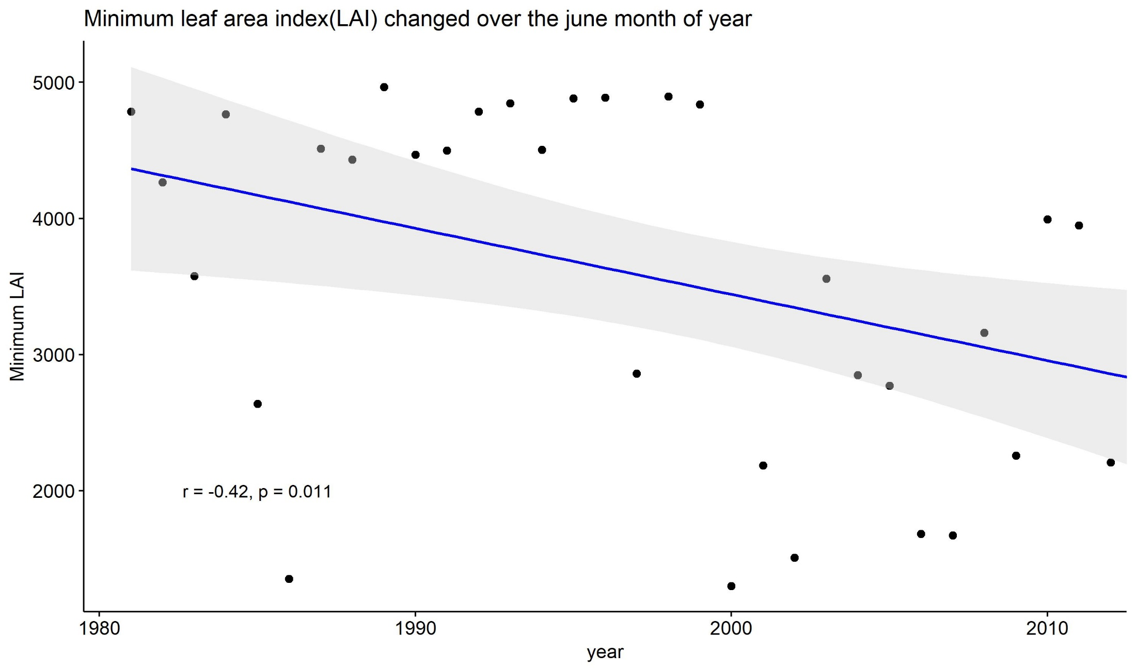
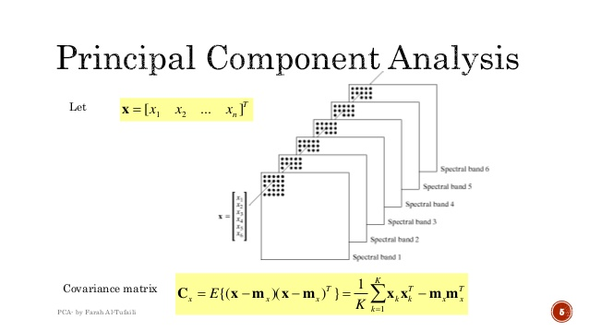
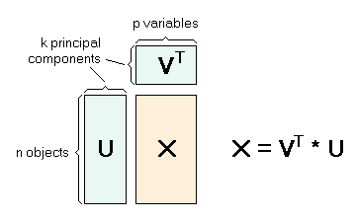
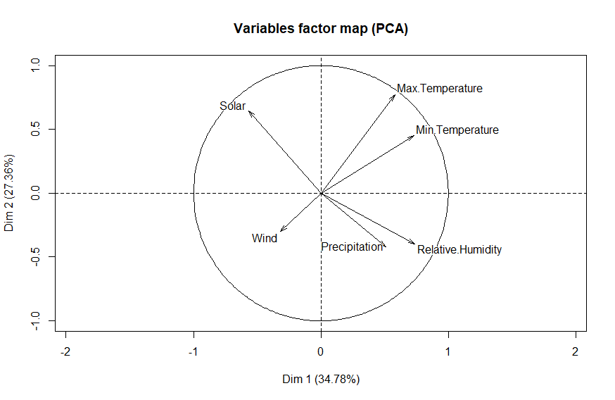
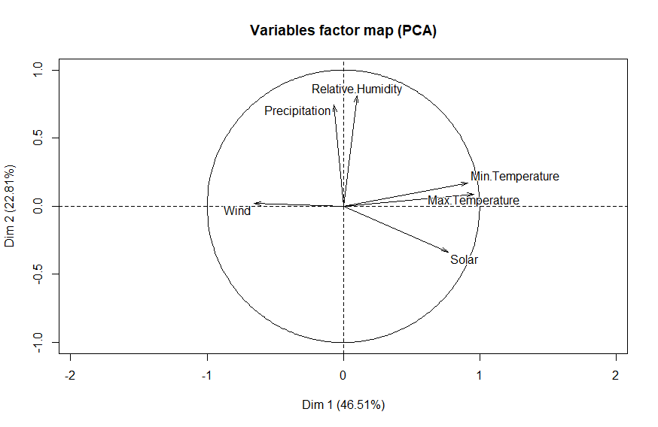
Principal component analysis for predicting defoliation over the Scituate area, RI
Supria Paul, PhD.
¹University of Rhode Island
Introduction
Results
Comparison | R-squared
Only May month | 0.116
Whole years | 0.612
The gypsy moth, Lymantria dispar Linnaeus, is one of the most notorious pests of deciduous trees in the Eastern United States. These pests are responsible to alter the forest landcover in certain month. They are defoliated close to a million or more forested acres each year since 1980. It has reported that 12.9 million acres were defoliated in 1981. This is an area larger than Rhode Island, Massachusetts, and Connecticut combined. When trees are visibly defoliated during periods of infestation, gypsy moth larvae crawl up and down walls, across roads, over outdoor furniture, and even inside homes.
Normally, Gpysy moth attach at the end of May and beginning of June.
Leaf area index is one way to know defoliation information.
For this purposes, I made a plot to check minimum LAI over the May month of year(fig.1) and over the June month of year (fig.2)
In fig.1 indicates there are stable change of LAI in the May. And also co-relationship is very low.
On the other hand, fig.2 indicates strong decreasing pattern in the June month. So, It can be concluded that Gpysy moth attack mostly happened in the June month.
After that I constructed principal component analysis(PCA) for the May month and June month.
After that I found the results which shown in the fig.3. It indicates all variables is not close 0 axis. That means Variables factor does not co-related.
On the other hand, when I consider whole month and also whole year for doing PCA analysis to find defoliation.
In the fig.4 shows most of weather parameters are close to 0 axis except solar radiation.
In the table shows the comparison of two analysis and I found the 2nd analysis have higher R-squared value.
Figure 1
Methods and Materials
Figure 2
Variables | Sources
Maximum Temperature (Predictor Variable) | Reanalysis product (1981-2014)
Minimum Temperature (Predictor Variable) | Reanalysis product (1981-2014)
Precipitation(Predictor Variable) | Reanalysis product (1981-2014)
Solar radiation (Predictor Variable) | Reanalysis product (1981-2014)
Relative Humidity (Predictor Variable) | Reanalysis product (1981-2014)
Wind ( Predictor Variable) | Reanalysis product (1981-2014)
Leaf area index(LAI) (target variable) | NOAA data (1981-2018)
Conclusions
It is very difficult to assess which parameters have more influences on the defoliation. Normally, single regression or multi-regression model have conducted for evaluating the relationship.
In this studies, I consider six variables to assess defoliation but not doing multi-regression model. I am looking the combined effects on defoliation.
Therefore, I used Principle component analysis to assess this relationship two ways just one month and whole month combination.
It has found that whole month combination have higher co-relation with defoliation.
Figure 3
Figure 4
Contact
References
<Supria Paul>
<University of Rhode Island>
Email: supria_paul@uri.edu
Website:
Phone: 347-265-4891
EcoRI News (2016, June 29) What Impact is All This Caterpillar Poop Having on Forest Floors? Accessed July 13, 2016.
de Beurs, K.M. & Towsend, P.A. (2008, October 15) Estimating the effect of gypsy moth defoliation using MODIS.Remote Sensing Environment, 112 (10), 3983-3990.
ForWarn (2016, August 10) Monitoring the state of Rhode Island’s forests. Accessed September 26, 2016.
Spruce, J. et al. (2011, February 15) Assessment of MODIS NDVI time series data products for detecting forest defoliation by gypsy moth outbreaks. Remote Sensing Environment, 2 (115), 427-437.
Wold, S., Esbensen, K., & Geladi, P. (1987). Principal component analysis. Chemometrics and intelligent laboratory systems, 2(1-3), 37-52.
Takepart (2016, July 11) Gypsy Moths Are Destroying Forests as the Climate Dries. Accessed July 13, 2016.
The Washington Post (2016, July 7) Northeast battles gypsy moths, an insect plague stripping trees bare and delaying airplanes. Accessed July 13, 2016.
University of Wisconsin-Madison CIMSS Satellite Blog (2016, June 26) Gypsy moth defoliation in parts of New England. Accessed July 13, 2016.
U.S. Forest Service (2003, October 29) Gypsy Moth in North America. Accessed July 13, 2016.

