Slide 1

“Mind-scope”-Mental
Health prediction
Using Machine Learning

Slide 2

PROBLEM STATEMENT:
● Predicting mental health conditions like anxiety, depression remains challenging due to the reliance on subjective self-reporting and the complexity of integrating physiological and psychological data.
● This study aims to develop machine learning models that analyze comprehensive datasets, including both physiological indicators (e.g., heartbeat, sleep, activity) and psychological self-reports (e.g., anxiety, emotional states).
● The goal is to create an accurate, real-time predictive system that can be integrated with wearable technology, offering personalized insights and improving mental health outcomes through early detection and intervention.

Slide 3
DATA COLLECTION:
The data was generated using a Python program designed to simulate health and emotional metrics for various set of peoples
DATA PREPROCESSING:
Handling Missing Values: Checked for any missing or null values in the dataset. Applied imputation techniques or removed records with significant missing data.
Outlier Detection: Identified and handled outliers that could skew the analysis, especially in metrics like heartbeat rate and steps walked

Slide 4
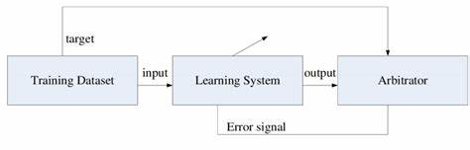
Model:
Supervised learning:
Supervised learning is a machine learning technique where algorithms are trained on labeled data to make predictions or decisions. It includes two main categories:
1.Regression: Predicts continuous values based on input features, aiming to model the relationship between independent and dependent variables.
2. Classification: Categorizes data into predefined labels by learning patterns from labeled examples, with the target variable being categorical.

Slide 5
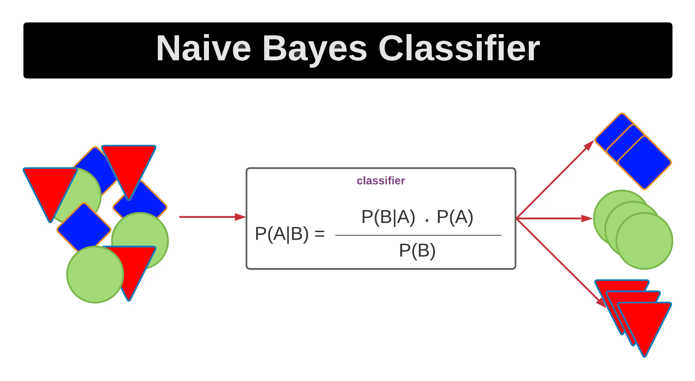
MODEL TRAINING
1. Naive Bayes :
- Purpose: Classifies data based on Bayes' theorem, assuming independence between features.
- Implementation: `GaussianNB()` fits the model to the training data and predicts the target for the test data. The model assumes that features are normally distributed.

Slide 6
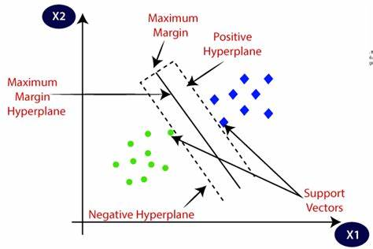
2.Support Vector Machine (SVM):
- Purpose: Finds the hyperplane that best separates different classes in the feature space.
- Implementation: `SVM()` fits the model to the training data and predicts class labels for the test data. It aims to maximize the margin between different classes.

Slide 7
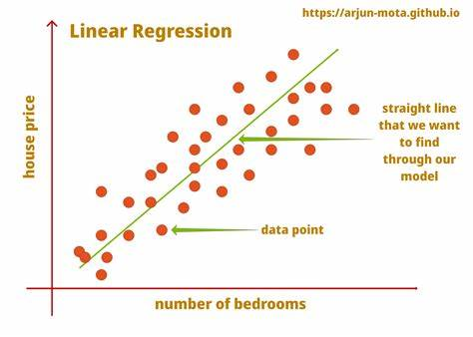
3. LinearRegression:
- Purpose: Predicts a continuous outcome based on input features. Here, it's used for binary classification by converting predictions to binary values.
- Implementation: `LinearRegression()` fits the model to the training data, predicts continuous values for the test data, and then rounds these predictions to binary values (0 or 1).

Slide 8
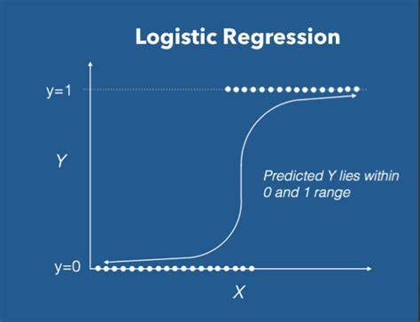
4.Logistic Regression:
- Purpose: Predicts a continuous outcome based on input features. Here, it's used for binary classification by converting predictions to binary values.
- Implementation: `LinearRegression()` fits the model to the training data, predicts continuous values for the test data, and then rounds these predictions to binary values (0 or 1).

Slide 9
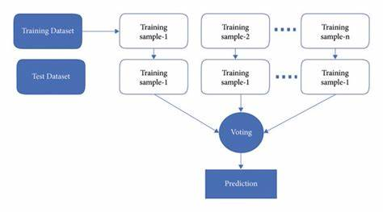
5. Random Forests:
- Purpose: An ensemble method that uses multiple decision trees to make predictions. It aggregates the results of individual trees to improve accuracy and robustness.
- Implementation: `RandomForestClassifier()` fits multiple decision trees to the training data and combines their predictions to classify the test data.

Slide 10
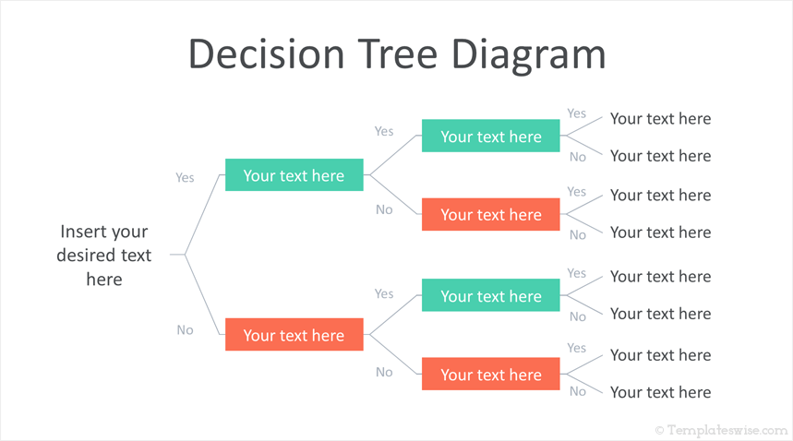
6. Decision Trees
- Purpose: A tree-based model that splits the data into branches based on feature values to make predictions.
- Implementation: `DecisionTreeClassifier()` fits a decision tree to the training data, where each node represents a decision based on a feature, and predictions are made by traversing the tree.

Slide 11
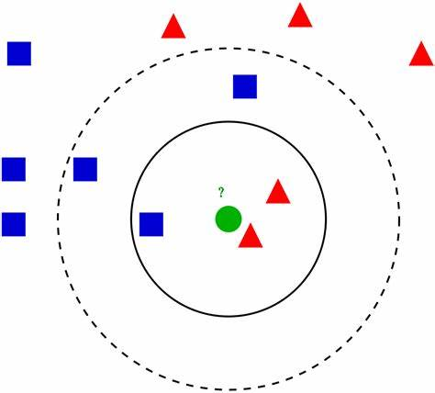
7. K-Nearest Neighbors:
- Purpose: Classifies data based on the majority class among the k-nearest neighbors in the feature space.
- Implementation: `KNeighborsClassifier()` fits the model to the training data and predicts the class of the test data based on the majority vote from the nearest neighbors

Slide 12
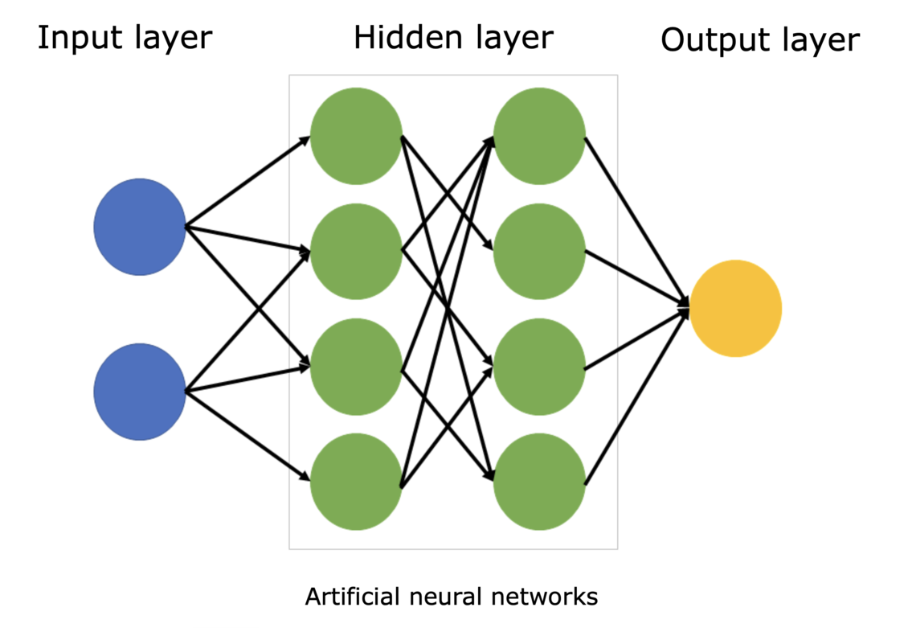
8. Neural Network :
- Purpose: A type of artificial neural network that uses multiple layers of neurons to model complex patterns in the data.
- Implementation: `MLPClassifier(max_iter=1000)` fits the model to the training data, using multiple layers and activation functions to learn complex patterns and make predictions on the test data.

Slide 13
Results Visualization :
- Plotting: `plot_results(accuracies, y)` visualizes:
- Depression Count: Pie chart showing the distribution of depression vs. non-depression cases.
- Model Accuracy: Bar chart showing the accuracy of each model.
-The pie chart titled "Depression Count" visualizes the distribution of individuals predicted to be in depression versus those not in depression based on the model's output.

Slide 14
Prediction Comparison :
● Highest Accuracy: Random Forest (60%)
- Best performance with 21 true negatives and 15 true positives, along with the lowest false positives and negatives.
● Second-Best Accuracy: Logistic Regression & Neural Network (58.33%)
- Neural Network has more true negatives; Logistic Regression has fewer false positives, making it slightly more conservative.
● Third-Best Accuracy: Linear Regression (56.67%)
- Balanced true positives and negatives but slightly more false positives than Random Forest.
●Moderate Performers: SVM, Decision Tree, KNN (53.33% - 55%)
- Comparable accuracies but higher false positives and negatives, making them less reliable.

Slide 15
● Lowest Accuracy: Naive Bayes (48.33%)
- Struggles with high false positives and negatives, making it the least effective.
Final Prediction
● Random Forest emerges as the top-performing model in terms of accuracy and balanced performance between predicting mental crises and non-crises.

Slide 16
Conclusion:
This study highlights the potential of machine learning in predicting and managing mental health conditions. Models like Random Forest and Neural Networks showed high accuracy, suggesting that integrating physiological and psychological data through wearable technology and self-reporting tools could enable real-time monitoring and timely interventions. Such advancements could transform mental health care, offering more proactive management strategies.
As younger generations face growing mental health challenges due to social media, economic uncertainty, and global crises, these predictive tools become even more vital. They provide hope for early intervention and support, helping youth navigate an increasingly complex world.

Slide 17

Thank you

