Slide 1
Suprit Choudhury
Task 2: Create a presentation on the following econometric methods, including how and when you would use it: OLS, 2SLS, and Logistic regression. Use any appropriate publicly available dataset, choose a problem statement and Implement OLS, Logistic and 2SLS models.
Solution- A publicly available dataset has been taken and OLS regression has been performed. The limitations are then explained along with the need for 2SLS. The results have been compared and the visualizations provided. Finally the target variable is changed and the need for Logistic Regression along with the implementation and results are provided. The last slide contains the packages used for this task.
Would take this opportunity to thank the recruiting team of ISB for giving me the opportunity to make this presentation and learn immensely during the process.

Slide 2
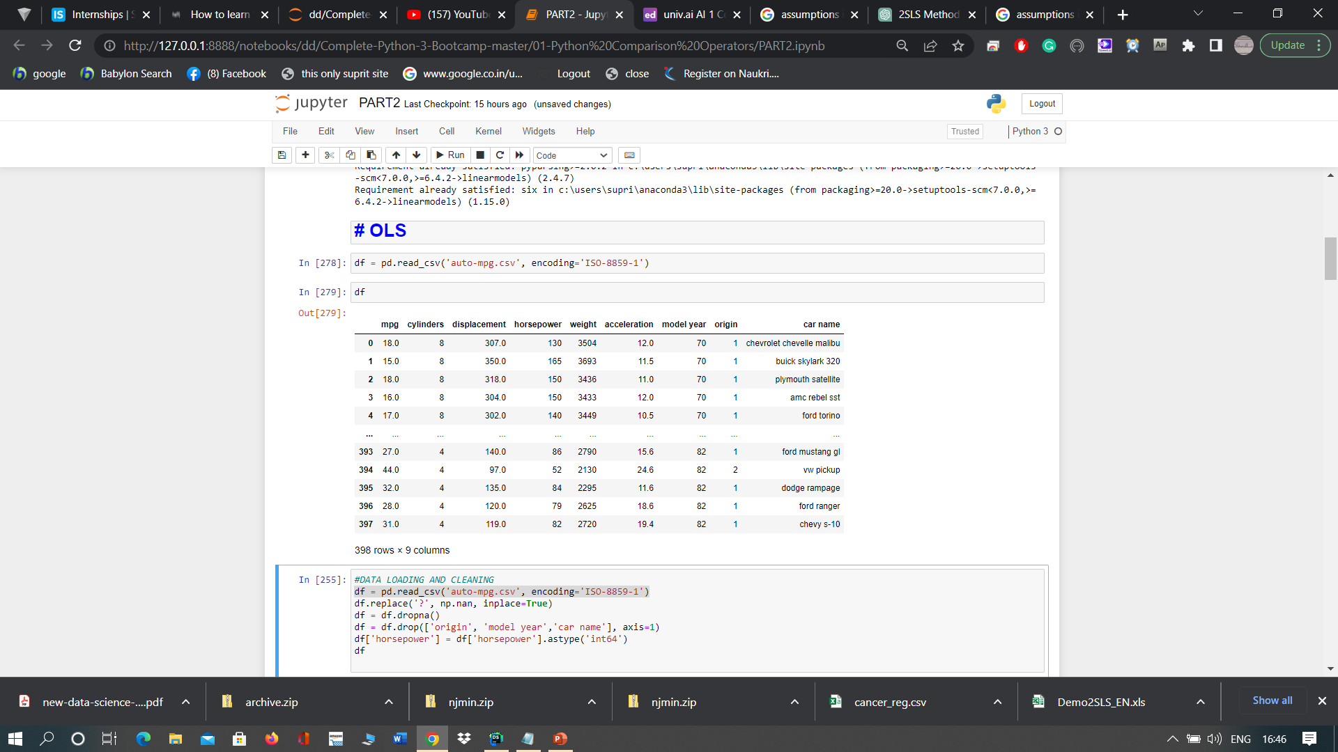
About the dataset
The Auto MPG dataset is a classic dataset used in machine learning and statistical analysis. It contains information about the fuel consumption (in miles per gallon, or mpg) and technical features of various cars from the late 1970s and early 1980s.
The dataset contains 398 instances and 8 features, which are:
mpg: continuous variable representing the miles per gallon of the car
cylinders: discrete variable representing the number of cylinders in the car's engine (ranging from 3 to 8)
displacement: continuous variable representing the volume of the engine displacement in cubic inches
horsepower: continuous variable representing the horsepower of the car's engine
weight: continuous variable representing the weight of the car in pounds
acceleration: continuous variable representing the acceleration of the car in seconds from 0 to 60 mph
model year: discrete variable representing the model year of the car (ranging from 70 to 82)
origin: discrete variable representing the origin of the car (1 for American, 2 for European, 3 for Japanese)
The dataset is commonly used for regression analysis and predictive modeling, with the goal of predicting the mpg of a car based on its other features. The Auto MPG dataset has been widely used in machine learning research and education, and it is often used as a benchmark dataset for evaluating the performance of regression models.

Slide 3
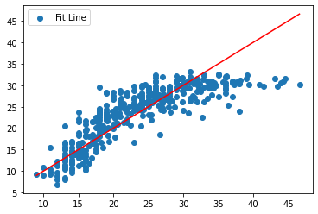
Ordinary Least squares Regression and visualization
OLS (Ordinary Least Squares) is a method used to estimate the parameters of a linear regression model. It aims to minimize the sum of squared differences between the observed values of the dependent variable and the predicted values from the linear regression model. The basic idea behind OLS is to find the values of the coefficients that minimize the residual sum of squares, which is the sum of the squared differences between the observed values and the predicted values.
OLS is a popular method for estimating the coefficients of a linear regression model because it is relatively simple to understand and implement. It can also provide useful insights into the relationships between the independent variables and the dependent variable.
OLS can be used when there is a linear relationship between the independent variables and the dependent variable. In other words, OLS assumes that the dependent variable is a linear combination of the independent variables plus a random error term. OLS also assumes that the error terms are normally distributed, have constant variance, and are independent of each other.
Here we are using ‘mpg’ as the dependent variable and all the others as independent variables.

Slide 4
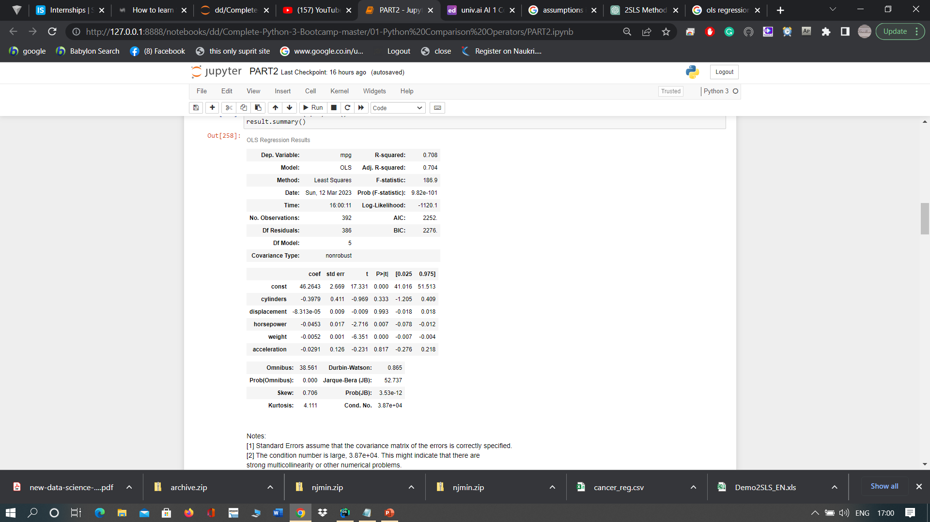
From the OLS regression results, we can draw the following inferences:
The R-squared value of 0.708 indicates that the independent variables (cylinders, displacement, horsepower, weight, acceleration) explain about 70.8% of the variation in the dependent variable (mpg).
The adjusted R-squared value of 0.704 is slightly lower than the R-squared value, which suggests that the addition of more independent variables may not significantly improve the model's performance.
The F-statistic of 186.9 and the associated p-value of 9.82e-101 indicate that the overall model is statistically significant.
Among the individual independent variables, weight and horsepower have the largest negative coefficients (-0.0052 and -0.0453, respectively), suggesting that they have a stronger negative impact on the dependent variable (mpg) compared to the other independent variables.
The coefficients for cylinders, displacement, and acceleration are not statistically significant, as their associated p-values are higher than the conventional significance level of 0.05.
The intercept coefficient (const) of 46.2643 suggests that when all the independent variables are zero, the expected value of the dependent variable (mpg) is around 46.26.
The model's normality assumption is confirmed by the Jarque-Bera (JB) test, which has a low p-value, indicating that the residuals are not normally distributed.
The Durbin-Watson statistic of 0.865 suggests that there is a positive autocorrelation in the residuals, which may affect the reliability of the model's predictions.
Results

Slide 5
From the OLS regression results, we can draw the following inferences:
The R-squared value of 0.708 indicates that the independent variables (cylinders, displacement, horsepower, weight, acceleration) explain about 70.8% of the variation in the dependent variable (mpg).
The adjusted R-squared value of 0.704 is slightly lower than the R-squared value, which suggests that the addition of more independent variables may not significantly improve the model's performance.
The F-statistic of 186.9 and the associated p-value of 9.82e-101 indicate that the overall model is statistically significant.
Among the individual independent variables, weight and horsepower have the largest negative coefficients (-0.0052 and -0.0453, respectively), suggesting that they have a stronger negative impact on the dependent variable (mpg) compared to the other independent variables.
The coefficients for cylinders, displacement, and acceleration are not statistically significant, as their associated p-values are higher than the conventional significance level of 0.05.
The intercept coefficient (const) of 46.2643 suggests that when all the independent variables are zero, the expected value of the dependent variable (mpg) is around 46.26.
The model's normality assumption is confirmed by the Jarque-Bera (JB) test, which has a low p-value, indicating that the residuals are not normally distributed.
The Durbin-Watson statistic of 0.865 suggests that there is a positive autocorrelation in the residuals, which may affect the reliability of the model's predictions.
Results

Slide 6
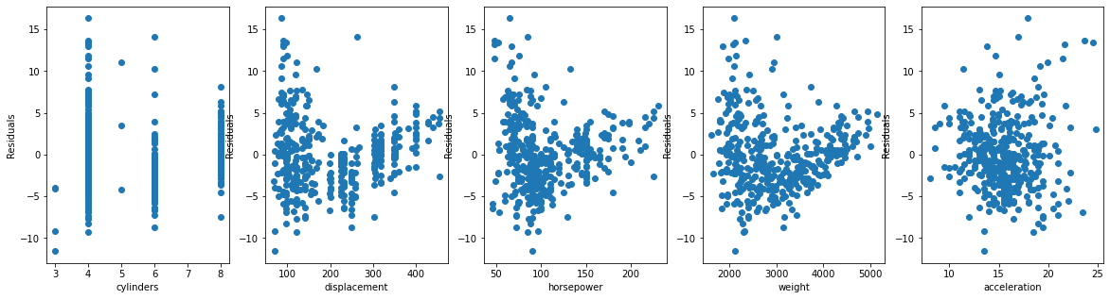
The OLS regression results also include two additional messages:
Standard Errors assume that the covariance matrix of the errors is correctly specified: This message indicates that the standard errors of the estimated coefficients assume that the covariance matrix of the errors (or residuals) is correctly specified. In other words, this means that the standard errors are based on the assumption that the errors have constant variance and are uncorrelated with each other. Violations of these assumptions may result in biased standard errors and incorrect statistical inferences.
The condition number is large, 3.87e+04. This might indicate that there are strong multicollinearity or other numerical problems: The condition number is a measure of the sensitivity of the regression coefficients to small changes in the independent variables. A high condition number suggests that there is multicollinearity, which is a situation where two or more independent variables are highly correlated with each other. In this case, the interpretation of the individual regression coefficients may become unstable, and the estimated coefficients may have large standard errors. High condition numbers may also be caused by other numerical problems, such as data scaling issues or computational errors. It is important to investigate the potential sources of the high condition number and take appropriate actions to address them before drawing any conclusions from the regression results.
3. To solve this problem we will plot the residuals vs each variable to check for any cases of correlation of a variable with the standard errors.
Results

Slide 7
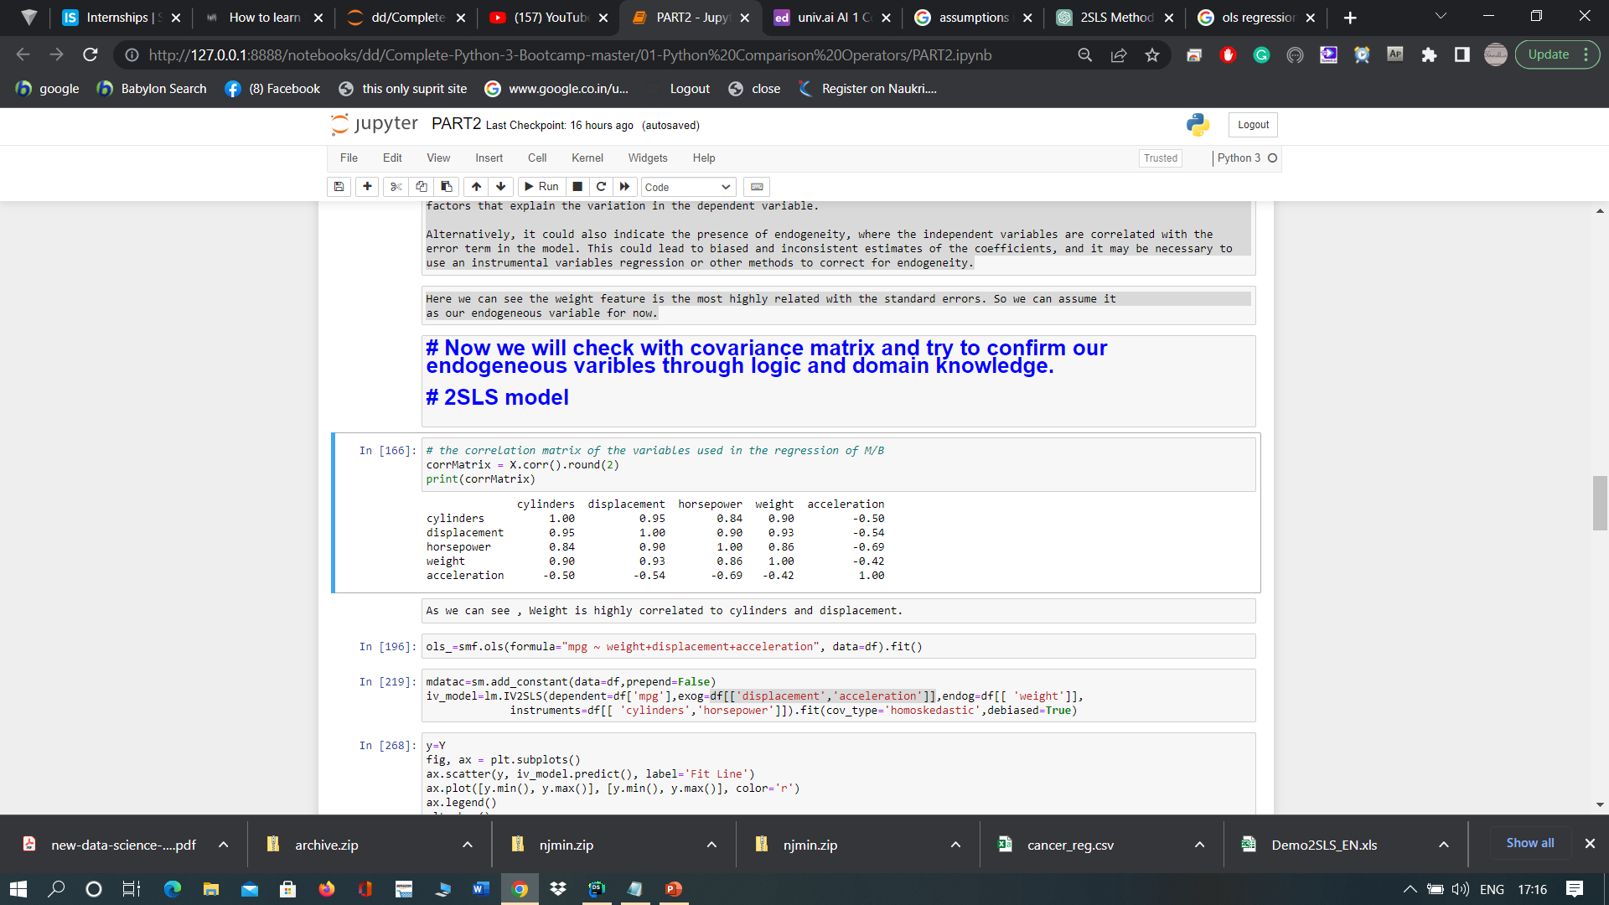

Inference
As we can see , Weight is highly correlated to cylinders and displacement.
If the residuals are decreasing continuously as the independent variables increase, it may suggest that there is a positive relationship between the dependent variable and the independent variables, and that the model may be missing some important factors that explain the variation in the dependent variable.
Alternatively, it could also indicate the presence of endogeneity, where the independent variables are correlated with the error term in the model. This could lead to biased and inconsistent estimates of the coefficients, and it may be necessary to use an instrumental variables regression or other methods to correct for endogeneity.
Covariance Matrix
Here we can see the weight feature is the most highly related with the standard errors. So we can assume it as our endogenous variable for now.

Slide 8
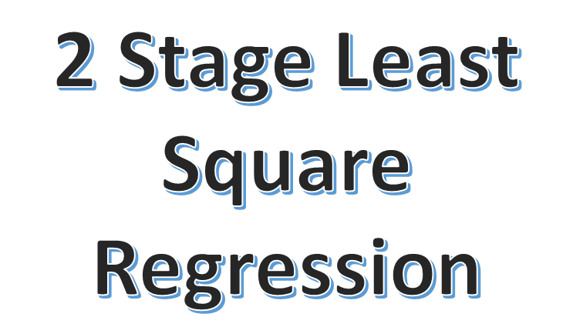
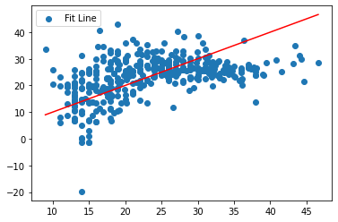
NEED
Exogeneity and endogeneity are two important concepts in econometrics that refer to the relationship between the independent variables and the error term in a regression model.
Exogeneity implies that the independent variables are not correlated with the error term in the regression model. In other words, the independent variables are unrelated to any unobserved factors that may influence the dependent variable. Exogeneity is essential in OLS regression because it ensures that the estimated coefficients are unbiased and consistent, and the statistical tests are valid.
Endogeneity, on the other hand, implies that the independent variables are correlated with the error term in the regression model. Endogeneity can arise due to various reasons, such as omitted variable bias, measurement error, simultaneity, and reverse causation. When endogeneity is present, the OLS estimates can be biased and inconsistent, and the statistical tests may not be valid.
Two-Stage Least Squares (2SLS) is a method used to address endogeneity in a regression model. The 2SLS method involves two stages: In the first stage, instrumental variables are used to estimate the endogenous independent variables, and in the second stage, the estimated values of the endogenous variables are used as independent variables in the OLS regression. The instrumental variables must satisfy two conditions: (1) they are correlated with the endogenous variables, and (2) they are not correlated with the error term. The 2SLS method can help to address the endogeneity bias and improve the estimation of the causal relationship between the independent variables and the dependent variable.
We have used ‘weight’ as endogenous variable and ‘cylinders’ and ‘horsepower’ as instrumental variables based on common logic and tests , residual plots and covariance matrix.

Slide 9
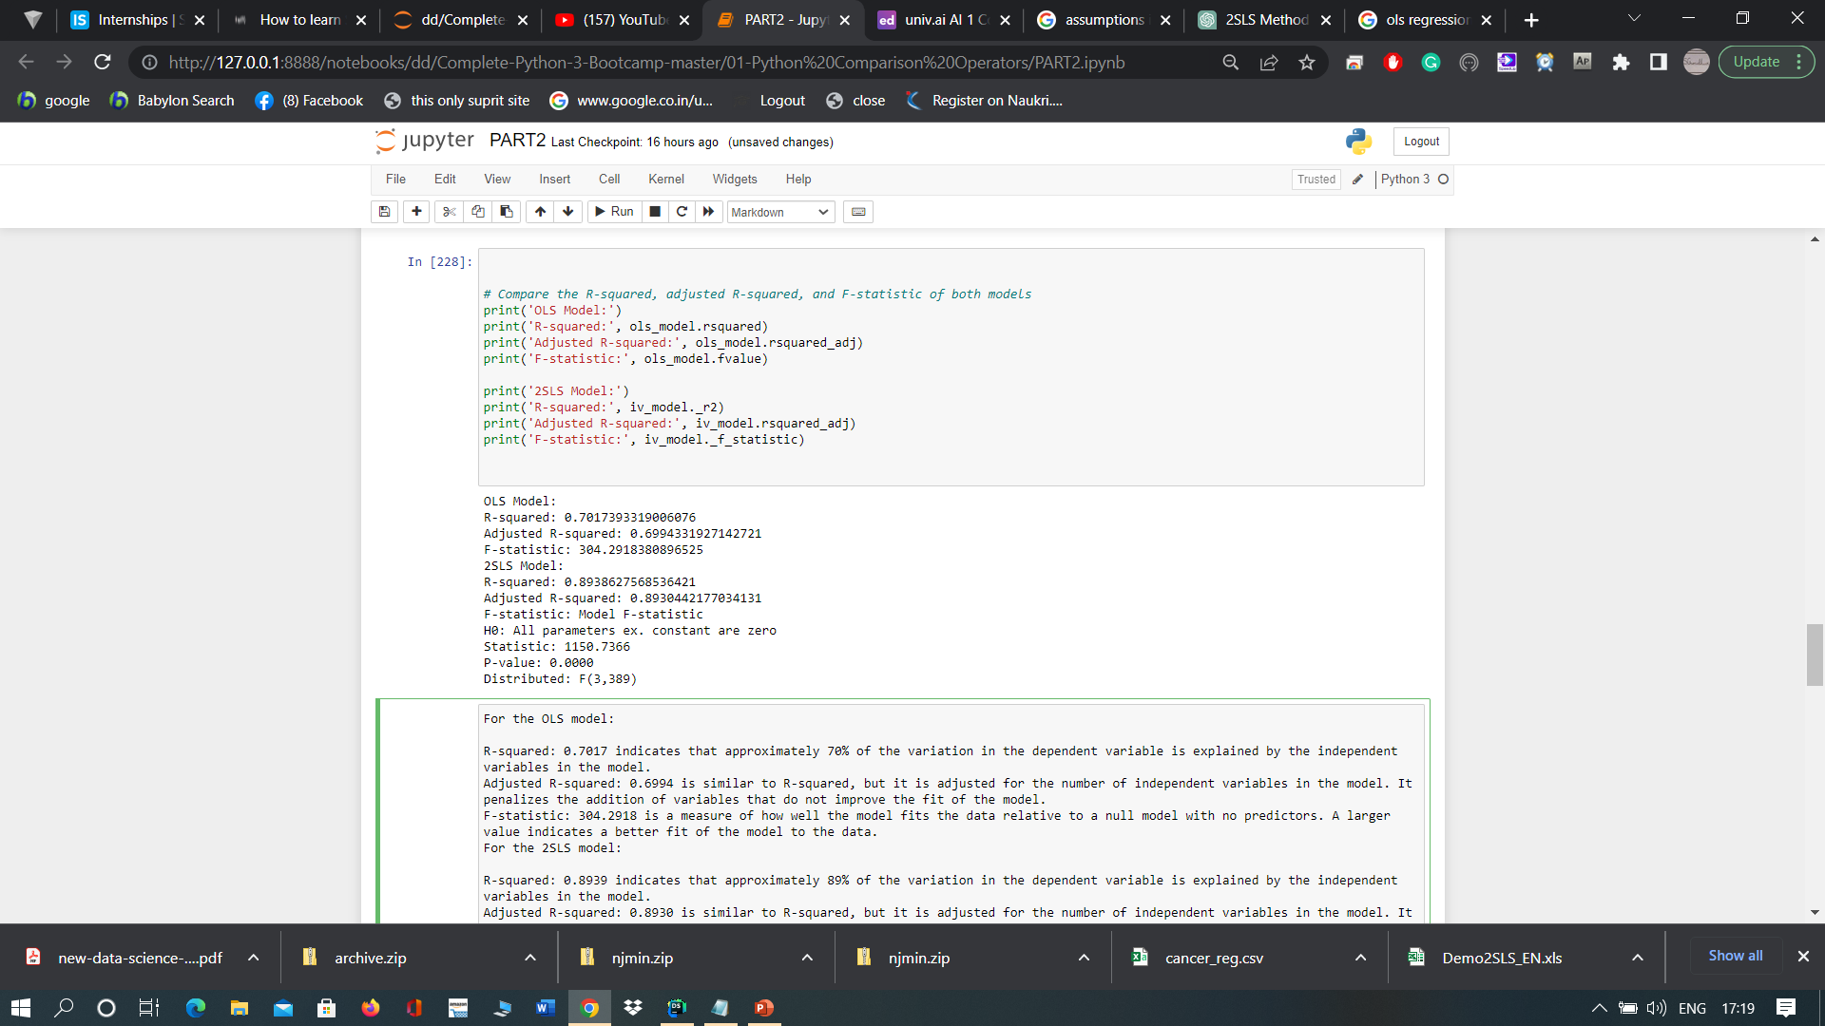
For the OLS model:
R-squared: 0.7017 indicates that approximately 70% of the variation in the dependent variable is explained by the independent variables in the model.
Adjusted R-squared: 0.6994 is similar to R-squared, but it is adjusted for the number of independent variables in the model. It penalizes the addition of variables that do not improve the fit of the model.
F-statistic: 304.2918 is a measure of how well the model fits the data relative to a null model with no predictors. A larger value indicates a better fit of the model to the data.
For the 2SLS model:
R-squared: 0.8939 indicates that approximately 89% of the variation in the dependent variable is explained by the independent variables in the model.
Adjusted R-squared: 0.8930 is similar to R-squared, but it is adjusted for the number of independent variables in the model. It penalizes the addition of variables that do not improve the fit of the model.
F-statistic: 1150.7366 is a measure of how well the model fits the data relative to a null model with no predictors. A larger value indicates a better fit of the model to the data.
The null hypothesis for the F-statistic is that all of the parameters in the model (excluding the intercept) are zero. The p-value of 0.0000 indicates that we can reject this null hypothesis at any reasonable level of significance (e.g., alpha = 0.05).
This means that at least one of the independent variables is significantly related to the dependent variable.
Results and Inferences

Slide 10
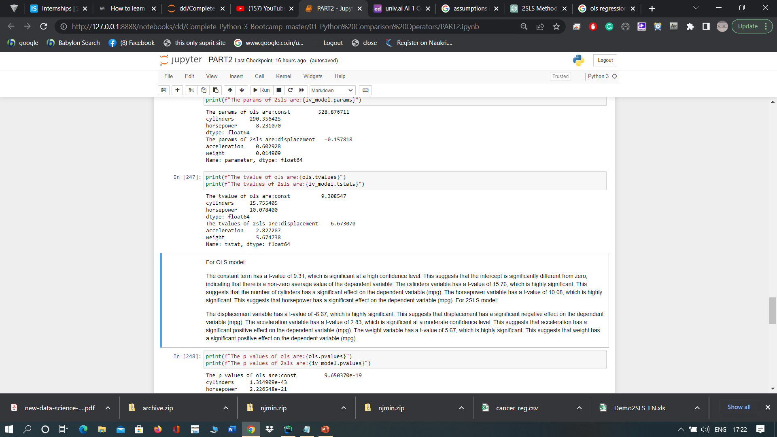
Results and Inferences
For OLS model:
The constant term has a t-value of 9.31, which is significant at a high confidence level. This suggests that the intercept is significantly different from zero, indicating that there is a non-zero average value of the dependent variable. The cylinders variable has a t-value of 15.76, which is highly significant. This suggests that the number of cylinders has a significant effect on the dependent variable (mpg). The horsepower variable has a t-value of 10.08, which is highly significant. This suggests that horsepower has a significant effect on the dependent variable (mpg).
For 2SLS model:
The displacement variable has a t-value of -6.67, which is highly significant. This suggests that displacement has a significant negative effect on the dependent variable (mpg). The acceleration variable has a t-value of 2.83, which is significant at a moderate confidence level. This suggests that acceleration has a significant positive effect on the dependent variable (mpg). The weight variable has a t-value of 5.67, which is highly significant. This suggests that weight has a significant positive effect on the dependent variable (mpg).

Slide 11
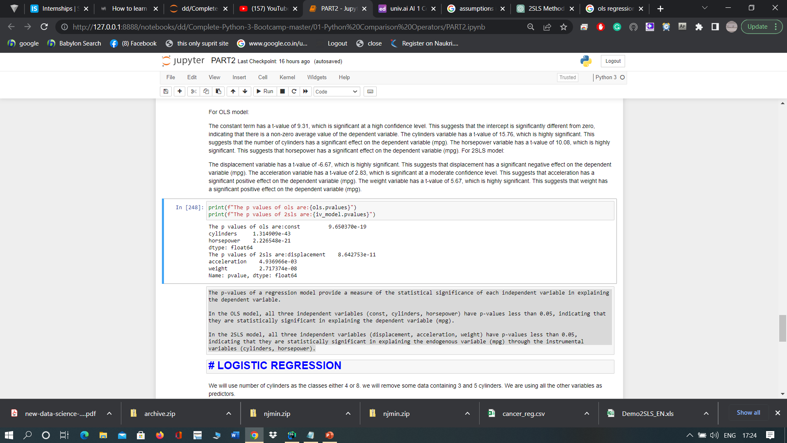
Results and Inferences
The p-values of a regression model provide a measure of the statistical significance of each independent variable in explaining the dependent variable.
In the OLS model, all three independent variables (const, cylinders, horsepower) have p-values less than 0.05, indicating that they are statistically significant in explaining the dependent variable (mpg).
In the 2SLS model, all three independent variables (displacement, acceleration, weight) have p-values less than 0.05, indicating that they are statistically significant in explaining the endogenous variable (mpg) through the instrumental variables (cylinders, horsepower).

Slide 12
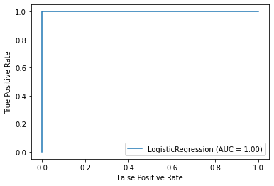
Logistic regression is a popular statistical method used to model the relationship between a binary outcome variable and one or more predictor variables. It is widely used in various fields, including medicine, social sciences, and marketing research, to predict the probability of an event occurring. Logistic regression models are often used when the dependent variable is binary (i.e., taking one of two possible values), and the independent variables can be continuous or categorical. The main idea behind logistic regression is to transform the outcome variable to a probability value between 0 and 1, which represents the likelihood of an event occurring given the predictor variables. Logistic regression models are useful for understanding the relationship between predictor variables and the outcome variable, and they allow researchers to estimate the effect of each predictor variable on the probability of the outcome variable. Logistic regression models can be extended to include multiple predictor variables, allowing researchers to examine the effects of multiple variables on the outcome variable simultaneously. The logistic regression model can be evaluated using various statistical measures, including accuracy, sensitivity, specificity, and area under the receiver operating characteristic curve (AUC-ROC).
We will use number of cylinders as the classes (either 4 or 8 ). We will remove some data containing 3 and 5 and 6 cylinders. We are using all the other variables as predictors. The data is scaled using Standard Scalar.
The results show that the MPG and the distance parameter are the most important in determining the number of cylinders. Though in theory we know mpg depends on the cylinders not the other way around.
Logistic Regression
Coefficients: [[ 0.22796165 -0.276047 0.12083271 0.01175305 0.11376608]] Intercept: [0.02114801] Accuracy: 1.0

Slide 13
Packages Used
NumPy and Pandas are popular libraries for data manipulation and analysis.
Matplotlib and Seaborn are visualization libraries for creating high-quality graphs and charts.
PyLab is a module that provides a convenient interface for Matplotlib and NumPy.
SciPy is a library for scientific computing and provides tools for optimization, integration, interpolation, and more.
Scikit-learn (sklearn) is a widely used machine learning library that includes many algorithms for classification, regression, and clustering.
Statsmodels is a statistical modeling library that provides tools for regression analysis, time series analysis, and other statistical methods.
Linear models is a package within Statsmodels that includes regression and instrumental variables models.
The IV2SLS and lm modules within Linear models are used for instrumental variables regression.
StandardScaler is a module within Scikit-learn used for feature scaling.

