Slide 1
OJT(On Job Training)-2
Name:
College name:-Government Polytechnic Udupi
Project name:-Wi-Fi network analysis
Project team members:-Supritha,Supreetha,Neeta,Kavana

Slide 2
Definition:
A Wi-Fi security analysis evaluates how protected a wireless network is against unauthorized access, data interception, and attacks. Below is a structured breakdown covering threats, protocols, vulnerabilities, and best practices.
In simple terms:
It is the examination of a Wi-Fi network’s protection mechanisms to determine how secure it is against hacking, data interception, and misuse.
In One Technical Sentence:
Wi-Fi security analysis is the systematic assessment of wireless network configurations, encryption standards, authentication protocols, and exposure risks to ensure confidentiality, integrity, and availability of transmitted data.

Slide 3
Key Components of Wi-Fi Security Analysis:
> Encryption assessment (e.g., WPA2, WPA3)
> Password strength evaluation
> Access control review
> Detection of rogue devices
> Configuration and firmware checks
> Risk identification and mitigation recommendations
Purpose:
The goal of Wi-Fi security analysis is to:
*Prevent unauthorized access
*Protect sensitive data
*Ensure network reliability
*Reduce cyberattack risks

Slide 4
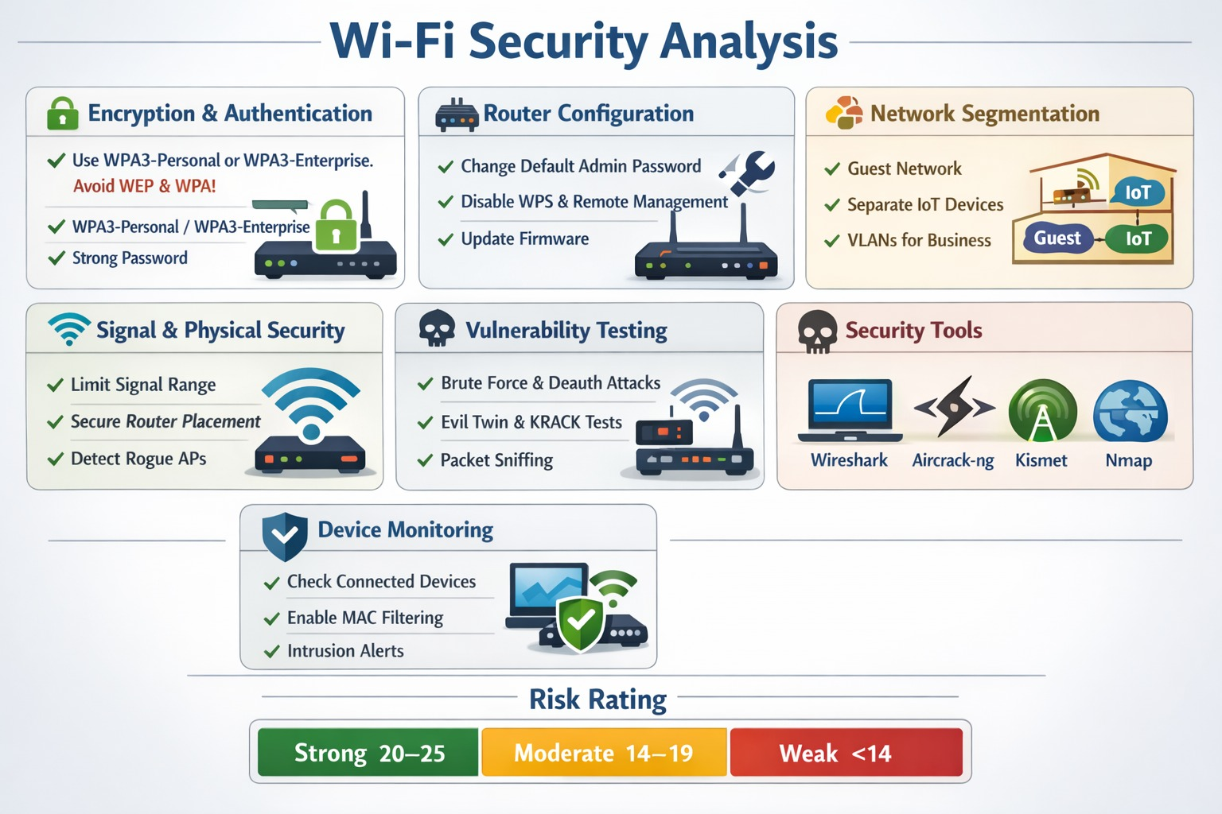

Slide 5
1️⃣ Common Wi-Fi Security Threats:
1. Unauthorized Access
Attackers try to connect to your network to steal bandwidth or access internal systems.
2. Rogue Access Points
A fake Wi-Fi hotspot mimics a legitimate network to steal user credentials.
3. Packet Sniffing
Unencrypted traffic can be intercepted and read.
4. Man-in-the-Middle (MITM) Attacks
Attackers intercept communication between users and the router.
5. Denial-of-Service (DoS)
Flooding the network to disrupt connectivity.
6. Brute-Force & Dictionary Attacks
Attempting to guess weak Wi-Fi passwords.

Slide 6
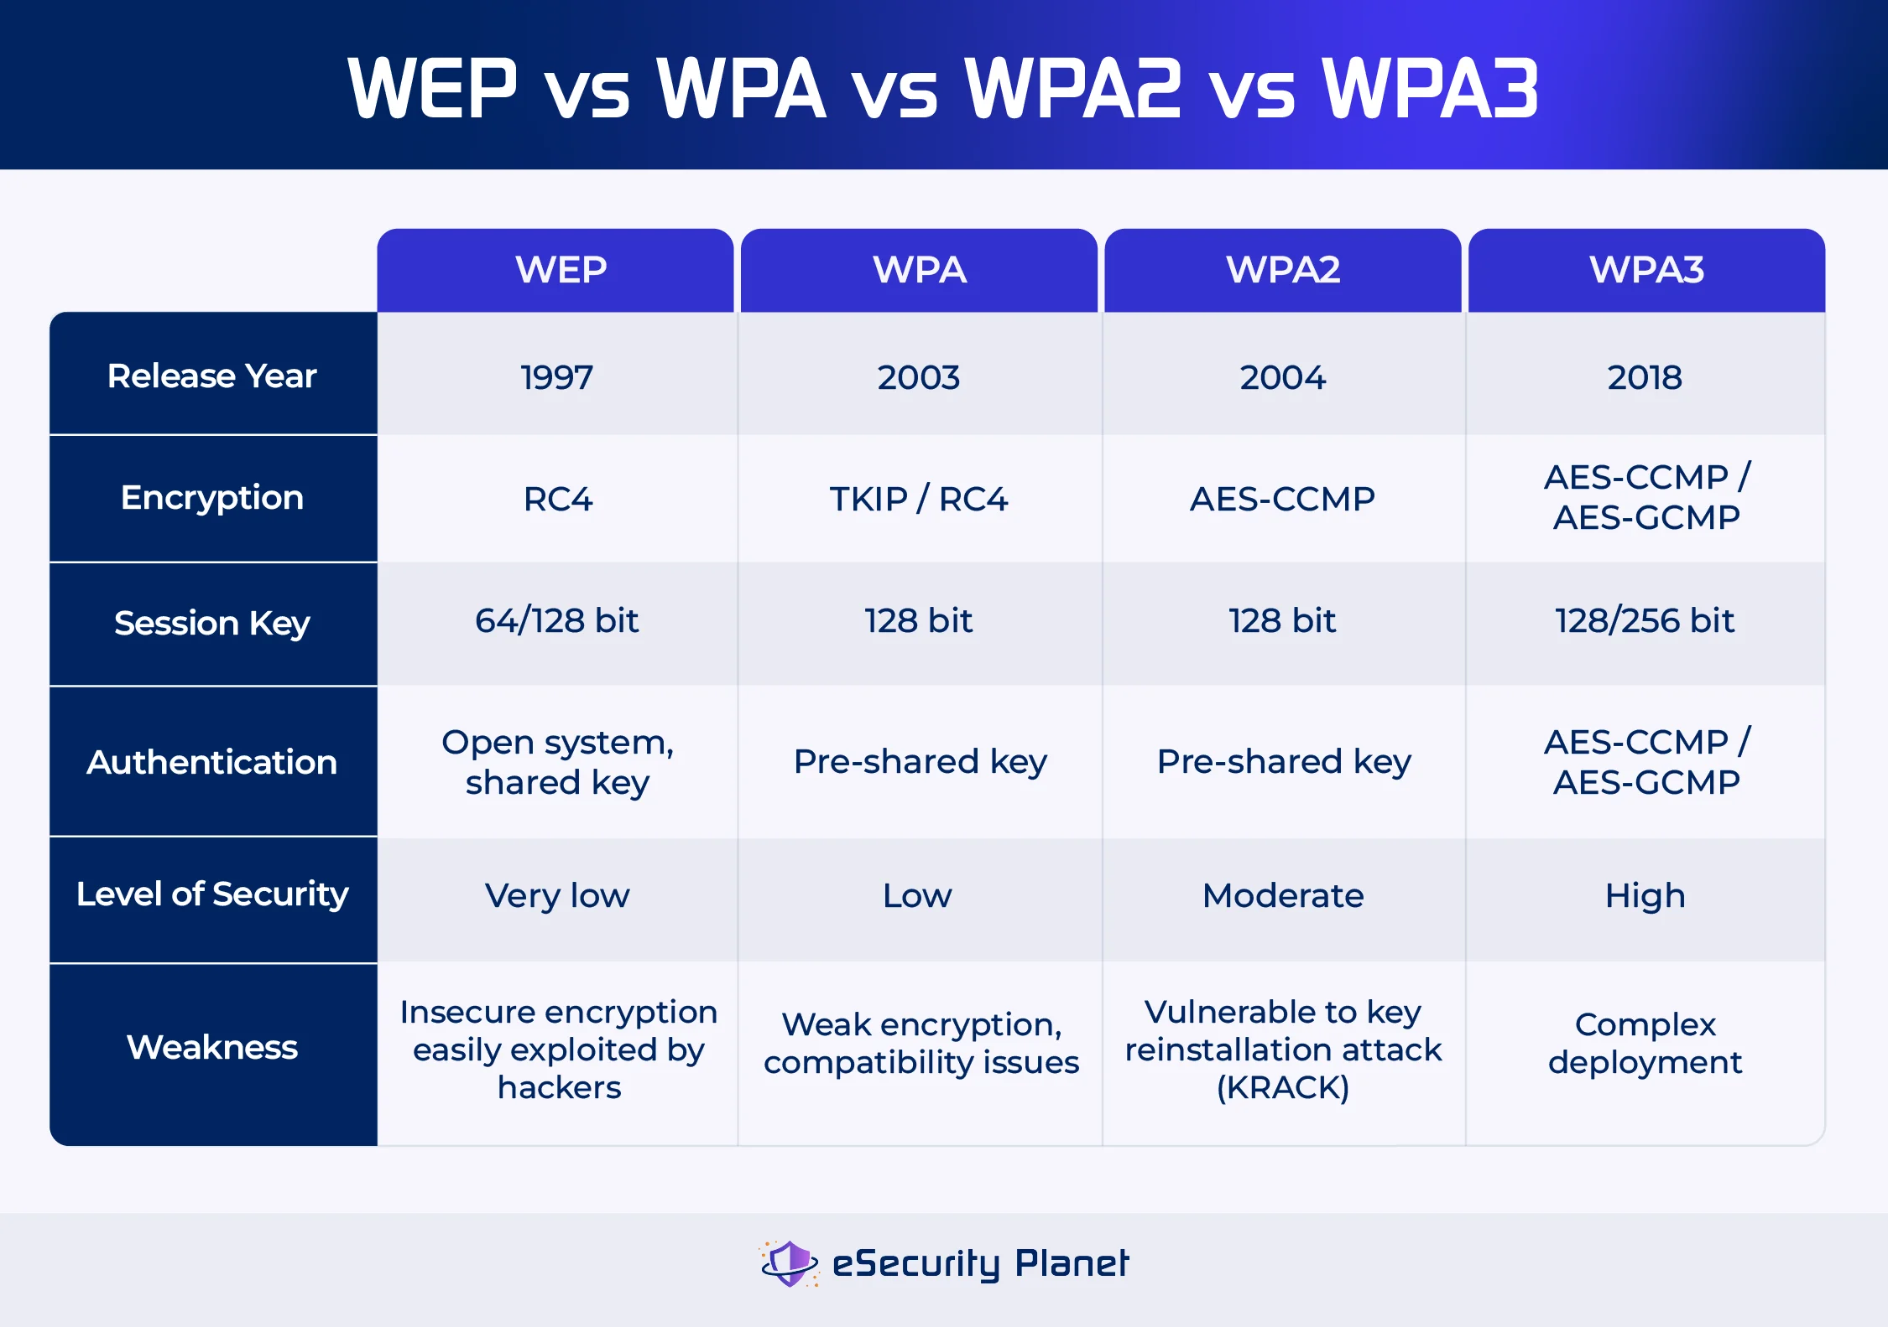
2️⃣Wi-Fi Security Protocols (Comparison):
WEP can be cracked in minutes.
WPA2-PSK is secure if using a strong password.
WPA3 protects against brute-force attacks and improves encryption.

Slide 7
3️⃣ Wi-Fi Vulnerability Assessment Steps:
Step 1: Network Discovery:
Identify SSID
Check hidden networks
Identify connected devices
Step 2: Encryption Analysis:
Determine protocol (WPA2/WPA3)
Check password strength
Verify AES usage
Step 3: Penetration Testing (Ethical Use Only):
Test for brute-force vulnerability
Check for WPS weakness

Slide 8
4️⃣ Key Wi-Fi Security Weaknesses:
Weak passwords (e.g., 12345678)
WPS enabled
Default router credentials
Outdated firmware
Open (unencrypted) networks
Poor router placement (signal leakage outside premises)
5️⃣ Wi-Fi Security Best Practices:
Essential Protections -:
✔ Use WPA3 (or WPA2-AES minimum) ✔ Create a 12–16+ character complex password ✔ Change default admin credentials ✔ Update router firmware regularly ✔ Enable firewall on router ✔ Use a guest network for visitors

Slide 9
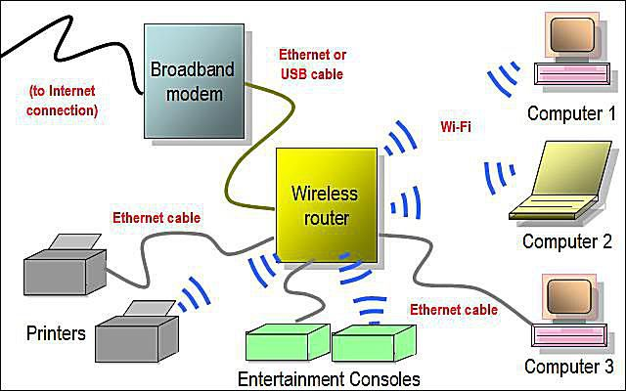
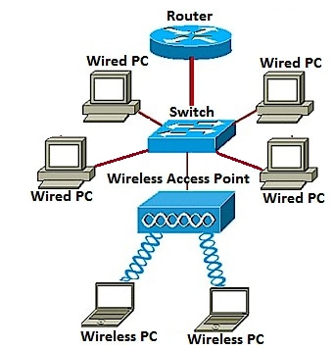
What It Involves-:
Router and access point configuration
SSID broadcasting settings
Network segmentation (guest vs internal)
Firewall placement

Slide 10


