Slide 1
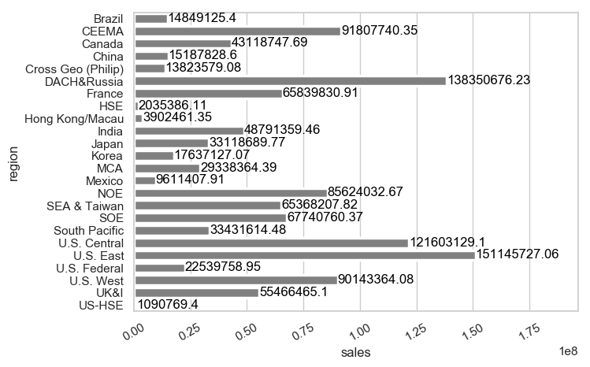
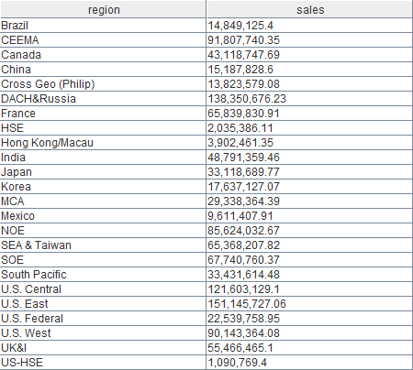
SALES BY REGION

Slide 2
SALES BY REGION

