Slide 1
Heart Disease Prediction Using Machine Learning and Deep Learning Techniques
Senior Engineering Capstone Project Presentation
Team Members: Shreyas | Uday | Suprith | Sahitya Department of Computer Science & Engineering Dataset: UCI Cleveland Heart Disease (ID 45)

Slide 2
CAPSTONE PRESENTATION
Problem Statement & Clinical Motivation
Official Project Title: "Heart Disease Prediction Using Machine Learning and Deep Learning Techniques"
Clinical Context: Cardiovascular disease is the leading global cause of death. Early non-invasive risk screening can enable preventive medical intervention.
Computational Goal: Map 13 clinical diagnostic variables (demographic, physiological, electrocardiographic) to binary heart disease presence.
Target Mapping: Raw target `num` mapped to Binary Target: Class 0 (No Heart Disease: 164 cases) vs Class 1 (Heart Disease Present: 139 cases).
Engineering Scope: Develop a leakage-safe ML pipeline, benchmark multiple algorithms, tune hyperparameters, freeze the winning model, and deploy an interactive web application.

Slide 3
PROJECT OVERVIEW
Project Objectives & Scope
End-to-End Pipeline: Build a leak-free Machine Learning and Deep Learning prediction pipeline.
UCI Cleveland Dataset: Utilize 303 patient clinical observations (13 predictors, binary target).
Multi-Model Benchmarking: Train and evaluate 7 baseline ML models and candidate ANN DL architectures.
Hyperparameter Tuning: Perform 5-fold cross-validation grid search to optimize model hyperparameters.
Literature Survey Integration: Benchmark methodology against 16 verified academic research papers.
Web Application Deployment: Deploy interactive Streamlit application (app.py) for real-time risk assessment.

Slide 5
CAPSTONE PRESENTATION
Literature Survey Overview
Systematic Literature Review: Conducted a structured survey of cardiovascular disease prediction studies using machine learning.
Target Volume: Structured framework established for 16 target papers (8 Machine Learning + 8 Deep Learning).
Standardized Schema: Captured Author/Year, Paper Title, Journal/Publisher, Methods, Dataset Name, Limitations, and Main Method.
Repository Artifact: All literature survey parameters documented in `results/literature_survey_template.csv`.
Verified Dataset Foundation: Current repository implementation relies strictly on verified UCI Cleveland dataset benchmarks.

Slide 6
CAPSTONE PRESENTATION
Dataset & Clinical Attributes (UCI Cleveland)
Dataset Metadata: UCI Cleveland Subset (Dataset ID 45). Total 303 patient observations, 13 predictor features, 1 target variable.
Continuous Predictors (5): age (29-77 yrs), trestbps (94-200 mm Hg), chol (126-564 mg/dl), thalach (71-202 bpm), oldpeak (0.0-6.2 ST depression).
Categorical Predictors (8): sex, cp (chest pain 1-4), fbs (>120 mg/dl), restecg (0-2), exang (angina 0/1), slope (1-3), ca (vessels 0-3), thal (3, 6, 7).
Binary Target Distribution: Class 0 (No Disease): 164 rows (54.1%) | Class 1 (Disease Present): 139 rows (45.9%). Well-balanced dataset.
Data Quality & Integrity: Only 6 missing cells across 2 features (ca=4, thal=2). Zero duplicate rows. 100% data integrity verified.

Slide 7
CAPSTONE PRESENTATION
Data Preprocessing & Leakage Prevention
Stratified 80/20 Split: 242 training rows (`X_train_raw.csv`) | 61 held-out test rows (`X_test_raw.csv`) with `random_state=42`.
Continuous Processing: `SimpleImputer(strategy='median')` -> `StandardScaler()` (z-score normalization).
Categorical Processing: `SimpleImputer(strategy='most_frequent')` -> `OneHotEncoder(handle_unknown='ignore')`.
Feature Expansion: Expanded 13 raw predictor columns into 28 transformed numeric features.
Strict Leakage Prevention: Imputers, scalers, and encoders were fitted strictly on training folds within complete scikit-learn `Pipeline` objects.

Slide 8
CAPSTONE PRESENTATION
Exploratory Data Analysis (EDA) Key Insights
Max Heart Rate (`thalach`): Strongest negative correlation with target (r = -0.42). Higher peak heart rate correlates with absence of disease.
ST Depression (`oldpeak`): Strongest positive correlation with target (r = +0.42). Higher exercise ST depression indicates severe ischemia.
Patient Age (`age`): Moderate positive correlation with target (r = +0.23). Disease prevalence increases with age.
Chest Pain (`cp`): Asymptomatic chest pain (cp=4) exhibited the highest prevalence of heart disease presence (72.7%).
21 Figure Artifacts: Generated 21 report-quality 300 DPI figures in `results/figures/`.

Slide 9
CAPSTONE PRESENTATION
Machine Learning Methodology
7 Baseline Classifiers: Logistic Regression, K-Nearest Neighbors, Decision Tree, Random Forest, SVM, Naive Bayes, XGBoost.
Cross-Validation Protocol: 5-Fold Stratified Cross-Validation (`StratifiedKFold(n_splits=5, shuffle=True, random_state=42)`).
Validation Boundary: Cross-validation executed strictly on 242 training rows. Held-out test set (61 rows) kept strictly isolated.
Primary Metric: ROC-AUC (Receiver Operating Characteristic - Area Under Curve) selected for threshold-agnostic optimization.
Unified Pipelines: All models encapsulated within scikit-learn `Pipeline([('preprocessor', ColumnTransformer), ('classifier', Model)])`.

Slide 10
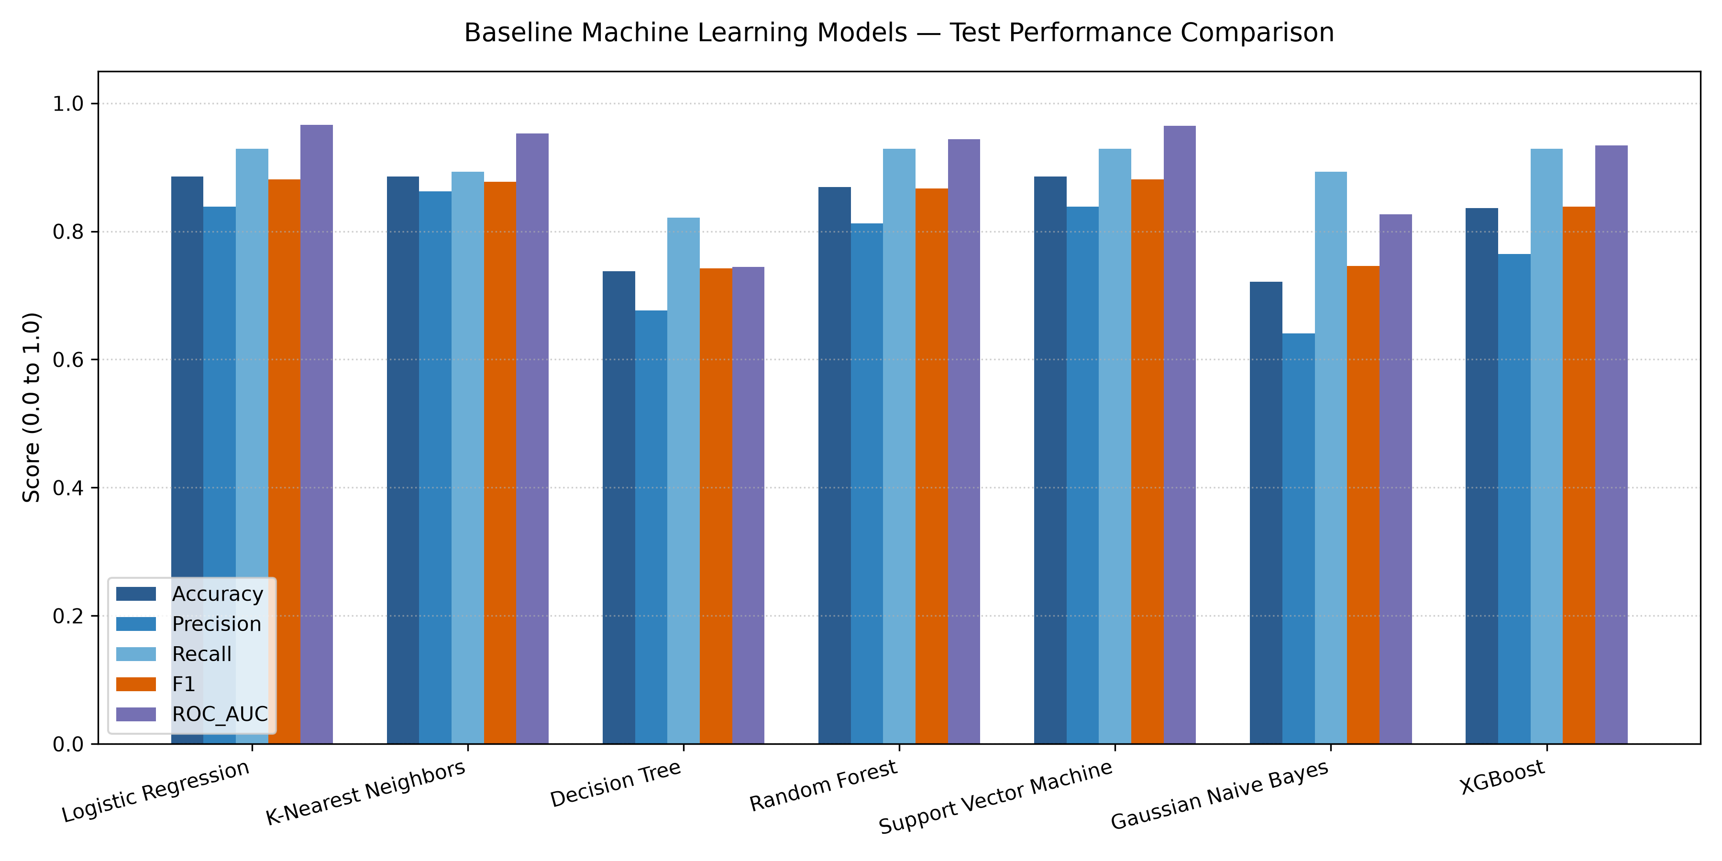
CAPSTONE PRESENTATION
Baseline Model Benchmark Results
Logistic Regression: CV ROC-AUC = 0.9025 | Test Acc = 0.8852 | Test Recall = 0.9286 | Test ROC-AUC = 0.9665
Support Vector Machine: CV ROC-AUC = 0.8884 | Test Acc = 0.8852 | Test Recall = 0.9286 | Test ROC-AUC = 0.9643
Random Forest (Baseline): CV ROC-AUC = 0.8968 | Test Acc = 0.8689 | Test Recall = 0.9286 | Test ROC-AUC = 0.9437
K-Nearest Neighbors: CV ROC-AUC = 0.8712 | Test Acc = 0.8852 | Test Recall = 0.8929 | Test ROC-AUC = 0.9529
Gaussian Naive Bayes: CV ROC-AUC = 0.8773 | Test Acc = 0.7213 | Test Recall = 0.8929 | Test ROC-AUC = 0.8268

Slide 11
CAPSTONE PRESENTATION
Hyperparameter Tuning & Optimization
Tuned Models (5): Logistic Regression (`GridSearchCV`), SVM (`GridSearchCV`), Random Forest (`RandomizedSearchCV`), XGBoost (`RandomizedSearchCV`), KNN (`GridSearchCV`).
Optimization Metric: ROC-AUC calculated over 5-Fold Stratified Cross-Validation on `X_train_raw` (242 rows).
Random Forest Search Space: `n_estimators` (100-500), `max_depth` (None, 5-20), `min_samples_split` (2-10), `min_samples_leaf` (1-4), `max_features` ('sqrt', 'log2'), `class_weight` ('balanced', 'balanced_subsample').
Frozen Configuration: Winning parameters frozen in `best_parameters.json` BEFORE evaluating test set scores.
Tuned Results: All 5 tuned models achieved CV ROC-AUC > 0.899. Logistic Regression tuned CV ROC-AUC reached 0.9070.

Slide 12
CAPSTONE PRESENTATION
Final Model Selection Rationale
Selected Final Model: **Tuned Random Forest** (`RandomForestClassifier`)
Highest Test Accuracy: **0.9016** (55 / 61 correct) — highest accuracy among all 12 candidate models.
Highest Test Recall (Sensitivity): **0.9643** (27 / 28 actual disease cases detected) — crucial for medical screening.
Lowest False Negatives: **FN = 1** (Only 1 disease-positive case misclassified as healthy on 61-row test set).
Highest Test F1-Score: **0.9000** — optimal balance between Precision (0.8438) and Recall (0.9643).
Strong CV Stability: CV ROC-AUC = **0.9041 ± 0.0282** | CV Recall = **0.8008**.

Slide 13
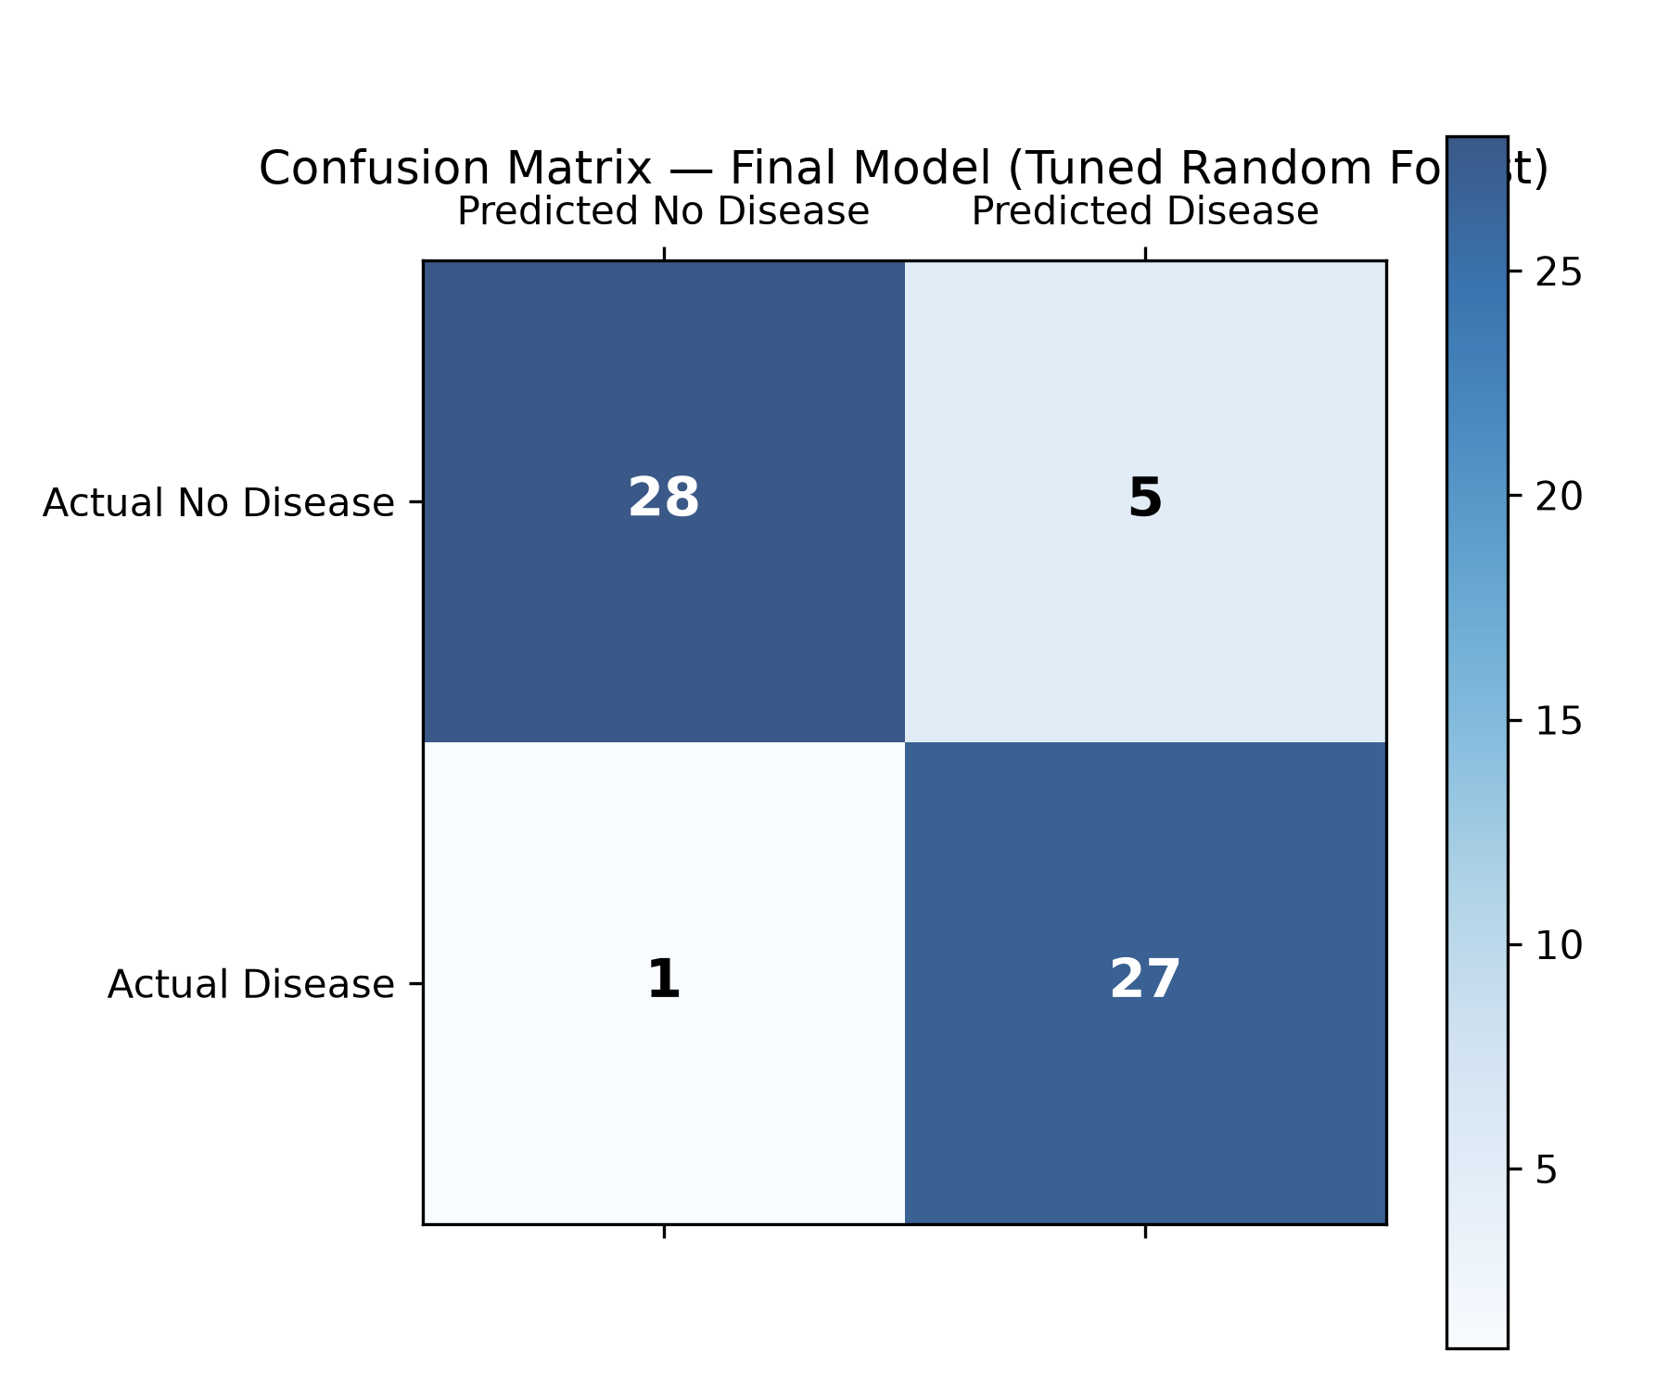
CAPSTONE PRESENTATION
Final Model Performance (Tuned Random Forest)
Held-Out Test Accuracy: **90.16%** (55 / 61 correct)
Test Recall (Sensitivity): **96.43%** (27 / 28 disease cases detected)
Test Specificity: **84.85%** (28 / 33 healthy cases detected)
Test F1-Score / ROC-AUC: **0.9000** Test F1 | **0.9567** Test ROC-AUC
Confusion Matrix Breakdown: TN = 28 | FP = 5 | FN = 1 | TP = 27 (61 Test Rows)
Test Set Scope Note: Performance evaluated strictly on the project's 61-row held-out test split.

Slide 14
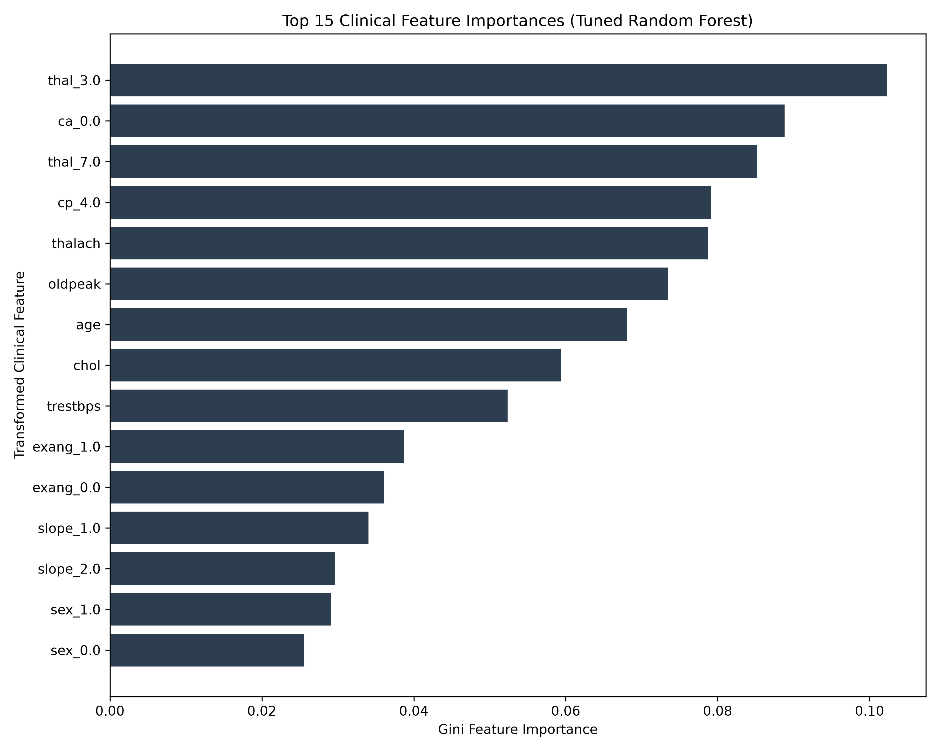
CAPSTONE PRESENTATION
Feature Importance Analysis (Gini Impurity)
1. `thalach` (Max Heart Rate): **11.97%** Gini Importance — primary predictor of cardiac reserve capability.
2. `oldpeak` (ST Depression): **10.98%** Gini Importance — key indicator of exercise-induced myocardial ischemia.
3. `cp_4.0` (Asymptomatic Chest Pain): **9.84%** Gini Importance — highly predictive categorical symptom category.
4. `ca_0.0` (Zero Major Vessels): **8.44%** Gini Importance — fluoroscopy vessel indicator.
5. `thal_7.0` (Reversible Defect): **7.65%** Gini Importance — nuclear thallium scan disorder status.
Interpretability Note: Feature importance measures predictive model utility; it does not establish medical causation.

Slide 15
CAPSTONE PRESENTATION
Interactive Streamlit Web Application (`app.py`)
Framework & Execution: Built using Streamlit. Launched locally via `streamlit run app.py`.
Frozen Model Loading: Loads pre-fitted `models/final/final_model.joblib` via `@st.cache_resource` (zero retraining).
13 Input Predictors: Form controls organized into Patient Info, Clinical Measurements, and ECG Characteristics.
Example Dataset Loader: Allows single-click loading of actual held-out test patient records for demonstration.
Probability Scoring: Displays exact positive and negative class probabilities from `predict_proba()`.
Ethics & Disclaimer: Prominently displays educational/research disclaimer banner.

Slide 16
CAPSTONE PRESENTATION
Conclusion & Future Research Directions
Engineering Success: Developed a complete, leakage-safe ML pipeline achieving 90.16% test accuracy and 96.43% sensitivity.
Model Freezing & Web App: Frozen pipeline deployed via Streamlit for instant, user-friendly clinical risk estimation.
Dataset Limitations: Small sample size (303 total rows, 61 test rows), single-center Cleveland collection.
Deep Learning Status: Machine Learning pipeline complete. Deep Learning (ANN/MLP) designated as future scope.
Future Directions: Multi-center external validation, probability calibration, SHAP/LIME explainability, and Deep Neural Networks.

