Slide 1
SUPPLY CHAIN
Visibility & Optimization
Milestone 1 & Milestone 2
Transforming supply chain data into actionable insights
Group 5 – Infosys Springboard Internship
Vijetha
Supriya
Supraja
Srilatha
17 August 2026

Slide 2
Agenda
Project journey from raw data to business insights
01
02
03
Introduction & Problem Statement
Objectives & Dataset
Data Import & Preprocessing
04
05
06
EDA & -Defined Analysis
Power BI Dashboards
Insights & Conclusion
Group 5 • Infosys Springboard Internship • 2

Slide 3
Introduction
Supply chain visibility, analytics and decision-making
SUPPLY CHAIN
VISIBILITY
ANALYTICS
Planning, sourcing, manufacturing, transport and delivery.
Monitor inventory, suppliers, logistics and fulfillment.
Identify bottlenecks, control costs and improve decisions.
Tools Used
Python • Preprocessing
Power BI • Dashboards
Group 5 • Infosys Springboard Internship • 3

Slide 4
Problem Statement
Common challenges in supply chain operations
Stock
Delivery
Cost
Shortages and excess inventory
Delays and logistics inefficiencies
Higher operational expenses
Planning
Quality
Customer
Inefficient inventory planning
Supplier and product quality issues
Reduced customer satisfaction
Aim: Identify inefficiencies and support better decision-making.
Group 5 • Infosys Springboard Internship • 4

Slide 5
Objectives
What we aim to achieve
Analyze inventory, product, supplier and logistics data.
Identify missing values, duplicates and inconsistencies.
1
2
Clean and preprocess the dataset using Python.
Perform EDA to identify patterns and trends.
3
4
Develop interactive Power BI dashboards.
Generate actionable insights for optimization.
5
6
Group 5 • Infosys Springboard Internship • 5

Slide 6
Dataset Overview
Supply chain dataset used for analysis
1,540
24
Supply Chain
Records
Attributes
Domain
• Product: type, SKU, price, availability, sold and revenue.
• Logistics: shipping time, carrier, cost, mode and route.
• Supplier & manufacturing: cost, lead time, inspection and defect rate.
Group 5 • Infosys Springboard Internship • 6

Slide 7
Data Import & Understanding
Initial inspection using Pandas
df.head()
df.shape
df.info()
df.describe()
Preview records
(1540, 24)
Data types & null counts
Statistical summary
Purpose: Understand structure and identify data-quality issues before preprocessing.
Group 5 • Infosys Springboard Internship • 7

Slide 8
Data Preprocessing
Preparing a clean and reliable dataset
1
→
2
→
3
→
4
→
5
Import
Quality Check
Data Cleaning
Validation
Export
• Check missing values, duplicates, incorrect data types and formatting issues.
• Standardize the cleaned data and prepare it for Power BI analysis.
Group 5 • Infosys Springboard Internship • 8

Slide 9
EDA – Complete Process
Exploratory Data Analysis before deeper business analysis
Exploratory Data Analysis (EDA) is the process of examining, summarizing, cleaning, visualizing, and analyzing data.
It helps us understand the data structure, identify patterns and anomalies, and discover useful relationships.
Understand Data
→
Data Quality Check
→
Data Cleaning
↓
Multivariate Analysis
←
Bivariate Analysis
←
Univariate Analysis
↓
Statistical Analysis
→
Visualization
→
Find Patterns
↓
conclusions
←
Business Insights
Group 5 • Infosys Springboard Internship • 9

Slide 10
Formula Reference – Supply Chain KPIs
Useful formulas for the dashboard and presentation reference
Inventory Turnover
Average Inventory
Fulfillment Rate
COGS ÷ Average Inventory
(Beginning + Ending Inventory) ÷ 2
On-Time Deliveries ÷ Total Deliveries × 100
Measures inventory movement efficiency.
Used to calculate inventory turnover.
Percentage of deliveries completed on time.
Revenue
Defect Rate
Inventory Share %
Price × Products Sold
Defective ÷ Total Inspected × 100
Inventory via Mode ÷ Total Inventory × 100
Revenue generated from product sales.
Measures the proportion of defective units.
Contribution of each transport mode.
Group 5 • Infosys Springboard Internship • Formula Reference

Slide 11
Formula Reference – Analysis & Power BI
Additional formulas for analysis
Average Shipping Time
Variance
On-Time Delivery Count
Σ Delivery Time ÷ Number of Deliveries
Actual − Target
CALCULATE(COUNTROWS(Orders), Delivery Status = "On Time")
Average time taken for shipments.
Difference between achieved and expected values.
Counts orders delivered on time.
On-Time Delivery %
Total Orders
Total Revenue
DIVIDE([On-Time Delivery], [Total Delivery])
COUNTROWS(Orders)
SUM(Orders[Revenue_generated])
Power BI measure for on-time percentage.
Counts order records in the dataset.
Aggregates revenue for the dashboard.
Group 5 • Infosys Springboard Internship • Formula Reference

Slide 12
Milestone 2 – KPI & Performance Reference
Formulas and measures used for dashboard analysis
Total Orders
Total Revenue
Inventory Turnover
COUNTROWS(Orders)
SUM(Revenue_generated)
COGS ÷ Average Inventory
Number of order records.
Total revenue generated.
Measures inventory movement.
Fulfillment Rate
Variance
Avg. Delivery Time
On-Time Deliveries ÷ Total Deliveries × 100
Actual − Target
Σ Delivery Time ÷ Number of Deliveries
Measures delivery performance.
Compares actual performance with the target.
Measures average delivery duration.
Group 5 • Infosys Springboard Internship • 12

Slide 13
Milestone 2 – Supply Chain Analytics
Supply Chain Analysis Areas
Variance
Total Orders / Sales / Inventory / On-Time %
Inventory Performance
Variance = Actual − Target
Category Sales & Product Performance
Warehouse Inventory / Inventory Trend
Daily Performance
On-Time vs Delayed Delivery by Region
Average Delivery Time Trend
Drill-down / Filters
Drill-down path: Region → State → City → Warehouse → Product
Group 5 • Infosys Springboard Internship • 11

Slide 14
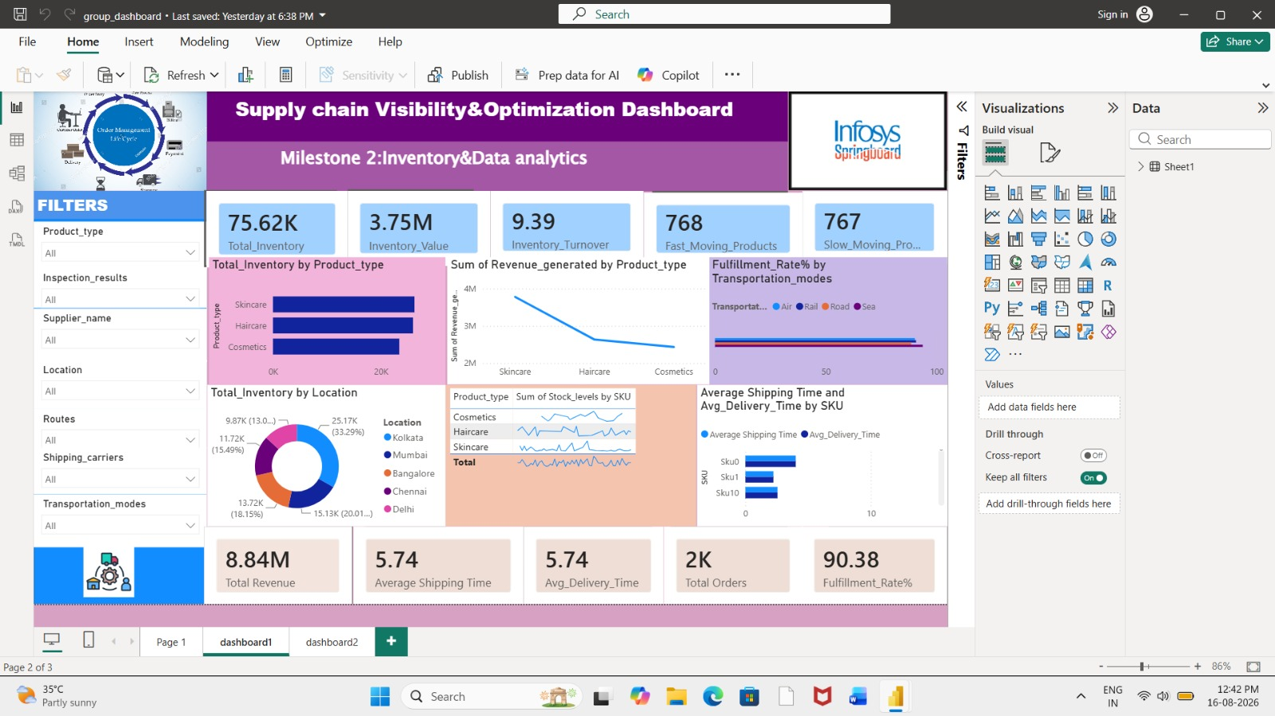
Dashboard 1 – Supply Chain KPIs
Actual Power BI dashboard
KEY METRICS
• Total Inventory: 75.62K
• Inventory Value: 3.75M
• Inventory Turnover: 9.39
• Total Revenue: 8.84M
• Avg. Shipping Time: 5.74
• Fulfillment Rate: 90.38%
Group 5 • Infosys Springboard Internship • 12

Slide 15
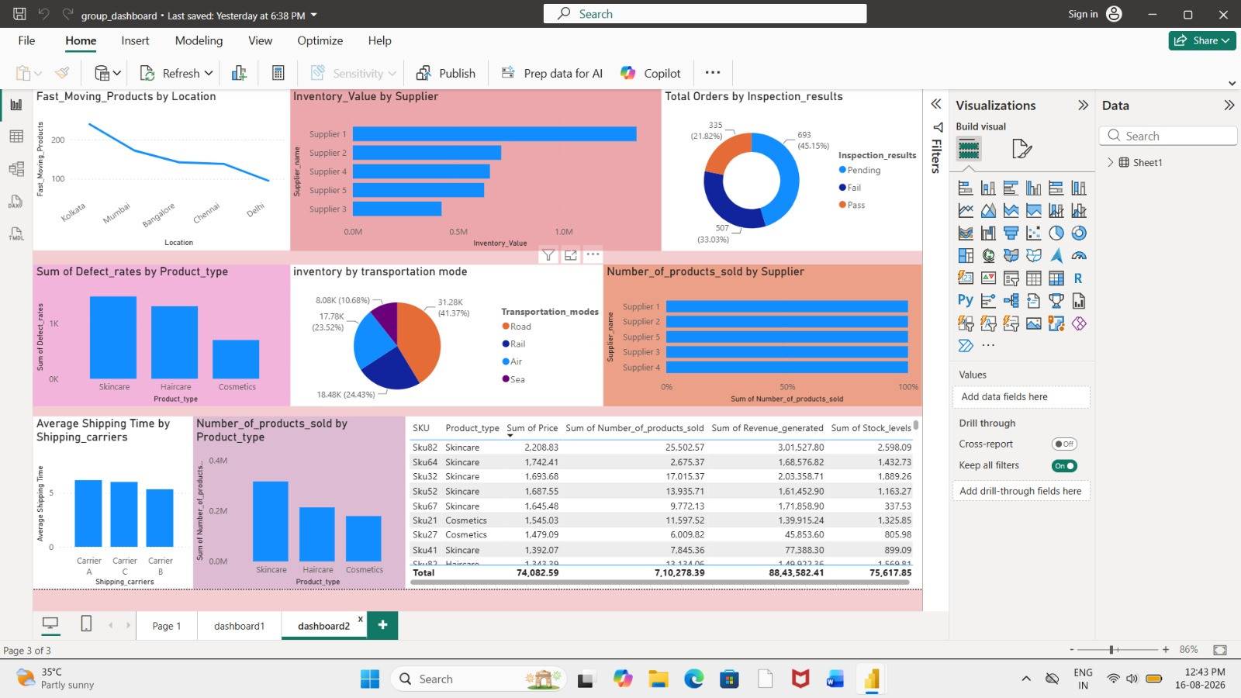
Dashboard 2 – Product & Supplier Analysis
Actual Power BI dashboard
KEY METRICS
• Supplier 1: highest inventory value
• Cosmetics: higher defect values
• Pending inspections: 45.15%
• Road inventory share: 41.37%
• Sales by supplier and product type
• Carrier shipping-time comparison
Group 5 • Infosys Springboard Internship • 13

Slide 16
Key Insights
What the dashboards reveal
Inventory
Transport
Fulfillment
Skincare contributes strongly to inventory and revenue.
Road has the largest inventory share (41.37%).
On-time fulfillment is 90.38%.
Shipping
Supplier
Quality
Average shipping time is 5.74 days.
Supplier 1 has the highest inventory value.
Cosmetics show comparatively higher defect values.
Group 5 • Infosys Springboard Internship • 14

Slide 17
Conclusion & Recommendations
From cleaned data to actionable decisions
CONCLUSION
FUTURE SCOPE
• Python preprocessing produced a structured dataset.
• EDA helped identify patterns, trends and anomalies.
• Power BI dashboards provide clear supply chain visibility.
• Insights support inventory, supplier, quality and logistics decisions.
• Demand forecasting using predictive analytics.
• Machine-learning based supplier risk assessment.
• Automated reporting for real-time monitoring.
RECOMMENDATIONS
Improve quality checks • Reduce pending inspections • Optimize transport
Group 5 • Infosys Springboard Internship • 15

Slide 18
THANK YOU
Supply Chain Visibility & Optimization
Group 5 – Infosys Springboard Internship
Vijetha • Supriya • Supraja • Srilatha
Data-driven insights for smarter supply chains

