Slide 1
SUPPLY CHAIN
Visibility & Optimization
Milestone 1 • Milestone 2 • Milestone 3
Transforming supply chain data into actionable insights
Group 5 – Infosys Springboard Internship
Vijetha • Supriya • Supraja • Srilatha
25 August 2026

Slide 2
Agenda
PROJECT OVERVIEW
Project journey from raw data to business insights
01 Introduction & Problem Statement
04 MILESTONE 2 – EDA & Power BI Supply Chain Analysis
02 Objectives & Dataset
05 MILESTONE 3 – Advanced Supply Chain Dashboards
03 MILESTONE 1 – Data Preprocessing & EDA
06 Insights, Recommendations & Conclusion
Group 5 • Infosys Springboard Internship • Supply Chain Visibility & Optimization
2

Slide 3
Introduction
PROJECT CONTEXT
From data preprocessing to supply chain performance optimization
SUPPLY CHAIN
VISIBILITY
ANALYTICS
Planning, sourcing, manufacturing, transport, and delivery.
Monitor inventory, suppliers, logistics, and fulfillment.
Identify bottlenecks, control costs, and improve decisions.
TOOLS USED
Python
Power BI
Data preprocessing and data-quality preparation.
Interactive dashboards and performance analysis.
Milestone 1 → Clean data • Milestone 2 → Analysis & dashboards • Milestone 3 → Advanced performance dashboards
Group 5 • Infosys Springboard Internship • Supply Chain Visibility & Optimization
3

Slide 4
Problem Statement
PROJECT CONTEXT
Common challenges in supply chain operations
Stock
Delivery
Cost
Shortages and excess inventory
Delays and logistics inefficiencies
Higher operational expenses
Planning
Quality
Customer
Inefficient inventory planning
Supplier and product quality issues
Reduced customer satisfaction
Aim
Analyze supply chain performance, identify inefficiencies, and support data-driven optimization.
Group 5 • Infosys Springboard Internship • Supply Chain Visibility & Optimization
4

Slide 5
Objectives
PROJECT CONTEXT
What we aim to achieve
01
02
Understand and analyze the supply chain dataset.
Identify and resolve data-quality issues using Python.
03
04
Perform exploratory data analysis to identify patterns and trends.
Develop interactive Power BI dashboards for supply chain analysis.
05
06
Evaluate supplier, transportation, route, and carrier performance.
Combine key performance indicators to generate actionable optimization insights.
Group 5 • Infosys Springboard Internship • Supply Chain Visibility & Optimization
5

Slide 6
Milestone 1: Dataset Overview
MILESTONE 1
Supply chain dataset used for analysis
1,540
24
Supply Chain
Records
Attributes
Domain
Product
Logistics
Supplier & Manufacturing
Type • SKU • Price • Availability • Products Sold • Revenue
Shipping Time • Carrier • Shipping Cost • Transportation Mode • Route
Supplier • Manufacturing Cost • Lead Time • Inspection • Defect Rate
Purpose
Provide the data foundation for preprocessing, analysis, and dashboard development.
Group 5 • Infosys Springboard Internship • Supply Chain Visibility & Optimization
6

Slide 7
Milestone 1: Data Import & Understanding
MILESTONE 1
Initial inspection using Pandas
df.head()
df.shape
df.info()
df.describe()
Preview records
Rows and columns (1540, 24)
Data types & null counts
Statistical summary
Purpose
Understand the dataset structure, data types, missing values, and statistical characteristics before cleaning.
Output
Identified the data-quality issues that required preprocessing.
Group 5 • Infosys Springboard Internship • Supply Chain Visibility & Optimization
7

Slide 8
Milestone 1: Data Preprocessing
MILESTONE 1
Preparing a clean and reliable dataset
1. Import
2. Quality Check
3. Data Cleaning
4. Validation
5. Export
Load raw dataset
→
Missing values, duplicates, formatting
→
Clean and standardize
→
Verify cleaned data
→
Prepare final dataset
Data-quality checks
Missing values • Duplicates • Data types • Formatting
Output
MILESTONE 1 OUTCOME
Clean, structured dataset ready for EDA and Power BI analysis.
Clean & reliable dataset for analysis.
Group 5 • Infosys Springboard Internship • Supply Chain Visibility & Optimization
8

Slide 9
Milestone 1: EDA – Complete Process
MILESTONE 1
Exploratory Data Analysis before deeper business analysis
Definition
Examining, summarizing, cleaning, visualizing, and analyzing data to discover useful relationships.
Understand Data
Quality Check
Cleaning
Univariate / Bivariate / Multivariate Analysis
Statistical Analysis
Visualization
Find Patterns
Business Insights
MILESTONE 1 OUTCOME
Cleaned and analyzed data ready for dashboard development.
Group 5 • Infosys Springboard Internship • Supply Chain Visibility & Optimization
9

Slide 10
Milestone 2: Supply Chain Analysis
MILESTONE 2
Exploring supply chain performance using cleaned data
Inventory Performance
Category & Product Performance
Warehouse inventory • Inventory trend
Daily performance
Fulfillment Analysis
Variance Analysis
On-time vs delayed delivery • Average delivery time trend
Variance = Actual − Target • Orders / Sales / Inventory / On-Time %
Drill-down Path
Purpose
Region → State → City → Warehouse → Product
Defines the analytical focus areas before viewing dashboard outputs.
Group 5 • Infosys Springboard Internship • Supply Chain Visibility & Optimization
10

Slide 11
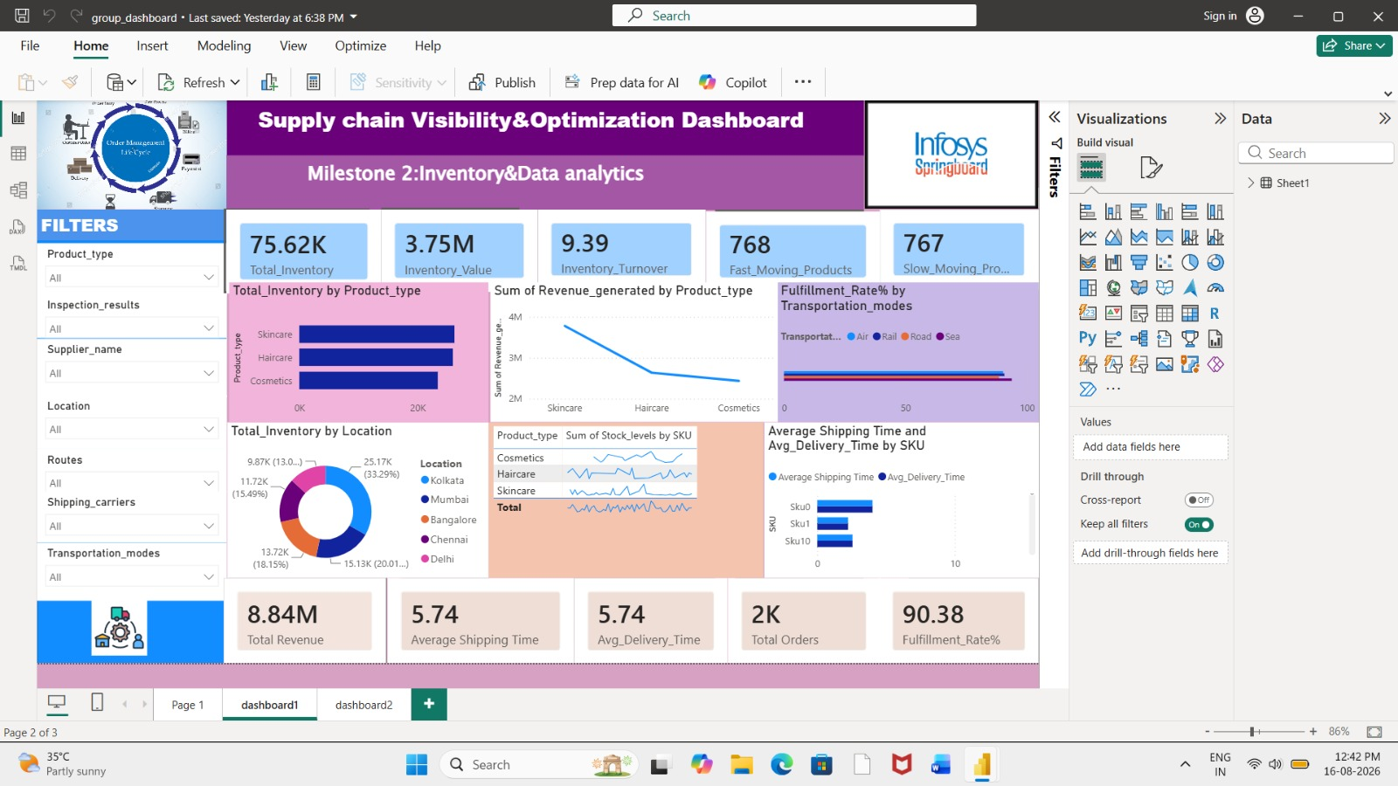
Milestone 2: Dashboard 1 – Supply Chain KPIs
MILESTONE 2
Monitor overall inventory, revenue, shipping, and fulfillment performance
KEY METRICS
75.62K
3.75M
Total Inventory
Inventory Value
9.39
8.84M
Inventory Turnover
Total Revenue
5.74 days
90.38%
Avg. Shipping Time
Fulfillment Rate
Existing Power BI dashboard screenshot
Group 5 • Infosys Springboard Internship • Supply Chain Visibility & Optimization
11

Slide 12
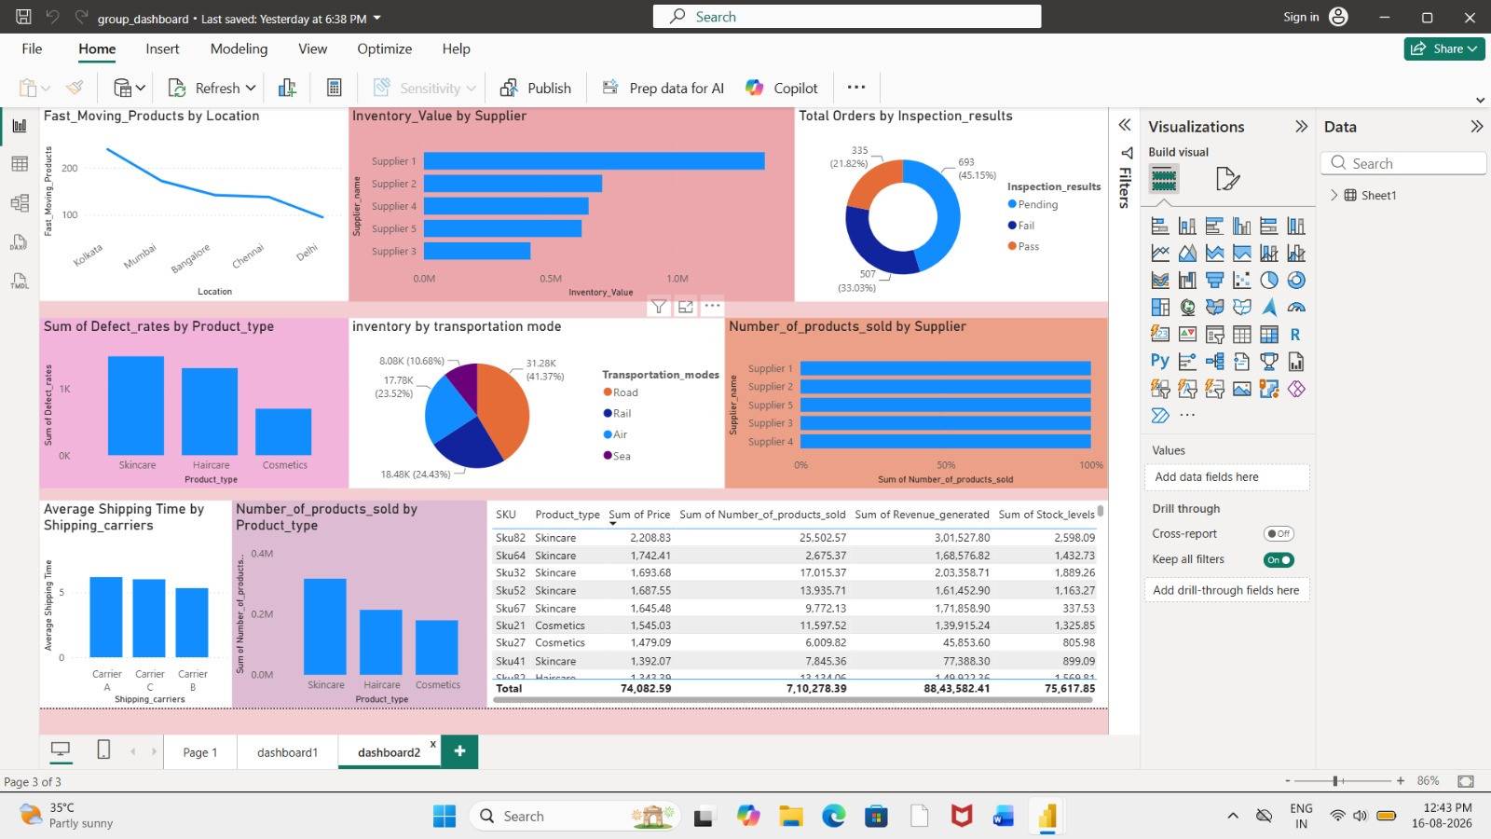
Milestone 2: Dashboard 2 – Product & Supplier Analysis
MILESTONE 2
Compare product, supplier, quality, and transportation performance
KEY OBSERVATIONS
Supplier 1: Highest inventory value
Cosmetics: Higher defect values
Pending Inspections: 45.15%
Road Inventory Share: 41.37%
Sales by Supplier & Product Type: Itemized tracking
Carrier Comparison: Shipping time comparison
Existing Power BI dashboard screenshot
Group 5 • Infosys Springboard Internship • Supply Chain Visibility & Optimization
12

Slide 13
Milestone 2: Key Insights
MILESTONE 2
Key observations from the existing Power BI analysis
Inventory
Transportation
Skincare contributes strongly to inventory and revenue.
Road has the largest inventory share (41.37%).
Fulfillment
Shipping
On-time fulfillment is 90.38%.
Average shipping time is 5.74 days.
Supplier
Quality
Supplier 1 has the highest inventory value.
Cosmetics show comparatively higher defect values.
Group 5 • Infosys Springboard Internship • Supply Chain Visibility & Optimization
13

Slide 14
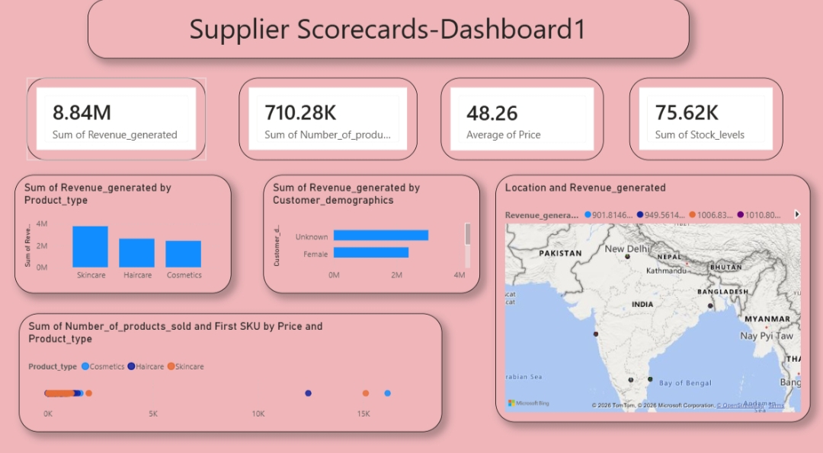
Milestone 3: Supplier Scorecards – Overview
MILESTONE 3
Main question: Which suppliers are performing well and which need improvement?
Evaluation Criteria
Revenue • Products Sold • Average Price • Stock Levels • Product Type
What This Dashboard Shows
Revenue 8.84M • Products Sold 710.28K • Average Price 48.26 • Stock Levels 75.62K
Purpose
Summarizes supplier-related sales, product and stock performance in one view.
Group 5 • Infosys Springboard Internship • Supply Chain Visibility & Optimization
14

Slide 15
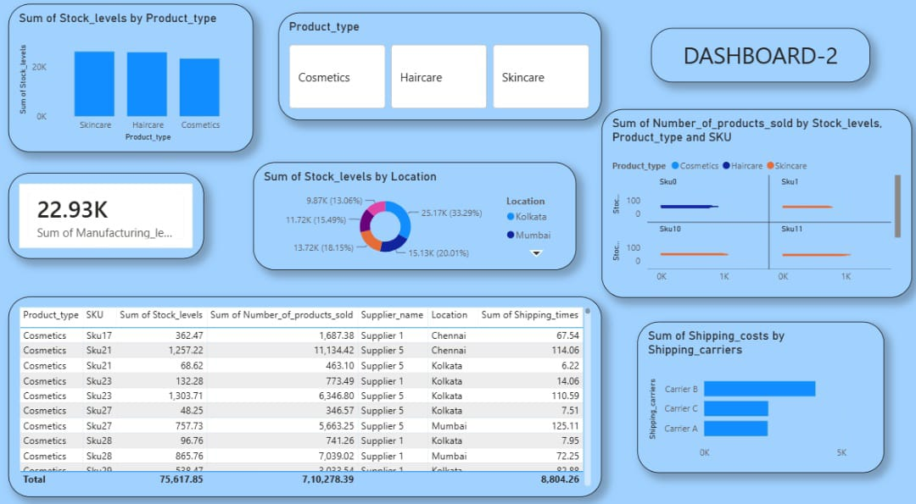
Milestone 3: Supplier Scorecards – Detailed Analysis
MILESTONE 3
Granular view of stock distribution, product contribution, and supplier logistics
What This Dashboard Shows
Stock by product type and location, SKU/product detail, supplier records and shipping cost by carrier.
Analysis Focus
Compare stock distribution, product contribution and logistics indicators across suppliers and locations.
Purpose
Provides a detailed supplier/product view for identifying areas that need attention.
Group 5 • Infosys Springboard Internship • Supply Chain Visibility & Optimization
15

Slide 16
Milestone 3: Supplier Scorecards – Analysis & Learning
MILESTONE 3
What we analyzed and what the dashboard helps us understand
What We Analyzed
What We Learned
Supplier revenue contribution Product volume Stock levels Location distribution Logistics costs
Supplier performance should be evaluated using multiple indicators such as sales contribution, stock levels, product contribution, and logistics cost.
Result: A multi-metric supplier view supports more balanced supplier evaluation.
Group 5 • Infosys Springboard Internship • Supply Chain Visibility & Optimization
16

Slide 17
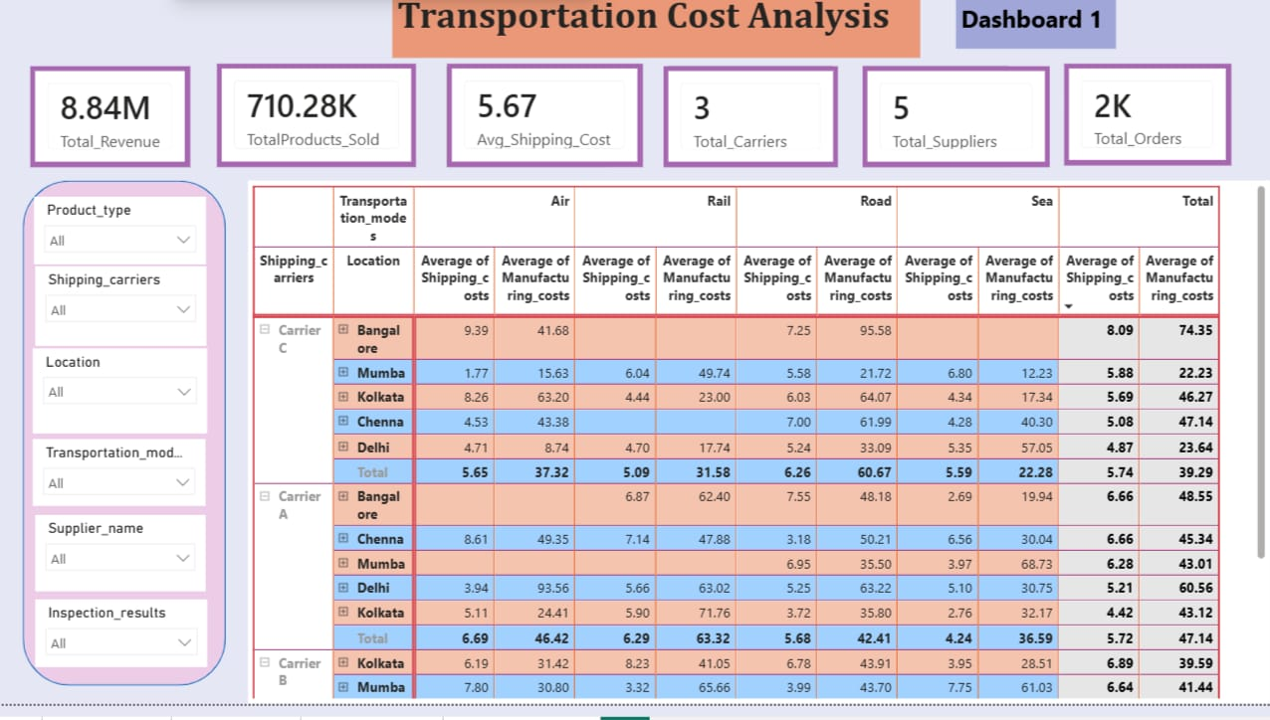
Milestone 3: Transportation Cost Analysis
MILESTONE 3
Main question: Where are we spending the most on transportation?
What This Dashboard Shows
Average Shipping Cost 5.67 • Total Revenue 8.84M • 3 Carriers • 5 Suppliers • About 2K Orders
Key Dimensions
Transportation Mode • Location • Carrier • Supplier • Product
Purpose
Shows where transportation spending is concentrated and supports cost comparison.
Group 5 • Infosys Springboard Internship • Supply Chain Visibility & Optimization
17

Slide 18
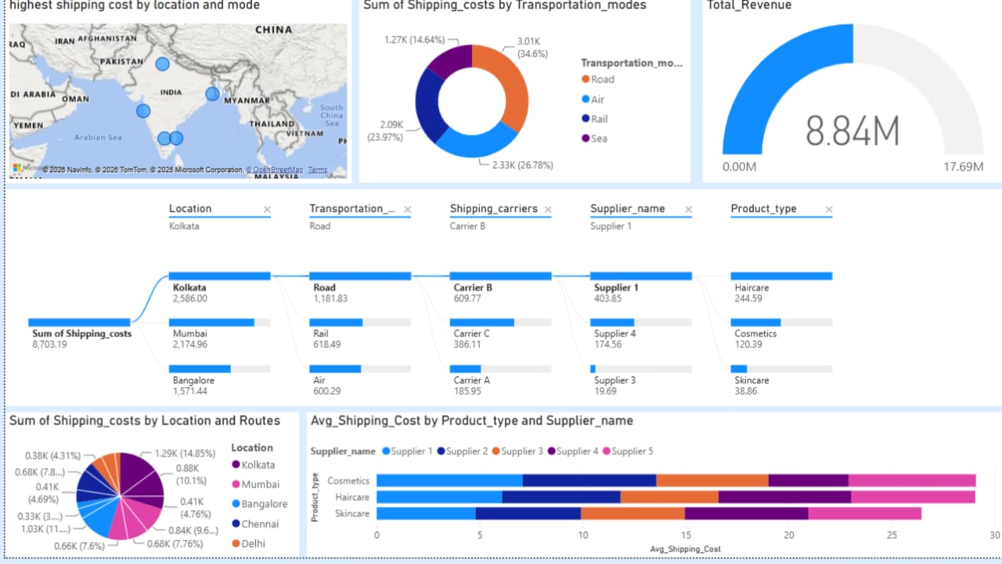
Milestone 3: Transportation Cost – Detailed Analysis
MILESTONE 3
Explore specific drivers generating high transportation expenses
What This Dashboard Shows
Shipping cost by transportation mode, location, carrier, route, supplier and product.
Analysis Focus
Compare transportation cost across multiple dimensions to locate major cost drivers.
Purpose
Uses comparisons and decomposition to locate major transportation cost drivers.
Group 5 • Infosys Springboard Internship • Supply Chain Visibility & Optimization
18

Slide 19
Milestone 3: Transportation Cost – Analysis & Learning
MILESTONE 3
What we analyzed and what the dashboard helps us understand
What We Analyzed
What We Learned
Shipping costs across modes Locations Carriers Products Suppliers
Comparing transportation mode, location, and carrier helps identify major cost drivers and potential areas for logistics optimization.
Result: Multi-dimensional cost analysis supports targeted transportation optimization.
Group 5 • Infosys Springboard Internship • Supply Chain Visibility & Optimization
19

Slide 20
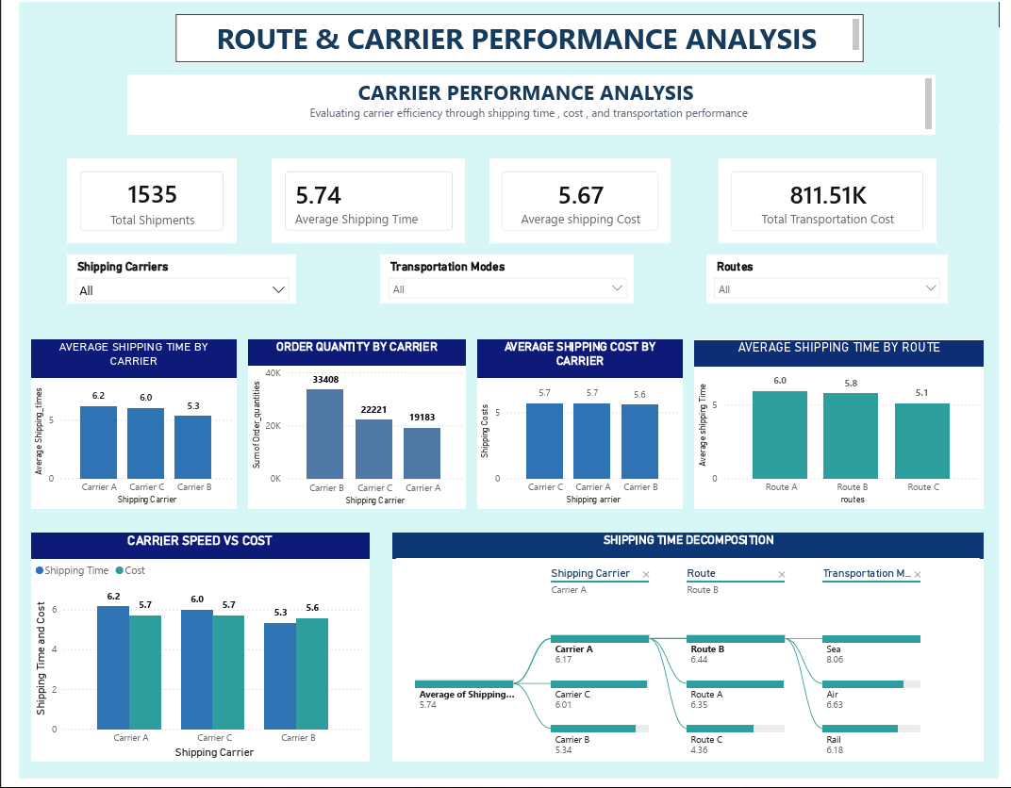
Milestone 3: Route & Carrier Performance
MILESTONE 3
Carrier Performance Analysis — compare carrier speed, cost and shipping quantity.
Key KPIs
Total Shipments 1,535 • Avg Shipping Time 5.74 • Avg Shipping Cost 5.67 • Total Transportation Cost 811.51K
What This Dashboard Shows
Carrier shipping time/cost, route shipping time, carrier speed vs cost, order quantity and shipping-time decomposition.
Purpose
Compares carrier and route performance using a common KPI framework.
Group 5 • Infosys Springboard Internship • Supply Chain Visibility & Optimization
20

Slide 21
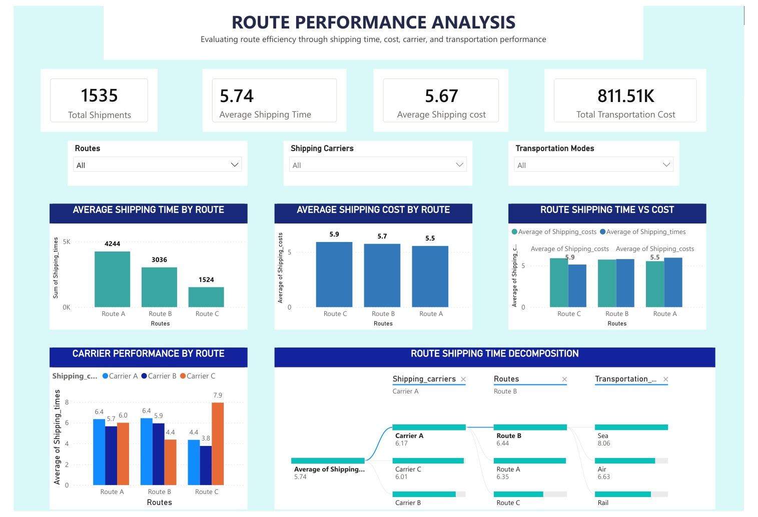
Milestone 3: Route & Carrier Performance – Detailed Analysis
MILESTONE 3
Route Performance Analysis — compare route speed, cost and carrier efficiency.
What This Dashboard Shows
Route-level shipping time and cost, route speed-vs-cost comparisons, decomposition and carrier performance by route.
Analysis Focus
Balance delivery speed and shipping cost rather than evaluating either measure alone.
Purpose
Supports evidence-based route and carrier selection.
Group 5 • Infosys Springboard Internship • Supply Chain Visibility & Optimization
21

Slide 22
Milestone 3: Route & Carrier Performance – Analysis & Learning
MILESTONE 3
What we analyzed and what the dashboard helps us understand
What We Analyzed
What We Learned
Shipping time Shipping cost Carrier performance Route performance Cost-time trade-offs
Comparing delivery speed and transportation cost together supports better route and carrier selection.
Result: Balanced route and carrier evaluation supports more efficient logistics decisions.
Group 5 • Infosys Springboard Internship • Supply Chain Visibility & Optimization
22

Slide 23
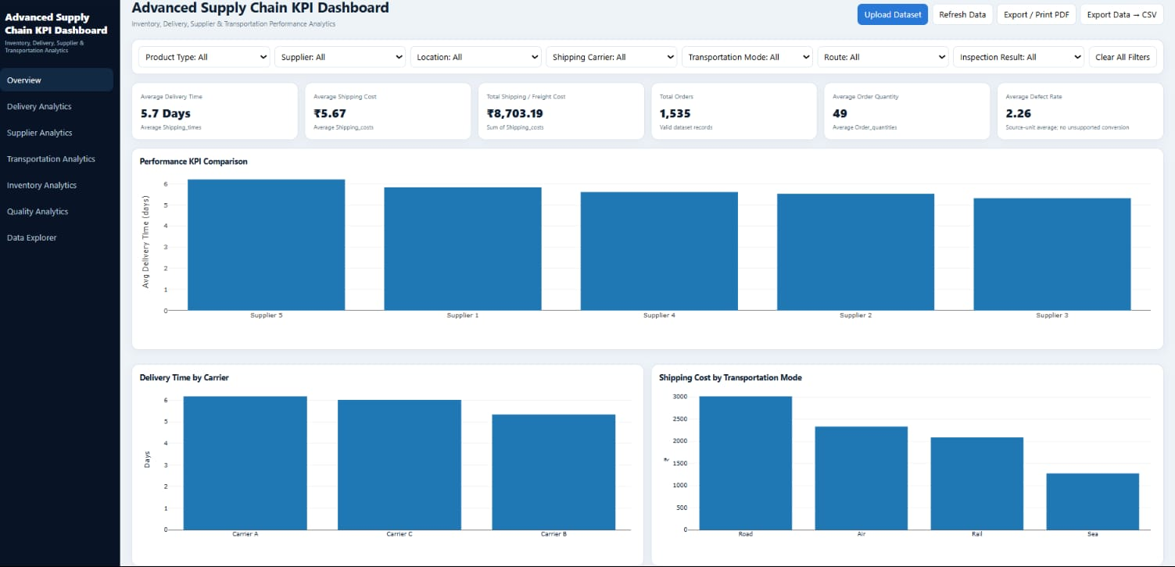
Milestone 3: Advanced KPI Visualization
MILESTONE 3
How can supply-chain KPIs be combined for quick performance analysis and decision-making?
KEY KPIs
On-Time Delivery %
Cost per Shipment
Average Delivery Time
Supplier Rating
Freight Cost
Purpose: Consolidate core supply chain metrics into a single screen.
Group 5 • Infosys Springboard Internship • Supply Chain Visibility & Optimization
23

Slide 24
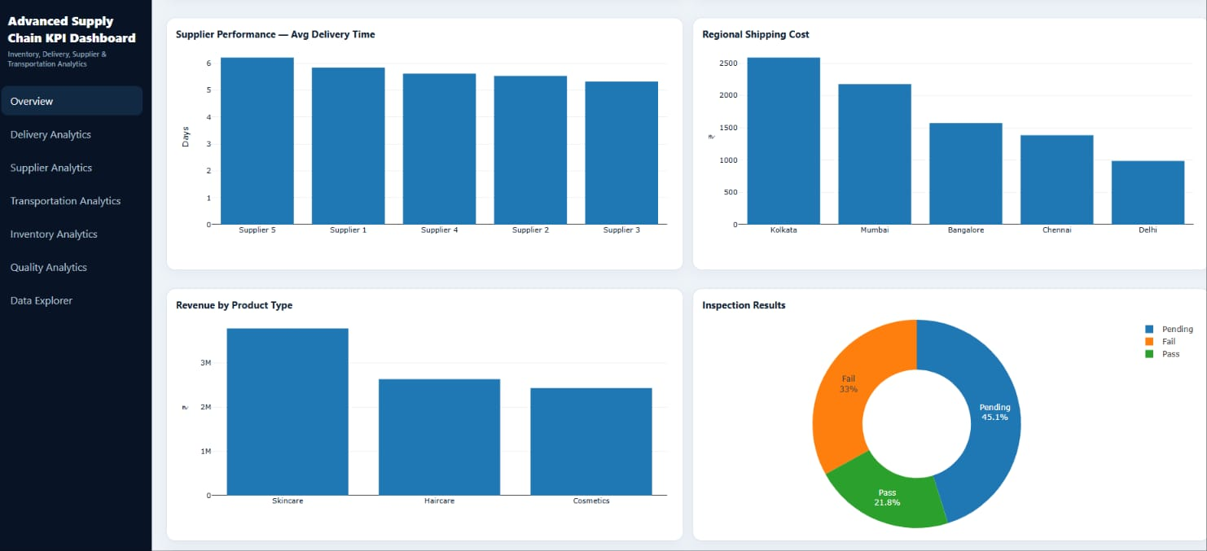
Milestone 3: Advanced KPI Visualization – Detailed Analysis
MILESTONE 3
Broader view connecting supplier, regional, revenue, and inspection metrics
What This Dashboard Shows
Supplier delivery performance, regional shipping cost, revenue by product type and inspection results.
Analysis Focus
Connect delivery, cost, revenue and quality indicators in one view.
Purpose
Provides a broader end-to-end view of supply chain performance.
Group 5 • Infosys Springboard Internship • Supply Chain Visibility & Optimization
24

Slide 25
Milestone 3: Advanced KPI Visualization – Analysis & Learning
MILESTONE 3
What we analyzed and what the integrated dashboard helps us understand
What We Analyzed
What We Learned
Delivery performance Transportation cost Supplier performance Product revenue Quality inspection results
A unified KPI dashboard provides a consolidated view of operational performance and helps identify bottlenecks across supply chain functions.
Result: Integrated KPIs improve visibility across multiple supply chain functions.
Group 5 • Infosys Springboard Internship • Supply Chain Visibility & Optimization
25

Slide 26
Overall Key Insights
PROJECT OUTCOMES
Integrated insights across all three milestones
Supplier Performance
Transportation Cost
Multi-metric supplier evaluation helps identify supplier strengths and improvement areas.
Mode-, location-, and carrier-level analysis helps identify major transportation cost drivers.
Route & Carrier Performance
Advanced KPI Visualization
Combining delivery time and cost provides a balanced view of logistics efficiency.
Integrated KPIs provide an overall view of supply chain performance and operational bottlenecks.
Group 5 • Infosys Springboard Internship • Supply Chain Visibility & Optimization
26

Slide 27
Key Findings & Recommendations
PROJECT OUTCOMES
Turning dashboard analysis into practical actions
Key Findings
Recommendations
• Supplier performance requires multiple performance indicators. • Transportation costs vary across modes, locations, and carriers. • Route and carrier efficiency depends on both cost and delivery speed. • Integrated KPIs improve overall supply chain performance monitoring.
1. Continuously monitor supplier performance scorecards. 2. Review high-cost transportation routes and modes. 3. Select routes and carriers using cost-time trade-offs. 4. Use interactive KPI dashboards for ongoing performance monitoring.
Focus: Improve visibility → identify bottlenecks → optimize decisions → monitor performance.
Group 5 • Infosys Springboard Internship • Supply Chain Visibility & Optimization
27

Slide 28
Conclusion & Future Scope
PROJECT OUTCOMES
From raw data to actionable supply chain performance insights
Milestone 1 – Data Preprocessing
Established a clean and structured dataset for analysis.
Milestone 2 – Supply Chain Analysis
Used EDA and Power BI to identify patterns and monitor operational KPIs.
Milestone 3 – Advanced Dashboards
Evaluated supplier, transportation, route, carrier, and KPI performance to support optimization.
Future Scope
Future Scope
Real-time supply chain data streaming and automated alerts.
Predictive demand forecasting and machine-learning-based supplier risk assessment.
Group 5 • Infosys Springboard Internship • Supply Chain Visibility & Optimization
28

Slide 29
THANK YOU
Supply Chain Visibility & Optimization
Group 5 – Infosys Springboard Internship
Vijetha • Supriya • Supraja • Srilatha
Data-driven insights for smarter supply chains
25 August 2026

