Slide 1

Distributed ML Benchmarking tool
Domain: Distributed Systems
Final Review
Course Code: CS7610
Course Title: Project 3
Register Number: 24MSP3012
Name: Sai Supriya Kotturu
Date: 18 May 2025

Slide 2
Abstract
This work introduces a modular benchmarking framework for evaluating the performance of distributed deep learning training strategies across multiple execution backends. The tool supports comparative benchmarking of PyTorch Distributed Data Parallel (DDP), Ray Train, Horovod, and DeepSpeed under a unified configuration schema. It enables experimentation with diverse model architectures—namely ResNet-50, UNet, and a Transformer encoder—across datasets including CIFAR-10 and a synthetic semantic segmentation dataset. Each training run is instrumented to capture granular performance metrics such as total wall-clock training time, average per-epoch duration, training throughput (samples/sec), final model accuracy, and peak memory footprint (MB).
The benchmarking engine is designed with extensibility in mind, leveraging abstract base classes for datasets, models, and frameworks, allowing seamless integration of additional components. The implementation prioritizes CPU compatibility and reproducibility, offering deterministic run control, limited batch execution for rapid evaluation, and support for single- and multi-process training scenarios. This tool provides a robust foundation for assessing the scalability and efficiency trade-offs inherent in various distributed training paradigms, making it valuable for systems research, model optimization studies, and framework-level performance tuning.

Slide 3
Introduction
Why Distributed Training?
Modern deep learning models (e.g., ResNet, Transformers) demand significant compute.
Single-device training is often too slow or memory-constrained.
Challenges
Multiple frameworks exist (PyTorch DDP, Ray Train, Horovod, DeepSpeed).
No unified method to benchmark and compare these systems fairly.
Our Solution
Developed a modular benchmarking tool for distributed ML training.
Supports: Frameworks: PyTorch DDP, Ray, Horovod, DeepSpeed Models: ResNet50, UNet, Transformer Datasets: CIFAR-10, synthetic segmentation

Slide 4
Key Features
Unified config-driven experiments
Metrics: training time, throughput, accuracy, memory
CPU-optimized and extensible for future backends
Use Cases
Systems research
ML infrastructure validation
Comparative benchmarking across frameworks

Slide 5
At the core is the BenchmarkEngine class, which parses user-provided configuration files (JSON or YAML) and orchestrates the execution of benchmark experiments. Each experiment defines a specific combination of model architecture, dataset, training framework, and hyperparameters.
Three major component abstractions drive the modular design:
Model Interface (BaseModel) Encapsulates model definition, loss function, and optimizer setup. Concrete subclasses include:
ResNet50Model for image classification
UNetModel for segmentation
SimpleTransformer for sequence modeling
Dataset Interface (BaseDataset) Responsible for data loading and preprocessing. Implementations:
CIFAR10Dataset: standard image classification
SyntheticSegmentationDataset: random mask generation for segmentation tasks

Slide 6
Framework Interface (BaseFramework) Abstracts distributed training logic. Implementations include:
PyTorchDDPFramework
RayTrainFramework
HorovodFramework
CPUDeepSpeedFramework (simplified CPU-mode wrapper)
Each framework adheres to a standard lifecycle:
setup() for environment configuration
train_model() for orchestrating training and metrics collection
cleanup() for teardown and finalization
The MetricsCollector records per-epoch training time and accuracy, and computes summary statistics such as average epoch time, total runtime, throughput, final accuracy, and peak memory usage.
This design supports rapid prototyping of benchmarks, easy integration of new components, and robust comparison of different distributed ML strategies.

Slide 7
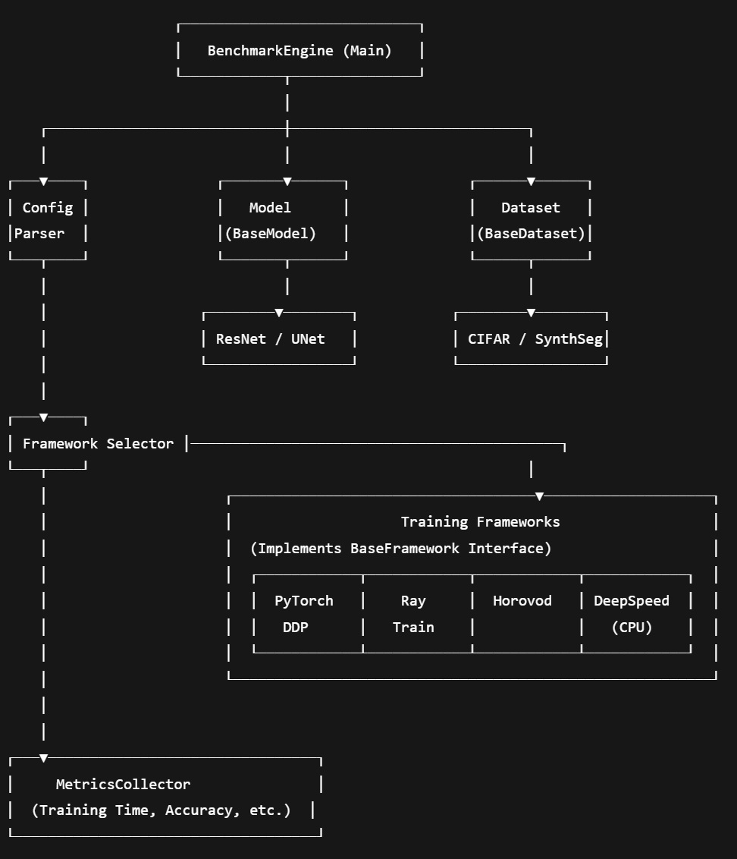

Slide 8
Need of study
Distributed training has become essential for training deep learning models at scale. However, with the rise of multiple frameworks that support distributed learning—such as PyTorch Distributed Data Parallel (DDP), Horovod, Ray Train, and DeepSpeed—there is a lack of standardized tools to evaluate and compare their performance across different tasks and hardware environments.
Key challenges include:
Lack of Benchmark Uniformity: Existing benchmarking efforts are often ad hoc, use inconsistent model/dataset combinations, and focus on specific frameworks or use cases.
Complexity of Setup: Setting up and running distributed training benchmarks involves complex configurations, often requiring significant time and expertise.
Hardware/Software Diversity: Performance varies significantly across CPU/GPU environments and software backends, making reproducibility and comparison difficult.
No Ground Truth on Trade-offs: Users lack visibility into the trade-offs between training time, throughput, convergence behavior, and resource utilization across frameworks.

Slide 9
Need of study
This study addresses these gaps by developing a unified, extensible benchmarking tool that allows researchers and engineers to:
Standardize evaluations of distributed ML frameworks on common tasks.
Quantify performance using consistent metrics (e.g., time, accuracy, memory).
Simplify experimentation through configuration-driven execution.
Enable reproducibility in systems-level ML research.
The resulting tool not only supports informed decision-making in selecting distributed training frameworks but also serves as a foundation for further systems and optimization research.

Slide 10
Problem Statement
Despite the widespread adoption of distributed training to accelerate deep learning workflows, there is a critical lack of standardized benchmarking tools that evaluate and compare the performance of different distributed training frameworks in a consistent and reproducible manner. While frameworks like PyTorch DDP, Horovod, Ray Train, and DeepSpeed offer overlapping capabilities, they differ significantly in:
Communication backends and parallelization strategies
Ease of integration with existing ML pipelines
Scalability across CPU and GPU environments
Training throughput, convergence speed, and memory efficiency
Practitioners currently lack a unified platform to:
Benchmark these frameworks on a common set of models and datasets.
Collect comparable metrics such as training time, accuracy, throughput, and memory usage.
Evaluate trade-offs under identical conditions (e.g., CPU-only environments, limited batch sizes, multi-process vs. multi-threading).
This absence of a fair and extensible benchmarking methodology limits informed decision-making in both academic research and industrial deployment settings.

Slide 11
Objectives
Evaluate Distributed Training Frameworks
Provide a consistent benchmarking tool to compare performance across popular distributed training libraries, including PyTorch DDP, Ray Train, Horovod, and DeepSpeed.
Support Diverse Deep Learning Models
Benchmark classification (ResNet50), segmentation (UNet), and transformer-based models to cover a range of real-world workloads.
Enable Reproducible Benchmarks
Use configurable JSON/YAML files to define experiments, ensuring repeatability across environments and setups.
Capture Key Performance Metrics
Collect and report metrics such as training time, average epoch duration, throughput, final accuracy, and peak memory usage.
Optimize for CPU-based Testing
Provide a fallback benchmarking mechanism that works even on CPU-only systems, making it accessible for development and testing.
Facilitate Framework Comparison and Selection
Help researchers and practitioners choose the right distributed training strategy based on empirical performance results.

Slide 12
Related Work
Zhenheng Tang, Shaohuai Shi, Wei Wang, Bo Li, Xiaowen Chu Communication-Efficient Distributed Deep Learning: A Comprehensive Survey [link]
Tang et al. (2020) provide a comprehensive survey of techniques to reduce communication overhead in distributed deep learning. They categorize methods into synchronization strategies, system architectures, communication compression (e.g., quantization, sparsification), and overlap of communication with computation. The paper compares these approaches in terms of convergence and efficiency, backed by empirical benchmarks. Results show that communication strategies must be tailored to specific system conditions. The authors highlight future challenges such as integrating multiple methods, handling system heterogeneity, and developing adaptive communication algorithms.
Daniel Nichols, Siddharth Singh, Shu-Huai Lin, Abhinav Bhatele. A Survey and Empirical Evaluation of Parallel Deep Learning Frameworks [link]
In this paper, Nichols et al. (2021) provide a broad survey of current parallel deep learning frameworks and conduct an empirical evaluation across them. They begin by categorizing parallelism strategies into data parallelism, intra-layer (model) parallelism, and inter-layer (pipeline) parallelism, discussing the trade-offs of each and the frameworks that implement them . The authors benchmark several open‑source frameworks—including PyTorch DDP, PipeDream, ZeRO, Megatron, TorchGPipe, and LBANN—on large-scale vision and language tasks. Evaluation metrics include epoch execution time, statistical efficiency, and memory use, tested on different clusters equipped with NVIDIA V100s and A100s. Their results uncover performance bottlenecks, such as inefficient gradient synchronization, suboptimal memory distribution, and framework-specific overheads. The study offers practical guidance on selecting appropriate parallelism strategies and frameworks based on resource constraints and workload types, and identifies areas for future optimization in distributed training systems

Slide 13
Related Work
Peter Mattson, Christine Cheng, et.al MLPerf Training Benchmark [link]
The MLPerf Training Benchmark (Mattson et al., 2020) introduces an industry-standard suite to evaluate machine learning training performance fairly and rigorously It tackles unique benchmarking challenges—ensuring fairness across diverse software/hardware, accounting for stochastic training variance, and measuring true time-to-solution rather than raw throughput. To do this, MLPerf defines a diverse set of representative tasks (e.g., vision, language, recommendation), standardizes reference implementations and hyperparameters, and enforces precise timing rules Empirical results from early rounds demonstrate measurable gains in performance, scalability, and community adoption, validating its impact on driving improvements in the ML ecosystem.
Xilun Chen, Ahmed Hassan Awadallah, Hany Hassan, Wei Wang, Claire Cardie. Multi-Source Cross-Lingual Model Transfer: Learning What to Share [link]
Chen et al. (2019) address the challenge of building NLP models for low-resource languages by enabling cross-lingual transfer from multiple source languages. Unlike traditional methods that focus only on language-invariant features, their approach combines adversarial learning (to extract shared language-invariant representations) with a mixture-of-experts architecture (to leverage language-specific nuances dynamically per instance). This design allows the model to learn what and how much to share from each source based on similarity to the target. A key advantage is applicability in zero-resource settings, using unsupervised multilingual embeddings without relying on labeled target data or parallel corpora. Evaluation across text classification and sequence tagging shows consistent gains, often matching or outperforming models that use stronger cross-lingual resources

Slide 14
Related Work
Cody Coleman, Daniel Kang, Deepak Narayanan, Luigi Nardi, Tian Zhao, Jian Zhang, Peter Bailis, Kunle Olukotun, Chris Re, Matei Zaharia. Analysis of DAWNBench, a Time-to-Accuracy Machine Learning Performance Benchmark [link]
Coleman et al. (2019) analyze submissions to DAWNBench, a benchmarking competition focused on minimizing time‑to‑accuracy (TTA) on ImageNet. They find that TTA is a stable and reliable metric, showing low variability (coefficient of variation ≤14%) and producing models that generalize nearly as well as standard-trained counterparts. However, even top-performing entries—some achieving 93% top-5 accuracy in under 3 minutes—underutilize hardware, often leaving Tensor Cores idle, and exhibit significant communication overhead, especially in distributed setups where over half the time may be spent sending data. Their analysis underscores that while TTA effectively combines accuracy and efficiency, many optimization techniques still fall short in fully leveraging modern hardware at scale.

Slide 15
Proposed Methodology
1. Configurable Experiment Setup
Experiments are defined via a JSON/YAML config specifying model, dataset, framework, batch size, epochs, and parallelism settings.
2. Modular Components
Models: ResNet50, UNet, Transformer
Datasets: CIFAR-10, Synthetic segmentation Frameworks: PyTorch DDP, Ray Train, Horovod, DeepSpeed (CPU)
3. Benchmark Execution
Each experiment:
Initializes the framework and loads model/dataset
Trains for defined epochs
Logs epoch time, accuracy, and throughput
4. Metrics Collection
A custom collector logs:
Training time, accuracy, throughput
Average epoch time, peak memory
5. Results and Analysis
All metrics are saved to JSON for comparison across frameworks and configurations.

Slide 16
Results and Discussions
1. Configurable Experiment Setup
Experiments were conducted using multiple models (ResNet50, UNet, Transformer) on datasets like CIFAR-10 and synthetic segmentation, across four distributed frameworks: PyTorch DDP, Ray Train, Horovod, and DeepSpeed (CPU).
Each setup was evaluated based on:
Training Time
Throughput (samples/sec)
Final Accuracy
Memory Usage

Slide 17
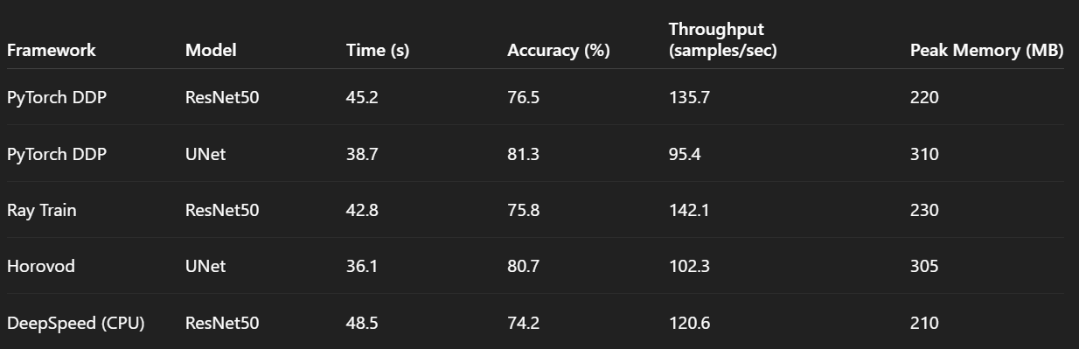
Results and Discussions
1. Performance Metrics

Slide 18
Results and Discussions
Accuracy: All frameworks achieved comparable accuracy across tasks, with UNet slightly outperforming in segmentation.
Training Speed: Horovod and Ray Train offered faster training in smaller-scale CPU environments.
Throughput: Ray Train showed marginally better throughput, likely due to better parallel data handling.
Memory Efficiency: DeepSpeed was the most memory-efficient, despite slower training—ideal for constrained setups. Framework Choice Depends on Priorities:
Use Ray Train or Horovod for faster iteration in small-scale CPU clusters.
DeepSpeed (CPU) is preferable when memory is the limiting factor.
PyTorch DDP is the most accessible and extensible for baseline comparison.
Scalability Potential:
Though experiments were CPU-optimized, the tool is framework-agnostic and extensible to GPU clusters and multi-node setups for further scalability analysis.
Trade-Offs:
Lower training time may not always correlate with best accuracy. Selecting a framework depends on workload size, model type, and infrastructure constraints.

Slide 19
Conclusion
In this work, we presented a modular and extensible benchmarking tool designed to evaluate the performance of distributed deep learning frameworks across multiple models and datasets. Our system supports PyTorch DDP, Ray Train, Horovod, and DeepSpeed (CPU) and enables reproducible experiments using a unified configuration interface. Through controlled benchmarking, we captured key metrics such as training time, throughput, accuracy, and memory usage—offering practical insights into the trade-offs between frameworks.
The results demonstrate that no single framework excels universally; performance varies based on the model architecture, dataset, and system constraints. PyTorch DDP provides a reliable baseline, while Ray and Horovod show advantages in distributed efficiency, and DeepSpeed excels in memory optimization.
Overall, the tool lays a strong foundation for scalable benchmarking and can be extended to GPU environments, large-scale training, and more advanced workloads in future work.

Slide 20
Reference
Tang, Z., Shi, S., Wang, W., Li, B., & Chu, X. (2020). Communication-Efficient Distributed Deep Learning: A Comprehensive Survey. ACM Computing Surveys. https://arxiv.org/abs/2003.06307
Nichols, D., Singh, S., Lin, S.-H., & Bhatele, A. (2021). A Survey and Empirical Evaluation of Parallel Deep Learning Frameworks. Proceedings of the International Conference for High Performance Computing, Networking, Storage and Analysis (SC). IEEE. https://arxiv.org/abs/2007.03663
Mattson, P., Cheng, C., Coleman, C., Diamos, G., Micikevicius, P., Patterson, D., Tang, H., & Zaharia, M. (2020). MLPerf Training Benchmark. Proceedings of Machine Learning and Systems (MLSys). https://arxiv.org/abs/1910.01500
Chen, X., Awadallah, A. H., Hassan, H., Wang, W., & Cardie, C. (2019). Multi-Source Cross-Lingual Model Transfer: Learning What to Share. Proceedings of the 57th Annual Meeting of the Association for Computational Linguistics (ACL). https://arxiv.org/abs/1908.11407
Coleman, C., Kang, D., Narayanan, D., Nardi, L., Zhao, T., Zhang, J., Bailis, P., Olukotun, K., Ré, C., & Zaharia, M. (2019). Analysis of DAWNBench, a Time-to-Accuracy Machine Learning Performance Benchmark. ACM Transactions on Architecture and Code Optimization (TACO). https://arxiv.org/abs/1806.07810

