Slide 1
IBM University Engagement Project Submission
“Exploring the Power of Agentic AI with IBM Granite and IBM Bob”

Slide 2

Project Tile – Smart Study Generator Agent
Domain of Project – Education
Student Name | Recent Passport Photo | Email ID | Mobile number [WhatsApp]
KODIDHALA SUPRIYA |  | 254g1a33h2@srit.ac.in | 6304400375

Slide 3
Problem Statement -
Problem Statement : Smart Study Generator Agent
The Challenge
Students today face an overwhelming flood of information—lecture notes, textbooks, research papers, YouTube tutorials, and online resources. This content is scattered, unorganized, and often not personalized to their learning pace or style. As a result, students struggle with finding the right study material, summarizing key concepts, and staying exam-ready. Traditional study tools only provide static notes or flashcards, failing to adapt dynamically to student needs. The challenge is to move beyond static resources toward an intelligent, adaptive study companion.
The Objective
Build an agentic AI-powered Smart Study Generator that personalizes and streamlines learning for students. The solution should:
Fuse Learning Resources: Aggregate content from class notes, textbooks, research articles, and online tutorials into structured, easy-to-digest study material.
Enable Multimodal Input: Allow students to upload notes, voice queries, or images (e.g., textbook pages), and generate concise summaries, flashcards, or concept maps.
Create a Predictive & Agentic Layer: Recommend personalized study plans, highlight important topics based on syllabus or past exams, and provide predictive alerts (e.g., “Focus on Topic X—frequently asked in exams”).
Visualize Study Progress: Offer a real-time dashboard showing learning milestones, weak areas, practice quizzes, and performance forecasts.

Slide 4
Proposed Solution -
Proposed Solution: Smart Study Generator Agent
The proposed solution is to develop a web-based Smart Study Generator Agent using Python and IBM Granite LLM that provides personalized and intelligent study support for students. The system collects student details, subjects, learning preferences, available study hours, and examination dates to generate customized study plans. It analyzes uploaded study materials and automatically creates concise notes, chapter summaries, important questions, quizzes, flashcards, and revision schedules. An interactive AI assistant helps students understand difficult concepts and resolve academic queries in simple language. The agentic AI workflow includes material analysis, content generation, validation, progress tracking, and adaptive recommendations. The application uses responsible AI practices, privacy protection, and guardrails to reduce inaccurate or misleading content. The solution aims to save students’ time, improve learning efficiency, and support effective examination preparation through an accessible, user-friendly web application.

Slide 5
Technology Used
IBM Bob platform -For designing and orchestrating multi-agent workflows visually
IBM Cloud – It provides the infrastructure to build, deploy, and scale the Nutrition Agent efficiently. IBM Cloud enables a reliable, secure, and scalable environment for deploying the Nutrition Agent.
RAG– RAG to fetch real data first, then generate intelligent answers, making the Nutrition Agent more trustworthy and effective.
Vector Database (FAISS/Chroma) – For RAG-based nutritional data retrieval

Slide 6
Technology | Purpose
Python | Backend development and agent workflow management
IBM Granite LLM | Generates study plans, summaries, notes, quizzes, and explanations
IBM watsonx.ai | Provides access to the IBM Granite model
Streamlit | Creates the interactive web application interface
PyPDF | Extracts text from PDF study materials
Python Libraries | Process text, validate inputs, and manage application logic
SQLite | Stores student details, study plans, quiz results, and progress
HTML & CSS | Customize the web interface and styling
Git & GitHub | Version control and project hosting
Windows Batch (.bat) | Automates dependency installation and application startup
Markdown (.md) | Stores project documentation and the implementation plan
Python-dotenv | Manages API keys securely through environment variables

Slide 7
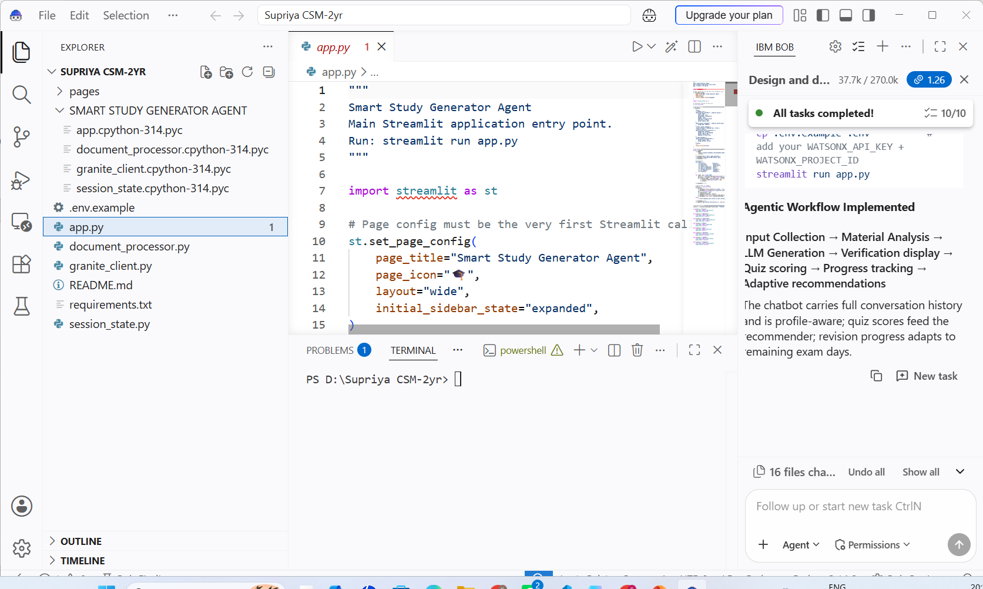
Required Files created using IBM bob -
App.py
Requirements.txt
3. .env

Slide 8
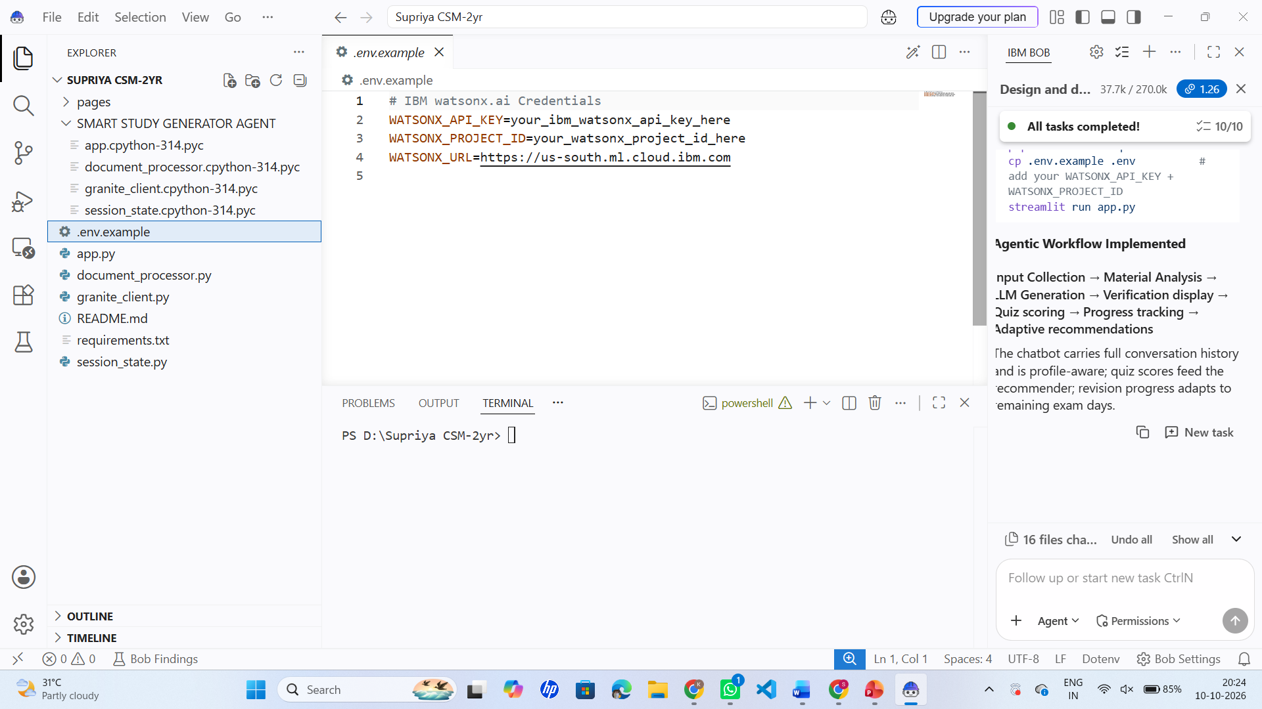

Slide 9
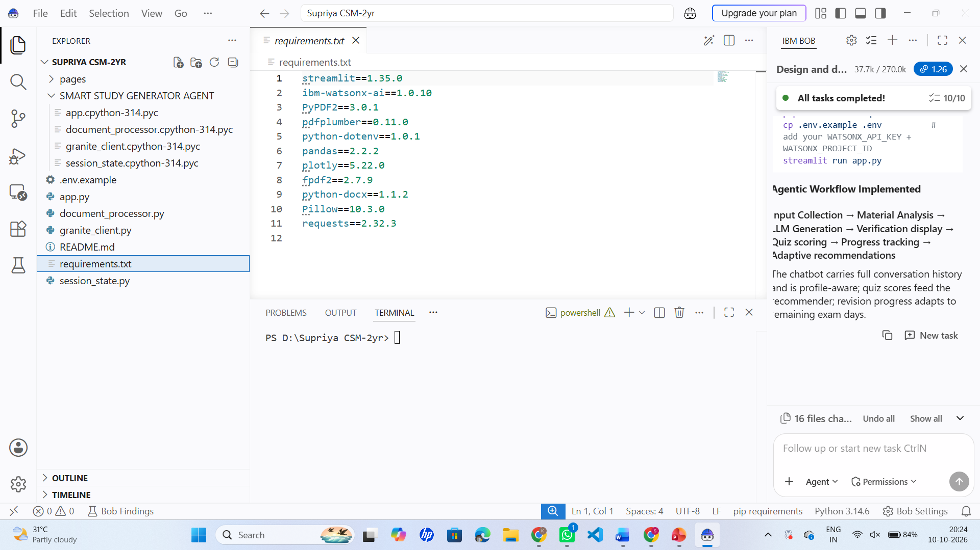

Slide 10

Role of Agentic AI in Smart Study Generator Agent:
Agentic AI plays a key role in making the Smart Study Generator an intelligent, personalized, and adaptive learning system. Unlike a basic chatbot that only answers questions, the agent follows a structured workflow to analyze study materials, plan learning activities, evaluate student performance, and recommend improvements.
1. Student Requirement Analysis: Collects student details, subjects, examination dates, learning preferences, and available study hours.
2. Intelligent Material Analysis: Analyses uploaded PDFs, notes, and textbooks to identify key concepts, important topics, and difficult areas.
3. Personalized Study Planning: Creates customized study timetables based on the syllabus, exam schedule, and student's learning needs.
4. Automatic Content Generation: Uses IBM Granite LLM to generate summaries, short notes, important questions, flashcards, and practice quizzes.
5. AI-Based Doubt Resolution: Answers academic questions and explains complex concepts in simple language.

Slide 11
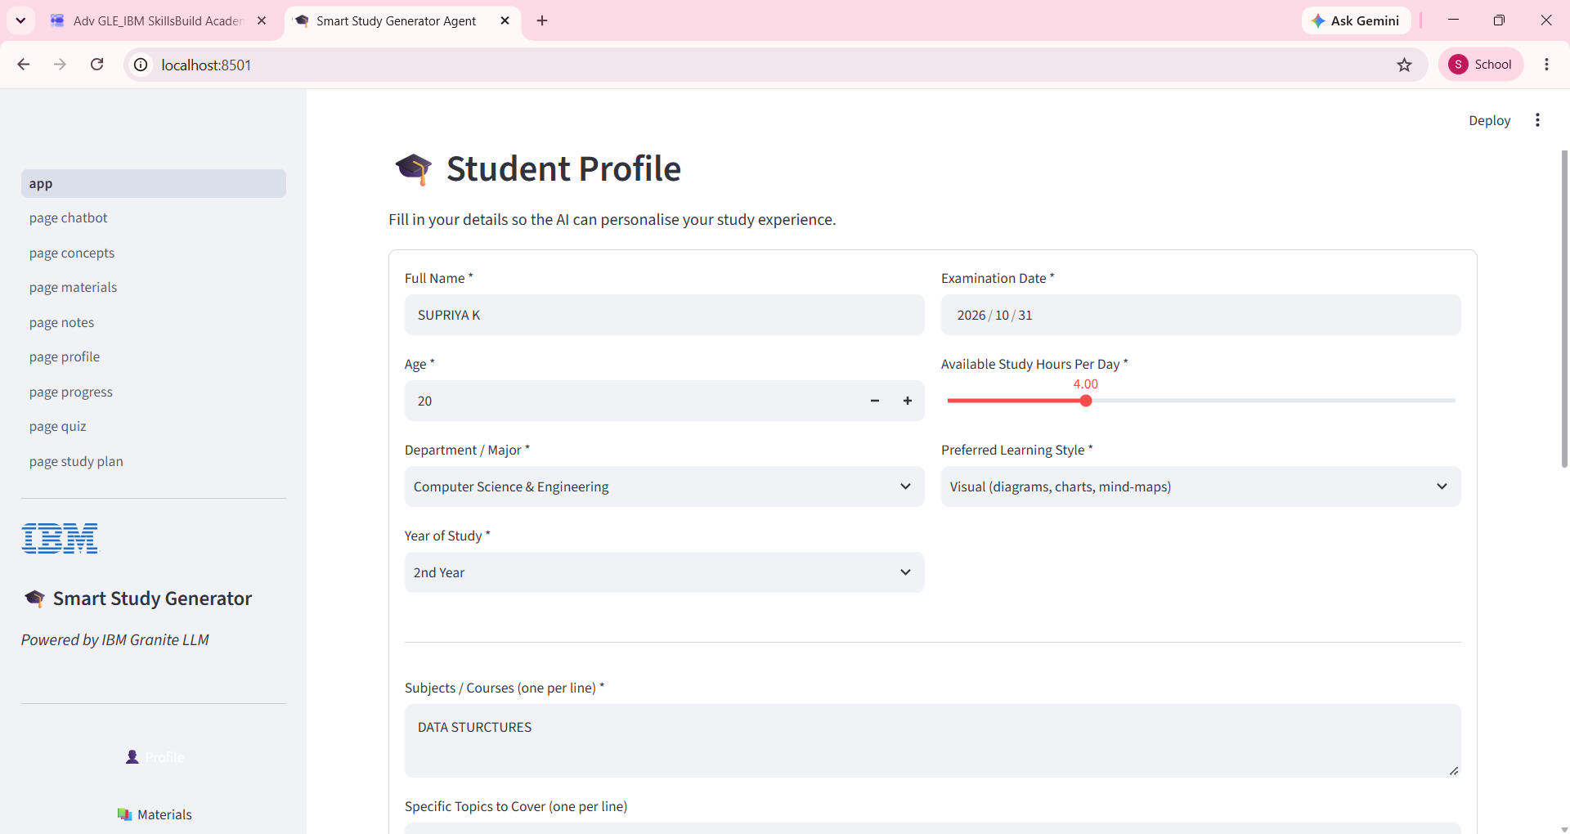
Project Output Screenshot
Please put IBM Bob output screenshots with 2-3 prompts.
You can take 2-3 more slides for each screenshot
·
·
·

Slide 12
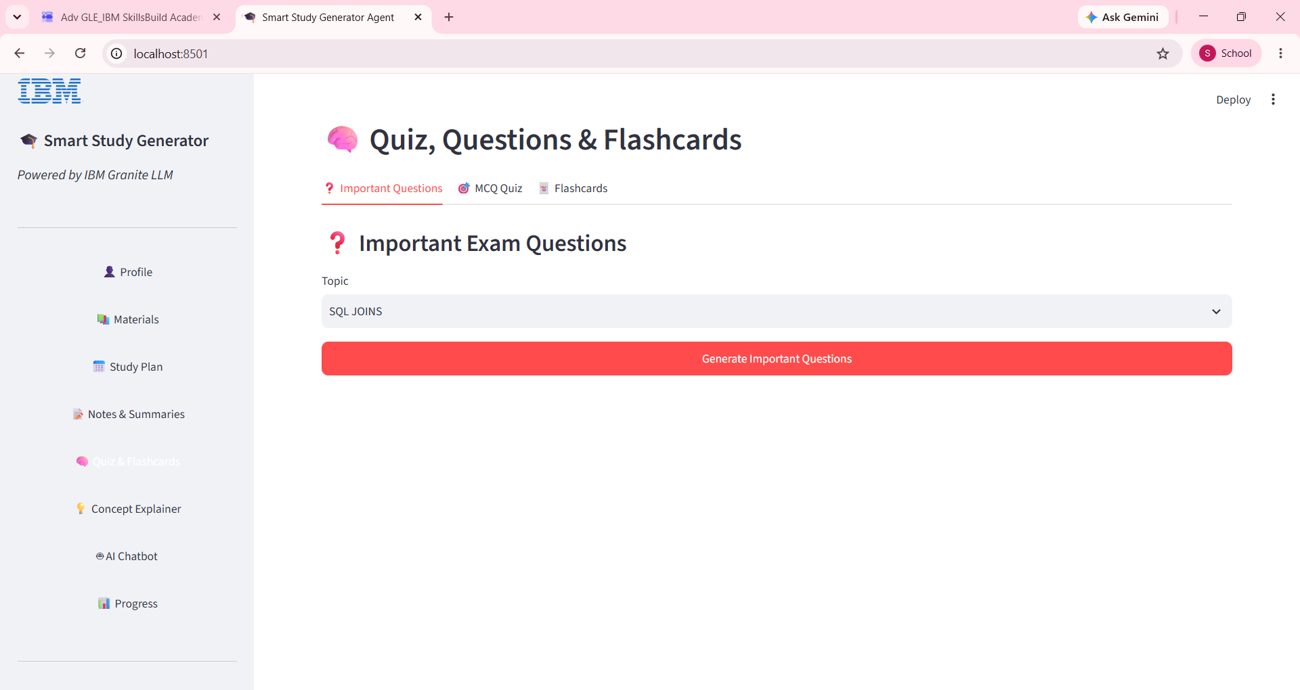
Project Output Screenshot
Please put IBM Bob output screenshots with 2-3 prompts.
You can take 2-3 more slides for each screenshot
·
·
·

Slide 13
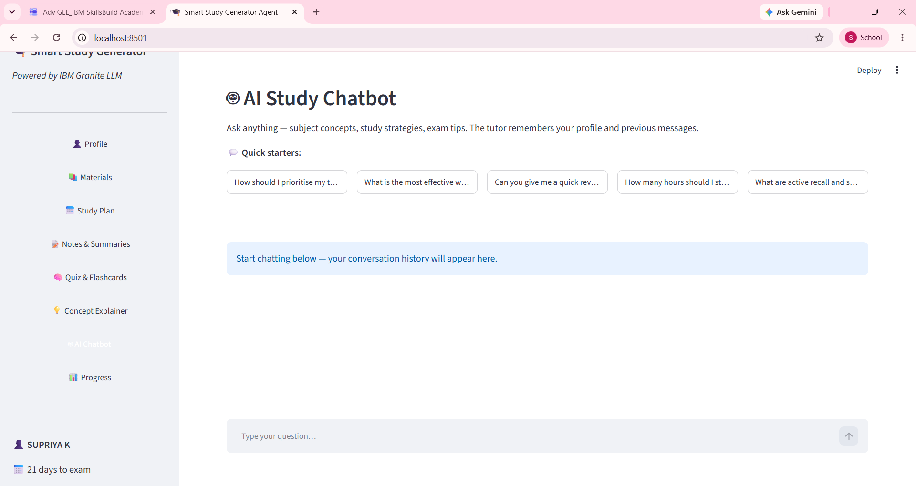
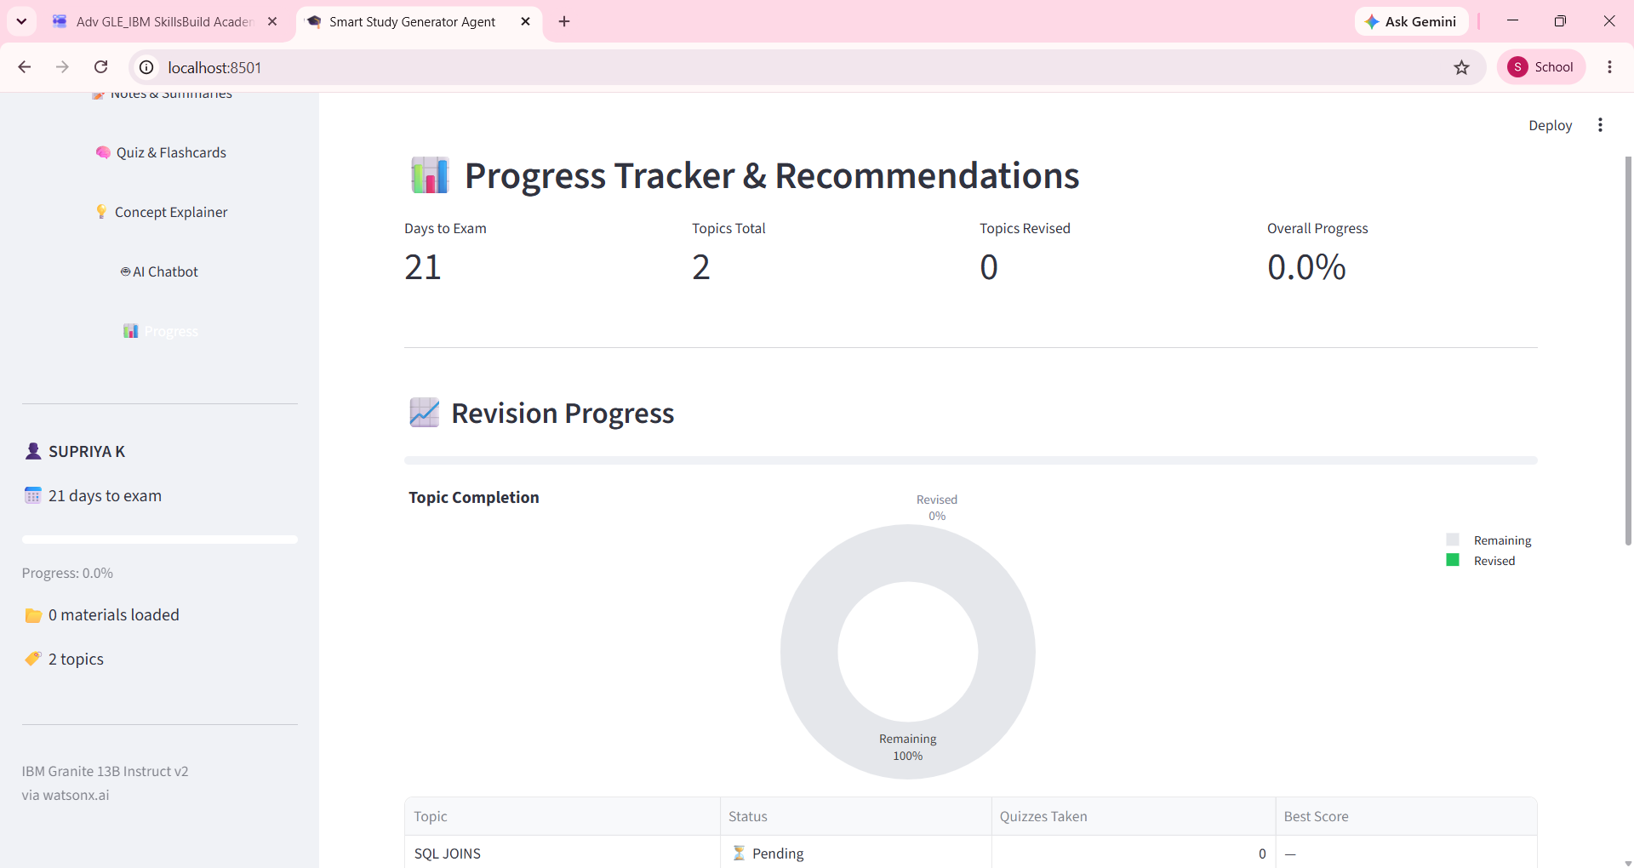
Project Output Screenshot

Slide 14
Novelty and Uniqueness
1. Personalized Learning
Generates customized study plans based on student details, subjects, learning preferences, and examination dates.
2. AI-Powered Study Material Generation
Uses IBM Granite LLM to create concise notes, summaries, important questions, quizzes, and flashcards.
3. Intelligent Document Analysis
Analyzes uploaded PDFs, lecture notes, and textbooks to identify key concepts and important topics.
4. Adaptive Learning System
Identifies weak areas from quiz performance and recommends targeted revision and additional practice.
5. Interactive AI Study Assistant
Resolves academic queries and explains complex concepts in simple, student-friendly language.
6. Automated Study Planning
Creates topic-wise timetables based on the syllabus, available study hours, and exam deadlines.
7. Continuous Progress Tracking
Tracks completed topics, quiz scores, and revision progress to help students monitor their preparation.

Slide 15
Git Hub Link
·Github URL –https://github.com/supriya2908/SMART-STUDY-GENERATOR-AGENT
·
·
·

Slide 16
Future Scope-
Advanced Personalized and Adaptive Learning
The system can be enhanced with advanced AI algorithms to understand individual learning patterns, predict weak areas, and automatically adjust study plans based on student performance. Future versions can support multilingual learning, voice-based interaction, video recommendations, and integration with learning management systems to deliver a more intelligent and engaging learning experience.
2. Smart Automation and Scalable Integration
The agent can be extended with automated syllabus analysis, previous question paper evaluation, exam performance prediction, and real-time progress analytics. Integration with cloud platforms, educational databases, and mobile applications can make the Smart Study Generator a scalable, accessible, and intelligent learning assistant for students across different courses and institutions.
·
·
·

Slide 17
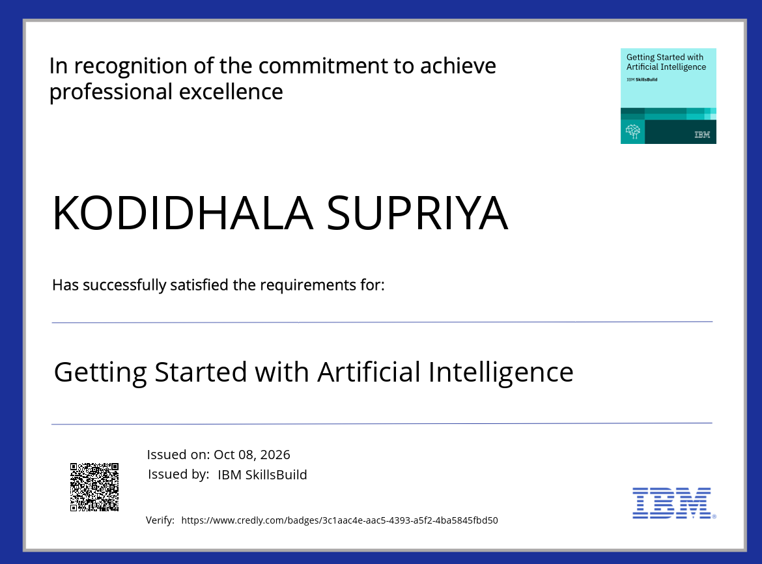
Certificates Earned:

Slide 18
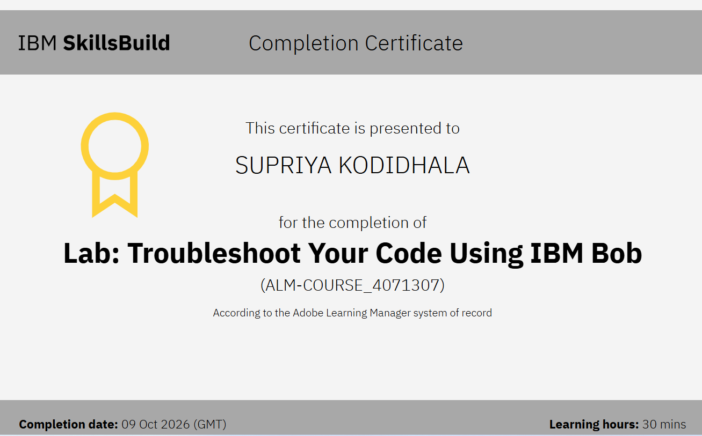
Certificates Earned:​

Slide 19


