Slide 1
Course 4:
SQL for Data Analysis and Insights
Project Title:
Sales Performance Analysis of Walmart Stores Using Advanced MySQL Techniques
Presented By:
Supriya Kore

Slide 2
Introduction
This project analyzes Walmart’s 2019 sales data to uncover key business insights. Using SQL queries and visualizations, I explored branch growth, product profitability, customer segmentation, and sales trends. The goal is to understand customer behavior, detect anomalies, and identify opportunities for revenue growth. The analysis concludes with recommendations to improve Walmart’s sales strategy.

Slide 3
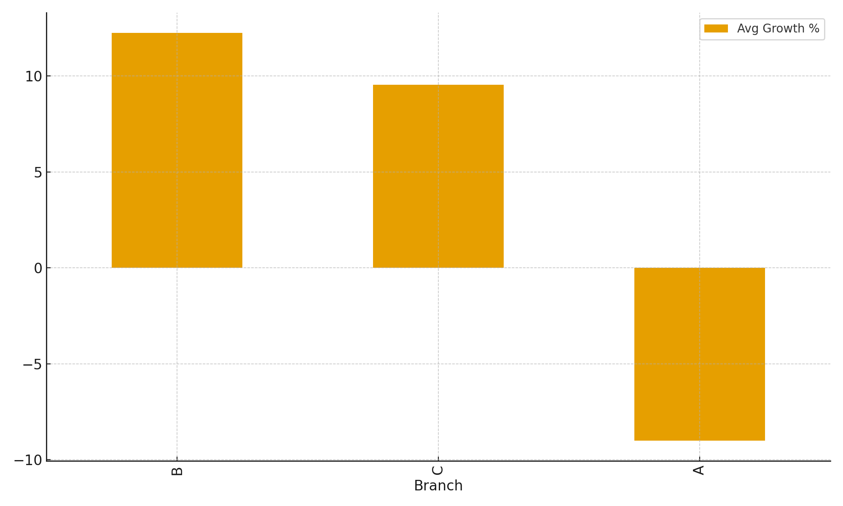
Task 1: Identifying the Top Branch by Sales Growth Rate
Query: WITH monthly_sales AS ( SELECT Branch, DATE_FORMAT(Date, '%Y-%m') AS sales_month, SUM(Total) AS monthly_sales FROM sales GROUP BY Branch, DATE_FORMAT(Date, '%Y-%m')),with_lag AS ( SELECT Branch, sales_month, monthly_sales, LAG(monthly_sales) OVER (PARTITION BY Branch ORDER BY sales_month) AS prev_month_sales FROM monthly_sales)SELECT Branch, ROUND(AVG((monthly_sales - prev_month_sales) / NULLIF(prev_month_sales,0) * 100),2) AS avg_growth_pctFROM with_lagWHERE prev_month_sales IS NOT NULLGROUP BY BranchORDER BY avg_growth_pct DESC;
Insights: Branch B shows the highest average monthly sales growth rate (12.24%), followed by C (9.54%), while A had negative growth (-9%).
Branch | Avg Growth %
B | 12.24
C | 9.54
A | -9.0

Slide 4
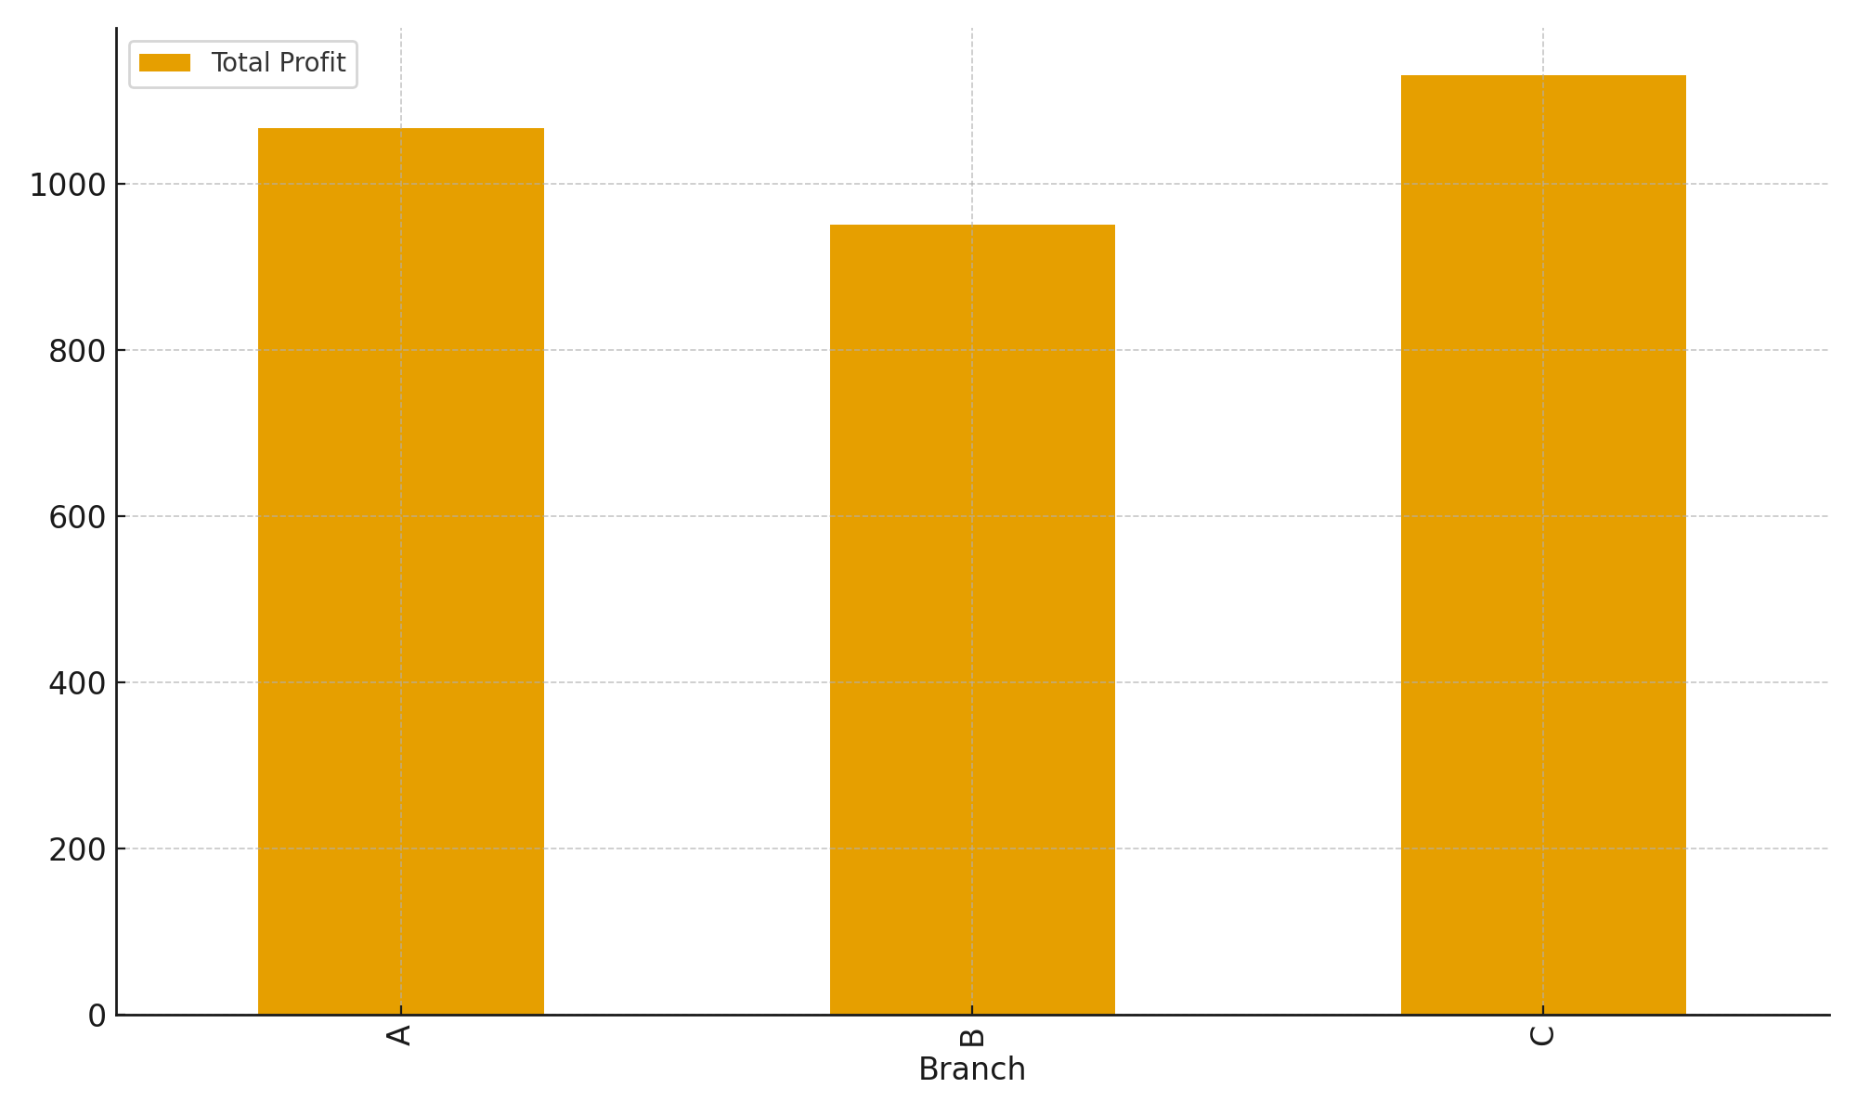
Task 2: Most Profitable Product Line for Each Branch
Query: SELECT s.Branch, s.`Product line`, s.total_profitFROM ( SELECT Branch, `Product line`, SUM(Total - cogs) AS total_profit FROM sales GROUP BY Branch, `Product line`) sJOIN ( SELECT Branch, MAX(profit_calc) AS max_profit FROM ( SELECT Branch, `Product line`, SUM(Total - cogs) AS profit_calc FROM sales GROUP BY Branch, `Product line` ) t GROUP BY Branch) mON s.Branch = m.Branch AND s.total_profit = m.max_profit;
Insights: Branch A: Home and Lifestyle Branch B: Sports and Travel Branch C: Food and Beverages
Branch | Product Line | Total Profit
A | Home and lifestyle | 1067.49
B | Sports and travel | 951.82
C | Food and beverages | 1131.75

Slide 5
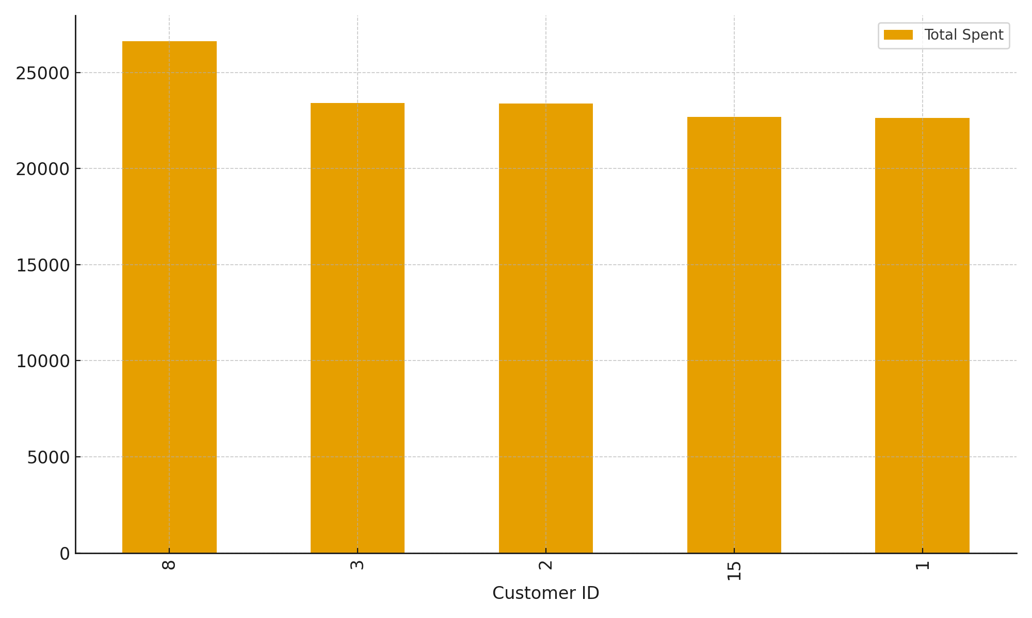
Task 3: Customer Segmentation (High / Medium / Low Spenders)
Query: WITH cust_totals AS ( SELECT `Customer ID`, ROUND(SUM(Total),2) AS total_spent FROM sales GROUP BY `Customer ID`),ranked AS ( SELECT `Customer ID`, total_spent, NTILE(3) OVER (ORDER BY total_spent DESC) AS tier FROM cust_totals)SELECT `Customer ID`, total_spent, CASE WHEN tier = 1 THEN 'High' WHEN tier = 2 THEN 'Medium' ELSE 'Low' END AS segmentFROM rankedORDER BY total_spent DESC;
Insights: Customers are segmented into High, Medium, and Low spenders using NTILE(3). Top spenders are IDs 8, 3, 2, 15, 1.
Customer ID | Total Spent | Segment
8 | 26634.34 | High
3 | 23402.26 | High
2 | 23392.28 | High
15 | 22674.46 | High
1 | 22634.55 | High

Slide 6
Task 4: Detect Anomalies in Sales Transactions
Query: WITH stats AS ( SELECT `Product line`, ROUND(AVG(Total),2) AS avg_sales, ROUND(STDDEV(Total),2) AS std_sales FROM sales GROUP BY `Product line`)SELECT s.`Invoice ID`, s.`Product line`, ROUND(s.Total,2) AS Total, st.avg_sales, st.std_sales, CASE WHEN s.Total > st.avg_sales + 2 * st.std_sales THEN 'High Anomaly' WHEN s.Total < st.avg_sales - 2 * st.std_sales THEN 'Low Anomaly' ELSE 'Normal' END AS anomaly_flagFROM sales sJOIN stats st ON s.`Product line` = st.`Product line`ORDER BY s.`Product line`, s.Total DESC;
Insights: Transactions significantly above or below the average ± 2*std are flagged as anomalies.
Invoice ID | Product Line | Total | Anomaly
817-69-8206 | Electronic accessories | 942.45 | High Anomaly
704-48-3927 | Electronic accessories | 931.04 | High Anomaly
267-62-7380 | Electronic accessories | 864.57 | High Anomaly

Slide 7
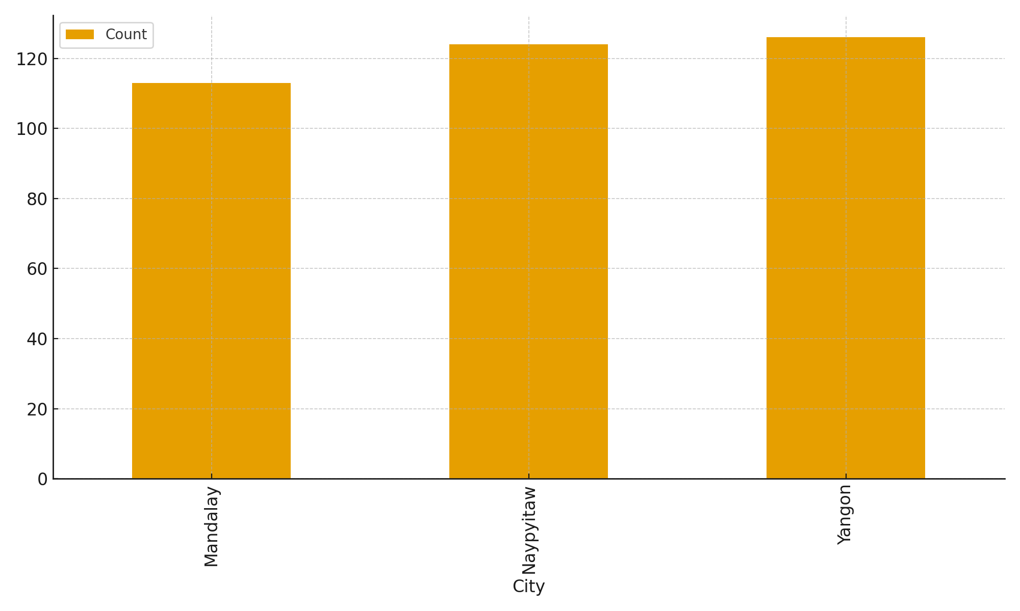
Task 5: Most Popular Payment Method by City
Query: SELECT t.City, t.Payment, t.method_countFROM ( SELECT City, Payment, COUNT(*) AS method_count, ROW_NUMBER() OVER (PARTITION BY City ORDER BY COUNT(*) DESC) AS rn FROM sales GROUP BY City, Payment) tWHERE t.rn = 1ORDER BY t.City;
Insights: Mandalay: Ewallet Naypyitaw: Cash Yangon: Ewallet
City | Payment | Count
Mandalay | Ewallet | 113
Naypyitaw | Cash | 124
Yangon | Ewallet | 126

Slide 8
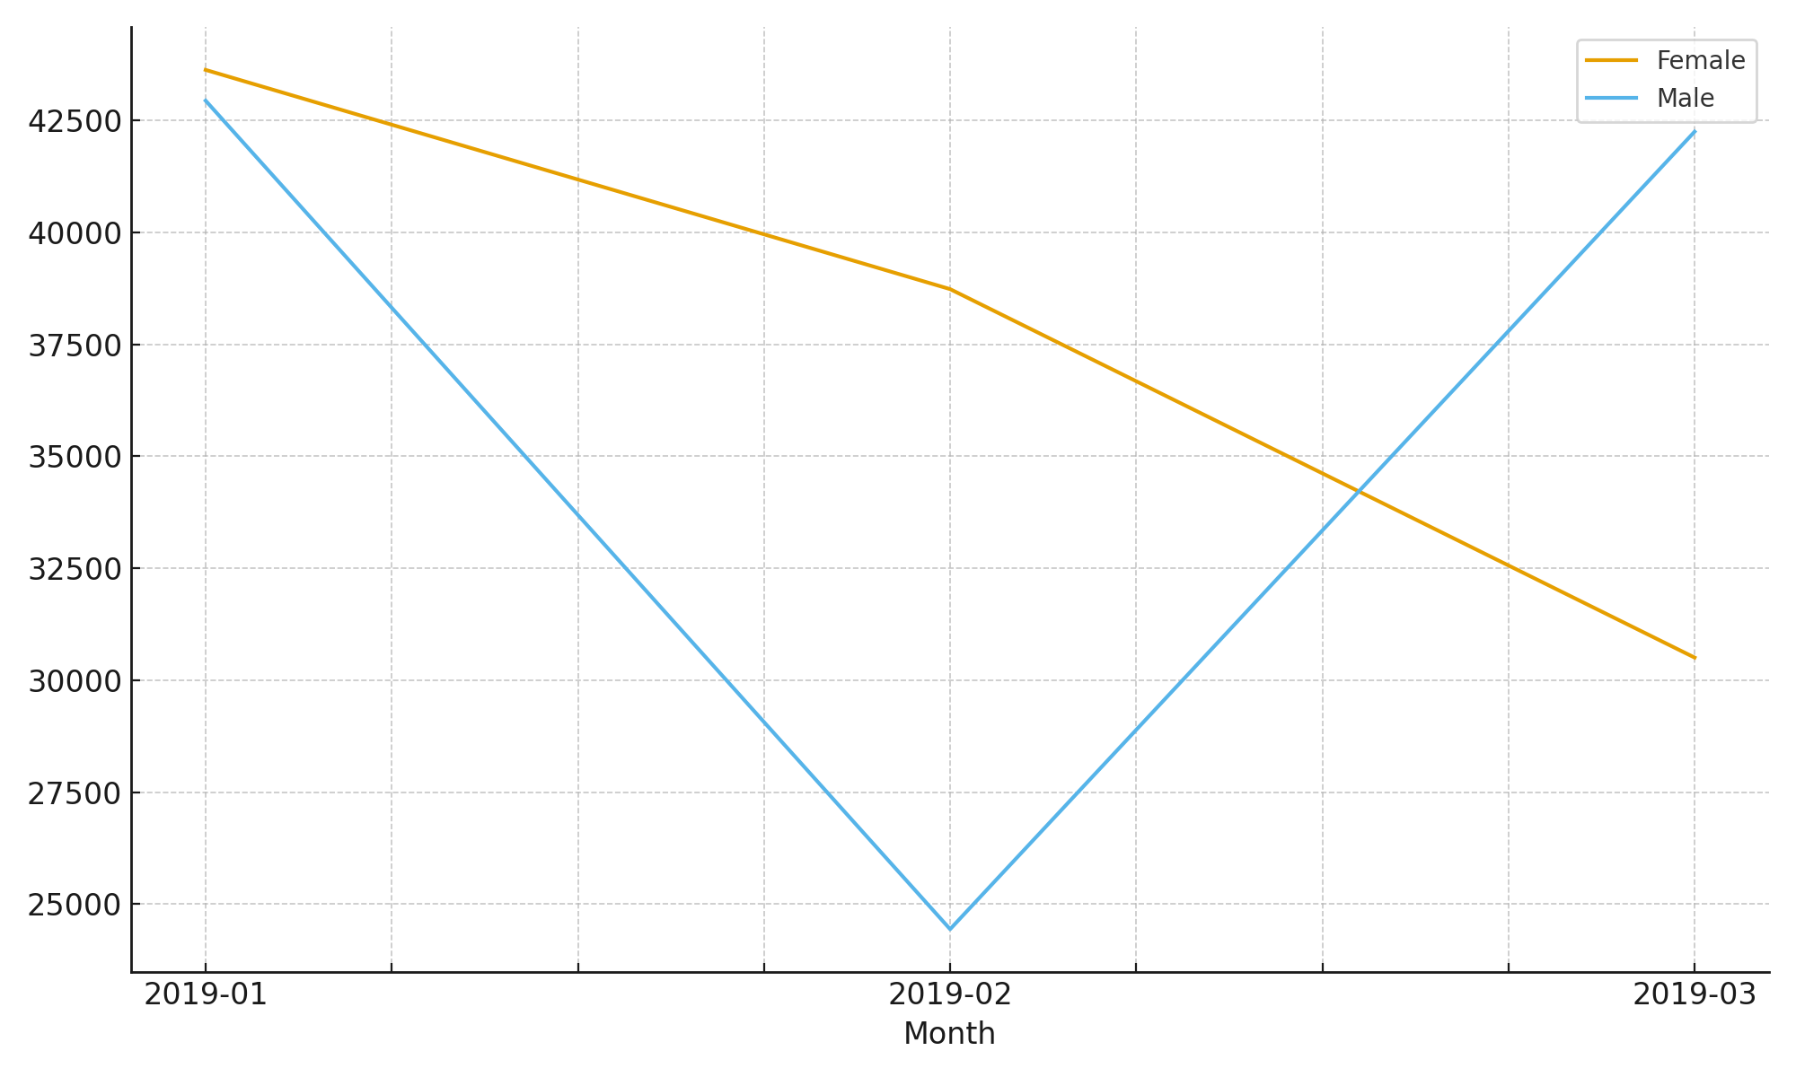
Task 6: Monthly Sales Distribution by Gender
Query: SELECT DATE_FORMAT(Date, '%Y-%m') AS sales_month, Gender, SUM(Total) AS total_salesFROM salesGROUP BY DATE_FORMAT(Date, '%Y-%m'), GenderORDER BY sales_month ASC, Gender;
Insights: Overall, female customers contributed more sales across most months.
Month | Female | Male
2019-01 | 43624.7 | 42937.87
2019-02 | 38729.91 | 24439.83
2019-03 | 30503.92 | 42245.33

Slide 9
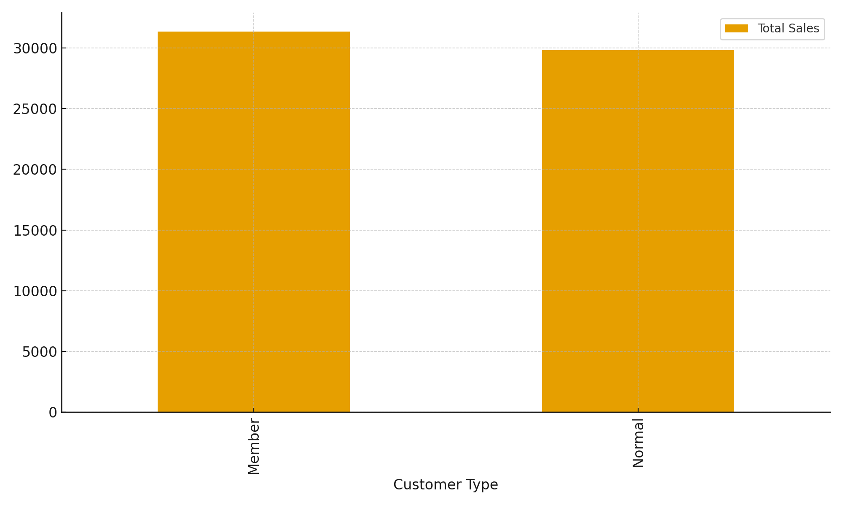
Task 7: Best Product Line by Customer Type
Query: SELECT t.`Customer type`, t.`Product line`, t.total_salesFROM ( SELECT `Customer type`, `Product line`, SUM(Total) AS total_sales, ROW_NUMBER() OVER (PARTITION BY `Customer type` ORDER BY SUM(Total) DESC) AS rn FROM sales GROUP BY `Customer type`, `Product line`) tWHERE t.rn = 1ORDER BY t.`Customer type`;
Insights: Members: Food and Beverages Normal: Electronic Accessories
Customer Type | Product Line | Total Sales
Member | Food and beverages | 31357.62
Normal | Electronic accessories | 29839.04

Slide 10
Task 8: Identifying Repeat Customers (purchases within 30 days)
Query: WITH cust_dates AS ( SELECT `Customer ID`, Date, LEAD(Date) OVER (PARTITION BY `Customer ID` ORDER BY Date) AS next_date FROM sales)SELECT DISTINCT `Customer ID`FROM cust_datesWHERE DATEDIFF(next_date, Date) <= 30;
Insights: All 15 customers had at least one repeat purchase within 30 days.
Customer ID
1
2
3
4
5

Slide 11
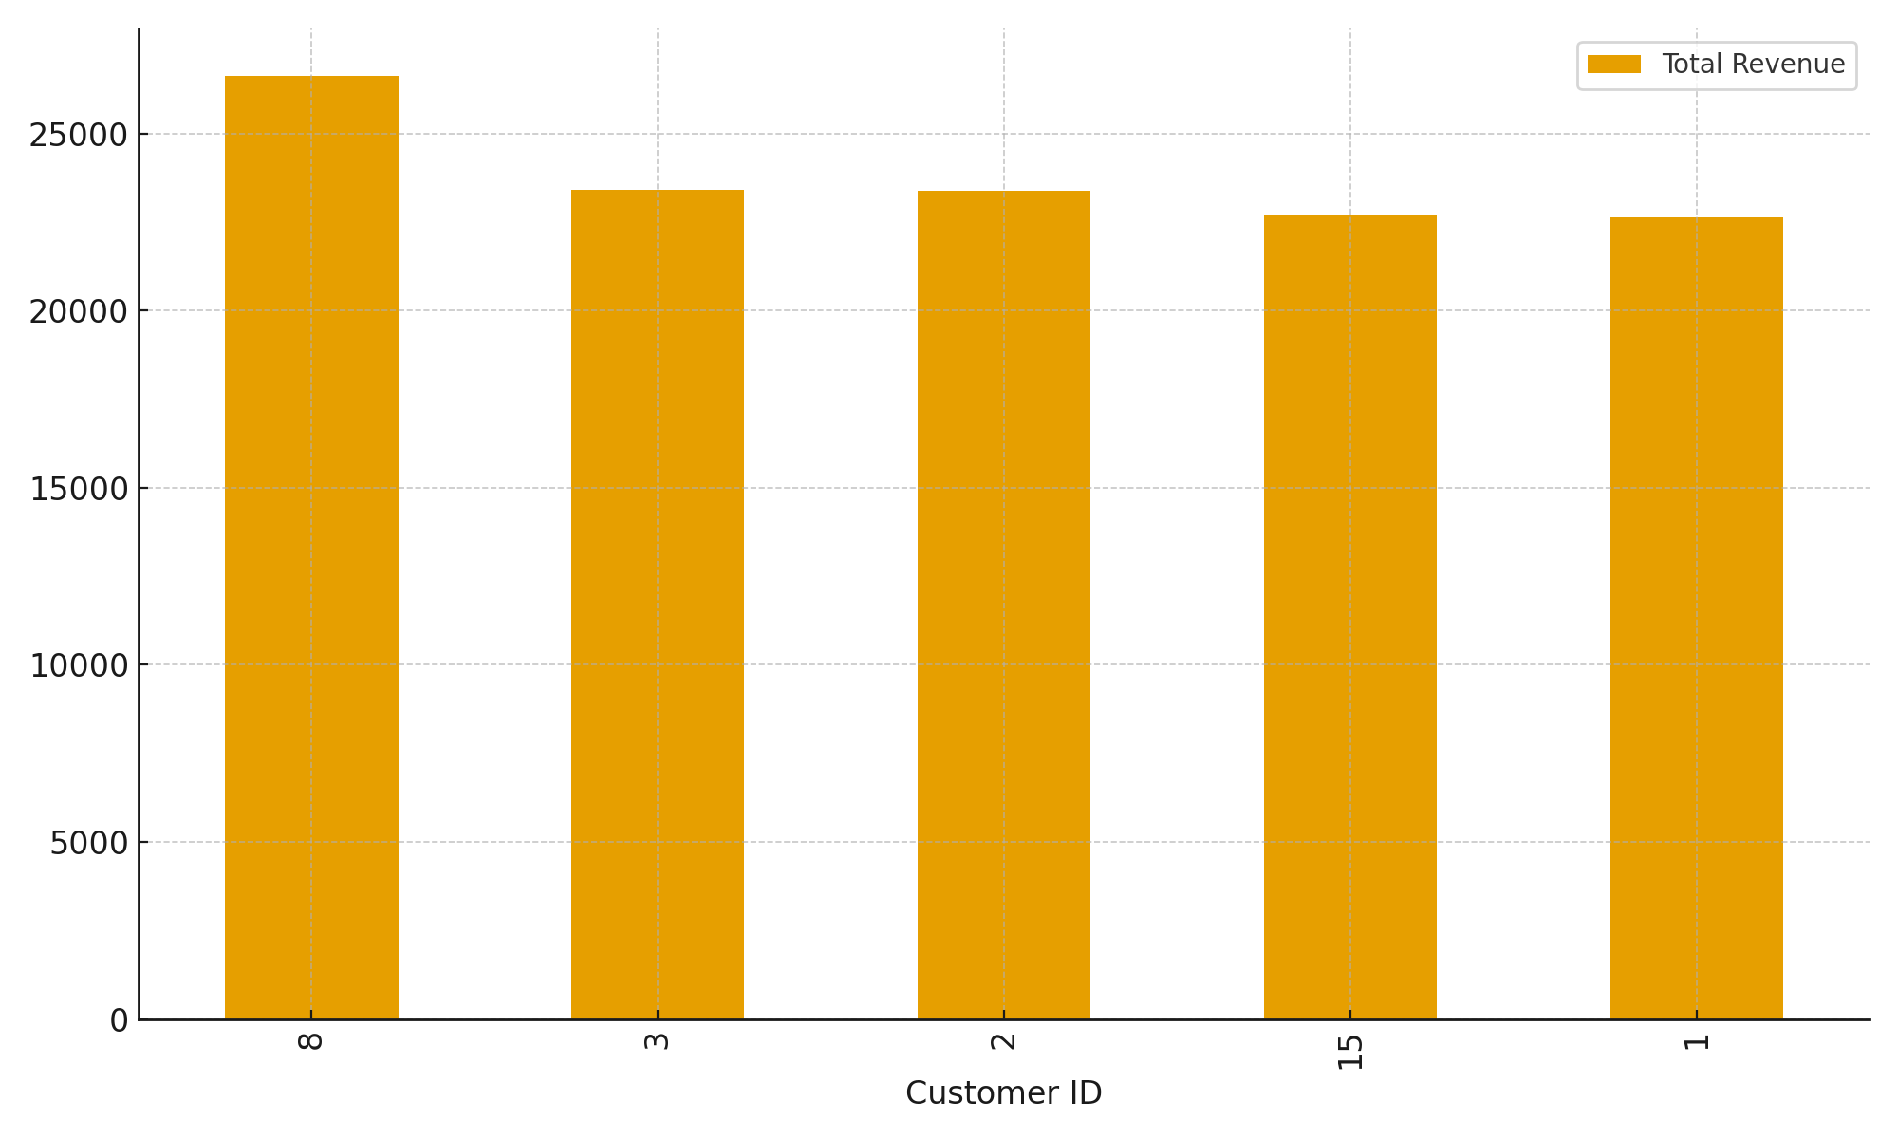
Task 9: Top 5 Customers by Sales Volume
Query: SELECT `Customer ID`, SUM(Total) AS total_revenueFROM salesGROUP BY `Customer ID`ORDER BY total_revenue DESCLIMIT 5;
Insights: Customer 8 is the top spender, followed by 3, 2, 15, and 1.
Customer ID | Total Revenue
8 | 26634.34
3 | 23402.26
2 | 23392.28
15 | 22674.46
1 | 22634.55

Slide 12
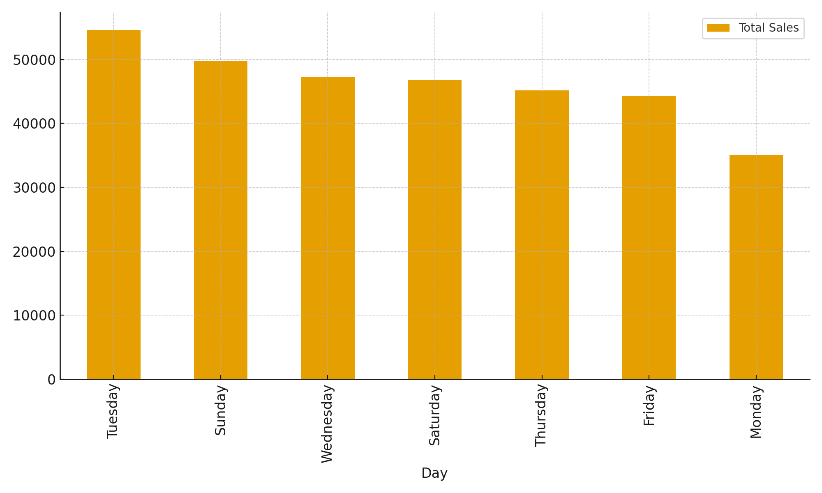
Task 10: Sales Trends by Day of the Week
Query: SELECT DAYNAME(Date) AS day_of_week, SUM(Total) AS total_salesFROM salesGROUP BY DAYOFWEEK(Date), day_of_weekORDER BY total_sales DESC;
Insights: Sales were highest on Tuesday, followed by Sunday and Wednesday. Monday had the lowest sales.
Day | Total Sales
Tuesday | 54630.22
Sunday | 49704.6
Wednesday | 47221.21
Saturday | 46842.79
Thursday | 45166.16
Friday | 44352.87
Monday | 35048.91

Slide 13
Conclusion & Insights
Branch B shows the highest sales growth.
Most profitable product lines vary by branch.
High-value customers are critical to revenue.
E-wallet and Cash dominate payment methods.
Female customers contribute more sales overall.
Food & Beverages (Members) and Electronic Accessories (Normal) are top choices.
Tuesdays recorded the highest sales; Mondays were lowest.

Slide 14


