Slide 1


TEEGALA KRISHNA REDDY ENGINEERING COLLEGE (UGC-Autonomous) Approved by AICTE, Affiliated by JNTUH, Accreditated by NAAC- ‘A’ Grade Medbowli, Meerpet, Balapur, Hyderabad, Telangana- 500097 Mob: 9393959597. Email: info@tkrec.ac.in, deanacademics@tkrec.ac.in
Department of Electronics and Communication Engineering
Batch : A3
SMART SHOPPING TROLLEY USING IOT
Presented By
1.A.Gowtham 20R91A0410
2.A.Supriya 20R91A0412
3.A.Suresh 20R91A0418
4.B.Mahesh 20R91A0428
Internal Guide
D.Ramadevi
Assistant Professor/ECE

Slide 2
CONTENTS
OBJECTIVE
ABSTRACT
BLOCK DIAGRAM
ADAVANTAGES & APPLICATIONS

Slide 3
OBJECTIVE
Enhance the shopping experience.
Improve overall store management through real-time data analytics.
Provides valuable insights for store management.

Slide 4
ABSTRACT
IOT Based Smart Shopping Cart
RFID Technology
Improvise the shopping experience
Efficient System for inventory management

Slide 5
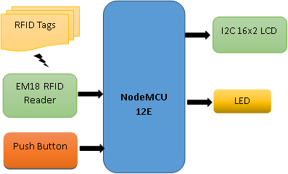
BLOCK DIAGRAM

Slide 6
ADAVANTAGES & APPLICATIONS
ADAVANTAGES
Time saving-Avoids long queues for payment.
Automatic billing.
Can connect multiple carts at a item.
Mobile self-checkout system.
APPLICATIONS
Real-time inventory Management.
Personalizes Shopping Experience.
Automated Checkout.
Enhanced Customer Engagement.

Slide 7
Thank You

