Slide 1
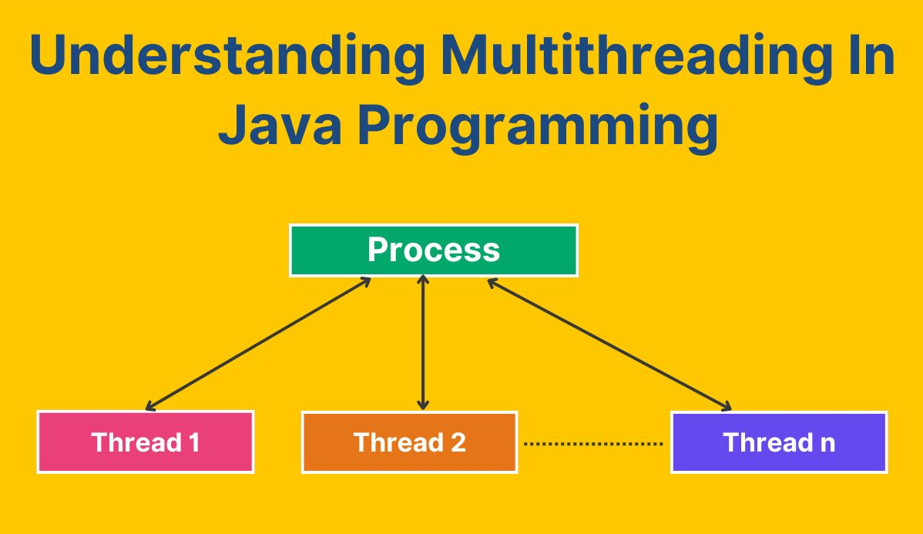

Slide 2

Topics we will cover
CPU, Core, Thread
Multitasking
Multithreading
How to create thread?
Lifecycle of threads
Thread class methods
Synchronization
Daemon thread
Inter-thread communication
Locks
Basic of Executor framework

Slide 3
CPU
Brain of computer, responsible for executing instructions from programs
Core is an individual processing unit within a CPU
Core
(Single core )

Slide 4
CPU
Brain of computer, responsible for executing instructions from programs
Music
Web browser
Core is an individual processing unit within a CPU
Core 1
Core 2
Download
Updating
(Multiple core)
Core 3
Core 4
Quad Processor – 4 core

Slide 5
CPU
Thread
Thread
Brain of computer, responsible for executing instructions from programs
Thread
Thread
Thread
Thread
Core is an individual processing unit within a CPU
Core 1
Core 2
Thread
Thread
Thread
Thread
Thread
Thread
Core 3
Core 4
Thread is the smallest unit of execution within a process

Slide 6





Multitasking

Slide 7
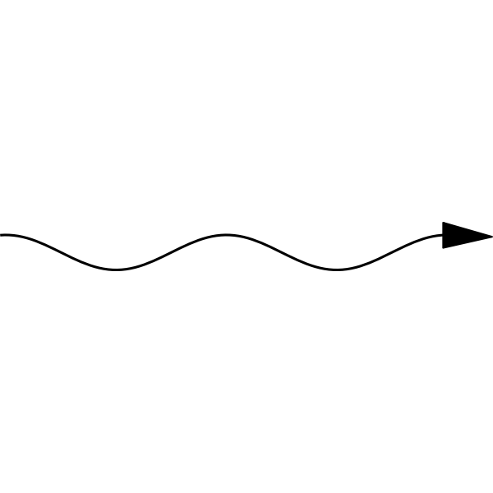
Multithreading
t1
Spell check and Grammer check
t2
Autosave
t3
Changing fonts or colors

Slide 8
Why use Multithreading ?
To increase the performance
Better utilization of CPU cores
Real time applications like gaming, web browsers

Slide 9
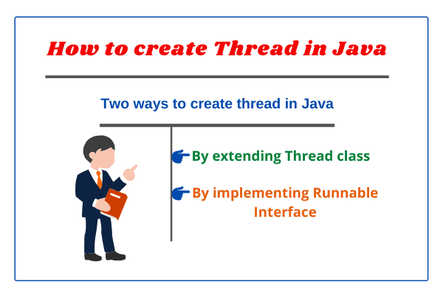

Slide 10
Extending Thread class :-
​ @Override public void run() { System.out.println("Thread task"); }
public class MyThread extends Thread{
}
​ ​ public static void main(String[] args) { ​ MyThread t = new MyThread(); ​ t.start(); ​ }
Output :
Thread task

Slide 11
Implementing Runnable interface :-
​public class MyThread implements Runnable{
}
@Override public void run() { System.out.println("Thread task"); }
public static void main(String[] args) { MyThread t = new MyThread(); Thread thread = new Thread(t); thread.start(); }
Output :
Thread task

Slide 12
Lifecycle of Thread
If Thread Schedular allocates processor
t.start();
If runs completes
New
Runnable
Running
Dead
MyThread t = new MyThread();

Slide 13
Thread class (implements Runnable)
public String getName()
public void setName(String name)
public boolean isAlive()
public void setPriority(int priority)
public static void sleep(long millis) throws InterruptedException
public static void yield()
public void join() throws InterruptedException
public void interrupt()

Slide 14
Get and set name of Thread
public class MyThread extends Thread{
@Override public void run() { System.out.println("Run method"); } public static void main(String[] args) { MyThread t = new MyThread(); t.start();
}
}
System.out.println(Thread.currentThread().getName())
Output:​
Main​
Run method​
Thread-0
System.out.println(Thread.currentThread().getName());
Thread.currentThread().setName("Supriya");
Output:
Main
Supriya
Run method
Thread-0
System.out.println(Thread.currentThread().getName());

Slide 15
To check if the Thread is alive
public class MyThread extends Thread{
@Override public void run() { System.out.println("Run method"); } public static void main(String[] args) { MyThread t = new MyThread(); t.start();
}
}
System.out.println(Thread.currentThread().isAlive());
Output:
true
Run method

Slide 16
To set priorities
Priorities are represented in the form of integer which ranges from 1-10.
1 >> MIN_PRIORITY
5 >> NORM_PRIORITY
10 >> MAX_PRIORITY
Default priority of main thread is 5.
Windows do not support priorities; it depends upon the platform.
If multiple threads having same priorities which thread will be executed depends upon JVM.

Slide 17
To set priorities
public class Priority extends Thread{
}
@Override public void run() { } public static void main(String[] args) {
}
System.out.println("Task priority thread : " + Thread.currentThread().getPriority()); //3
System.out.println("Main thread old priority : " + Thread.currentThread().getPriority()); //5
Thread.currentThread().setPriority(6);
System.out.println("Main thread new priority : " + Thread.currentThread().getPriority()); //6
Priority t = new Priority();
t.setPriority(3);
t.start();

Slide 18
To prevent thread execution : sleep()
public class Sleep extends Thread{
}
@Override public void run() { } public static void main(String[] args) {
}
for(int i = 1; i<=10; i++){ System.out.println(i); } Sleep t = new Sleep(); t.start();
try{
Thread.sleep(2000);
}catch (Exception e){ }

Slide 19
To prevent thread execution : sleep()
Sleeping state
If time expires
If sleeping thread got interrupted
Thread.sleep(1000);
If Thread Schedular allocates processor
t.start();
If runs completes
New
Runnable
Running
Dead
MyThread t = new MyThread();

Slide 20
To prevent thread execution : yield()
yield() method stops the current executing thread and give a chance to other threads for execution.
Till java 5 it internally used sleep() method
From java 6 thread provides hint to the thread schedular, then it depends on thread schedular to accept or ignore it.

Slide 21
To prevent thread execution : yield()
public class MyThread extends Thread{
}
@Override public void run() { for (int i = 0; i<=10 ; i++){ System.out.println("Child Thread"); } } public static void main(String[] args) { MyThread t = new MyThread(); t.start(); for (int i =0; i<=10; i++){ System.out.println("Main method"); } }
Thread.yield();

Slide 22
To prevent thread execution : yield()
Thread.yield();
If Thread Schedular allocates processor
t.start();
If runs completes
New
Runnable
Running
Dead
MyThread t = new MyThread();

Slide 23
To prevent thread execution : join()
If a thread wants to wait for another thread to complete its task then we should use join() method.
If main method calls join method on child thread object and child thread calls main method on main thread object than both threads will wait forever, and program will be stuck (deadlock).
main
join()
child
join()

Slide 24
To prevent thread execution : join()
public class MyThread extends Thread { @Override public void run() { for (int i =0; i<=10; i++){ System.out.println("child thread"); try { Thread.sleep(2000); }catch (Exception e){ } } } public static void main(String[] args) throws InterruptedException { MyThread t = new MyThread(); t.start(); t.join(); for (int i = 0; i<=10; i++){ System.out.println("main thread"); } }
}

Slide 25
To prevent thread execution : join()
If time expires
If sleeping thread got interrupted
If the 't' completes execution
waiting state
t.join();
t.join(1000);
If Thread Schedular allocates processor
t.start();
If runs completes
New
Runnable
Running
Dead
MyThread t = new MyThread();

Slide 26
interrupt() :
It is used to interrupt an executing thread.
It only works when the thread is in sleeping or waiting state. When we use this method it throws InterruptionException.
If a thread is not in sleeping or waiting state then calling an interrupt() method will perform normal behaviour.

Slide 27
@Override public void run() { for (int i = 1; i<= 5; i++){ System.out.println(i); } } public static void main(String[] args) { Interrupt t = new Interrupt(); t.start(); }
public class Interrupt extends Thread{ }
interrupt() :
try {
Thread.sleep(1000);
}catch (Exception e){ System.out.println("Thread interrupted : " + e); }
Output :
1
Thread interrupted : java.lang.InterruptedException: sleep interrupted
t.interrupt();

Slide 28
Synchronization
Synchronization in Java is a mechanism used to control access to shared resources by multiple threads. It ensures that only one thread can access a critical section of code at a time, preventing race conditions and ensuring data consistency.
Advantages : No data inconsistency problem
No thread interference
Disadvantages : Increase waiting period of threads
Create performance problems

Slide 29

Let us consider one example where we are developing application for booking seats in theatre.
Total Seats = 10

Slide 30
public class Seat {
}
int total_seats = 10;
void bookSeat(int seats){
if (total_seats >= seats){
System.out.println(seats + " seats booked successfully");
total_seats = total_seats - seats;
System.out.println(total_seats + " seats are left");
}else {
System.out.println("Sorry seats cannot be booked....!");
System.out.println("Seats left : " + total_seats);
}
}

Slide 31
public class BookSeat extends Thread { }
static Seat s; int seats;
@Override public void run() { s.bookSeat(seats); }
public static void main(String[] args) { s = new Seat(); BookSeat john = new BookSeat(); john.seats = 7; john.start();
}
BookSeat alice = new BookSeat(); alice.seats = 6; alice.start();

Slide 32
John = 7
Alice = 6
Seats

Slide 33
public class Seat {
}
int total_seats = 10;
synchronized void bookSeat(int seats){
if (total_seats >= seats){
System.out.println(seats + " seats booked successfully");
total_seats = total_seats - seats;
System.out.println(total_seats + " seats are left");
}else {
System.out.println("Sorry seats cannot be booked....!");
System.out.println("Seats left : " + total_seats);
}
}

Slide 34
John = 7
Alice = 6
Waits till john thread completes
Seats

Slide 35
John = 7
Alice = 6
Now Alice will get chance for execution
Seats

Slide 36
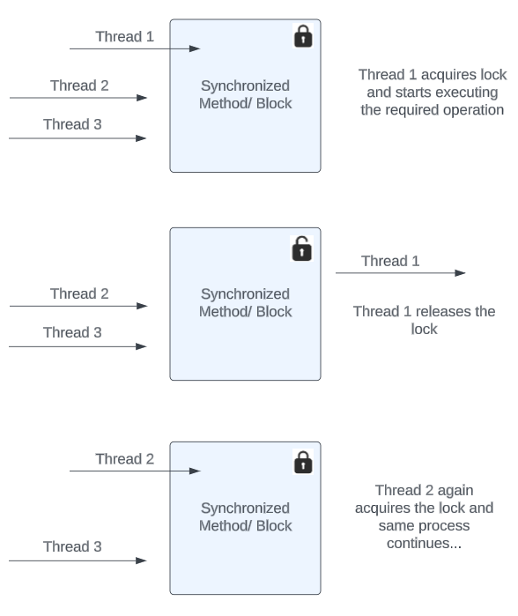

Slide 37
Daemon Thread
Daemon thread in java is a service provider thread that provides services to the user thread, or which runs at the background of another thread.
Best example : Garbage collector
Daemon
main

Slide 38
public class Test extends Thread{ }
@Override public void run() { System.out.println("Child Thread"); }
public static void main(String[] args) { System.out.println("Main thread"); Test t = new Test(); t.start(); }
t.setDaemon(true); System.out.println(t.isDaemon());
Output :
Main thread
true

Slide 39
Daemon thread (Important notes) :
We must create the daemon thread before starting of the thread if not it throws IllegalThreadStaticException.
Most of the times daemon thread have low priority.
Here in above example if we do not write System.out.println ("Main thread"); then it will not execute run as daemon runs behind main and main is doing nothing so daemon can't provide service.
Life of daemon thread depends upon another thread.
In this example, the child thread does not print because the main thread finishes execution before the JVM schedules the child thread

Slide 40
Inter – thread communication
It is a mechanism in which a thread releases the lock and enter paused state, and another thread acquires the lock and continue to executed.
It is implemented by the following methods present in java.lang.Object
wait();
notify();
notifyAll();
To call this methods on any object, thread should own the lock of that object i.e the thread should be inside synchronized area.

Slide 41
Inter – thread communication
wait() - If any thread calls wait() method, it causes the current thread to release the lock and wait until another thread invokes the notify() or notifyAll() method for an object, or a specified amount of time has elapsed.
notify() - This method is used to wake up a single thread and releases the object lock.
notifyAll() - This method is used to wake up all threads that are in waiting state.

Slide 42
Inter – thread communication
If time expires
If sleeping thread got interrupted
If waiting state got notify
waiting state
obj.wait();
obj.wait(1000);
Another waiting state
If waiting thread got lock
t.start();
New
Runnable
Running
Dead
If Thread Schedular allocates processor
If runs completes
MyThread t = new MyThread();

Slide 43
Shared Resource
Vi
R
S
V

Slide 44
Lock
In java 1.5 java.util.concurrent.locks package was introduced.
Lock is an interface.
Lock implementations provide more extensive operations than traditional implicit locks.
Methods : void lock();
boolean tryLock();
boolean tryLock(long time, TimeUnit unit);
void unlock();

Slide 45
import java.util.concurrent.locks.Lock; import java.util.concurrent.locks.ReentrantLock; public class MyThread extends Thread { private static final Lock lock = new ReentrantLock();
}
@Override public void run() {
}
// Acquire the lock lock.lock();
try { System.out.println(Thread.currentThread().getName() + " has acquired the lock."); // Simulate some work Thread.sleep(6000); System.out.println(Thread.currentThread().getName() + " is executing."); } catch (InterruptedException e) { e.printStackTrace(); } finally { // Release the lock System.out.println(Thread.currentThread().getName() + " has released the lock."); lock.unlock(); }
public static void main(String[] args) { MyThread t1 = new MyThread(); MyThread t2 = new MyThread(); t1.start(); t2.start(); }

Slide 46
Reentrant Lock
It is the implementation class of Lock interface, and it is direct child class of Object.
Reentrant means a thread can acquire same lock multiple times without any issue.
Internally ReentrantLock increments threads personal count whenever we call lock method and decrement the count value whenever threads call unlock method, and lock will be released when count reaches 0.

Slide 47
import java.util.concurrent.locks.ReentrantLock; public class ReentrantLockDemo { public static void main(String[] args) {
} }
ReentrantLock l = new ReentrantLock();
l.lock();
l.lock();
System.out.println(l.isLocked());
//true
System.out.println(l.getHoldCount());
//2
System.out.println(l.isHeldByCurrentThread());
//true
l.unlock();
System.out.println(l.getHoldCount());
//1
System.out.println(l.isLocked());
//true
l.unlock();
System.out.println(l.isLocked());
//false
System.out.println(l.isFair());
//false

Slide 48
Thread Pools (Executor Framework)
Creating a new thread for every job may create performance on memory problems. To overcome this we should go for Thread pool.
Thread pool is the pool of already created threads ready to do our job.
Java 1.5 version introduces Thread pool framework to implement Thread pools.
Thread pool framework is also known as Executor framework.

Slide 49
