Slide 1
IBM University Engagement Project Submission
“Exploring the Power of Machine Learning with IBM Cloud”

Slide 2

Project Tile – Inferexa – AI-Powered Interview Trainer Agent
Domain of Project – Education Technology (EdTech) / Artificial Intelligence
Student Name | Recent Passport Photo | Email ID | Mobile number [WhatsApp]
Supriya B |  | 1sj24cs149@gmail.com | 8073614761

Slide 3
Problem Statement -
Problem Statement: AI-Powered Interview Trainer Agent using IBM Granite
Job seekers often struggle to prepare effectively for interviews because existing platforms provide static question banks, generic mock interviews, and limited feedback that do not consider a candidate's resume, skills, experience, or target job role. This lack of personalization reduces the effectiveness of interview preparation and makes it difficult for candidates to identify their strengths and areas for improvement. The objective of this project is to develop an AI-powered Interview Trainer Agent using IBM Granite and IBM Cloud Lite Services that generates personalized interview questions, evaluates user responses, and provides intelligent feedback to help candidates improve their interview performance and confidence.

Slide 4
Proposed Solution -
Inferexa is an AI-powered interview coaching platform that combines IBM Granite with Retrieval-Augmented Generation (RAG) to deliver personalized interview preparation.
The workflow includes:
User registration and profile creation
Resume upload and parsing
Skill and project extraction
Knowledge retrieval using semantic search
Personalized interview question generation
AI-based answer evaluation
Performance tracking and analytics
Unlike traditional interview platforms, Inferexa adapts every interview based on the user's resume, experience level, and target job role.

Slide 5
Technology Used
IBM Cloud – Secure cloud platform, scalable deployment, cloud infrastructure
IBM watsonx.ai – IBM Granite 3 8B Instruct, prompt engineering, AI inference
IBM Cloud Object Storage – Resume PDFs, generated reports, exported documents
IBM Cloudants – User accounts, authentication, interview history, analytics, profiles
RAG Components – ChromaDB, Sentence Transformers, semantic search, vector embeddings
Backend – Python, FastAPI, Async APIs, Pydantic
Frontend – Streamlit, HTML, CSS, custom Streamlit components

Slide 6
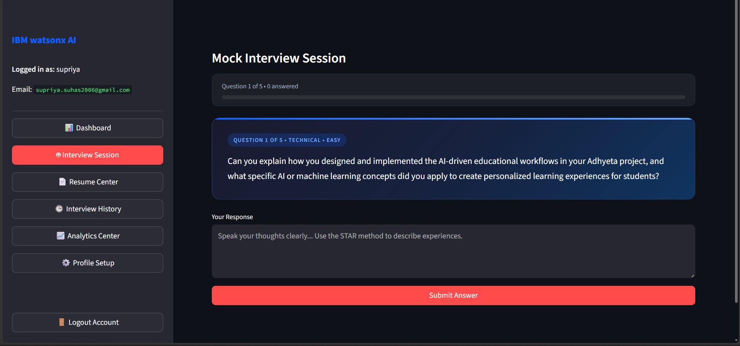
Training Screenshots-

Slide 7
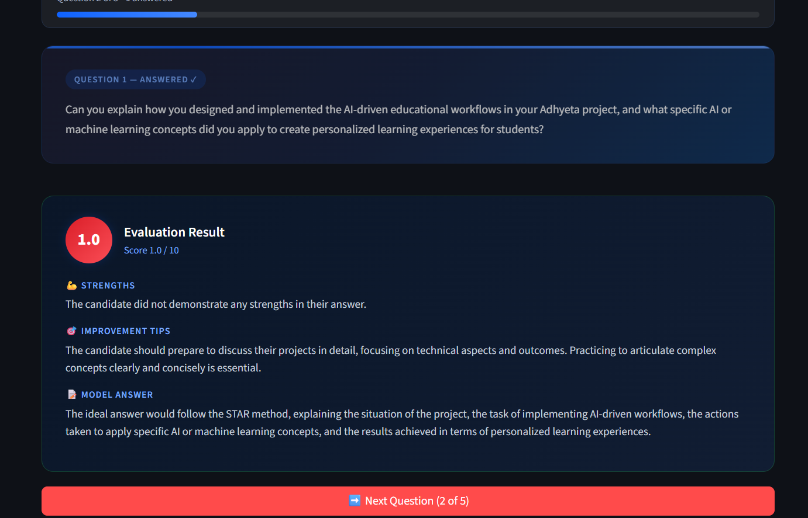
Training Screenshots-

Slide 8
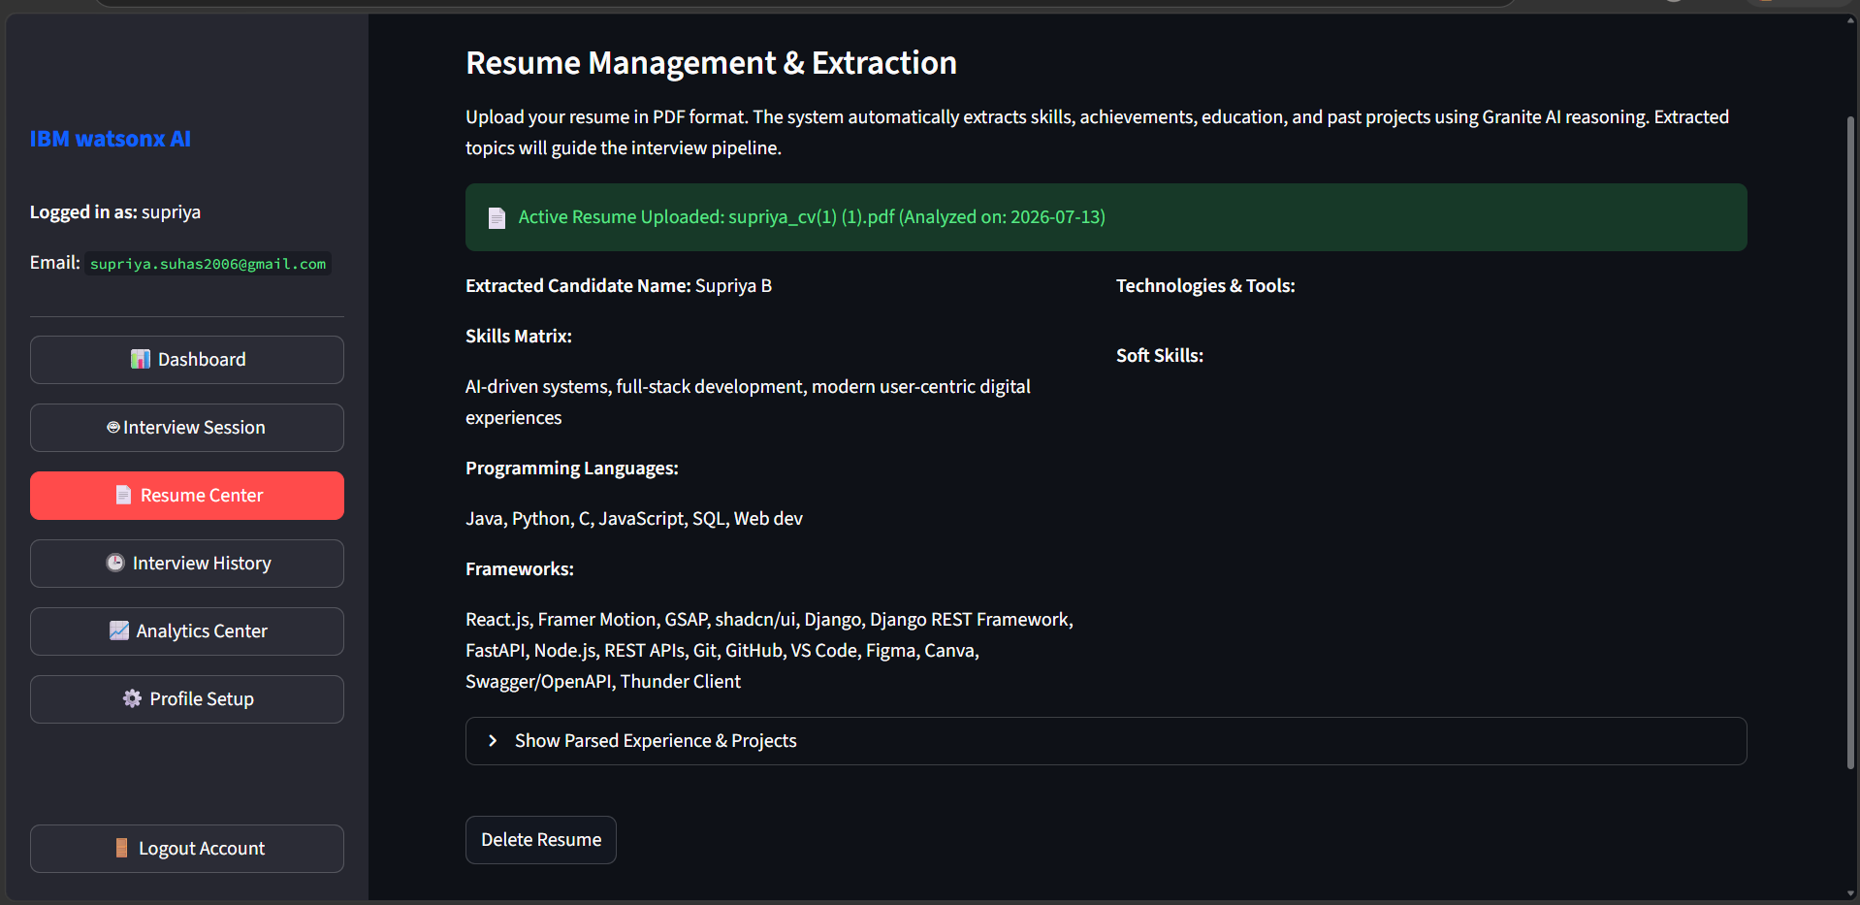
Testing Screenshot:

Slide 9
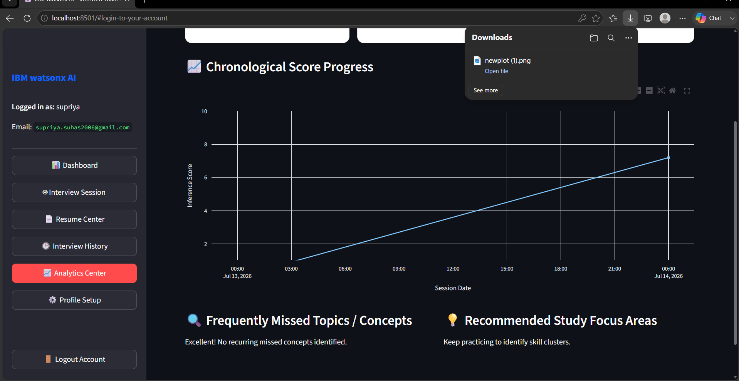
Testing Screenshot:

Slide 10
Novelty and Uniqueness
Resume-aware interview generation
RAG-powered contextual questioning
Personalized AI feedback
Adaptive interview difficulty
Performance analytics
IBM Cloud-native architecture
Interactive interview simulation

Slide 11
Git Hub Link
working Github URL – https://github.com/supriyab280602/interview-trainer-agent
·
·
·

Slide 12
Future Scope
Voice-based interviews
AI speech analysis
Mock video interviews
Live coding interviews
Company-specific interview preparation
Multilingual support
LinkedIn integration
AI learning roadmap
·
·
·

Slide 13
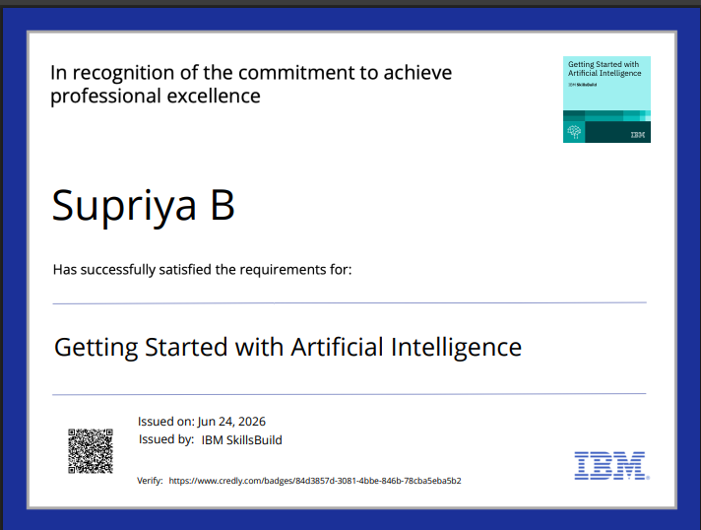
Certificates Earned:

Slide 14
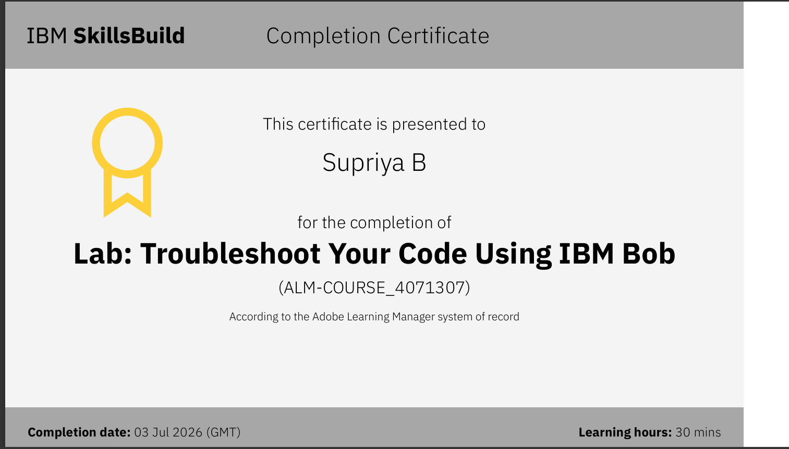
Certificates Earned:​
IBM BOB Certificate

Slide 15
_{THANK YOU}

