Slide 1
Online Food Delivery
Gauri Rankhamb [EBEON062261501]
Sandya Dharpure [EBEONFWL613827]
Supriya Guggilla[EBEON0622613798]
Komal Dangde [EONFWL619647]
Priyanka Pawar [EBEON0622617844]
Vaishnavi Jadhav[EONFWL615833]
Guided by:-Varadharajan Sir

Slide 2
Introduction
The Online Food delivery System's main purpose is to maintain track of information such as Item Category, Food, Delivery Address, Order, and Cart. It keeps track of information about the Item Category, the Customer, the Cart, and the Item Category. Only the administrator gets access to the project because it is totally built at the administrative level.
The project's purpose is to develop software that will cut down on the time spent manually managing Item Category, Food, Customer, and Delivery Address. It saves the Delivery Address, Order, and Cart information.

Slide 3
Objective of Applicaton
In that web page we Designed as simple and easy .
It’s fast, easy and comfortable.
An online menu is simpler to manage.
To provide the bug-free Online Food Delivery system to user as well as admin.
The main objective is here to provide a nice and secure platform for delivering food.
To maintain the records Product ,Category available into the system.

Slide 4
Online Food Delivery Modules
Delivery module : We can manage all the operations related to Delivery from this module.
Food Item module : This module is normally developed for managing the Food Item operations.
Order module : All the operations related to Order will be managed by Order.
Customer module : This module manages Customer functionalities.
Category module : Category modules performs all the create, read, update and delete operations of Category.
Login module: all the operation related to login of user and admin will be managed by this module .

Slide 5
MyModule: FOOD ITEM
Food Item Module plays a Key role and a very important module in Online Food Delivery Application.
This Food item module is very easy for customer , When customer enters the page it displays the customer what kind of food is available .
They can select whatever they want and below it shows information regarding the Food Item , i.e. about Food Cost, and what kind of food it is .
It displays details such as Type of food, Category , Price , Discount available , Image and Description.
Whenever the customer selects that food, it directs them to the order.
Then it shows the quantity available and discount that can be applicable to your order.
In My Food Item module when the Admin access the page, they have the access to modify the items by using Add Food Images , Food Category .
But when we login as user , we have to register first and login to the page , only then you are able to access to order and user can’t access the modification of food items.

Slide 6
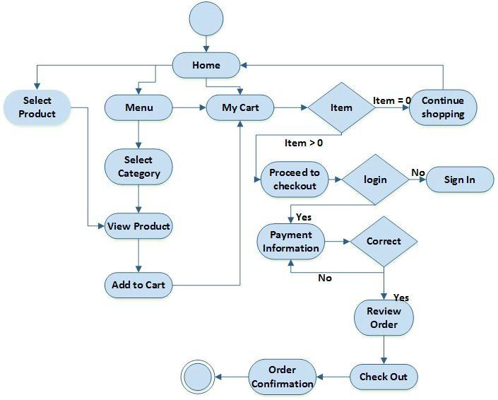
Project Architecture

Slide 7
Entity Relationship Diagram
id
Catrgory_id
Mobile_no
category
Email_id
id
has
user
city
food
name
discount
First_name
name
password
Last_name
price
description
has
have
id
description
have
payment
Delivery_status
have
order
Food_id
card
Delivery_date
Food_id
User_id
Order_date
Email_id
bank
Order_id

Slide 8
Future Work
Allow customers to modify orders: Allow clients to customise their food orders.
Improve the user interface by include more interactive features for the user. Add information about deals and promotional offers on the home page.
Payment Options: PayPal, cash, and gift cards are just a few of the options available. Allows you to save payment details for future use.
Order Process Estimate: Show the customer a graphical order status gauge.

Slide 9
Challenges issues
I faced error issue while creating connection with mysql database. After that I am resolve with the help of mysqlconnection.javapoint.com
In this project ,challenging thing is the emerging technologies in java like spring frame works spring boot ,spring security, microservices and it get resolve with the help of stackoverflow site .
I got more ideas from our project guide ,they always tell me easy way to remove error.

Slide 10
Technologies Used
Backend :Spring Boot, Spring MVC, Java
Frontend :JSP , HTML , CSS , Java Script
Styling : Bootstrap
Project Management : Maven
Database :MYSQL
Server : Embedded Tomcat Server
Operating System : Windows-10

Slide 11
Conclusion
Finally, for the online food delivery system, we created a secure, user-friendly food delivery administration system.
Whether they are Administrators or Customers, this system can look after them all. This system will let them manage client meals, delivery boy data, and expand without creating any disruption.
This system is completely secure because each user is assigned a unique user ID and password, preventing unauthorised access.
With online payment, registration, and cancellation, it's a lot easier to use.
As a result, using this strategy will help to minimise labour expenses while also giving clients more opportunity to enjoy the services.

Slide 12
THANK YOU

