Slide 1
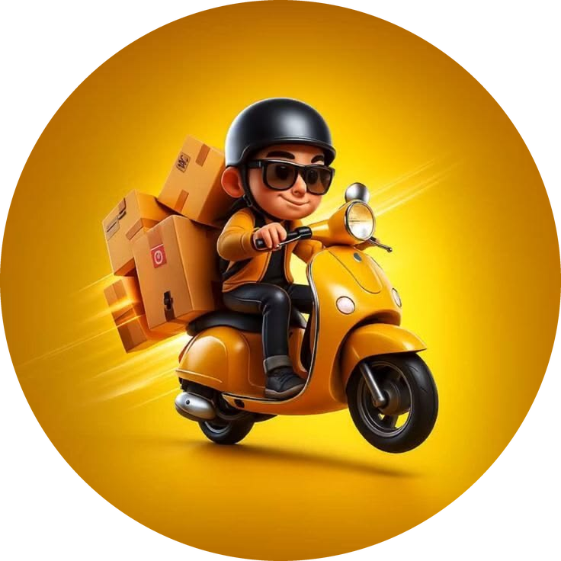
STRATEGIC MANAGEMENT | GROUP PRESENTATION
blinkit
Scanning the environment.
Preparing for the future.
A strategic assessment of India’s quick-commerce business
PESTEL
SCENARIOS
STRATEGY
10-MIN PROMISE
PRESENTED BY Chandan • Amlan • Rudraksh • Aman • Supriya
Case scenario • October 2026

Slide 2




Simple promise, complex delivery
01 | CASE CONTEXT
Blinkit’s model rests on three moving parts — and three tensions between them
CUSTOMER PROMISE
OPERATING ENGINE
STRATEGIC PRESSURE
Essentials delivered in minutes
Dark stores, inventory, suppliers, tech, riders
Balance growth, speed & price with cost
01
02
03
Growth vs Profitability
Speed vs Sustainability
Price vs Loyalty
More dark stores widen reach — but raise investment and operating cost.
Fast delivery must coexist with rider safety, weather resilience and less packaging.
Discounts win orders; reliability, availability and value build lasting loyalty.
Strategic question: How should Blinkit prepare for the next three years — not just react to today?

Slide 3
PESTEL: what is changing outside Blinkit
02 | ENVIRONMENTAL SCAN
External signals from the case brief — possibilities to investigate, not confirmed outcomes
P
E
S
POLITICAL
ECONOMIC
SOCIAL
Urban policy, transport rules and infrastructure can enable or restrict expansion.
Inflation lifts operating costs; price-sensitive buyers and discounting squeeze margins.
Busy urban lives favour convenience — but customers also want affordability and trust.
T
E
L
TECHNOLOGICAL
ENVIRONMENTAL
LEGAL
AI forecasting, inventory and route optimisation boost efficiency but need investment.
Heat, rain and floods disrupt delivery; packaging waste raises sustainability concerns.
Food safety, consumer protection, data privacy and labour rules shape compliance.

Slide 4








Top opportunities and threats
03 | PRIORITY ASSESSMENT
Prioritised by direct impact on growth, unit economics and customer trust
OPPORTUNITIES
THREATS
AI-led operations
Cost & margin pressure
Better forecasts and routing cut waste, lift fulfilment.
Inflation, delivery costs and price wars erode margins.
VS
Digital urban demand
Regulatory & workforce risk
Busy lifestyles and app adoption raise repeat orders.
Food-safety, data and labour rules may raise costs.
Trust as differentiator
Weather & resilience
Reliable availability and quality strengthen loyalty.
Extreme weather disrupts service, stock and rider safety.
Management priority: lower the cost-to-serve while protecting reliability and customer confidence.

Slide 5





Two forces reshaping quick commerce
04 | DRIVERS OF CHANGE
Both are highly important — and their direction over the next three years is uncertain
DRIVER 1
DRIVER 2
Customer demand
Operating costs
Will demand for quick commerce keep growing strongly?
Can Blinkit keep the cost of serving each order under control?
Why these two?
Demand sets the size of the opportunity.
Operating cost decides whether it becomes sustainable profit.
Together they create four plausible futures.
High growth
Manageable
Convenience becomes a routine habit.
Better density, technology and efficiency.
Low growth
High cost
Affordability concerns and local retail limit adoption.
Inflation, delivery and infrastructure costs rise.
HIGH IMPORTANCE
HIGH UNCERTAINTY

Slide 6

Four plausible futures for Blinkit
05 | SCENARIO ANALYSIS
Customer demand × operating-cost environment
1
The Scale-Up Window
2
Growth Under Pressure
High demand + manageable costs
High demand + high costs
HIGH
DEMAND
Expand selectively; invest in automation and dark-store productivity.
Grow carefully; lift basket size, route density and cost per order.
MOST RISKY
Scenario 4
Weak demand and rising costs hit growth and margins at once — the plan must stay viable even here.
3
Efficiency First
4
Defensive Reset
Low demand + manageable costs
Low demand + high costs
LOW
Consolidate weak locations; focus on retention and profitable categories.
Pause expansion; cut waste, protect cash, redesign unviable operations.
MANAGEABLE COSTS
HIGH COSTS

Slide 7



Our recommendation: grow with discipline
06 | STRATEGIC RESPONSE
A resilient model — not one dependent on speed and discounts alone
Profitable density
3-YEAR ROADMAP
Expand only where order density and fulfilment economics justify it.
24–36 M
Build resilient ops; deepen compliance, partner care & packaging.
Smarter operations
Forecasting, inventory and route optimisation to cut cost-to-serve.
12–24 M
Scale profitable clusters; optimise assortment, stock and routes.
Trust & resilience
Quality, rider safety, compliance and sustainable packaging.
0–12 M
Measure unit economics; pilot AI forecasting; track service & safety.
Convenience customers trust — at a cost the business can sustain.

Slide 8


