Slide 1



Brain Tumor Detection using CNN on
MRI Images
BY B. SUPRIYA LAXMI BAI
G. HARSHITHA
T. SHIVA SHESHU

Slide 2
Introduction
Brain tumors are among the most critical neurological disorders and require early diagnosis for effective treatment. Magnetic Resonance Imaging (MRI) is commonly used to identify abnormal brain tissues; however, manual analysis of MRI scans is time-consuming and may lead to diagnostic variability. Recent advancements in Artificial Intelligence and Deep Learning have enabled automated medical image analysis with improved accuracy and efficiency. This project presents a brain tumor detection system using the MobileNetV2 Convolutional Neural Network (CNN) architecture to classify MRI images into tumor and non-tumor categories. The proposed system aims to provide accurate, lightweight, and computationally efficient tumor detection for healthcare applications.
01

Slide 3
Background
Brain tumors are abnormal growths of cells within the brain that can affect normal brain function and become life-threatening if not detected at an early stage. MRI imaging is widely used in medical diagnosis because it provides detailed visualization of brain tissues without harmful radiation. Traditionally, radiologists examine MRI scans manually to identify tumors, but this process can be time-consuming and may vary depending on clinical expertise.
With the rapid growth of Artificial Intelligence and Deep Learning, automated image classification systems have become an important research area in healthcare. Convolutional Neural Networks (CNNs), especially lightweight architectures such as MobileNetV2, have shown significant potential in accurately detecting brain tumors from MRI images while reducing computational complexity and improving diagnostic efficiency.
02

Slide 4
Project Goals
To develop an automated brain tumor detection system using deep learning techniques for analyzing MRI brain images
To implement the MobileNetV2 CNN architecture for efficient feature extraction and accurate classification of tumor and non-tumor images.
To improve diagnostic efficiency and reduce computational complexity by creating a lightweight and reliable model suitable for real-time healthcare applications.
To enhance classification performance through image preprocessing and data augmentation techniques for better model generalization and reduced overfitting.
03

Slide 5
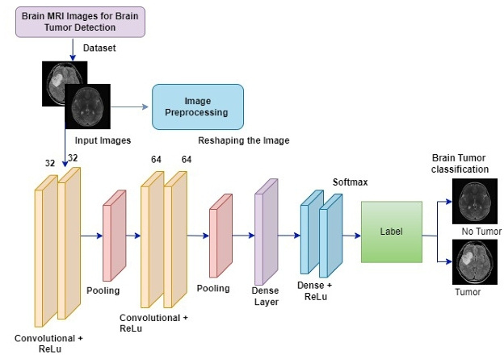
CNN Architecture
Convolutional Neural Network (CNN) is a deep learning architecture widely used for image classification and computer vision tasks. CNN automatically extracts important spatial features from images using convolutional layers, pooling layers, and activation functions. In this project, CNN is used to analyze MRI brain images and identify patterns associated with tumors. The MobileNetV2 architecture is adopted because of its lightweight structure and computational efficiency, enabling accurate brain tumor classification with reduced processing time and fewer parameters compared to traditional deep learning models.
04

Slide 6
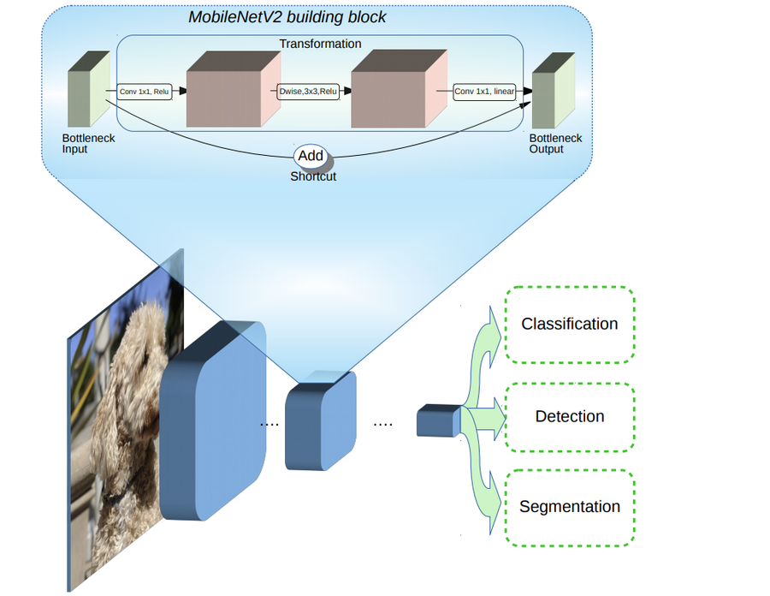
MRI Image Analysis
MRI Image Analysis is the process of examining Magnetic Resonance Imaging (MRI) scans to identify abnormalities in brain tissues. MRI provides high-resolution images that help in detecting tumors, tissue damage, and structural changes within the brain. In this project, MRI images are preprocessed using resizing, normalization, and augmentation techniques before being analyzed by the deep learning model. The CNN-based MobileNetV2 architecture extracts important spatial features from the MRI scans and classifies them into tumor and non-tumor categories, enabling efficient and automated brain tumor detection.
05

Slide 7
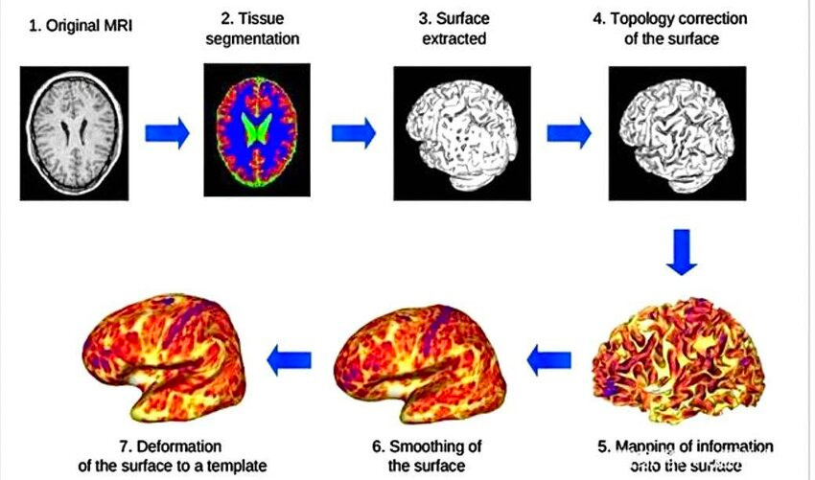
Medical Image Processing
Medical Image Processing involves the application of computational techniques to analyze and enhance medical images for accurate diagnosis. In healthcare systems, MRI image processing plays an important role in identifying abnormalities such as brain tumors. In this project, MRI scans are processed using preprocessing techniques including image resizing, normalization, and data augmentation to improve image quality and model performance. The processed images are then provided to the MobileNetV2 deep learning model for automated tumor classification, enabling faster and more reliable medical image analysis.
06

Slide 8
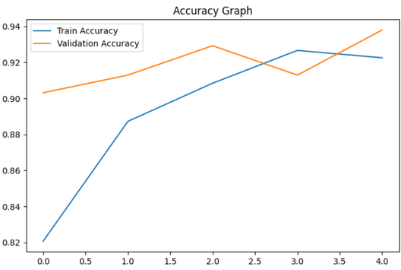
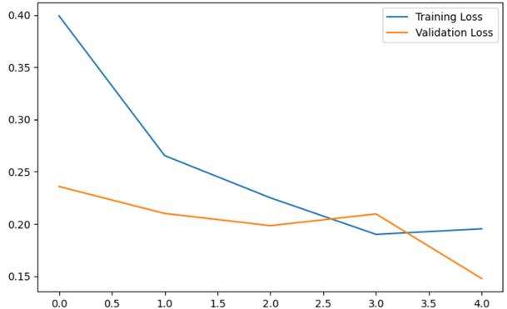
Analysis
The proposed MobileNetV2-based model was evaluated using standard classification metrics such as accuracy, precision, recall, and F1-score. Training and validation accuracy graphs indicate stable model learning and good generalization performance. The loss curves demonstrate effective convergence with reduced overfitting. Confusion matrix analysis further confirms the model’s capability to correctly classify tumor and non-tumor MRI images. The experimental results indicate that the lightweight CNN architecture achieves reliable performance with lower computational complexity.
07

Slide 9
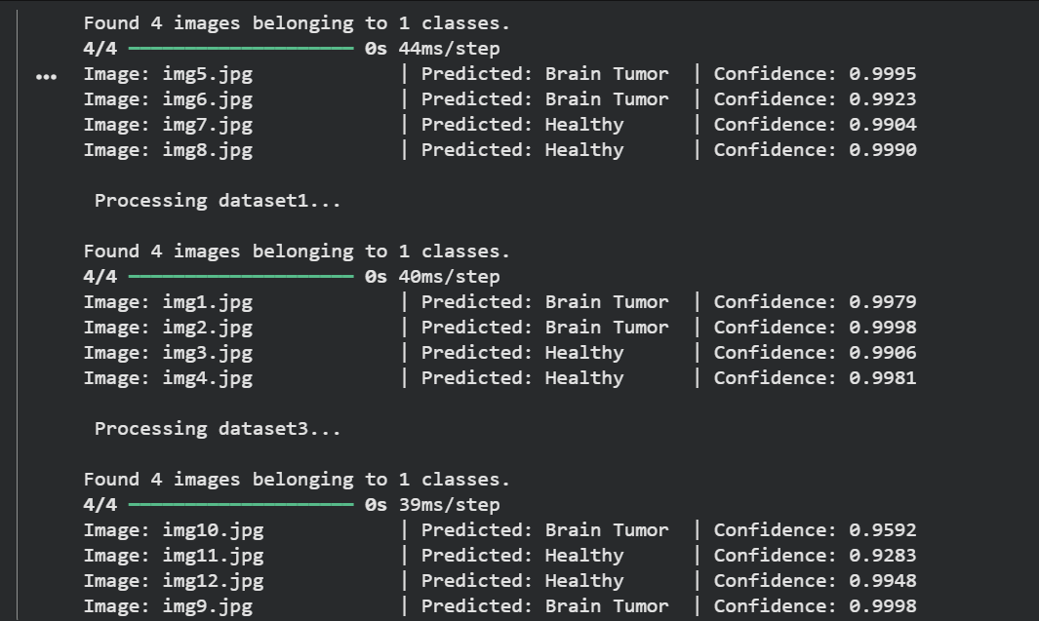
Result
The proposed MobileNetV2-based brain tumor detection system achieved effective classification performance on MRI images. Experimental results demonstrated high accuracy in distinguishing tumor and non-tumor cases. The training and validation graphs indicated stable learning behavior with reduced overfitting. Confusion matrix analysis confirmed reliable prediction capability with improved classification efficiency. The lightweight architecture of MobileNetV2 also reduced computational complexity and training time, making the proposed model suitable for efficient medical image analysis and real-time healthcare applications.
08

Slide 10
Conclusion
This project presented an automated brain tumor detection system using the MobileNetV2 Convolutional Neural Network architecture on MRI images. The proposed model successfully performed tumor and non-tumor classification with effective accuracy and reduced computational complexity. Image preprocessing and augmentation techniques improved model performance and generalization capability. The experimental results demonstrated that lightweight deep learning architectures can provide reliable and efficient medical image analysis. The proposed system can support healthcare professionals in early brain tumor detection and may be further extended for advanced multi-class tumor classification in future research.
10

Slide 11
Thank You

