Slide 1

DISASTER TWEET
CLASSIFICATION
An NLP and machine-learning project
Classifying social media posts as disaster-related or non-disaster using TF-IDF and supervised learning.
PROJECT PRESENTATION
Based on the project brief, supplied dataset, code, and app screenshots

Slide 2
01 | Problem Statement & Objectives
Why disaster-tweet classification matters
The challenge
Project goal
Tweets may describe real emergencies—or use words such as “fire,” “flood,” and “disaster” metaphorically. Context matters.
Build a binary text classifier that predicts whether a tweet is related to a real disaster (1) or not (0).
Objectives
• Prepare and explore the labelled tweet dataset.
• Convert text into numerical features with TF-IDF.
• Train and compare classification models using evaluation metrics.
• Provide a simple web interface for entering a tweet and viewing a prediction.
2

Slide 3
02 | Dataset & Data Exploration
Structure of the supplied Excel dataset
7,613
5
0 / 1
Rows in supplied file
Columns
Target labels
Dataset columns
• id — tweet identifier
• keyword — associated keyword
• location — location information
• text — tweet content
• target — 0 = non-disaster, 1 = disaster
Exploration steps
• Inspect columns and data types
• Check missing values
• Plot target-class distribution
• Identify frequent words and phrases
Note: the project brief mentions 10,000 tweets; the attached Excel file contains 7,613 rows.
3

Slide 4
03 | Text Preparation & Feature Engineering
Turning raw tweet text into machine-readable features
1
2
3
4
Clean text
→
Split data
→
TF-IDF
→
Train models
Remove URLs, HTML, and user mentions; normalize whitespace.
Create stratified training and test sets (80% / 20%).
Represent words and two-word phrases as weighted numeric features.
Fit candidate classifiers on the training portion.
Feature setup: lowercase text • unigram + bigram features • up to 100,000 TF-IDF features
The baseline model uses tweet text; metadata columns are not fed directly into the classifier.
4

Slide 5
04 | Model Training & Evaluation
Two baseline classifiers are compared
Logistic Regression
Multinomial Naive Bayes
TF-IDF text features with balanced class weights; maximum 1,500 iterations.
A probability-based text classifier using TF-IDF features and smoothing.
Evaluation measures
Diagnostics generated by the training script
• Confusion matrix
• ROC curve and AUC
• Precision–recall curve
• Model-metrics CSV
• Accuracy — overall correct predictions
• Precision — reliability of positive predictions
• Recall — how many disaster tweets are found
• F1-score — balance of precision and recall
Scores must be generated by running train_model.py; no test metrics are assumed here.
5

Slide 6
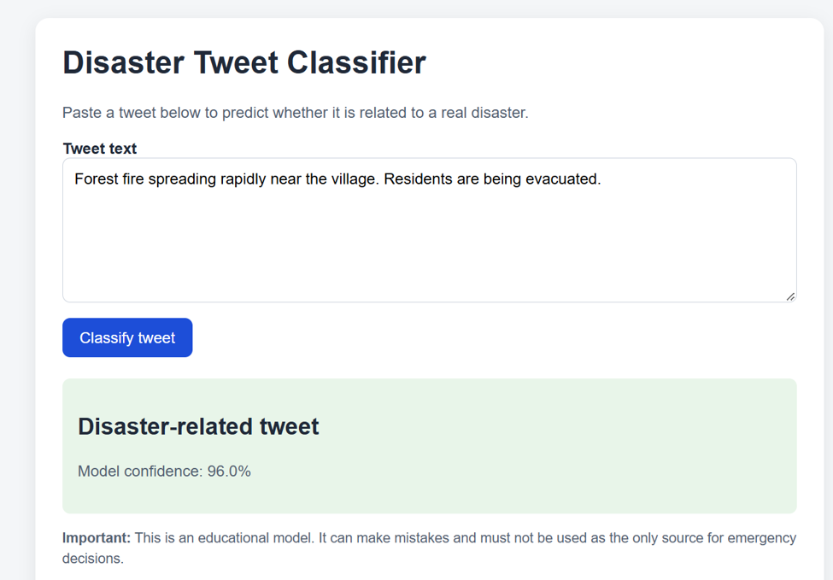
05 | Web Application Demo
Screenshot: a disaster-related tweet is classified in the shown example
Example 1
Forest fire and evacuation
Prediction shown
Disaster-related
Model confidence shown: 96.0%
Demo result from screenshot
6

Slide 7
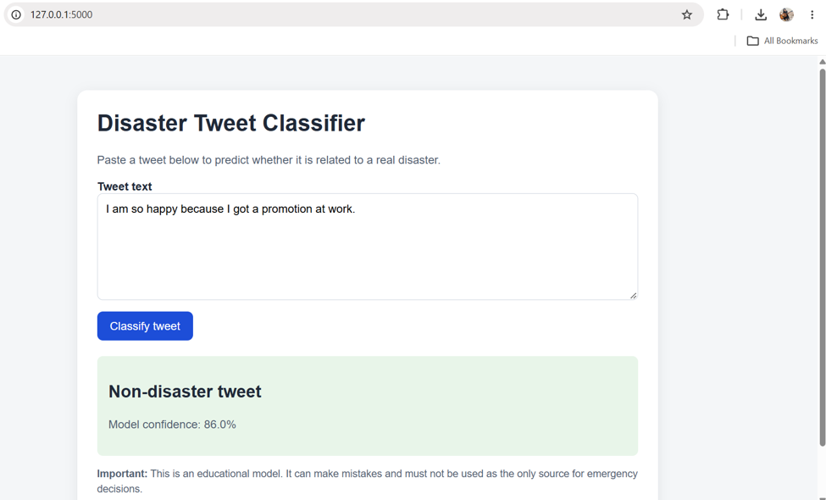
06 | Demo Result & Limitations
Everyday work-related text is classified as non-disaster
Example 2
Promotion at work
Prediction shown
Non-disaster
Model confidence shown: 86.0%
Limitations
• Predictions can be wrong
• Confidence is not a guarantee
• Not for emergency decisions
7

Slide 8
07 | Conclusion & Next Steps
What the project delivers
Future improvements
• A complete text-classification pipeline
• Baseline models and evaluation visualizations
• A Flask interface for single-tweet predictions
• Add cross-validation and hyperparameter search
• Tune thresholds to reduce false alarms
• Test on unseen, diverse tweet examples
• Deploy securely only after further validation
Thank you | Questions?

