Slide 1

Scientific Calculator
• Using Python (Tkinter)
• A simple and user-friendly calculator made using Python.
• It helps users perform both basic and scientific calculations easily.
Developed by: Supriya Prasad

Slide 2
Introduction & Objective
Introduction :-
• Python is a popular programming language used to build applications.
• Tkinter helps create graphical interfaces.
Objective:-
• Build an easy-to-use calculator
• Perform daily and scientific calculations
• Make it simple for any user to understand

Slide 3
Technologies & Features
Technologies Used:-
• Python
• Tkinter Library
• Math Library
Features:-
• Basic calculations (+, -, *, /)
• Scientific functions (sin, cos, tan, log, sqrt)
• Special values (π, e)
• Error handling for wrong inputs

Slide 4
Working Mechanism
• When the user clicks buttons, the numbers and symbols are
shown on the screen.
• The calculator stores everything as a simple text expression.
• When '=' is pressed, Python calculates the result automatically.
• For scientific functions like sin or log, special math formulas
are used.
• Finally, the result is displayed instantly to the user.

Slide 5
Code Explanation
• The calculator is divided into small functions for better understanding.
• For example, one function handles button clicks,
another clears the screen.
• A special function is used to calculate results safely.
• Error handling ensures the app does not crash if wrong input is given.
• This makes the program simple, organized, and easy to maintain.

Slide 6
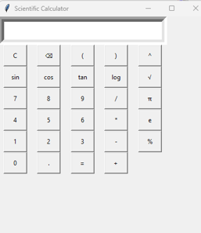
Output/GUI
• This is the final calculator interface where users can
perform calculations easily.
• It is designed to be simple, clean, and user-friendly.

Slide 7
Conclusion
• This project shows how we can build a real application
using Python.
• It combines coding logic with a visual interface.
• The calculator is easy to use and useful in daily life.
• It can be improved further by adding more features like
history or themes.
THANK YOU

