Slide 1
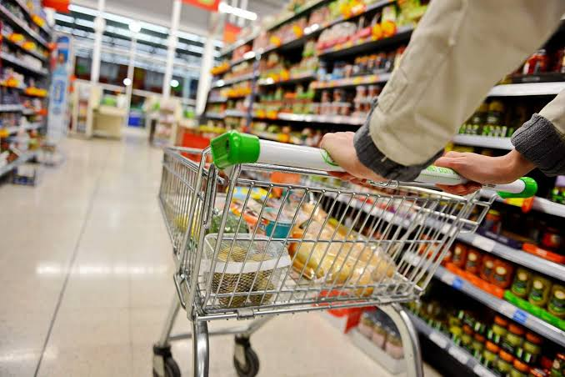
Retail Store Sales Forecasting
Complete Rossmann end-to-end project.
The process involves several key steps, including data preprocessing, model building (using both machine learning and deep learning approaches), evaluation, and deployment. The prediction task is central to the overall sales forecasting challenge and serves as the foundation for subsequent analysis and decision-making within the company
The project covers the full workflow requested in the brief: EDA, feature engineering, ML, deep learning/LSTM, model serialization, MLflow, DVC, Flask deployment and submission generation.

Slide 2
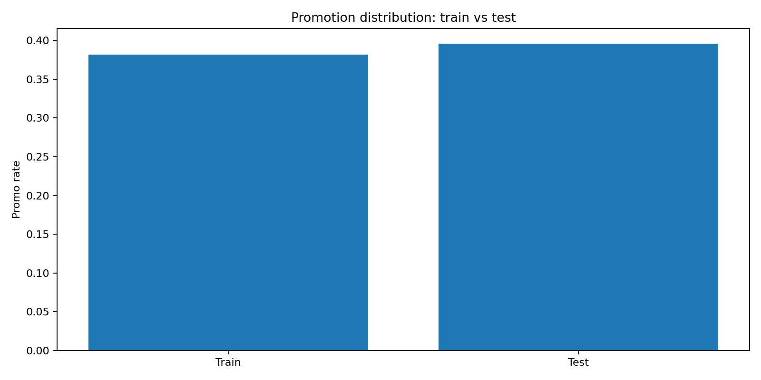
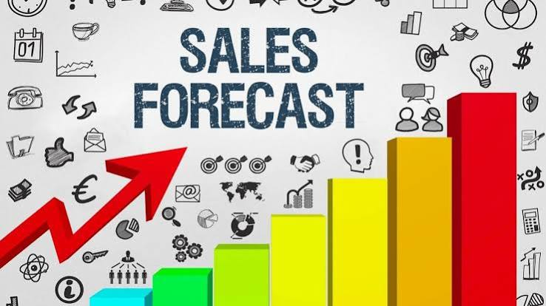
Rossmann Sales Forecasting — Interim EDA
Dataset: 1.017M train rows, 41,088 test rows, 1,115 stores.
Promo prevalence is similar: 38.2% train vs 39.6% test.
Sales–Customers correlation for open stores: 0.824.
The data supports strong temporal, promotional and store-level segmentation.

Slide 3
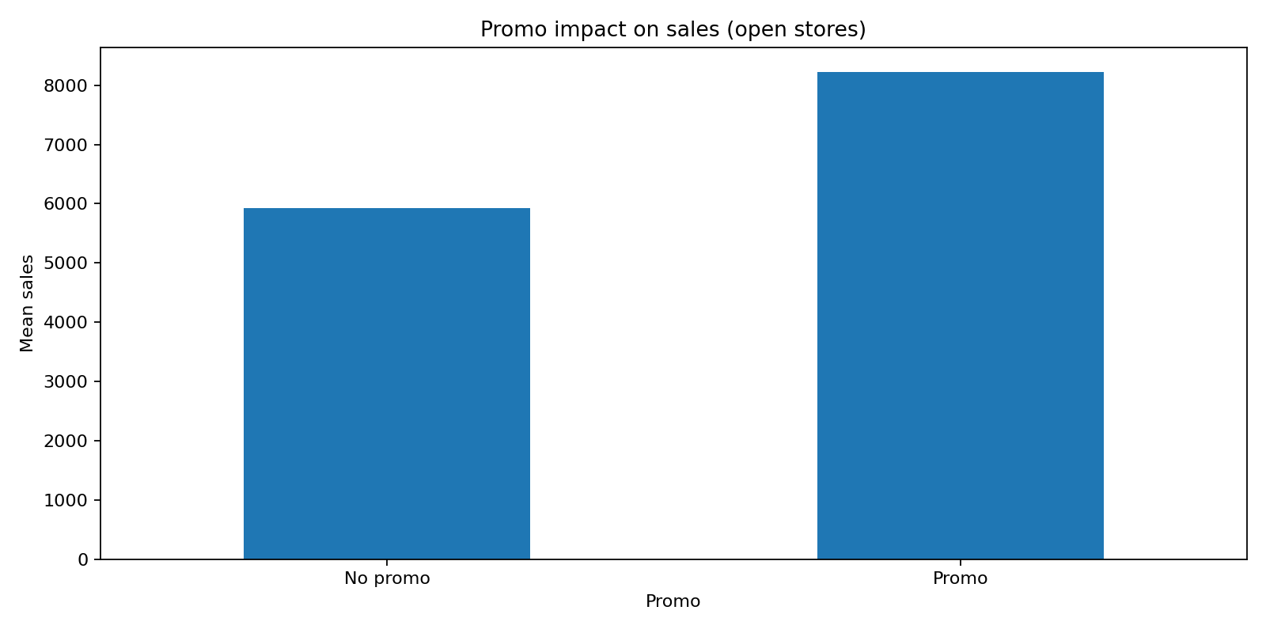

Customer purchasing behaviour
Promo is associated with mean sales increasing from 5,929 to 8,228.
Mean customers increase from 697 to 844 on promo days.
This is an association, not a causal estimate; promotion timing may be confounded by seasonality/day of week.
December has the strongest average open-store sales, indicating meaningful seasonality.

Slide 4
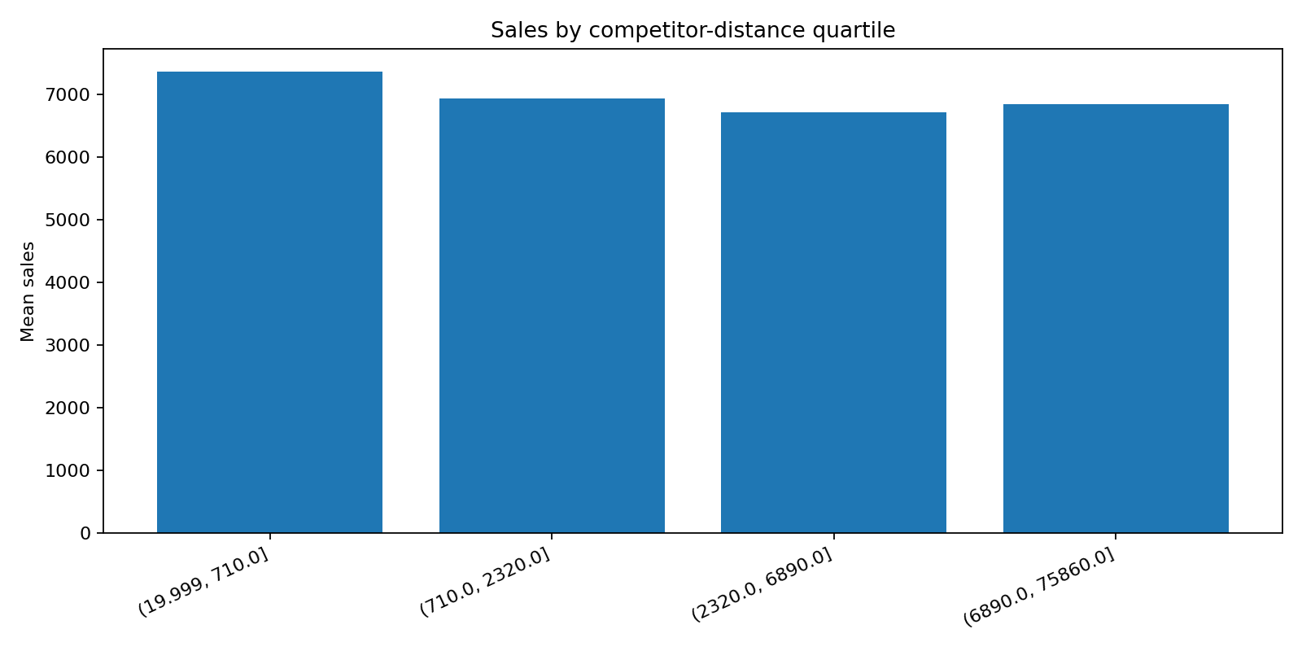

Store, calendar and competition insights
Only 10 stores are open on every observed weekday.
Weekend behaviour differs substantially between always-open and other stores.
Competitor distance has a non-linear relationship with sales.
Three stores have missing CompetitionDistance; the supplied store table has no time-varying competition-distance history.

Slide 5
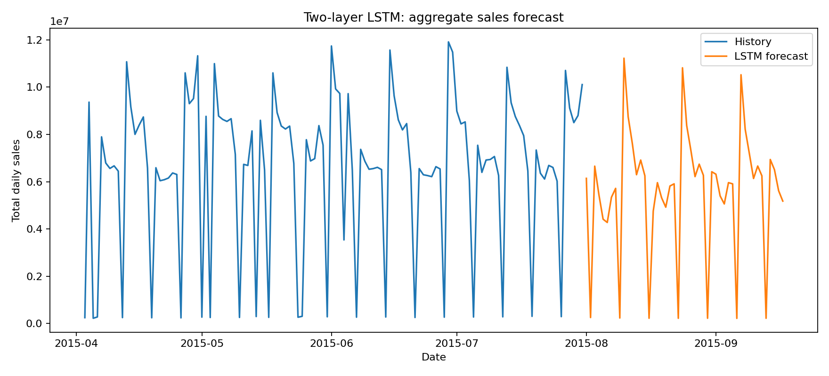
Modelling direction and next steps
Trained the production LightGBM model using a chronological July 2015 validation set rather than randomly splitting the time series: RMSLE 0.0535, MAE 256, RMSPE 0.0573.
Production model: LightGBM in a sklearn Pipeline with date, holiday, promotion, store and competition features.
Deep-learning track: stationarity + ACF/PACF + (-1,1) scaling + two-layer LSTM.
Next: MLflow screenshots, DVC version screenshots, GitHub push and deploy Flask app.

Slide 6
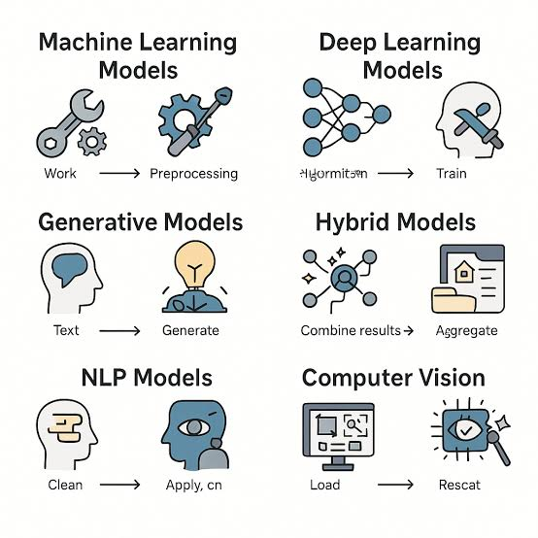
Important EDA Findings & FACTS
Train promotion rate: 38.15%
Test promotion rate: 39.58%
Sales–Customers correlation: 0.824
Average open-store sales without promotion: 5,929
Average open-store sales with promotion: 8,228
December has the strongest average sales.
Only 10 stores are open on every observed weekday.
Competitor distance shows a non-linear relationship with sales.
Three stores have missing competitor-distance values.
The dashboard is coded in:
app.py
templates/index.html
static/style.css

Slide 7
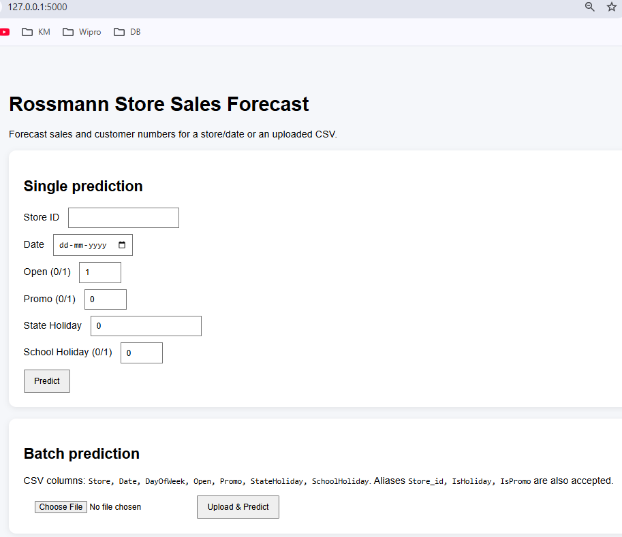
How to Predict sales using Web UI
The project provides a Flask-based web UI where store managers can enter/upload required information such as Store ID, Date, Holiday, Weekend, and Promotion details. The UI then displays the predicted sales and customer numbers, along with a prediction plot, and allows the user to download the predictions as a CSV file.

Slide 8
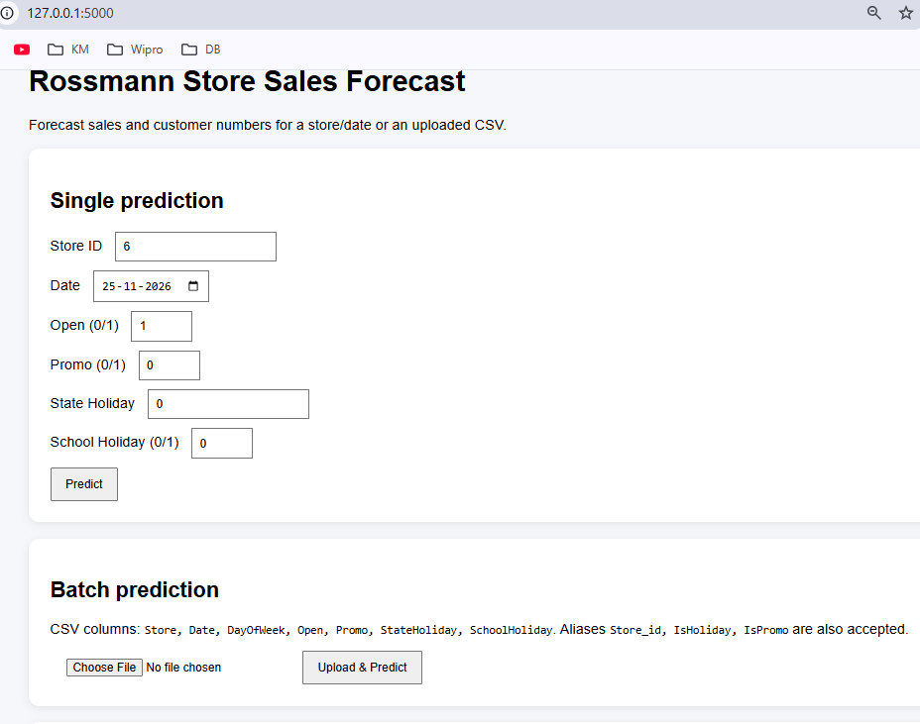
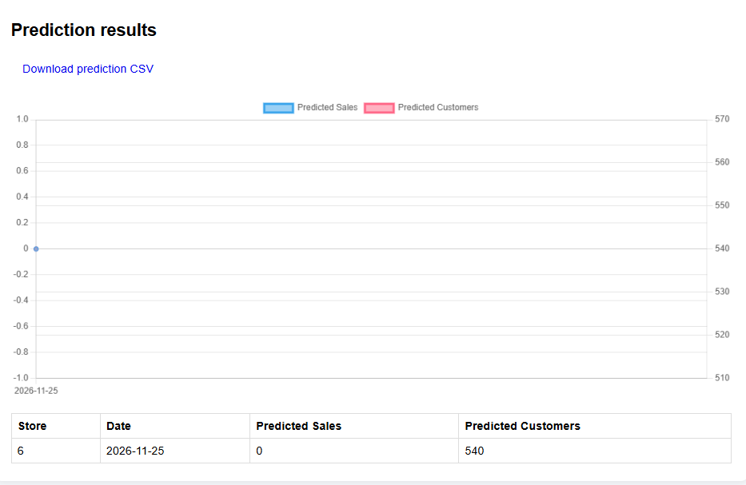
Prediction Result through Web UI

