Slide 1

YOUTUBE DATA ANALYSIS
"Let’s Gather Some Valuable Insights."

Slide 2
CONTENTS
01
02
03
04
05
06
Objective
Collection of Data
EDA
Tableau Dashboard
Sentiment Analysis
Streamlit dashboard
07
Insight

Slide 3
Objective!
The analysis aims to extract meaningful insights regarding video content, engagement metrics, and audience demographics.

Slide 4
01
Data collection and sources

Slide 5
Data Collection Process
Step 1
Step 2
Step 3
Step 4
Get API Key
Install Required Libraries
Authenticate
Collecting Channel ID
Step 5
Step 6
Step 7
Fetching the playlist ID
Based on channel details
Retrieving the Video ID
with the Playlist ID
Retrieving the all video detail from Video ID

Slide 6
02
Data processing and Enrichment

Slide 7
Data cleaning Process
Import Libraries
Raw Data
Data Processing
Data enrichment
Imported all the Python libraries required for data processing.
Imported the raw data file and reviewed its details.
Initiating the data cleaning process to ensure accuracy and reliability.
Embarking on data enrichment procedures to enhance its depth and quality.

Slide 8
03
Visualization with Tableau

Slide 9
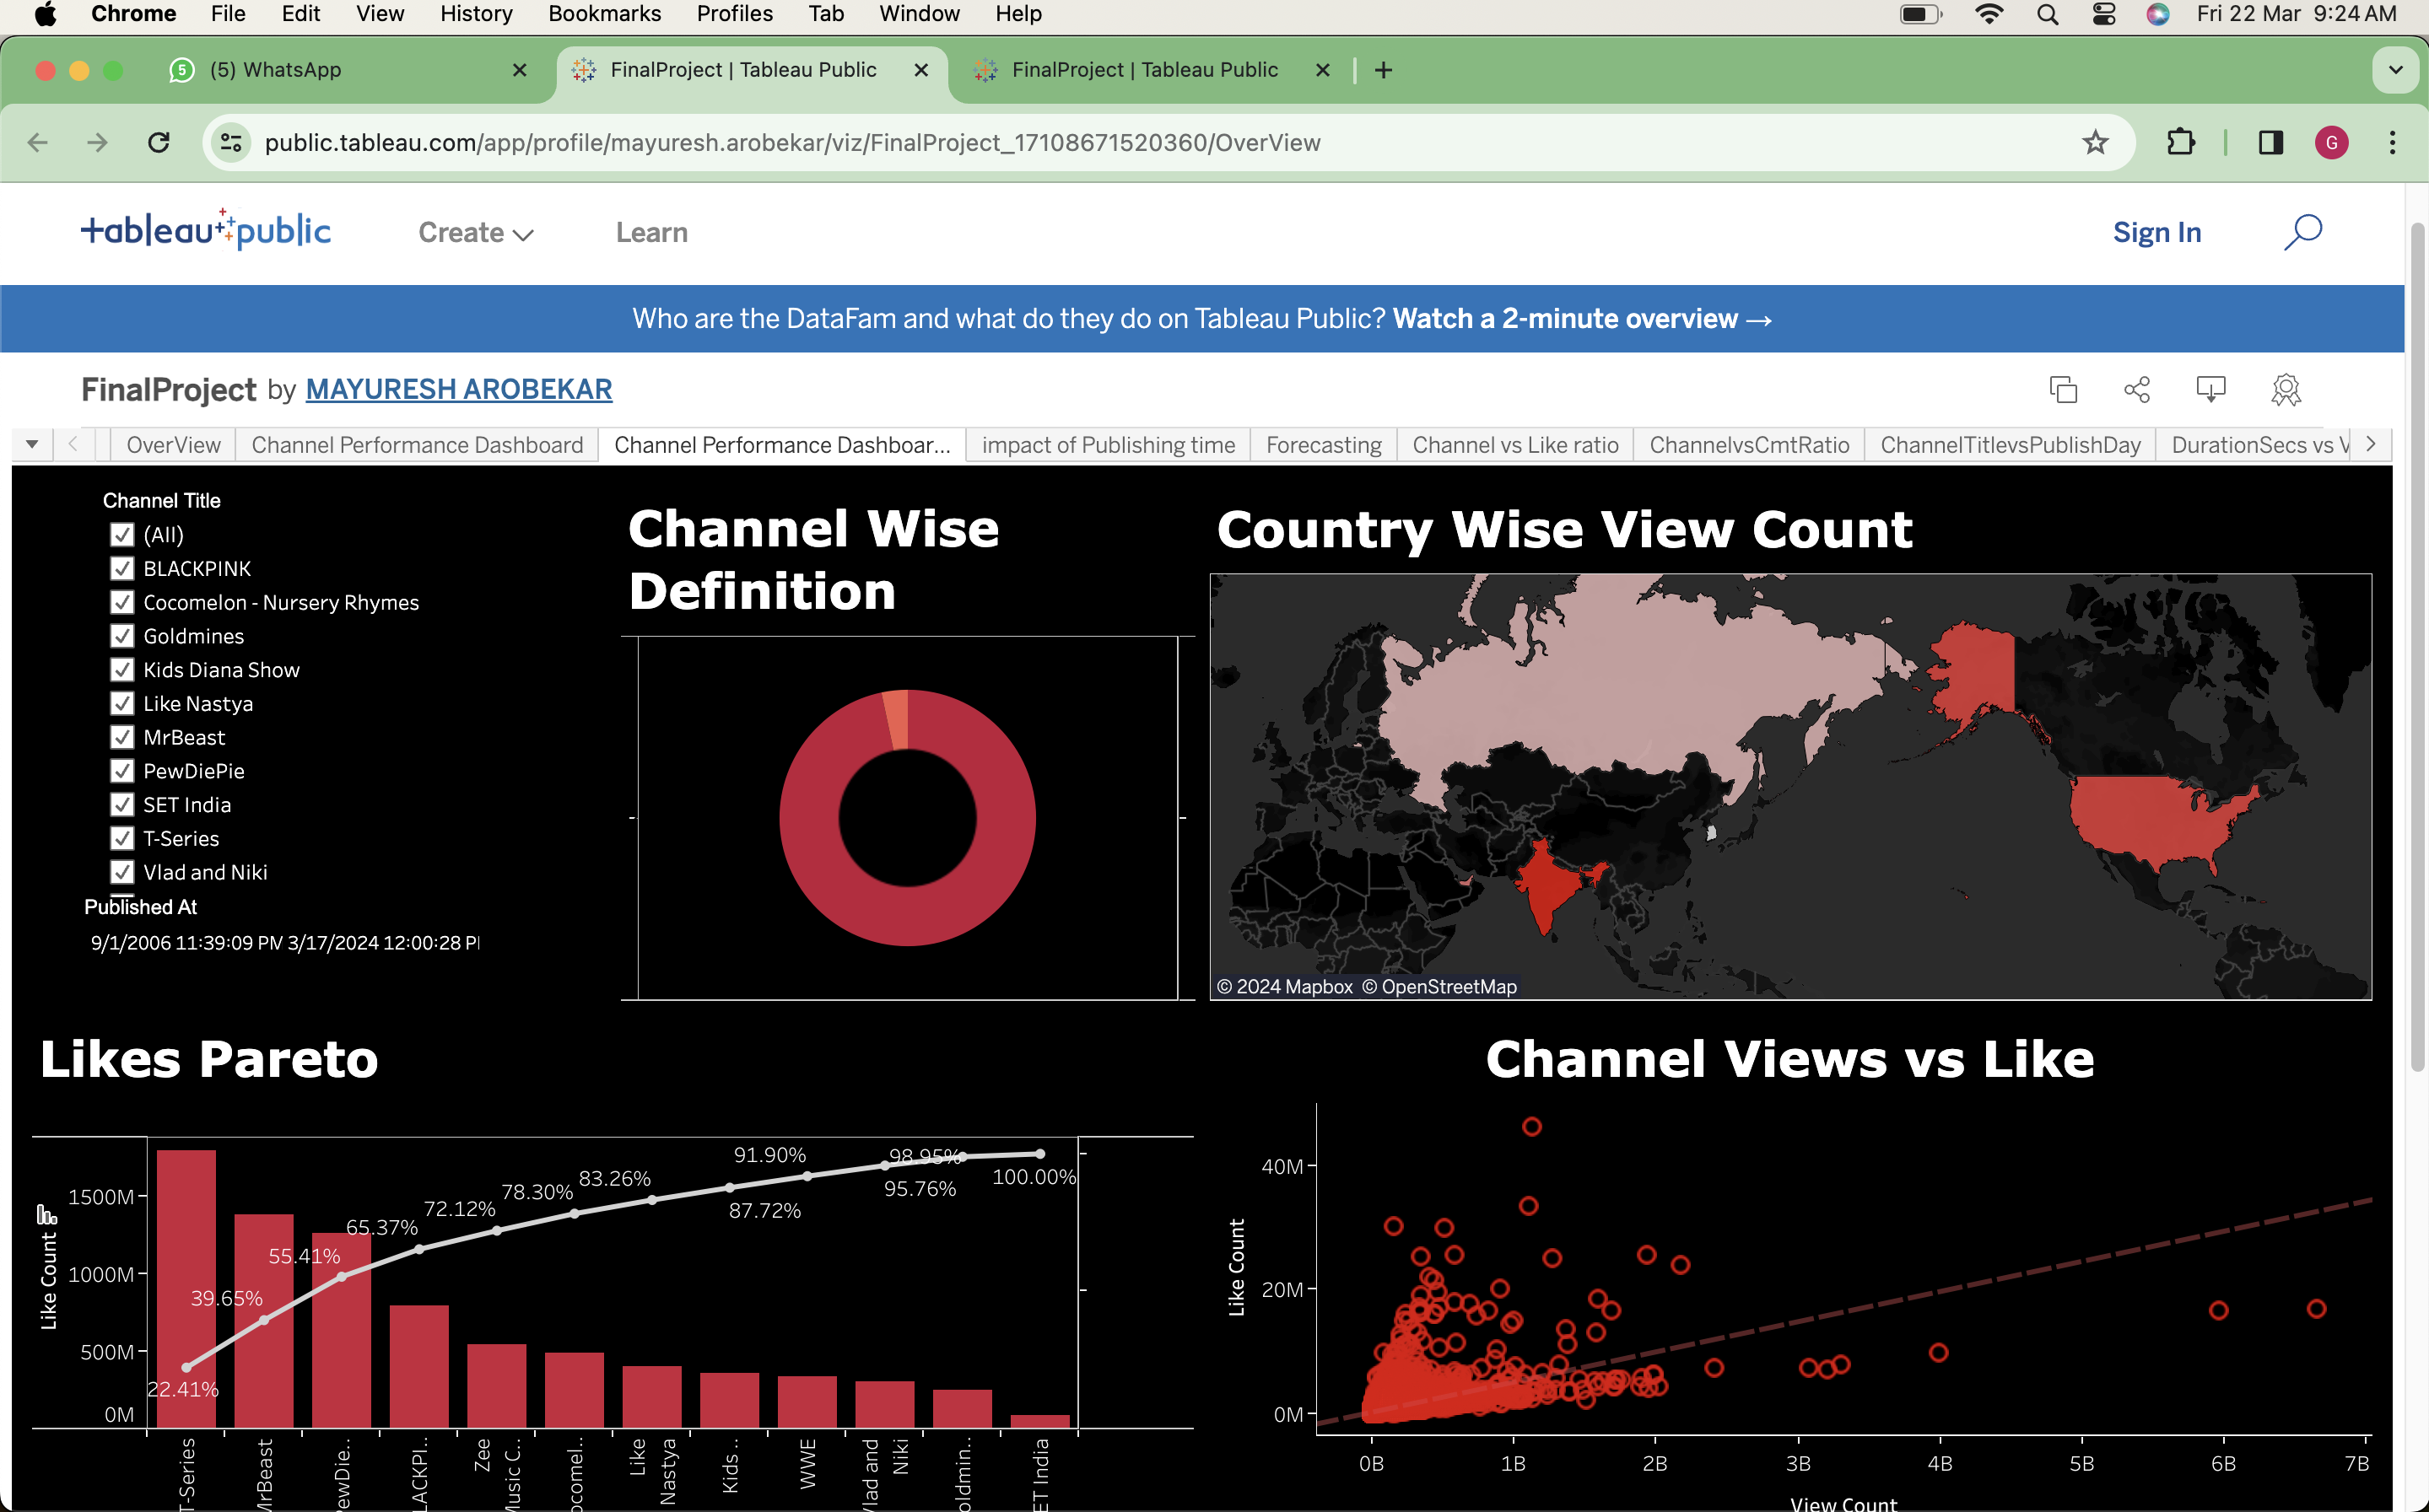
Tableau Dashboard
Easily navigate through rich YouTube channel insights using our sleek Tableau dashboard interface.

Slide 10
04
Sentiment Analysis

Slide 11
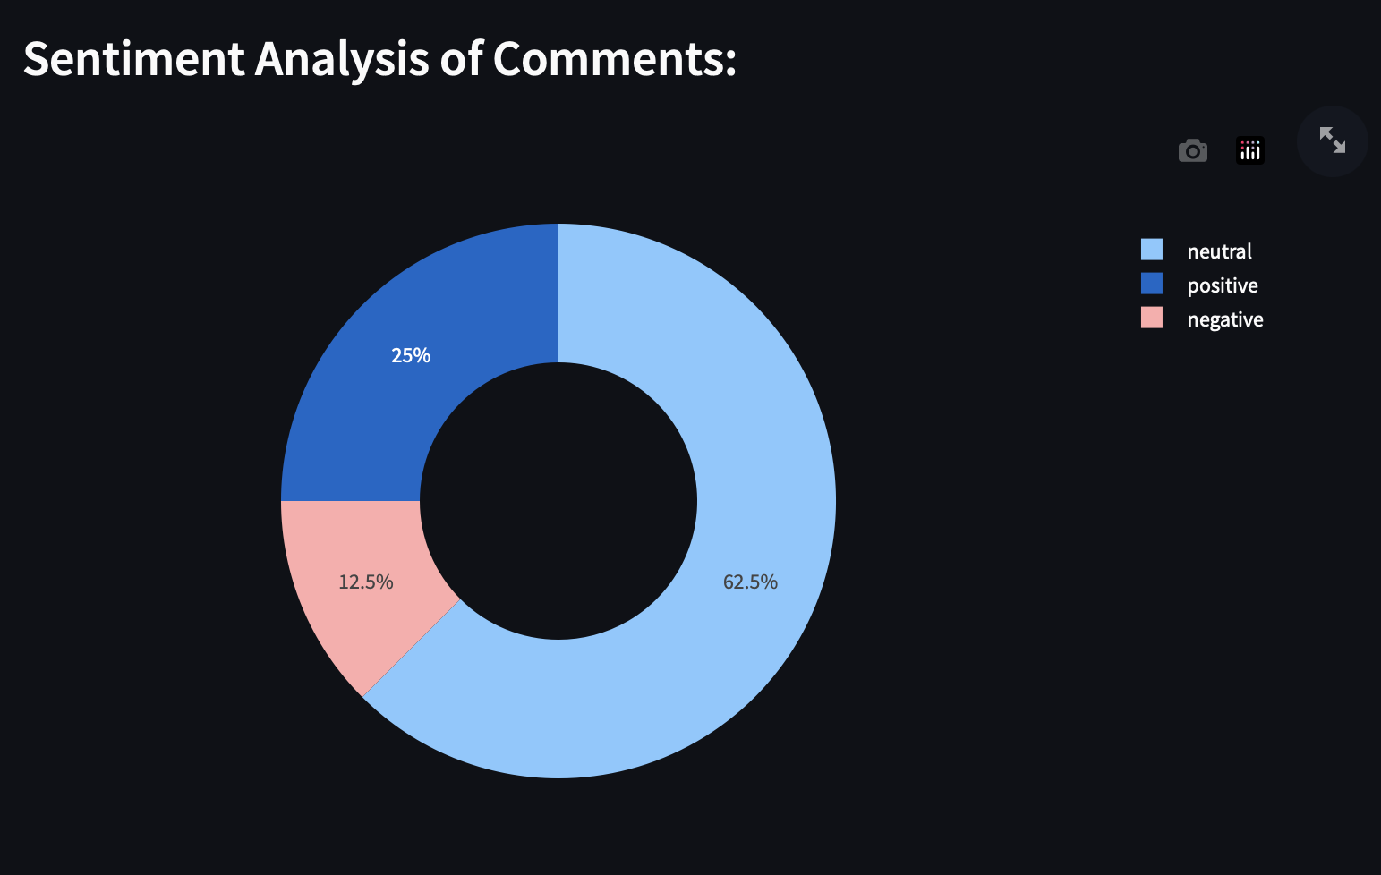
Sentiment Analysis
Sentiment analysis, a technique within natural language processing (NLP), serves to ascertain the sentiment conveyed in textual content.

Slide 12
05
Streamlit App

Slide 13
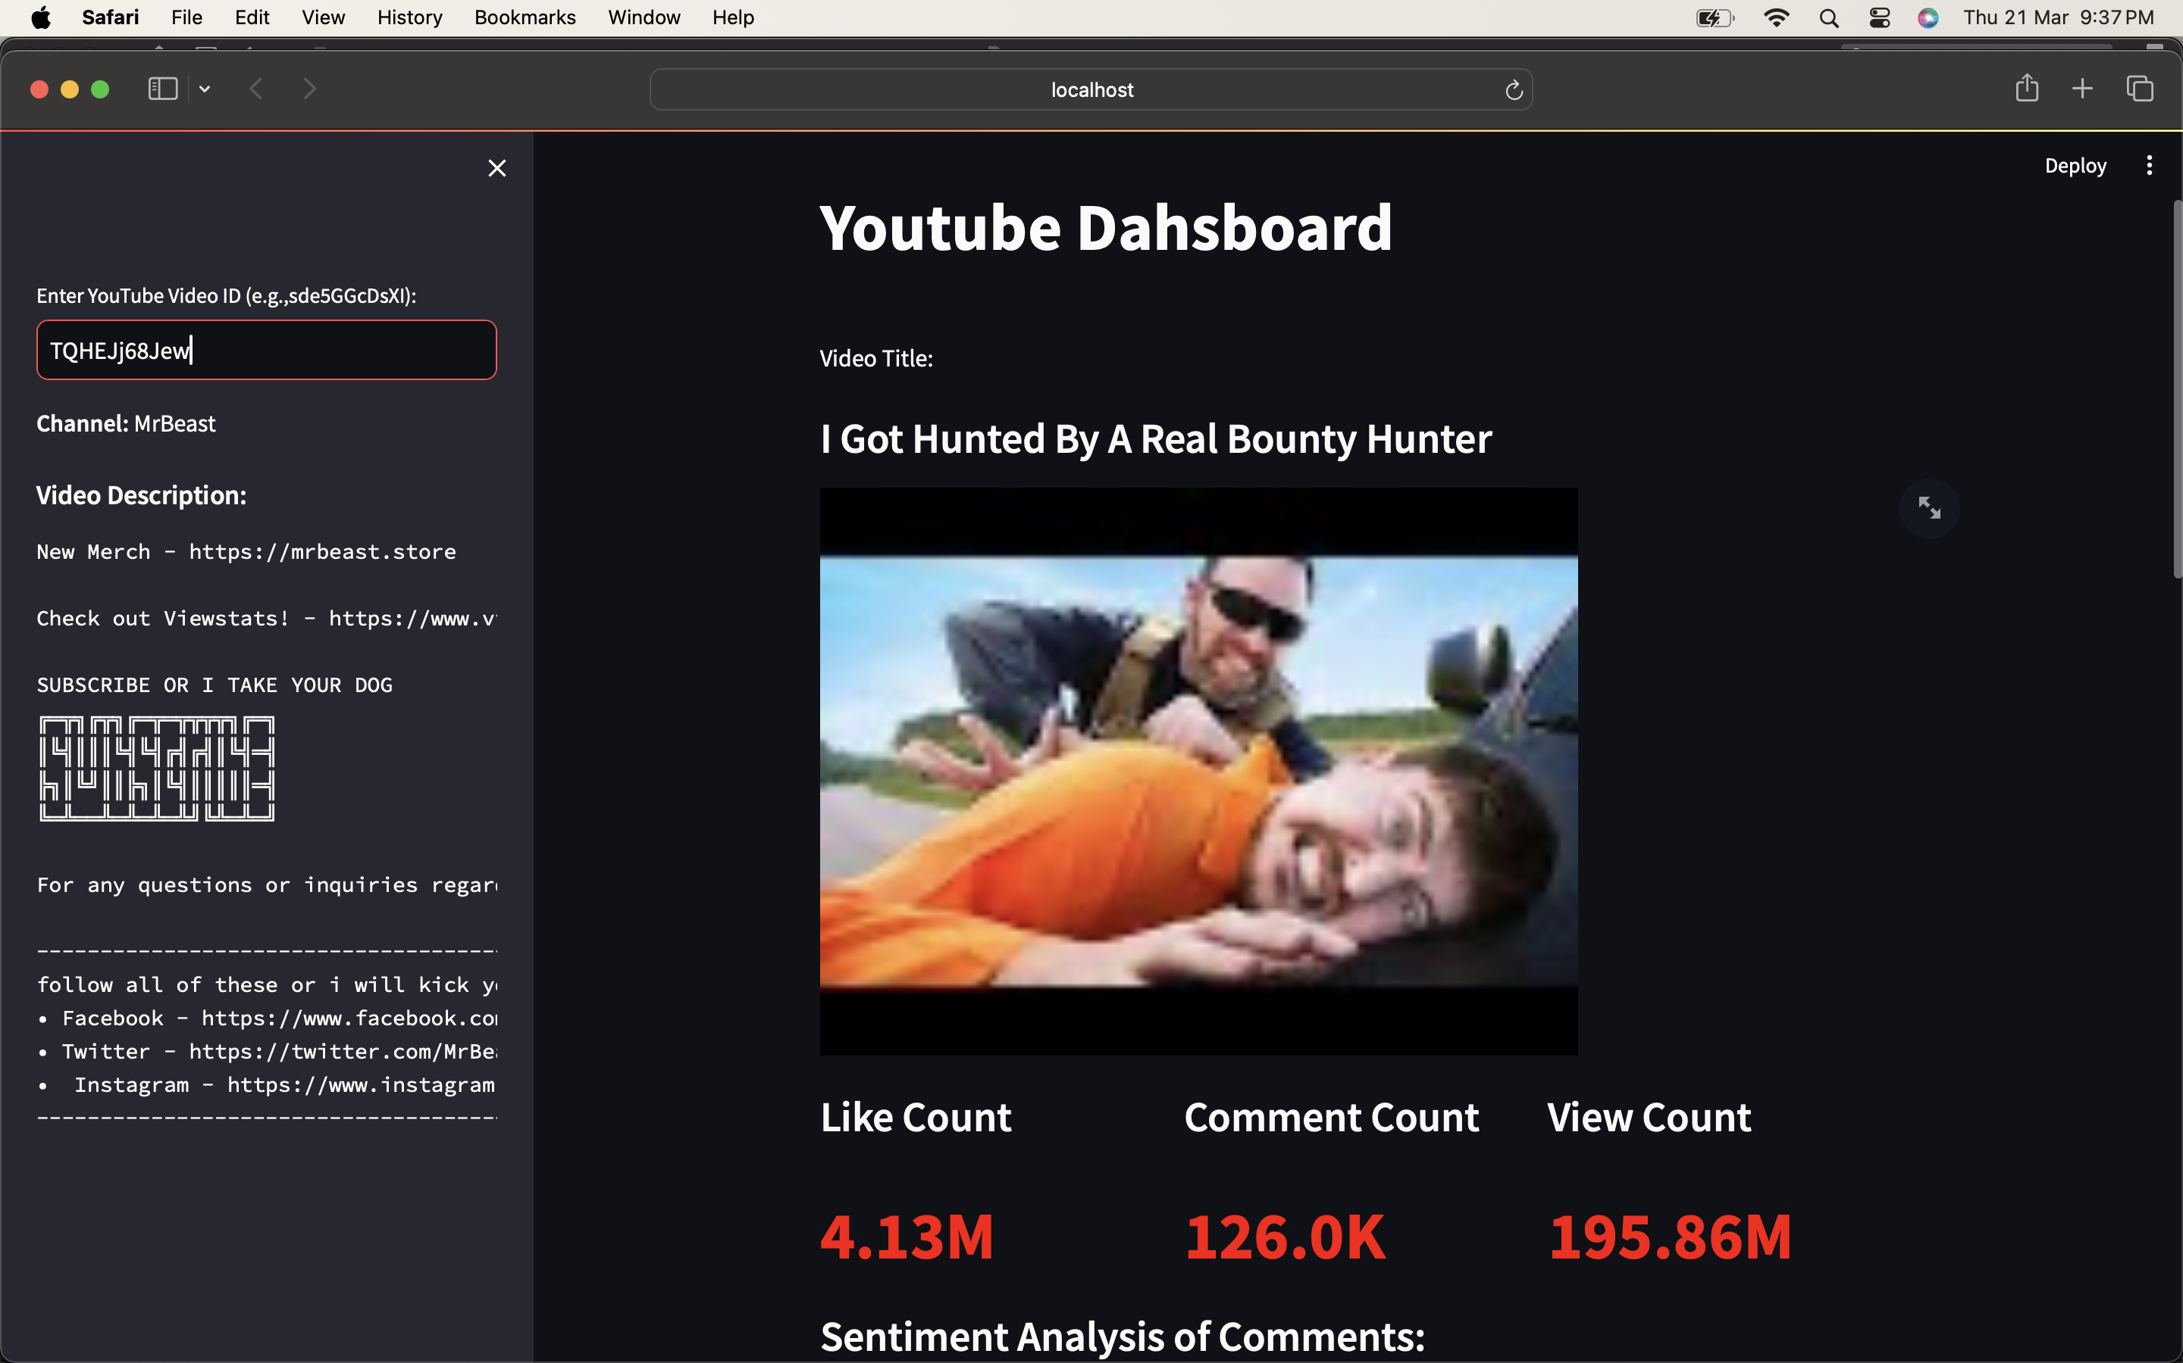
YouTube Video Stats in Streamlit App
Explore real-time statistics of YouTube videos within a user-friendly Streamlit application, providing insights into viewer engagement, trends, and performance metrics.

Slide 14
06
Insight and Findings

Slide 15
Insight and findings
Highest Video count
Pareto Insight
T-series, Set- India, WWE have the highest number of video count
from the Pareto chart we can see just 4 channel account for 65 percentage of the total likes
Country View Counts
Views Drive Likes
we have analysed view counts from 5 countries India, Russia, USA, south Korea, And UAE
our scatter plot shows more views leads more likes

Slide 16
Insight and findings
Weekend Videos Prevail
April Upload Dip
video usually come out on Tuesday and Wednesday but people like one's released on Saturday , Friday, Thursday more
video uploads dip in April but rise towards the years's end
Channel Data Forecast
Tag vs View
we forecasted future video counts, likes, comments, and views for each channel using past data
there is no clarity between tag count and view count

Slide 17
07
Conclusion

Slide 18
Conclusion
Popular Video Analysis
Insightful Demographics Analysis
we identified popular video types and view engagement levels
Demographics analysis provided insights into audience
Viewer Sentiment Analysis
Easy Exploration Interface
sentiment analysis of comments measured overall viewer feelings
Our user- friendly interface allows easy exploration of findings

Slide 19

Q & A

Slide 20

Thanks!

