Slide 1
Analysis of H1b Data using Hadoop Ecosystem
Presented by :
Supriya Sonawane
S1711075000164
Pune Deccan

Slide 2
Objective
The aim of this project is to examine and analyse H1B data using different data analysis tools like MapReduce, Hive ,Pig.

Slide 3
What is big data?
The big data refers to all the data that is being generated across the globe at an unprecedented rate. this data could be either structured or unstructured.
This data can’t be processed using tradition computing techniques.
Hadoop is a complete eco-system of open source that provide the framework to deal with big data.

Slide 4
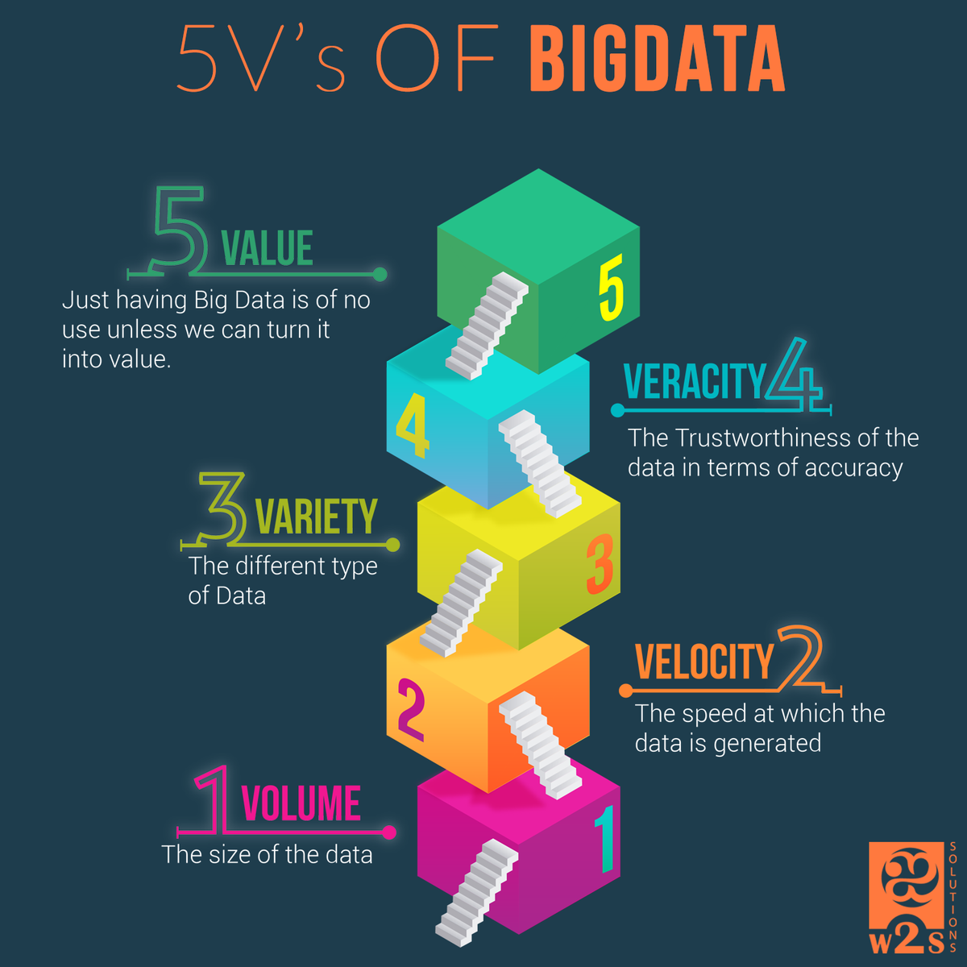
5V’s of BigData

Slide 5
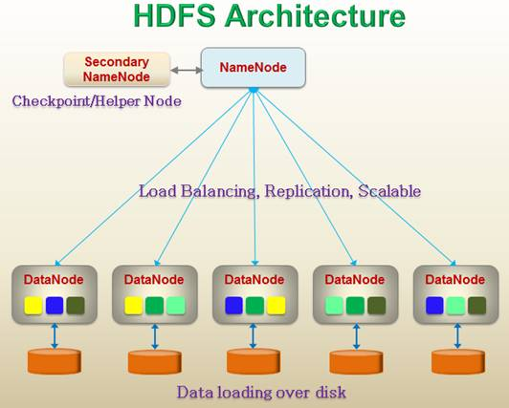
HDFS Architecture

Slide 6
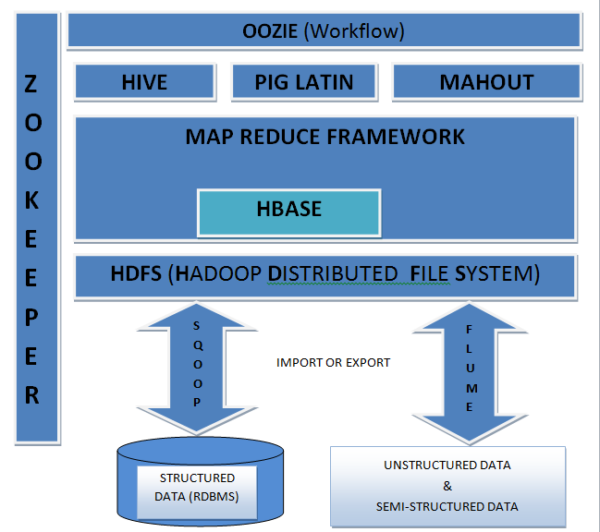
HADOOP ECOSYSTEM

Slide 7
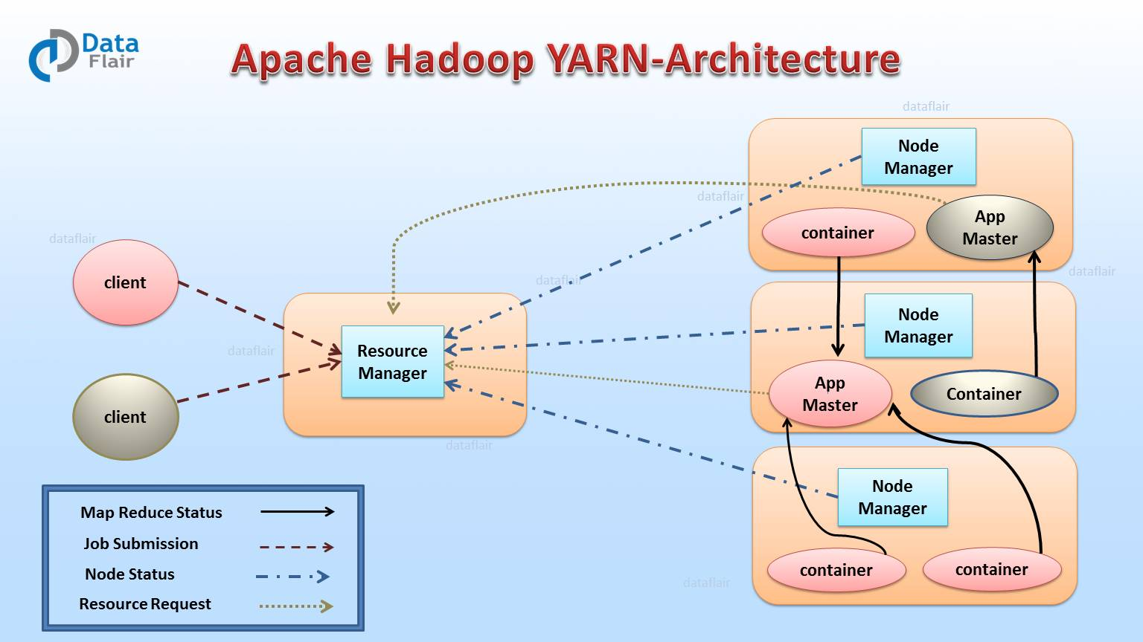
Yarn

Slide 8
Hadoop features
1. Scalable : Hadoop is a highly scalable storage platform, because it can store and distribute very large data sets across hundreds of inexpensive servers that operate in parallel.
2.Cost Effective : It is cost effective because it is open source and file-system relies on commodity storage disks which are much less expensive. , the file-system shares the hardware with the computation framework as well.
3.Flexible : Hadoop enables you to easily access new data sources and processing of different kind of data like structured and unstructured.
4.Fast processing of data : the tools for data processing are often on the same servers where the data is located, resulting in much faster data processing. if you're dealing with large volumes of unstructured data, hadoop is able to efficiently process terabytes of data in just minutes,
5.Fault tolerance : a key advantage of using hadoop is its fault tolerance. when data is sent to an individual node, that data is also replicated to other nodes in the cluster, which means that in the event of failure, there is another copy available for use

Slide 9
Technologies Used
Mapreduce :
Hadoop map-reduce is a software framework for easily writing applications which process vast amounts of data in-parallel on large clusters (thousands of nodes) of commodity hardware in a reliable, fault-tolerant manner.
Hive :
Aapache hive is an open-source data warehouse system for querying and analyzing large datasets stored in hadoop. it supports queries expressed in a language called HIVEQL, which automatically translates sql-like queries into mapreduce jobs executed on hadoop.
PIG :
Pig is a high level scripting language that is used with apache hadoop. pig works with data from many sources, including structured and unstructured data. pig scripts are translated into a series of mapreduce jobs that are run on the apache hadoop cluster.
sqoop :
SQOOP is used to import and export data from external datastores into hadoop distributed file system or related hadoop eco-systems like hive and Hbase. similarly, sqoop can also be used to extract data from hadoop or its eco-systems

Slide 10
Analysing Factors
we will be performing analysis on the h1b visa applicants between the years 2011-2016. after analysing the data, we can derive the following facts.
1 a) Is the number of petitions with data engineer job title increasing over time?
b) find top 5 job titles who are having highest avg growth in applications.[all]
2 a) Which part of the us has the most data engineer jobs for each year?
b) Find top 5 locations in the us who have got certified visa for each year.[certified]
3)Which industry(soc_name) has the most number of data scientist positions? [certified]
4)Which top 5 employers file the most petitions each year? - case status - all

Slide 11
Analyzing Factors
5) find the most popular top 10 job positions for h1b visa applications for each year?
a) for all the applications
b) for only certified applications.
6) find the percentage and the count of each case status on total applications for each year. create a line graph depicting the pattern of all the cases over the period of time.
7) create a bar graph to depict the number of applications for each year [all]
8) find the average prevailing wage for each job for each year (take part time and full time separate). arrange the output in descending order - [certified and certified withdrawn.]
9) which are the employers along with the number of petitions who have the success rate more than 70% in petitions. (total petitions filed 1000 or more than 1000) ?

Slide 12
Analysing Factors
10) Which are the job positions along with the number of petitions which have the success rate more than 70% in petitions (total petitions filed 1000 or more than 1000)?
11) Export result for question no 10 to mysql database.

Slide 13
1 a) Is the number of petitions with Data Engineer job title increasing over time? Technology Used : HIVE

Slide 14
1.b) Find top 5 job titles who are having highest avg growth in applications.[ALL] Technology used : PIG
JOB_TITLE | AVG_GROWTH
SENIOR SYSTEMS ANALYST JC60 | 4255.4
SOFTWARE DEVELOPER 2 | 3480.8
(PROJECT MANAGER 3 | 3233.4
(SYSTEMS ANALYST JC65 | 2985
(MODULE LEAD | 2917.2

Slide 15
2 a) Which part of the US has the most Data Engineer jobs for each year? Technology used : HIVE
WORK_SITE | YEAR | NO. OF DATA ENGG JOB
SAN FRANCISCO, CALIFORNIA | 2011 | 3
SAN FRANCISCO, CALIFORNIA | 2012 | 7
MENLO PARK, CALIFORNIA | 2013 | 10
MENLO PARK, CALIFORNIA | 2014 | 13
SAN FRANCISCO, CALIFORNIA | 2015 | 33
MENLO PARK, CALIFORNIA | 2016 | 35

Slide 16
Q2.b)Find top 5 locations in the US who have got certified visa for each year.[certified] Technology used : HIVE
OUPUT : FOR 2011
WORK_SITE YEAR COUNT
NEW YORK, NEW YORK 2011 23172
HOUSTON, TEXAS 2011 8184
CHICAGO, ILLINOIS 2011 5188
SAN JOSE, CALIFORNIA 2011 4713
SAN FRANCISCO, CALIFORNIA 2011 4711

Slide 17
Q3.Which industry(SOC_NAME) has the most number of Data Scientist positions? [certified] Technology Used : HIVE
OUTPUT :
STATISTICIANS 369

Slide 18
4)Which top 5 employers file the most petitions each year? - Case Status - ALL Technology Used : PIG
employer | year | count
TATA CONSULTANCY SERVICES LIMITED | 2011 | 5416
MICROSOFT CORPORATION | 2011 | 4253
DELOITTE CONSULTING LLP | 2011 | 3621
WIPRO LIMITED | 2011 | 3028
COGNIZANT TECHNOLOGY SOLUTIONS U.S. CORPORATION | 2011 | 2721
INFOSYS LIMITED | 2012 | 15818
WIPRO LIMITED | 2012 | 7182
TATA CONSULTANCY SERVICES LIMITED | 2012 | 6735

Slide 19
5) Find the most popular top 10 job positions for H1B visa applications for each year? a) for all the applications Technology used : PIG
job title | year | count
PROGRAMMER ANALYST | 2016 | 53743
SOFTWARE ENGINEER | 2016 | 30668
SOFTWARE DEVELOPER | 2016 | 14041
SYSTEMS ANALYST | 2016 | 12314
COMPUTER PROGRAMMER | 2016 | 11668
BUSINESS ANALYST | 2016 | 9167
COMPUTER SYSTEMS ANALYST | 2016 | 6900
SENIOR SOFTWARE ENGINEER | 2016 | 6439
DEVELOPER | 2016 | 6084
TECHNOLOGY LEAD - US | 2016 | 5410
PROGRAMMER ANALYST | 2011 | 31799
SOFTWARE ENGINEER | 2011 | 12763
COMPUTER PROGRAMMER | 2011 | 8998

Slide 20
5) Find the most popular top 10 job positions for H1B visa applications for each year? b) for only certified applications. Technology used : PIG
job title | year | count
PROGRAMMER ANALYST | 2011 | 28806
SOFTWARE ENGINEER | 2011 | 11224
COMPUTER PROGRAMMER | 2011 | 8038
SYSTEMS ANALYST | 2011 | 7850
BUSINESS ANALYST | 2011 | 3444
COMPUTER SYSTEMS ANALYST | 2011 | 3152
ASSISTANT PROFESSOR | 2011 | 3050
PHYSICAL THERAPIST | 2011 | 2911
SENIOR SOFTWARE ENGINEER | 2011 | 2595
SENIOR CONSULTANT | 2011 | 2585

Slide 21
6) Find the percentage and the count of each case status on total applications for each year. Create a line graph depicting the pattern of All the cases over the period of time. Technology used : MapReduce

Slide 22
7) Create a bar graph to depict the number of applications for each year [All] Technology used : MapReduce

Slide 23
8) Find the average Prevailing Wage for each Job for each Year (take part time and full time separate). Arrange the output in descending order - [Certified and Certified Withdrawn.] Technology Used : PIG
JOB_TITLE | YEAR | FULL_TIME_POSITION | AVG_PREVILING_WAGE
(AREA MANAGER PHARMACEUTICAL PACKAGING | 2011 | Y) | 2.13E+08
(DEVELOPER (SOFTWARE SYSTEMS APPLICATIONS) | 2011 | Y) | 1.77E+08
(SYSTEMS ENGINEER (DIAGNOSTICS) | 2011 | Y) | 9.55E+07
(SENIOR COST CONSULTANT | 2011 | Y) | 8.56E+07
(RADIATION ONCOLOGIST | 2011 | Y) | 7.66E+07
(IT ADMINSTRATIVE ASSISTANT | 2011 | Y) | 7.11E+07
(VERIFICATION AND VALIDATION ENGINEER | 2011 | Y) | 6.69E+07
(SENIOR STAFF TEACHER | 2011 | Y) | 3.32E+07
(TECHNICAL SOFTWARE CONSULTANT | 2011 | Y) | 1.64E+07
(PRINCIPAL ARCHITECT | 2011 | Y) | 9925884.706

Slide 24
9) Which are the employers along with the number of petitions who have the success rate more than 70% in petitions. (total petitions filed 1000 OR more than 1000) ? Technology Used : MapReduce
Employer_name | Total applications | Certified+certified_withdrawn applications | Sccess_rate
HTC GLOBAL SERVICES INC | 1164 | 1164 | 100
INFOSYS LIMITED | 130592 | 129992 | 99.54055
DIASPARK INC | 1419 | 1412 | 99.50669
ACCENTURE LLP | 33447 | 33244 | 99.39307
TECH MAHINDRA (AMERICAS) INC | 10732 | 10661 | 99.33843
TATA CONSULTANCY SERVICES LIMITED | 64726 | 64297 | 99.33721
YASH TECHNOLOGIES INC | 2214 | 2198 | 99.27733
YASH & LUJAN CONSULTING INC | 1372 | 1362 | 99.27114
HCL AMERICA INC | 22678 | 22512 | 99.26801
RELIABLE SOFTWARE RESOURCES INC | 1992 | 1975 | 99.14659
NTT DATA INC | 4611 | 4571 | 99.13251
ERP ANALYSTS INC | 1785 | 1769 | 99.10364

Slide 25
10) Which are the job positions along with the number of petitions which have the success rate more than 70% in petitions (total petitions filed 1000 OR more than 1000)? Technology Used : MapReduce
Job_Title | Total no. of applications | Certified +Certified_Withdrawn applications | Success_Rate
PRODUCTION SUPPORT LEAD - US | 1301 | 1301 | 100
ASSOCIATE CONSULTANT - US | 4393 | 4390 | 99.93170954
SYSTEMS ENGINEER - US | 10036 | 10026 | 99.90035871
TEST ENGINEER - US | 2198 | 2195 | 99.86351228
PRODUCTION SUPPORT ANALYST - US | 1451 | 1449 | 99.86216402
TEST ANALYST - US | 4958 | 4949 | 99.81847519
CONSULTANT - US | 7426 | 7412 | 99.8114732
TECHNOLOGY LEAD - US | 28350 | 28294 | 99.80246914
TECHNICAL TEST LEAD - US | 5374 | 5363 | 99.79531076
SENIOR TECHNOLOGY ARCHITECT - US | 1417 | 1414 | 99.78828511
TECHNOLOGY ARCHITECT - US | 4707 | 4696 | 99.7663055
TECHNOLOGY ANALYST - US | 26055 | 25993 | 99.76204183

Slide 26
11) Export result for question no 10 to MySql database. Technology Used : Sqoop
1.mysql –u root –p
2. create database h1b;
3. use h1b;
4.CREATE TABLE success_rate(job_title varchar(100)NOT NULL,total_no_of_appl INT NOT NULL,certifiedANDcertified_withdrwan_count INT NOT NULL,
5.desc success_rate;
+---------------------------------------+--------------+------+-----+---------+-------+
| field | type | null | key | default | extra |
+---------------------------------------+--------------+------+-----+---------+-------+
| job_title | varchar(100) | no | | null | |
| total_no_of_appl | int(11) | no | | null | |
| certifiedandcertified_withdrwan_count | int(11) | no | | null | |
| success_rate | float | no | | null | |
+---------------------------------------+--------------+------+-----+---------+-------+
6. sqoop export --connect jdbc:mysql://localhost/h1b --username 'root' --password 'hduser' --table success_rate --export-dir /problem10 --input-fields-terminated-by ',' --mysql-delimiters -m 1;

Slide 27
Conclusion
Having highest average growth in applications. SENIOR SYSTEMS ANALYST JC60
Petitions for DATA ENGINEER job position is increased over time.
STATISTICIAN Industry have most number data scientist.
Number of application are increased each year.
HTC GLOBAL SERVICES INC employer have max success rate than other employers.
Success rate is max for PRODUCTION SUPPORT LEAD – US.

