Slide 1
TELEMATIC FORTIGO
Done By
Supriya Sundar
Deepak Raj
R. Meghna

Slide 2
OBJECTIVE
To Provide monitoring and tracking of containment ensuring secure logistics in transportation at real-time.
To boost fuel efficiency.
To provide enhanced customer service.

Slide 3
PARAMETERS
Driver’s Cabin access
Automatic side shield Closure
To detect drunken drive
Speed monitoring
Live Tracking
Containment access
Diesel level monitoring

Slide 4
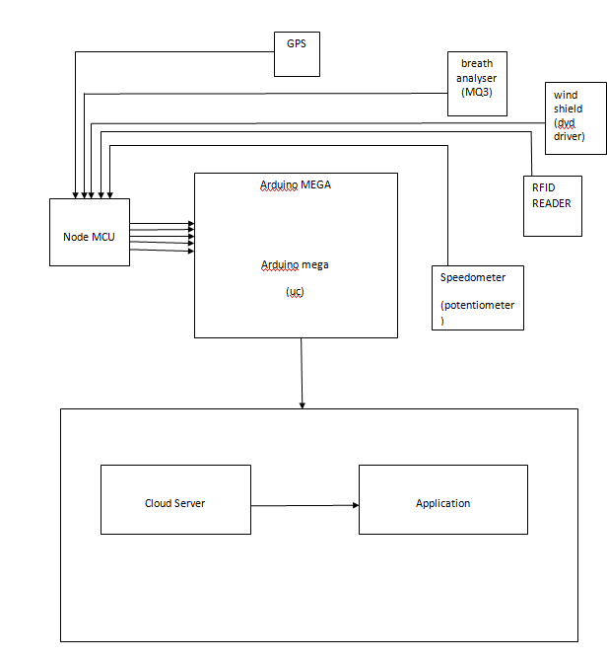
BLOCK DIAGRAM

Slide 5
FUNCTION
DRIVER’S CABIN ACCESS SYSTEM:
The indigenous principle is the implementation of near field communication(NFC) to provide controlled access to the cabin which moves with the help of a servo motor.
The implantation of NFC in real-time application has been demonstrated by RFID(Radio Frequency Identification) Reader and Tag in this prototype.
The reader reads the tag and opens the door of the driver’s cabin and thus gives the driver access to get into the cabin to start manoeuvring.

Slide 6
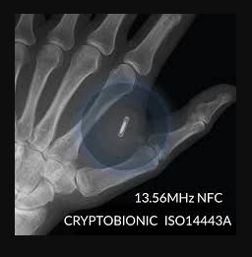
Implantation of NFC

Slide 7
WORKING:
Cabin’s side shield Closure:
Cabin windows are automated such that they provide closure upon motion of the vehicle.
This is exclusively done to restrict air flow and external agents inside the cabin for effective working of breath analyzer which checks for the presence of ethanol.

Slide 8
Breath Analyzer:
A MQ3 alcohol sensor to check if the driver is drunk and alerts the owner in the corresponding case.
It is suitable for detecting Alcohol, Benzine, CH4, Hexane, LPG, CO. Due to its high sensitivity and fast response time, measurements can be taken as soon as possible. The sensitivity of the sensor can be adjusted by using the potentiometer.
It is used in proving/disproving insurance claims in case of accidents or other mishaps.

Slide 9
Speed Detection:
The speed of the vehicle available at the speedometer is also logged within a cloud based server and the owner is alerted in case of extreme speeding.
Containment Lock:
This is controlled by the NFC; notification regarding opening of the lock of the container would reach the owner immediately.

Slide 10
Diesel Lock and Supervision:
The diesel lock would opened by the driver under authorisation via NFC .The diesel compartment is opened only upon the contention of the owner/client.
Opening and closure of the fuel tank and hence the amount of fuel consumed is under the direct control of the owner/client , eliminating the possibility of any discrepancy.

Slide 11
SIGNIFICANCE OF IoT
All details regarding the parameters are stored in a cloud server, via FireBase
This information is conveyed to an application developed through Kodular interface.
Mere installation of the application would provide the consumer with required access and improved security over his/her containment.

Slide 12
THANK YOU

